Slide 1

Feature Engineering and Imputation
Rayid Ghani

Slide 2
Scope
Data
Exploration
Modeling
Get Data
Store Data
Link Data
Rows
Features
Labels
Model Selection
Train-Test Splits
Performance Metrics
Model Interpretation
Entities
temporal
Spatial
…
Models
Dealing with Bias and Fairness
Field Trial Design
Deployment
Monitoring
Goals, Actions, Data, Analysis, Ethics

Slide 3
Reminders
This week:
Tomorrow: Group Check-Ins
Thursday: Triage Q&A + time for group work
Coming up after fall break:
Monday: Project Update 3
Tuesday: Weekly Feedback Form
Tuesday: Building Features in Triage

Slide 4
Plan for the week
What you should be discussing this week within your team
  Validation strategy & temporal parameters
  Brainstorming on features you’d like to build
What you should be building this week
  Getting comfortable with running triage
  Temporal Validation Parameters
  Updated Cohort & Label Queries

Slide 5
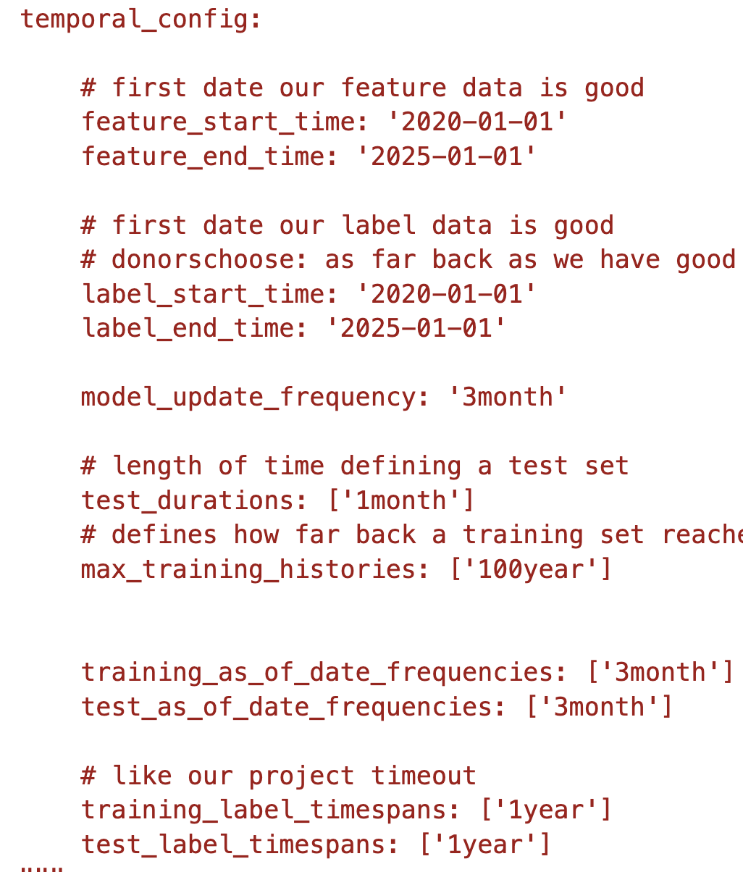
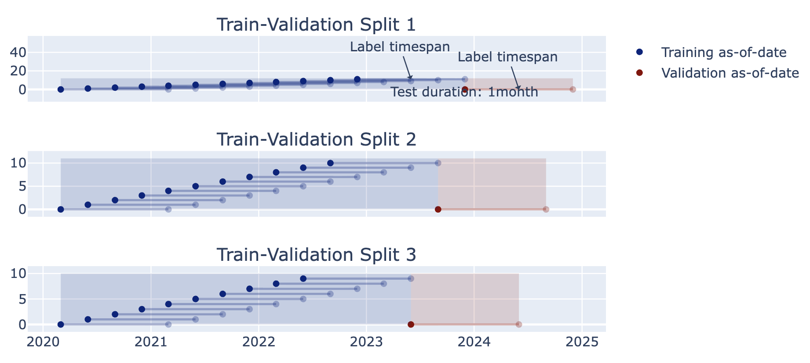
2014 2015 2016 2017 2018

Slide 6
Some tips
Set up validation set(s) to match deployment scenarios (and constraints)
Set up training set(s) any way we want but match data (both features and labels) available at training time
  Making sure labels are not censored based on label period
  Sampling (if helpful)
  Data collection and update lag

Slide 7
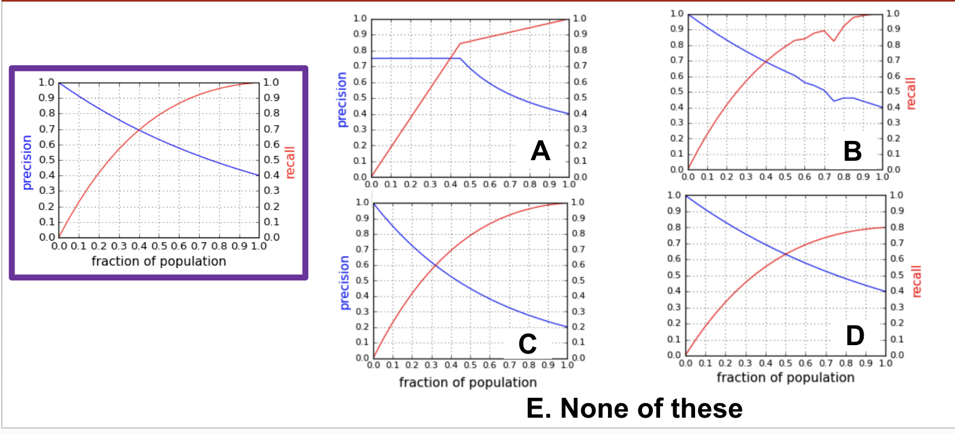
Which of these is a possible PR-k curve on the same dataset as the one outlined?

Slide 8
Do not edit
How to change the design
Given that the PR-k curve outlined is from a model applied to some validation data, which of the other curves shown could be from other models applied to the same validation data (check all that apply)?
The Slido app must be installed on every computer you’re presenting from

Slide 9
What We’ll Cover Today
Feature Creation/Engineering
Dealing with Missing Data
How to do features and imputation in Triage

Slide 10
Feature Engineering: Why do we care?
Features are hypothesis/hints/rules of thumb you give your model
  Encoding domain knowledge and context for the model to use
Feature generation is still a critical part of the machine learning modeling process with tabular/relational data.

Slide 11
Feature Engineering: Why we need to do it
A pretrained language model helps on your text because grammar and world knowledge transfer.
A column named: x or x1 or dsl_event_1y may not mean anything in anyone else's dataset.
When there's no shared structure to learn from, the structure has to come from the ML Developers. That's what a feature is.

Slide 12
Key Points
Data does not come with features - you need to turn it into features
Big Constraint: When generating a feature, you need to know what did you know and when did you know it?
You can only create features from information available before the “training” date for a given row
Do it systematically instead of an arbitrary list of features
Spend time understanding domain/expert knowledge and prior research in the application area you’re woking in

Slide 13
Feature development is an iterative process
  Start simple: build a couple features (from each data source) you think are most important and expand from there
Come up with Feature Ideas
Implement Features
Test Results in ML Pipeline
Discard or Keep

Slide 14
Bias in Feature Development: Examples
Inferring age/gender from name
Creating "other" categories, e.g., multi-racial or non-binary gender
How are race and ethnicity collected? Self-reported? Recorded by third party? Inferred from other data?
Geocoding for distance or geographic features –– how are homeless and more mobile populations handled?

Slide 15
Feature Generation: Practical Pointers
Historical aggregations (especially of outcomes) are often the most predictive features (and give the model plenty of variations)
Aggregate outcomes for similar entities (for various definitions of “similar” are often very useful as well)
So are features that tell you how the current entity compares to the population
Make sure you handle missing data, and do so thoughtfully (DON’T throw away the records)
Remember to scale your features when necessary
Notes:
Only reviewed briefly in class – should pick back up here + slido + collate

Slide 16
Features in triage
All features are temporal aggregates, reflecting the nature of the data we typically get. Even gender, race, etc. can be a function of time (but may not be captured as such sometimes)
Need to specify what data you’re using and when that information was known
Need to specify how you’ll handle missingness explicitly
YAML structure can take a little getting used to, but powerful for specifying many aggregations over many time frames in compact format

Slide 17
Features in triage
Features get defined in blocks (feature groups) – each feature group comes from a data source (called from_obj and all features in that feature group share a prefix
from_obj : can be a table or sql query and needs a field for entity_id and a knowledge_date_column field that specifies when that event happened

Slide 18
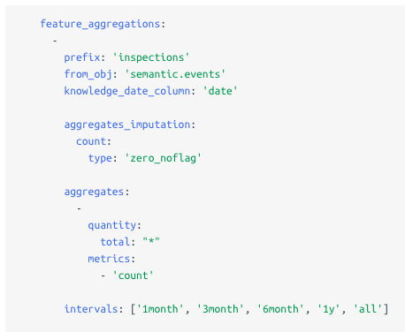
Features in triage – aggregate features
Naming Prefix shared by all the features in this group
Table or SQL snippet (used to generate the feature)
Date field specifying when the event happened
Imputation method for missing data - default for this group (each feature can override this)
Column or SQL snippet and aggregation function
Historical time periods for aggregation

Slide 19
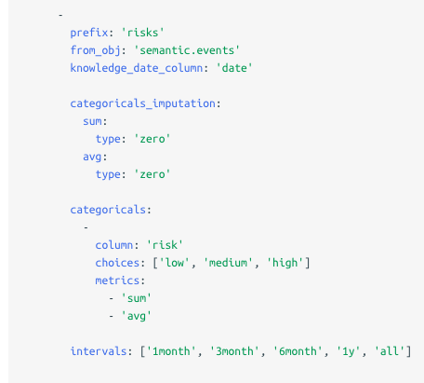
Features in triage: Categorical features
Similar structure for categoricals
Specify categorical values as a list or through a query (such as select distinct value from tablename)

Slide 20
Features in triage: Naming Conventions
For aggregates:
{prefix}_entity_id_{interval}_{quantity}_{metric}
For categoricals:
{prefix}_entity_id_{interval}_{quantity}_{value}_{metric}

Slide 21
Features in triage: Naming Conventions
For aggregates:
{prefix}_entity_id_{interval}_{quantity}_{metric}
For categoricals:
{prefix}_entity_id_{interval}_{quantity}_{value}_{metric}
Important note:
Even categoricals need to be aggregated over time!

Slide 22
Features in triage: Aggregaton and Imputation
Aggregation functions available: 'min', 'max', 'sum', 'avg', 'stddev'
Imputation options: need to be defined at least for each feature group. For eacjh feature group, there can be default imputation methods defined for aggregate and categorical features, or at any level below that (for each aggregation function or for each feature generated)
      Mean
      Zero_noflag
      Constant value
      Zero
      null_category
      binary_mode
      error

Slide 23
Common Features
Categorical features
  Dummy for all values
  Dummy for selected values
Continuous features – aggregates over the past X time
Special types of features
  Age Feature
  Days since last event (by type) – min
  Days since first event (by type) – max
  Days between events (by type) – min, max, avg, stddev (Days between inspection cases in San Jose)

Slide 24
Triage Detour

Slide 25
Features in triage: Some Examples
https://dssg.github.io/triage_cookbook/configure/features.html
Liver disease prediction project
Kidney disease prediction project
Homelessness prevention project

Slide 26
Features in triage: Some Considerations
No built-in way to do “most recent value” (need to pre-compute)
Single/identical values still considered aggregates (can just take “max”)
Categoricals get aggregated, too (one-hot encoded first)
Postgres column length limits / truncation
Need to specify imputation strategy for all features (can do at aggregate-level)
May want to pre-compute especially computationally expensive features

Slide 27
Feature Generation – A Deeper Look
Categorical to Binary (Dummies)
Features for missing values
Discretization
Date/Time Features
Scaling/Normalizing
Transformations
Aggregations (space, time, space and time)
Relative (compared to the average…)
Interactions

Slide 28
Back to Features

Slide 29
Categorical to Binary
One vs All (Dummy Variables)
Groups
Presence vs Absence

Slide 30
Discretization
Equal width bins
Equal size bins
Entropy-based bins
Domain-Specific bins to incorporate domain specific discontinuities
  Age in general
  Education/school data
  High school data
  Infant mortality

Slide 31

Feature Scaling
Usually a good idea to scale features to have similar range: [-1,1] or [0,1] for example
  Be careful with outliers
Standardize/Normalize
  Zero mean and unit variance
  Sklearn.preprocessing.normalize

Slide 32
Feature Transformations
Non-linear
  Log (decreasing marginal utility)
  (Square) Root
  Squared

Slide 33
Aggregations
Date differences (# of days since…)
Aggregates over different time periods
  min, max, avg, stdev
  Avg spend in the past 3 months
Relative aggregates
  1.5x avg spend
Distances
Aggregates over different distances
Seasonality

Slide 34
Feature Interactions
Generate features for combination of features
  Age x gender
Allows you to use linear models but still model non linear relationships
Random Forests are one way of discovering useful interactions

Slide 35
Features are also model-dependent
Linear models may need … ?
Non-linear models may need …?

Slide 36
Dealing with missing values

Slide 37
Missing Values
Impute (Fill in) missing values based on why you think they may be missing and what you want the model to do with those missing values
  Missing Completely at Random
  Missing at Random
  Missing Not at Random
Typically, also add binary feature (dummy) for missing vs not missing in case “missingness” is predictive of the outcome

Slide 38
Imputing Missing Values: Some Options
Nothing?
Central Tendency: Mean / Median / Mode
ML methods that handle missing data (e.g., xgboost)
Others
  Regression
  k-Nearest Neighbor
  Multiple Imputation

Slide 39
Imputing – Central Tendency
Simple to calculate and computationally fast
Often a reasonable starting point
May be able to capture more nuance by using other, correlated data to help fill in missing values
Under-represents variance/covariance of data

Slide 40
Imputing – ML Methods with Missing Data Handling
Some models have built-in handling of missing data, such as xgboost (which decides which direction to send missing values at each split)
May not be the best modeling method for your problem, don’t want to be locked into certain type of model
Nevertheless, worth exploring performance of other imputation methods even when using these models as well

Slide 41
Imputing – Regression
Make use of information in correlated features, more flexible than central tendency
However, may not be flexible enough to capture complex relationships or interactions
May be somewhat more computationally expensive
Generally will still underestimate variation in data

Slide 42
Imputing – k-Nearest Neighbor
More flexible option, capture more complexity in relationships in data
Difficult to choose appropriate distance metric, value of k
More computationally expensive than other methods of imputation
Requires entire training set to calculate imputed values for new examples

Slide 43
Imputing – Multiple Imputation
Create multiple “complete” datasets with different values using different regression models
Helps analyze sensitivity to handling of missing values
Much more computationally expensive, both for imputation and downstream modeling
Can provide better representation of variability in data

Slide 44
Missing Value Tips
Do not remove rows or columns with missing values (unless there is a really really really good reason)
Missingness can be a useful predictor: create a flag even if you impute a value
Data can be missing for different reasons and missingness for each row/column/cell may need to be handled differently
Only use data from the past for imputation

Slide 45
How can imputation introduce bias in your models?

Slide 46
Takeaways
Features are hypotheses you make about the world
Enumerate them systematically - entity x time x space x aggregation, ratio, peer comparison, trends, etc.
Treat time as a hard constraint
Deal with missingness and outliers carefully and deliberately
Use LLMs to propose features - verify if they make sense and don’t leak
FMs and Embeddings (to generate features) - verify

