Slide 1

Model Selection (and Validation)
Part I
Rayid Ghani

Slide 2
Teamwork Question
How’s teamwork going?
sli.do #94889
sli.do/94889

Slide 3



Do not edit How to change the design
How’s teamwork going?
The Slido app must be installed on every computer you’re presenting from

Slide 4
Reminders
This week:
Today: Proposal Peer Reviews
Wednesday: Triage Tech Session
Thursday: Project Work Time (use feedback from proposals to update plan)
Coming up next week:
Reading for Tuesday (“cross-validation” strategies)
Project check-in on Wednesday (MCRT1, Bills3, Bills2, Bills1)
First Project Assignment due Monday – posted on Canvas

Slide 5
Plan for the week
What you should be discussing this week within your team
Your analytical formulation and baselines to compare against
Evaluation Metrics
What you should be building this week
How to operationalize the formulation
Cohort and label logic
Baserates and baselines calculations
Exploring triage configuration and parameters

Slide 6
Scope
Data
Exploration
Modeling
Get Data
Store Data
Link Data
Rows
Features
Labels
Model Selection
Train-Test Splits
Performance Metrics
Model Interpretation
Entities
temporal
Spatial
…
Models
Dealing with Bias and Fairness
Field Trial Design
Deployment
Monitoring
Goals, Actions, Data, Analysis, Ethics

Slide 7
How to solve a prediction problem
Define and Create Rows (unit of prediction)
Define and Create Label (outcome/target variable – what event and when?)
Define and Create Features (features/predictors)
Create Training and Validation/Test Sets
Train model(s) on Training Set(s)
Validate model(s) on Validation/Test Set(s)
Select “best” model

Slide 8
What is the goal of model selection?

Slide 9
What is the goal of model selection?
You’ve run a large number of different types of models varying …
You need to understand what types of models are effective under what circumstances, and
You need to decide which one(s) to use in the future

Slide 10
What do we need our selected model to do?

Slide 11
What do we need our selected model to do?
Perform well
What metric?
Compared to what?
Generalize
To what?

Slide 12
You're working for a non-profit and a vendor is trying to sell you a donation propensity model that is validated to have 98% accuracy. Is this model good enough for your organization to purchase?
sli.do #94889
sli.do/94889

Slide 13
Do not edit How to change the design
You're working for a non-profit and a vendor is trying to sell you a donation propensity model that is validated to have 98% accuracy. Is this model good enough for your organization to purchase?
The Slido app must be installed on every computer you’re presenting from

Slide 14
Performance Metrics

Slide 15
Score Distribution on the Test Set
# of people
Score

Slide 16
Evaluation - Metrics
Predictions are often scores between 0 and 1
We need to first turn them into 0 or 1 by selecting a threshold
Predicted Class
 | Yes | No
Yes | True Positives (TP) | False Negatives (FN)
No | False Positives (FP) | True Negatives (TN)
Actual Class

Slide 17
Evaluation – Metrics (at a threshold k)
Accuracy = (TP + TN) / (TP + TN + FP + FN)
Precision (or PPV) = TP / (TP + FP)
Recall (or Sensitivity) = TP / (TP + FN)
Specificity = TNR
Predicted
 | Yes | No
Yes | True Positives (TP) | False Negatives (FN)
No | False Positives (FP) | True Negatives (TN)
Actual

Slide 18
How to communicate these metrics to policy audiences?

Slide 19
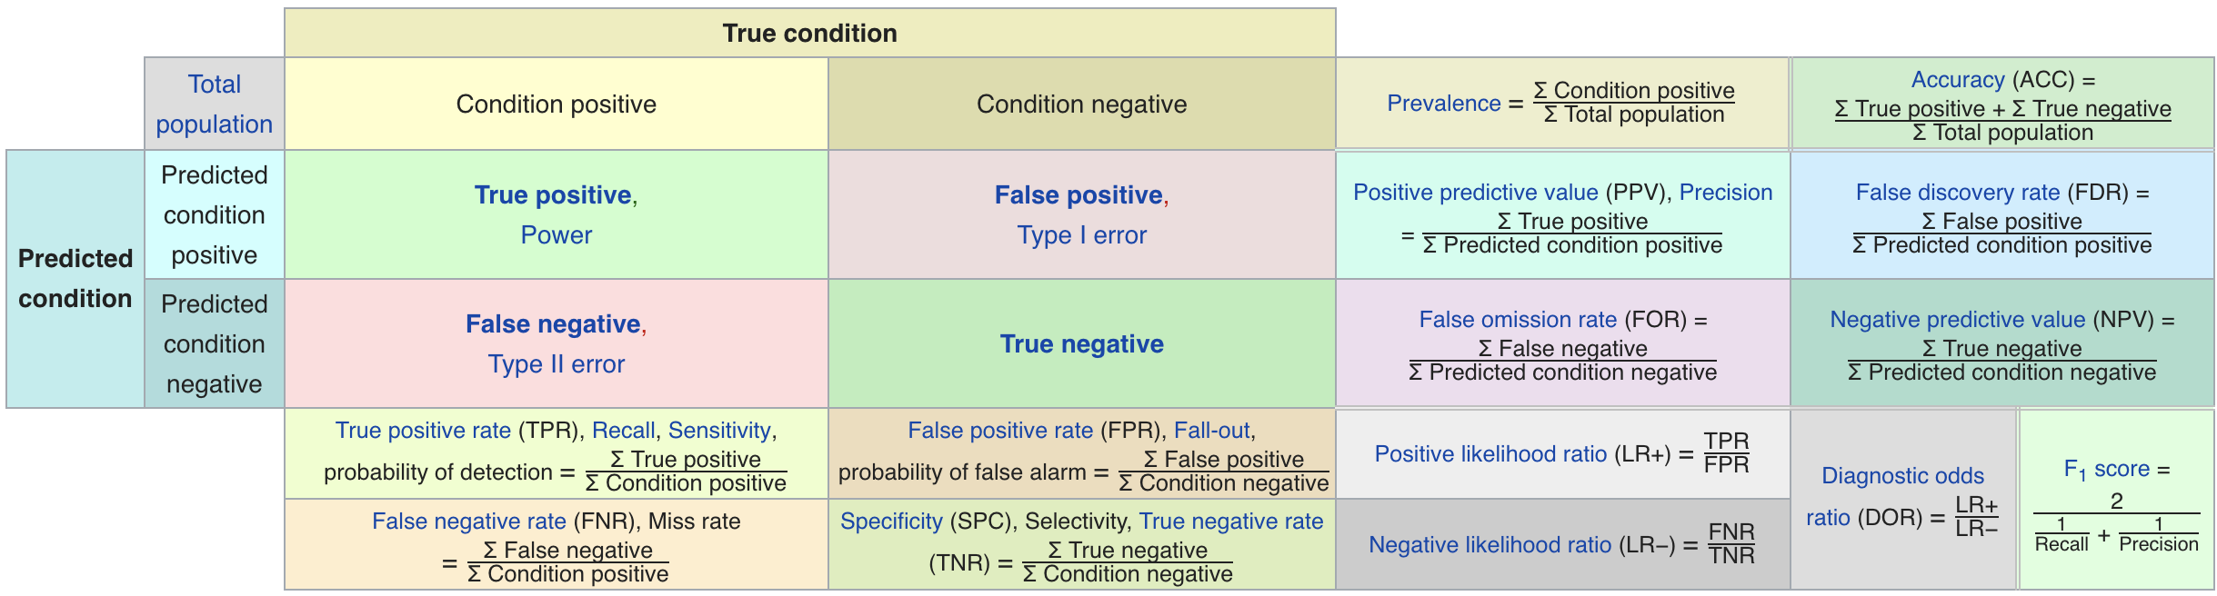
Metric Cheatsheet
Source: https://en.wikipedia.org/wiki/Sensitivity_and_specificity

Slide 20
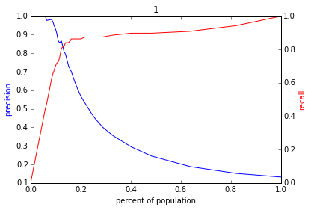
Varying the Threshold
Score
1 .9 .8 .7 .6 .5 .4 .3. .2 .1
| | | | | | | | | |
Baseline

Slide 22
ROC Curve
Receiver Operator Characteristic Curve

Slide 23
AUC (Area Under Curve)
Overall measure of performance
1 if all 1s are ranked above all 0s
0 if all 0s are above all 1s

Slide 24
AUC – Area Under Curve
If you care about the entire space

Slide 25
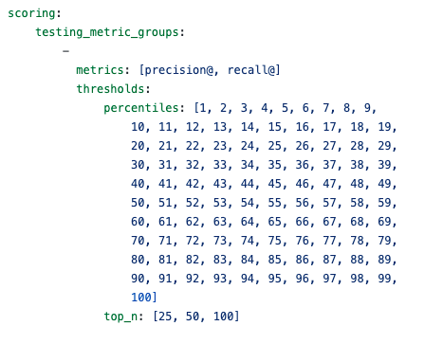
Evaluation – triage configuration

Slide 26
Discussion Question
What would be some potential strategies for integrating considerations around fairness in the process of model evaluation and selection?

Slide 27
Reminders
This week:
Today: Proposal Peer Reviews
Wednesday: Triage Tech Session
Thursday: Project Work Time (use feedback from proposals to update plan)
Coming up next week:
Reading for Tuesday (“cross-validation” strategies)
Project check-in on Wednesday (MCRT1, Bills3, Bills2, Bills1)
First Project Assignment due Monday – posted on Canvas

