Slide 1

Class Wrap-Up,
Causal Inference, and ML Experiments
Rayid Ghani and Kit Rodolfa

Slide 2
Reminders
This week:
Project Presentations on Thursday
No group meetings on Wednesday
Coming up next week:
Final Reports due on Wednesday

Slide 3
Things to cover today
Quick Review and Wrap-Up
Causal Inference 001
With Observational Data
Methods
Examples
Experiments
Standard Randomized Controlled Trials
Trial Design
Examples
Validating ML models/systems
Trial Design
Examples

Slide 4
Final Reports
https://canvas.cmu.edu/courses/31334/assignments/515888

Slide 5
Project checklist
Train Test Splits – make sure you’re using all of them
Features – make sure you have relevant features
Imputation
scaling
Models
Make sure you have an appropriately large grid and model types
Model Selection
Initial metric (sanity check with PR-k curve), and selection metric over time
Interpretability
Feature importances, Cross-Tabs
Bias
Protected Group and Bias Metric

Slide 6
Seven Big Takeaways

Slide 7
All Your Modeling Decisions
Should Reflect How
It Will Be Used
What is your goal (it’s not to build a model)? Constraints?
What are you trying to generalize to?
Who/what is this model going to be applied to? When?
What’s the right metric for “accuracy” (rarely is this AUC or F1)?
What does fairness mean in this context?

Slide 8
Remember to Think
4th-Dimensionally
(Time Matters)
When is your prediction being made?
What information is available for features at that time? What isn’t?
How frequently will the model be updated?
Over what time horizon is your label occurring?
Leave time to collect labels between training and validation

Slide 9
Data != Matrix
Data doesn’t come with labels, you have to create them
Data doesn’t come with features, you have to construct them
Rows in the raw data are rarely the rows in the training/validation matrix

Slide 10
The Defaults Are
Mostly Bad
(aka Models Don’t Give 0/1 Labels)
Models give scores not predicted classes, and these are rarely probabilities
There’s no such thing as absolute accuracy, precision, or recall
A 0.5 score threshold is almost never what you want
Hyperparameters matter and defaults in many packages aren’t great

Slide 11
Compared To What?
What is the right baseline that your model needs to beat to be useful? By how much?
How is this decision currently made (or what commonsense, non-ML approach could be used)?
What is the performance of the current, human-driven decision-making process? How fair is it?
Do explainability methods give you more information than crosstabs and feature importances?

Slide 12
Be Skeptical
Most published results are overstated (at best), not tested on real-world uses
Try things out for yourself, understand their limitations in your context/use case
Interpretability is far from a solved problem. So is algorithmic fairness.
… or for that matter, generalizing to the future, top k classification, etc.

Slide 13
Models Encode Values
Be explicit about what you want the model to do
… and validate that the model actually does this
Understand (and seek out) the perspectives of different stakeholders, people affected by model
Goal is to have a fair overall system, not just a fair model

Slide 14
Wrap-Up and Review

Slide 15
Scope
Data
Exploration
Modeling
Get Data
Store Data
Link Data
Rows
Features
Labels
Model Selection
Train-Test Splits
Performance Metrics
Model Interpretation
Entities
temporal
Spatial
…
Models
Dealing with Bias and Fairness
Field Trial Design
Deployment
Monitoring
Goals, Actions, Data, Analysis, Ethics

Slide 16
Recap so far
Scope: Goals, Actions, Data, Analysis, Ethics
Data: Getting, storing, linking, exploring, and understanding
Formulation: Rows, Labels, Time, Metric, Baselines
Pipeline: Rows, Labels, Features, Train-Validation Pairs, Metrics, Models + hps
Model Selection:
Run Experiments
Analyze results to choose best model
Iterate

Slide 17
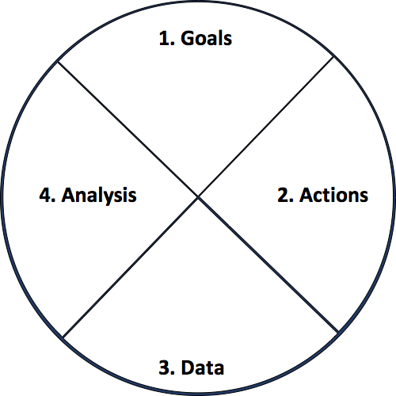
Actionable and Goal-Driven Project Scope
Goals: Define the goal(s) of the project
Actions: What actions/interventions will you inform?
Data: What data do you have internally? What data do you need? What can you augment from external and public sources?
Analysis: What analysis needs to be done? How will it be validated?
Ethics
dsapp.uchicago.edu
Center for Data Science and Public Policy University of Chicago

Slide 18
Analytical Formulation Examples
How often is the recommendation/decision being made?
On the first of every month, for all the individuals who have been released from Johnson County Jail during the past 2 years and have demonstrated mental health needs, can we identify the 200 highest risk individuals who are likely to return to jail in the next 6 months to prioritize for proactive mental health interventions?
Who/what is included in the cohort?
What is the output?
What outcome are you predicting/estimating?
For what purpose?

Slide 19
Baseline Options
Common Sense
What they do today
What they could do today easily (without any or very simple ML involved)
Prior/Base Rate
What expected value would you get if you just choose at random (based on the data distribution)?

Slide 20
Train Validation Pairs
 | Train Set |  |  |  | Validation Set
Train-Validation Pair ID | Earliest project submission date | Latest project submission date | Start date for labels | End date for labels | Start date for rows | End date for rows | Start date for labels | End date for labels
1
2
3 (most recent)
Train-Validation Pair 1
Training Examples
Label Buffer
Validation Examples
Label Buffer
Train-Validation Pair 2
Training Examples
Label Buffer
Validation Examples
Label Buffer

Slide 21
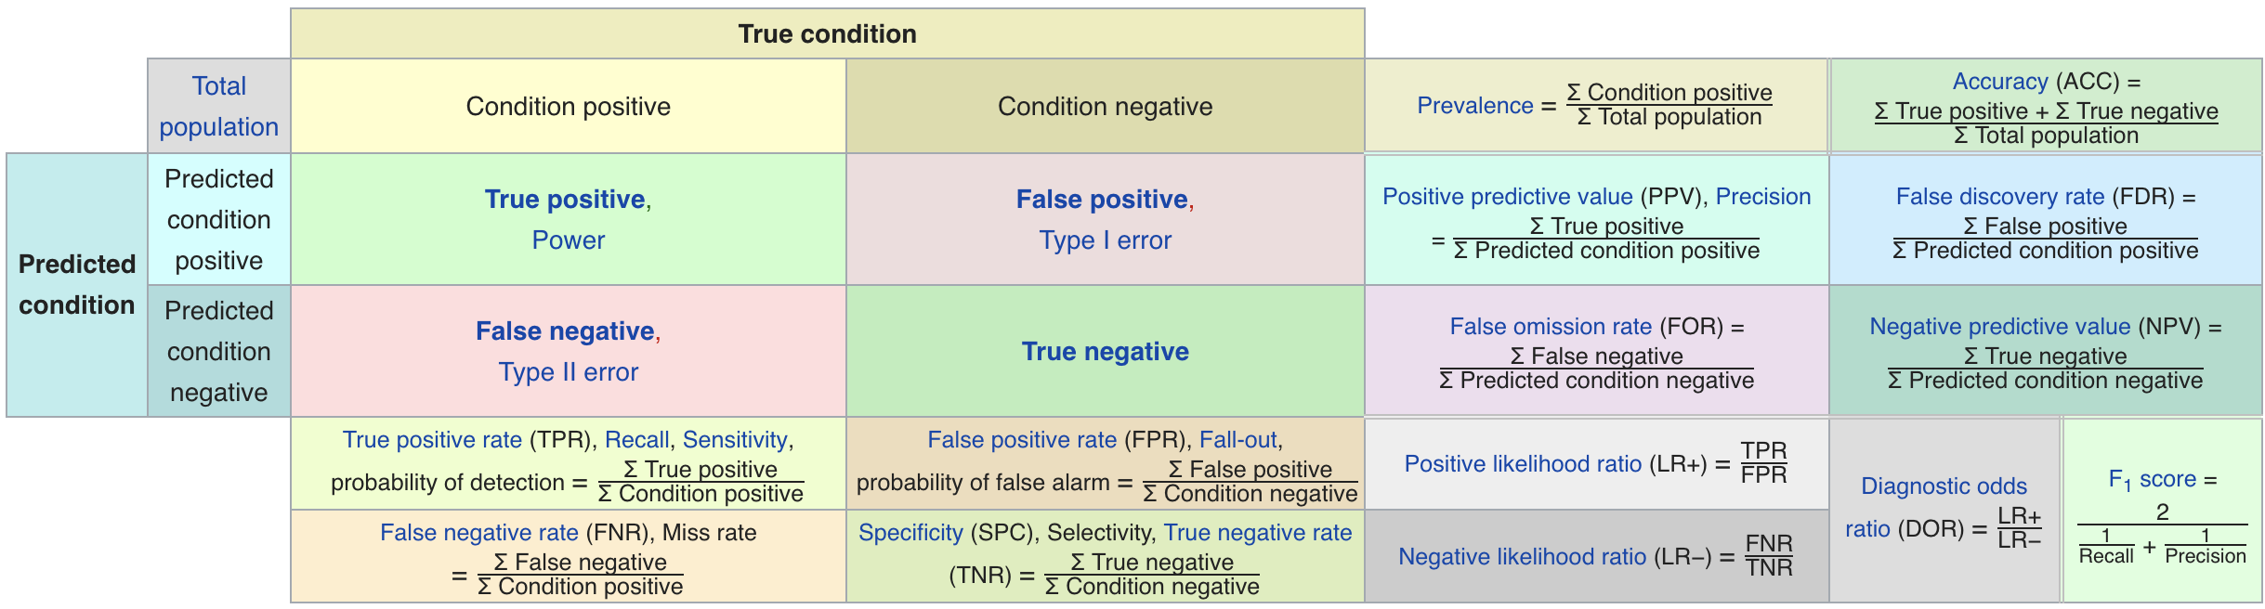
Confusion Matrix-based Metrics Cheatsheet
Source: https://en.wikipedia.org/wiki/Sensitivity_and_specificity
How to create a metric that makes sense for your problem and describing these metrics to non-ML people in their own terms

Slide 22
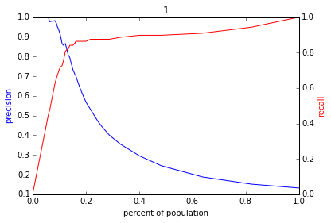
Varying the Threshold – Policy Menu
Score
1 .9 .8 .7 .6 .5 .4 .3. .2 .1
| | | | | | | | | |
Baseline

Slide 23
Feature Generation
Categorical to Binary (Dummies)
Features for missing values
Discretization
Date/Time Features
Scaling/Normalizing
Transformations
Aggregations (space, time, space and time)
Relative (compared to the average…)
Interactions

Slide 24
config.yaml
Pipeline Runner
Orchestration + Config Parameters
Time Splitter
Cohort Creator
Label Creator
Feature Creator
Matrix Creator
Model Trainer
Database
Score Predictor
Model Evaluator

Slide 25
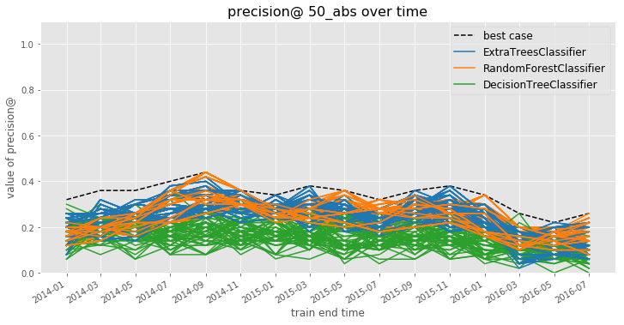
Model Selection
Notes:
Jane

Slide 26
Model Selection
Notes:
Jane

Slide 27
Explainability Use Cases
Use Case | User | Goal | Global or Local
Debugging | ML Developer | Sanity check | Both
Improving performance | Action- taker | Decide to agree or override | Local
Trust | Policymaker/Action-Taker | Model use => better outcomes | Both
Interventions | Action-Taker | Improve outcomes | Local
Recourse | Individual affected | Recourse | Local

Slide 28
Initial Interpretability checklist
For “smaller” models, print it out
Feature importances (or “feature group” importances)
Cross-tabs on your predicted list

Slide 29
Data and AI Ethics Issues
Privacy
Data Ownership
Bias, Equity, & Fairness
Transparency
Trustworthiness and Accountability

Slide 30
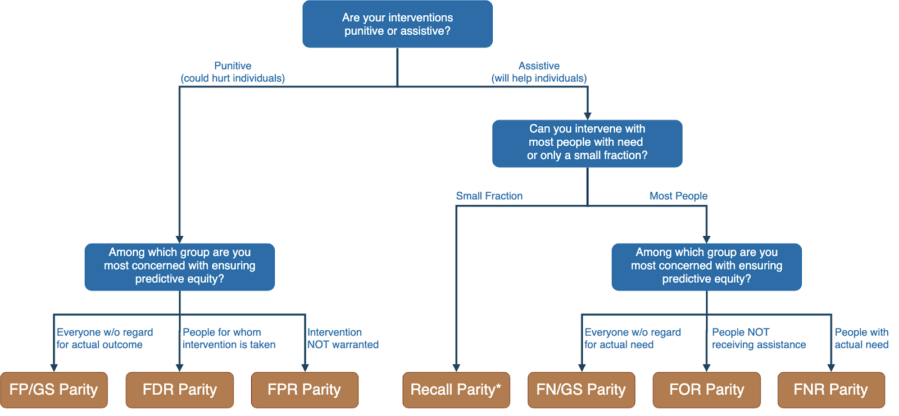
Translating policy goals to fairness metrics

Slide 31
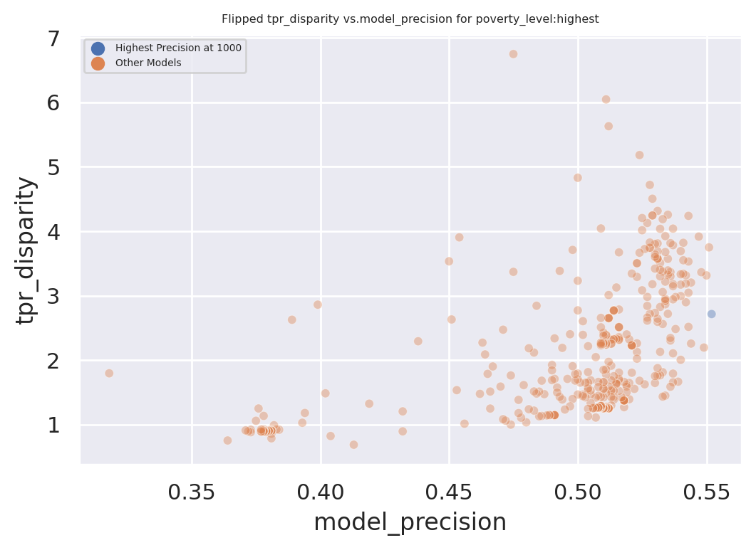
Dual Goals: Fairness and Accuracy
Disparity
Our hope:
Fairness-improving
methods can expand this
frontier by adding new
points
Precision@k

Slide 32
Class Recap
Scoping
Data Acquisition
Data Storage
Data Linkage
Data Exploration
Analytical Formulation
Modeling
Evaluation Metrics
Train Test Splits
Feature Generation
Baselines
ML Pipelines
Model Selection
Interpretability
Bias/Fairness
Field Trials
Deployment
Maintenance & Monitoring

Slide 33
Causal Inference
and Field Trials

Slide 34
What is the purpose of doing field validation?

Slide 35
Field Validation: Beyond A/B Testing
How well does the model perform in the real world?
Validation on truly unseen future data; only way to ensure against leakage
What key assumptions in our formulation need to be tested?
Are we intervening with the “right” people?
Are we intervening in the best way possible?
Impact of historical decision making / selective labels?
Most importantly: how well does the ML system we’re building help the organization realize its goals?

Slide 36
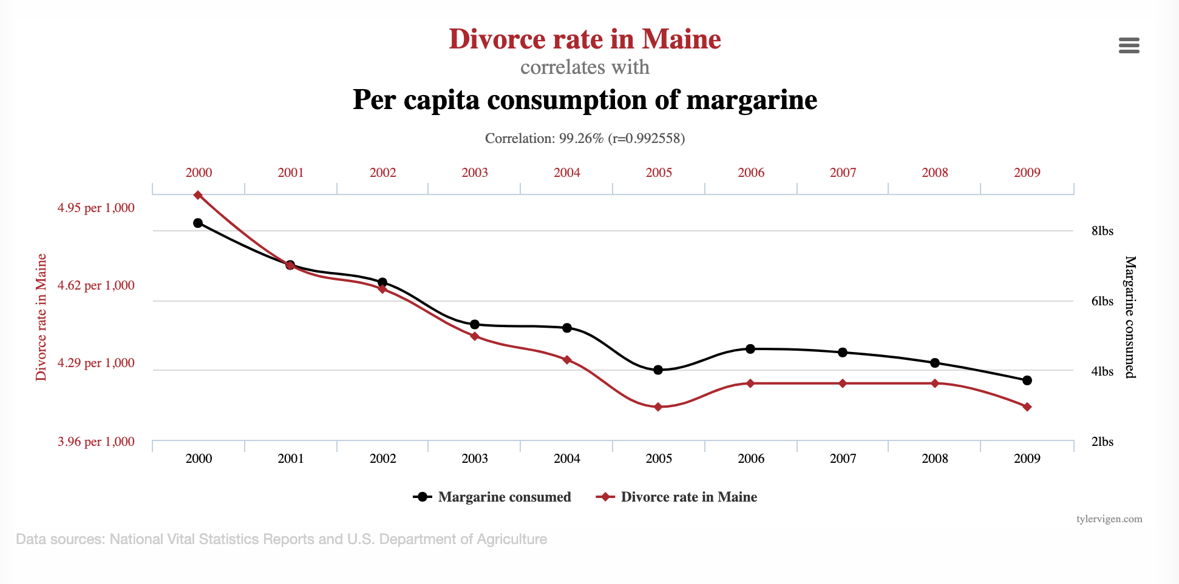
Goals of Causal Inference

Slide 37
Do sports programs affect school graduation rates?
sports programs
?
graduation

Slide 38
Do sports programs affect school graduation rates?
sports programs
Confounders
?
graduation

Slide 39
Do sports programs affect school graduation rates?
sports programs
Confounders
?
graduation
Examples?

Slide 40
Causal Research Design
Experiments
Quasi-experiments
Observational studies

Slide 41
Experiment
sports programs
Confounders
?
graduation
Researcher randomly assigns sports programs

Slide 42
Quasi-Experimental
sports programs
Confounders
?
graduation
Nature/World randomly assigns sports programs

Slide 43
Observational Study
sports programs
Confounders
graduation
Include confounders in regression

Slide 44
CASE STUDY: Mental Health and Incarceration
Cycle of Incarceration
UNMET
NEEDS
MISDEMEANOR
ARREST
JAIL
worsening or failing to improve

Slide 45
CASE STUDY: Mental Health and Incarceration
Breaking the Cycle
UNMET
NEEDS
X
MISDEMEANOR
ARREST
JAIL
MENTAL HEALTH OUTREACH

Slide 46
CASE STUDY: Mental Health and Incarceration
Return to Jail Risk
Released From Jail
In Past 3 Years
ID | SCORE
27 | 0.95
13 | 0.93
1 | 0.89
93 | 0.89
53 | 0.82
23 | 0.75
59 | 0.72
64 | 0.65
20 | 0.61
18 | 0.59
46 | 0.52
82 | 0.48
49 | 0.37
56 | 0.22
17 | 0.12
Mental
Health
Outreach
Model
X
…With History of
Mental Health
Needs
Return to
Jail

Slide 47
CASE STUDY: Mental Health and Incarceration
Return to Jail Risk
Released From Jail
In Past 3 Years
ID | SCORE
27 | 0.95
13 | 0.93
1 | 0.89
93 | 0.89
53 | 0.82
23 | 0.75
59 | 0.72
64 | 0.65
20 | 0.61
18 | 0.59
46 | 0.52
82 | 0.48
49 | 0.37
56 | 0.22
17 | 0.12
Mental
Health
Outreach
Model
X
…With History of
Mental Health
Needs
Return to
Jail
What would you want to learn
through a field trial?

Slide 48
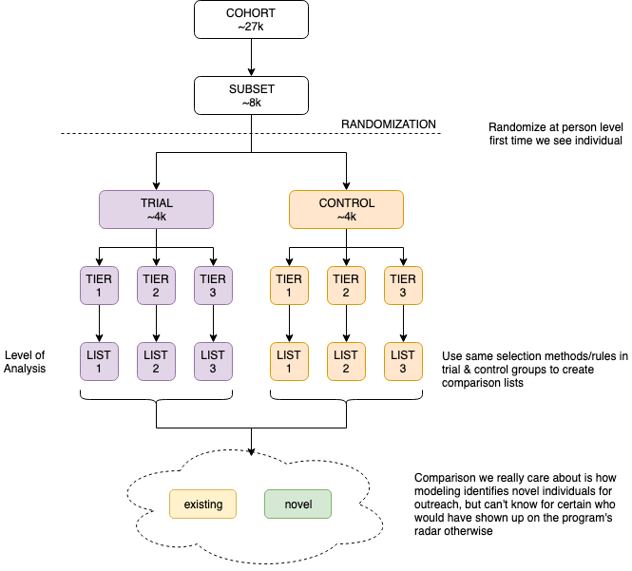

Slide 49
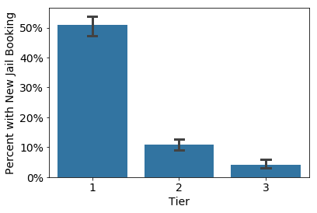
Q1: Is the Model Predictive?

Slide 50
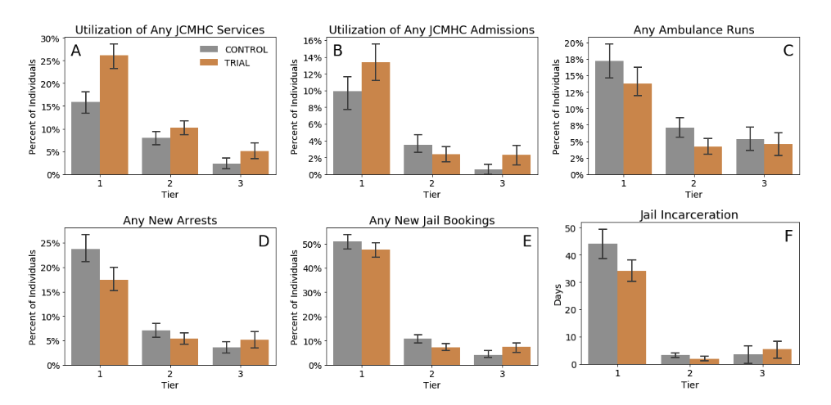
Q2: Does Model+Intervention Affect Outcomes? For Whom?

Slide 51
Methods for causal inference
Using Observational Data
Using Experiments

Slide 52
Causal inference with observational data
Matching
Difference-in-Difference (DID)
Regression Discontinuity Design (RDD)
Instrumental Variables
Limitations?

Slide 53
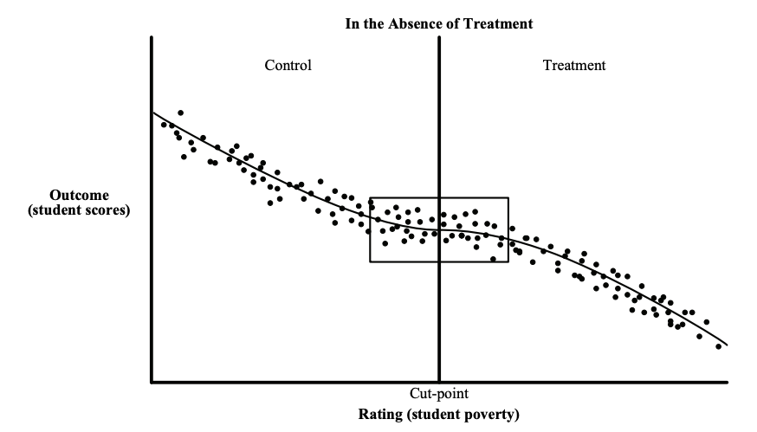
Causal inference with observational data
https://www.mdrc.org/sites/default/files/RDD%20Guide_Full%20rev%202016_0.pdf

Slide 54
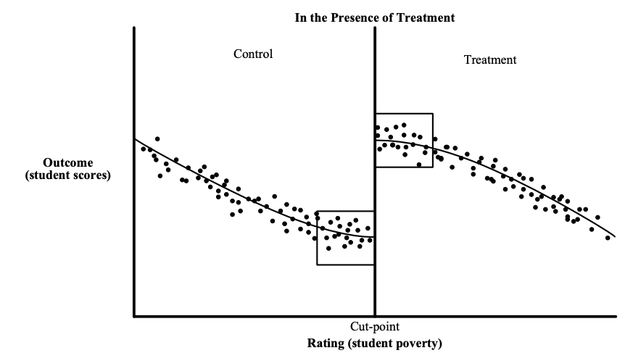
Causal inference with observational data
https://www.mdrc.org/sites/default/files/RDD%20Guide_Full%20rev%202016_0.pdf

Slide 55
Causal inference with experiments
Standard “Randomized Controlled Trials”
Trial Design
Outcome
Sample size
Power
Randomization
Ethical Concerns

Slide 56
Some things to keep in mind
Sample Size
Power Effect Size Significance Level
Effect size > what is practically useful and significant
Significance Level ~ cost of implementing the new system/model

Slide 57
Designing Trials to Validate ML Systems
What can we do with historical data?
Model Selection
Performance Estimation
How do we select the model to deploy?
Compare shortlisted models against baseline
How do we validate whether our ML system will work when deployed?

Slide 58
Designing an experiment
What are we trying to test?
How do we create different arms of the experiment?
How we do we run the experiment?
What do we measure?
How do we evaluate?

Slide 59
What are we testing in an experiment?
Lift?
Classification?
Probability estimates?
Ranking?
How does the experiment design change?

Slide 60
How many [students, inspections, projects] should we include in our trial?
Doing a trial over [y] years with [n] students every year will give us a [p%] chance to detect an [e%] increase in [outcome] with a statistical significance of [s%]

Slide 61
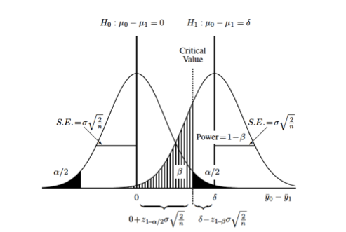
How many [students, inspections, projects] should we include in our trial?
https://clincalc.com/stats/samplesize.aspx

Slide 62
How would you design a trial to validate what you’ve built this semester?

Slide 63
Some Readings
References on causal inference
The seven tools of causal inference, with reflections on machine learning by Pearl, J. Comm ACM. 2019
Elements of Causal Inference by Peters et al. MIT Press. (Open Access Text)
Counterfactuals and Causal Inference: Methods and Principles for Social Research by Morgan and Winship. Cambridge University Press.
Data Analysis Using Regression and Multilevel/Hierarchical Models by Gelman and Hill. Cambridge University Press.

Slide 64
Reminders
This week:
Project Presentations on Thursday
No group meetings on Wednesday
Coming up next week:
Final Reports due on Wednesday

