Slide 1

ML in Practice
and
Model Selection Part III
Rayid Ghani and Kit Rodolfa

Slide 2
Reminders
This week:
Wednesday team check-ins
Coming up next week:
Monday: Update 4 (on Canvas): v0 ML Results and Planned Model Grid
Tuesday: Feedback Form
Midterm Update Presentations (Tuesday and Thursday in class)

Slide 3
Plan for the week
What you should be discussing this week within your team
Finalizing your configuration file for preliminary model runs
Plans for what larger model grid your want to run
Plans for iterating on features
What you should be building this week
Encoding your baselines into triage
Initial “v0” triage runs with very simple models and features

Slide 4
ML Modeling
in Practice

Slide 5
Scope
Data
Exploration
Modeling
Get Data
Store Data
Link Data
Rows
Features
Labels
Model Selection
Train-Test Splits
Performance Metrics
Model Interpretation
Entities
temporal
Spatial
…
Models
Dealing with Bias and Fairness
Field Trial Design
Deployment
Monitoring
Goals, Actions, Data, Analysis, Ethics

Slide 6
How to train and validate models in python and sklearn
Define the model and hyperparameter
Load training matrix
Train (.fit)
Load Validation Matrix
Score examples (.predict_proba)
Calculate evaluation metric(s)
Define set of models and hyperparameter grid for each model

Slide 7
Which models to run and how?

Slide 8
Which hyperparameters to explore?

Slide 9
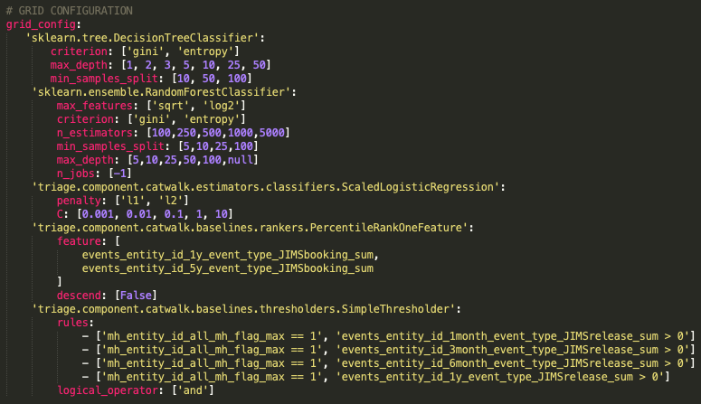
Triage config file: Models and hyperparameter grid

Slide 10
Reminders
This week:
Wednesday team check-ins
Coming up next week:
Monday: Update 7 (on Canvas): ML Results Over Time and Model Selection
Tuesday: Feedback Form

Slide 11
Model Selection
Part III

Slide 12
Scope
Data
Exploration
Modeling
Get Data
Store Data
Link Data
Rows
Features
Labels
Model Selection
Train-Test Splits
Performance Metrics
Model Interpretation
Entities
temporal
Spatial
…
Models
Dealing with Bias and Fairness
Field Trial Design
Deployment
Monitoring
Goals, Actions, Data, Analysis, Ethics

Slide 13
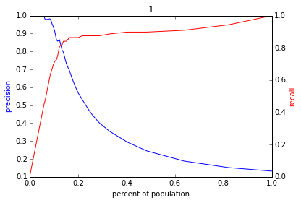
Reminder: The PR-k graph
Score
1 .9 .8 .7 .6 .5 .4 .3. .2 .1
| | | | | | | | | |
Baseline

Slide 14
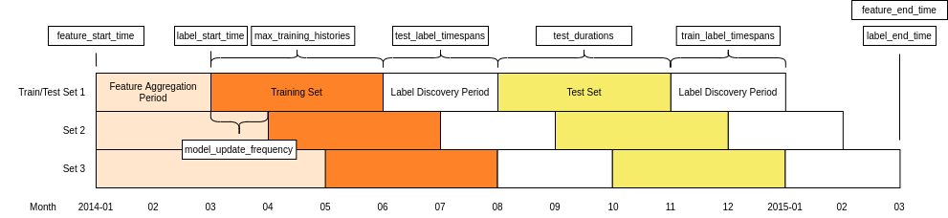
Reminder: Temporal Validation

Slide 15
Why do we need to do model selection?
You’ve run a large number of different types of models varying …
You need to understand what types of models are effective under what circumstances, and
You need to decide which one(s) to use in the future

Slide 16
The wonderful for loop
For train-test splits (CV or temporal)
For subsets of Feature Sets (Demographic only, Behavior only, Temporal only, etc.)
For Classifiers (RFC, SVM, DT, NN, Logit, GB, Boosting)
For parameters (cross products of different parameters)
Fit
Predict
Evaluate

Slide 17
Results
Classifier | Param 1 | Param 2 | Validation Split | Feature Subsets used | Accuracy | Prec @ 1% | AUC

Slide 18
Analyzing the results
Which approaches work best?
Which classifiers?
Which parameters?
Over which metrics?
Value of different features/feature sets?
Variance in performance over time?
Highest average?
Lowest variance?
Getting better over time?

Slide 19
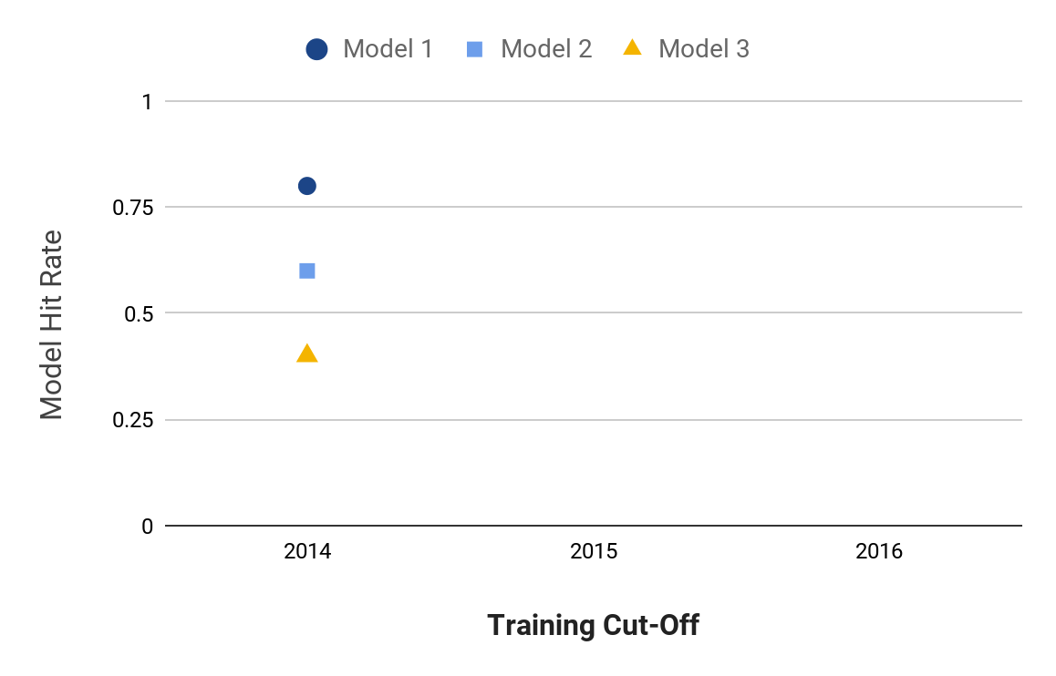
Model Selection
Notes:
Jane

Slide 20
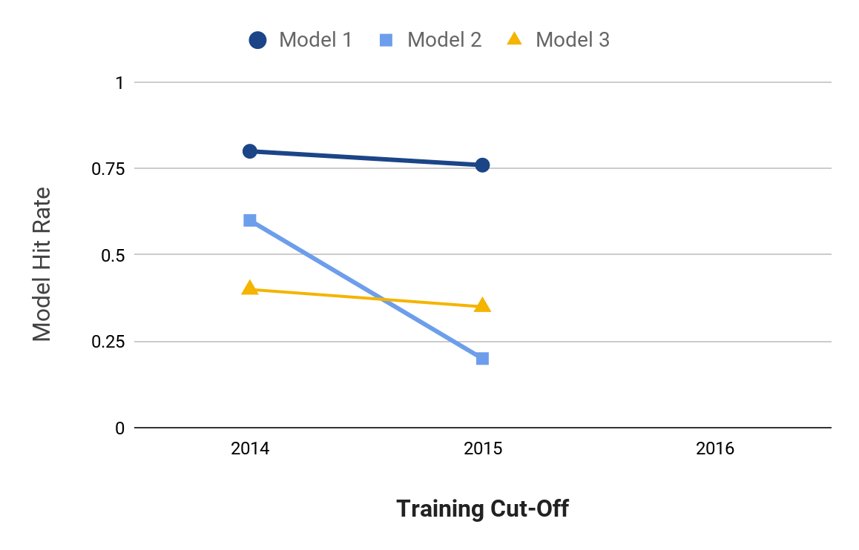
Model Selection
Notes:
Jane

Slide 21
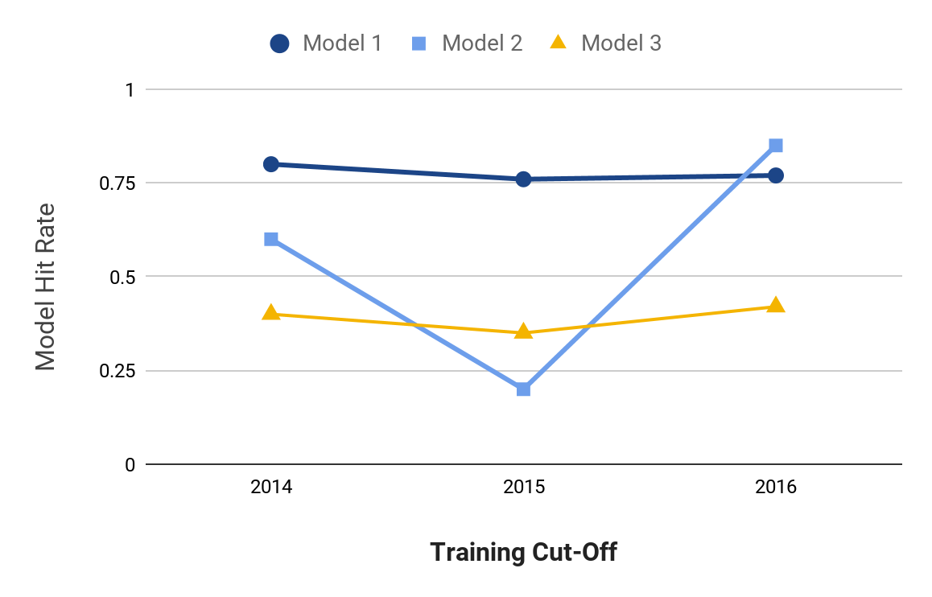
Model Selection
Notes:
Jane

Slide 22
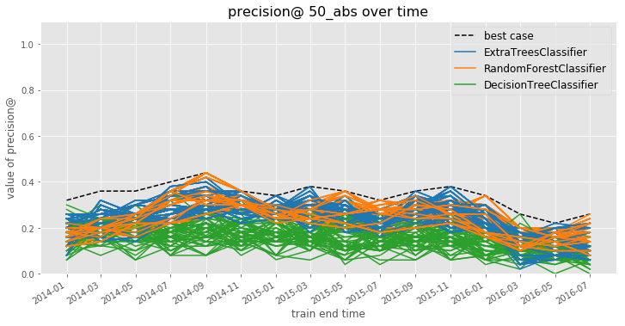
Model Selection
Notes:
Jane

Slide 23
Model Selection
How can you narrow hundreds or thousands of model specifications down to a handful of the best-performing ones?
How do you balance performance and stability?
mean performance?
balancing mean and variance?
recency-weighted mean?
What is the “regret” in subsequent time periods from using different strategies for choosing a model to deploy?
Notes:
Jane

Slide 24
Model Selection
Comparing Model Selection Strategies:
Use validation set performances up to a given point in time to do model selection using each strategy
On the subsequent validation set, calculate a regret for the model selection strategy as the difference between the performance of the model specification that strategy chooses and the best-performing model specification on this new validation set
Notes:
Jane

Slide 25
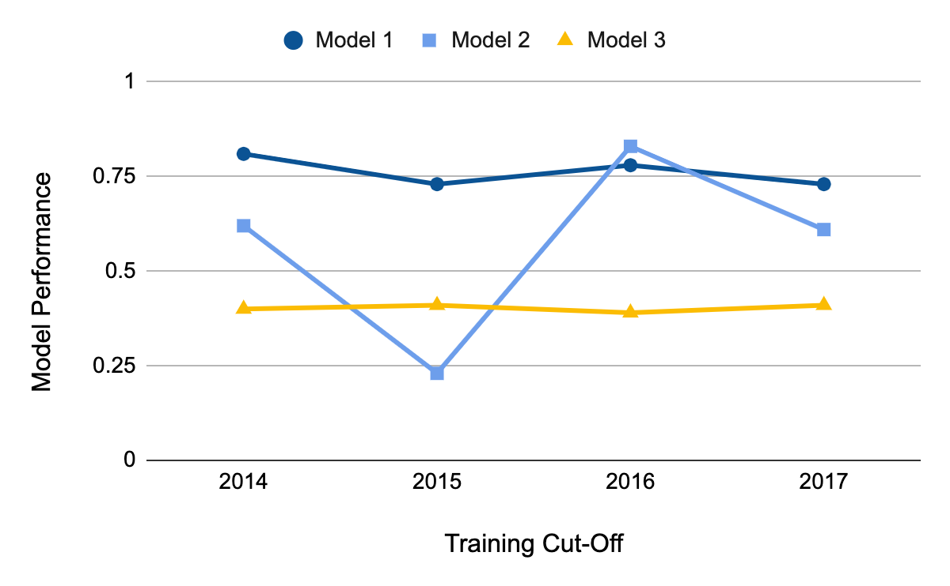
Model Selection
Apply model selection strategies to validation set performance through 2016
Notes:
Jane

Slide 26
Model Selection
Apply model selection strategies to test set performance through 2016
Calculate regret based on 2017 validation set performance
Notes:
Jane

Slide 27
Model Selection
Best Recent Perf:
Model 2
Best Average Perf:
Model 1
Lowest Variance: Model 3
Notes:
Jane

Slide 28
Model Selection
Best Model in 2017:
Model 1
Perf = 0.73
Notes:
Jane

Slide 29
Model Selection
Best Recent Perf:
Model 2
Regret:
0.73 – 0.61 = 0.12
}
Notes:
Jane

Slide 30
Model Selection
Best Average Perf:
Model 1
Regret:
0.73 – 0.73 = 0.00
}
Notes:
Jane

Slide 31
Model Selection
Lowest Variance: Model 3
Regret:
0.73 – 0.41 = 0.32
}
Notes:
Jane

Slide 32
Model Selection
Strategy | Best Model Through 2016 | Regret in 2017
Best Recent Perf. | Model 2 | 0.12
Best Average Perf. | Model 1 | 0.00
Lowest Variance | Model 3 | 0.32
Notes:
Jane

Slide 33
Model Selection
Strategy | Best Model Through 2016 | Regret in 2017
Best Recent Perf. | Model 2 | 0.12
Best Average Perf. | Model 1 | 0.00
Lowest Variance | Model 3 | 0.32
Notes:
Jane

Slide 34
Model Selection
Notes:
Jane

Slide 35
Model Selection
Notes:
Jane

Slide 36
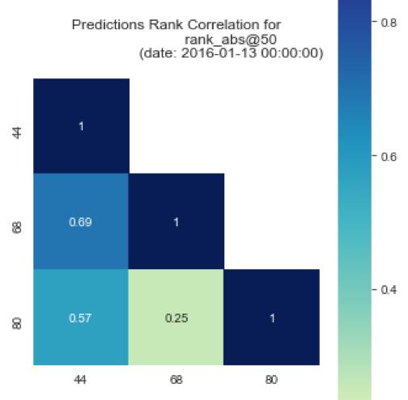
Model Selection
May not be obvious which strategy / model specification is “best”
Among good candidates, may be instructive to ask how similar or different the lists each strategy would produce are
May ultimately want to deploy (or at least test) a strategy that combines across several specifications
Notes:
Jane

Slide 37
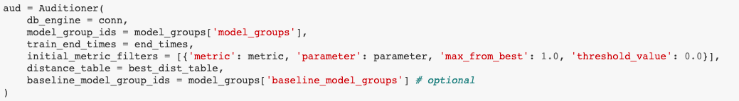
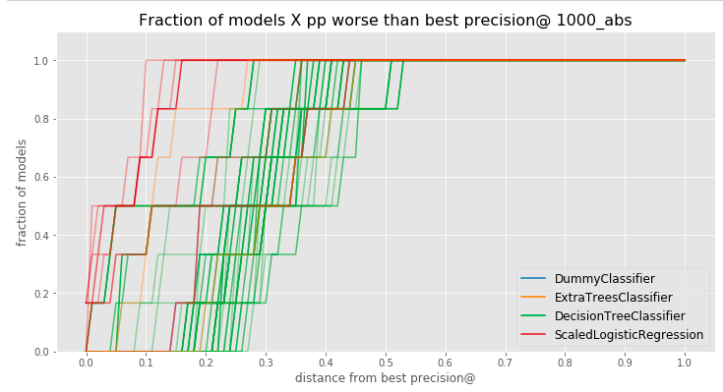
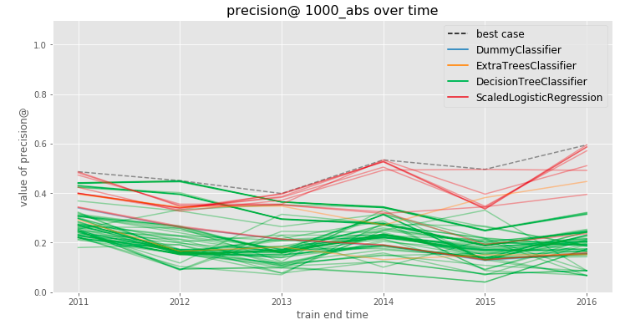
Model Selection in Triage: Audition

Slide 38
Model Selection in Triage: Audition
Audition Notebook:
https://github.com/dssg/triage/blob/master/src/triage/component/audition/Audition_Tutorial.ipynb

Slide 39
Some Open Research Questions
What are the conditions under which temporal validation out-performs traditional cross-validation? By how much?
Likewise, what can we learn about how well certain strategies perform in terms of regret under different real-world conditions?
Many problems in policy settings involve resource constraints that require optimization at the top of the list, but few methods optimize for this directly.
e.g., Transductive Top k

Slide 40
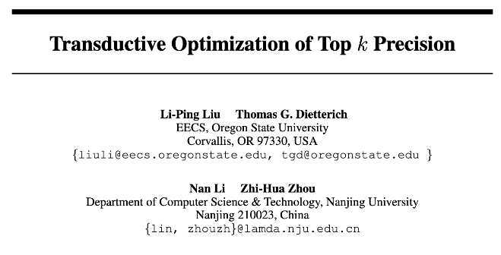
Some Open Research Questions

Slide 41
Some Open Research Questions
The SVM loss function will find the “best” separating hyperplane overall, but perhaps we could draw a better hyperplane to separate just k positive examples?
Transductive method: needs to be aware of the test set without labels to select just k test examples.
Modified gradient descent procedure to project gradient direction for L2-regularized SVM loss onto a “feasible solution cone” such that no more than k test examples will be predicted positive after the step.

Slide 42
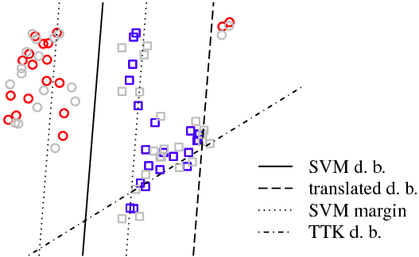
Some Open Research Questions

Slide 43
Some Open Research Questions
Paper shows improvements on synthetic examples and some “standard” datasets, but still more to investigate:
Can be slow to converge on larger datasets
“At most” k examples can yield many fewer than the desired k, particularly for rare events (why doesn’t the algorithm target exactly k?)
Although creating a “top k” boundary, still penalizes false positives and false negatives equally during optimization
Can we do better at the top, even if we don’t have access to the test list?

Slide 44
A Quick Recap

Slide 45
Skills needed to solve real-world problems with ML
Computer Science &
Programming
Problem
Formulation
Statistics
Communication
REAL
WORLD
Social Sciences
Ethics &
Legal Issues
Experimental
Design
Notes:
For ML students, previous iterations of this class probably involved some readings and assignments in each of these areas. This semester, we’re taking a more hands-on project-focused approach.

Slide 46
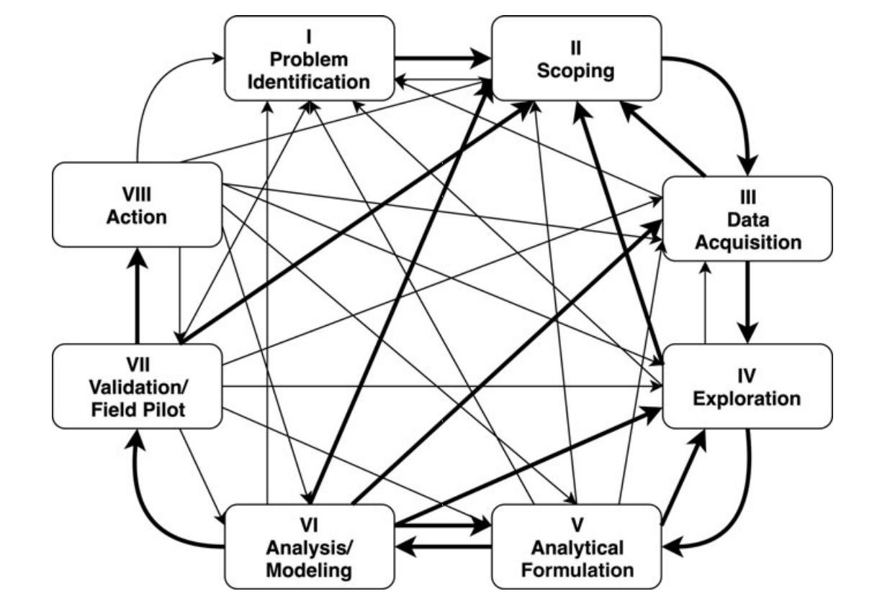
Scoping is an iterative and ongoing process
Involves different types of people
Gets refined over time
Gets modified as a result of later project phases

Slide 47
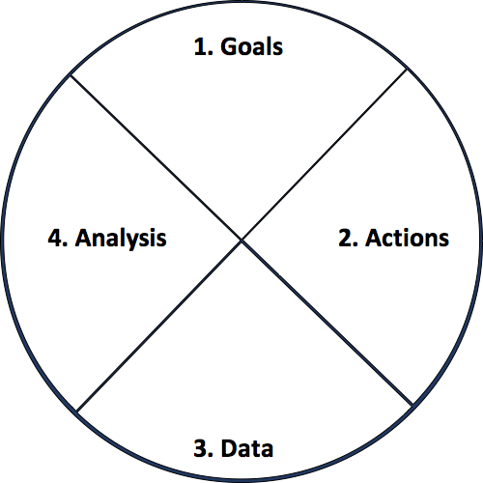
Actionable and Goal-Driven Project Scope
Goals: Define the goal(s) of the project
Actions: What actions/interventions will you inform?
Data: What data do you have internally? What data do you need? What can you augment from external and public sources?
Analysis: What analysis needs to be done? How will it be validated?
47
dsapp.uchicago.edu
@datascifellows
Center for Data Science and Public Policy University of Chicago

Slide 48
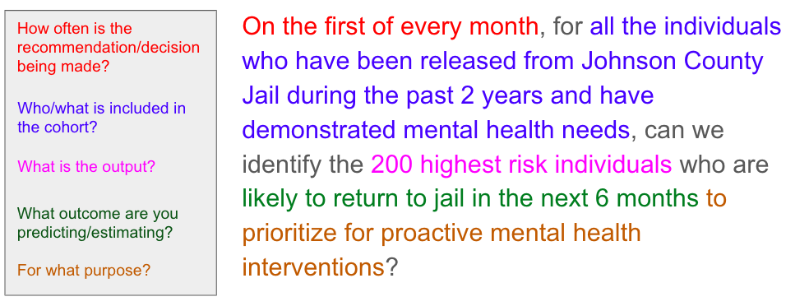
Analytical Formulation
48
dsapp.uchicago.edu
@datascifellows
Center for Data Science and Public Policy University of Chicago

Slide 49
Baseline Considerations
How much better than baselines does our system need to be in order to deploy?
Important to compare performance against the base rate/prior, but this prior rarely represents a “common sense” baseline
Good baselines should provide an ordering to sort the entities
Heuristic rules (or shallow decision trees) might reflect current practice, but can yield a small number of unique scores with lots of ties
In many real-world problems, a good baseline can be difficult to beat

Slide 50
Practical Pointers for Features
What did you know and when did you know it?
Feature development is an iterative process
Start simple: build a couple features (from each data source) you think are most important and expand from there
Domain / expert knowledge and prior research in the field can help a lot!

Slide 51
Missing Value Tips
Do not remove rows or columns with missing values (unless there is a really really really good reason)
Missingness can be a useful predictor: create a flag even if you impute a value
Data can be missing for different reasons and missingness for each row/column/cell may need to be handled differently
Only use data from the past for imputation

Slide 52
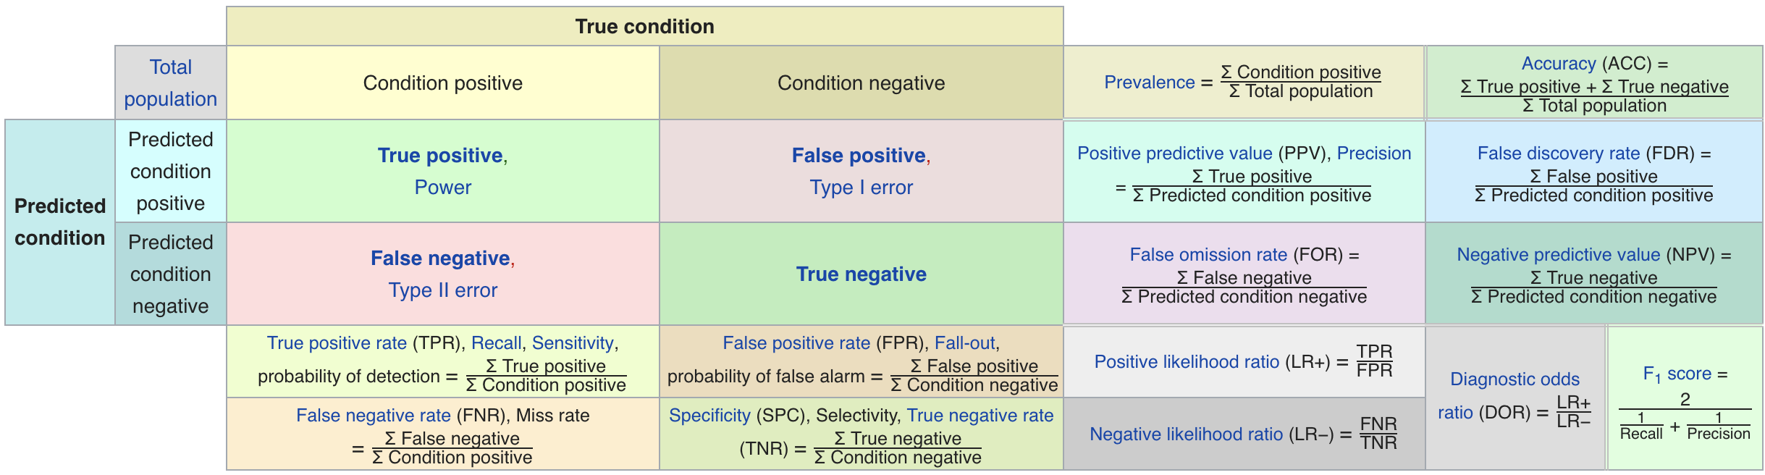
Metric Cheatsheet
Source: https://en.wikipedia.org/wiki/Sensitivity_and_specificity

Slide 53
Varying the Threshold
Score
1 .9 .8 .7 .6 .5 .4 .3. .2 .1
| | | | | | | | | |
Baseline

Slide 54
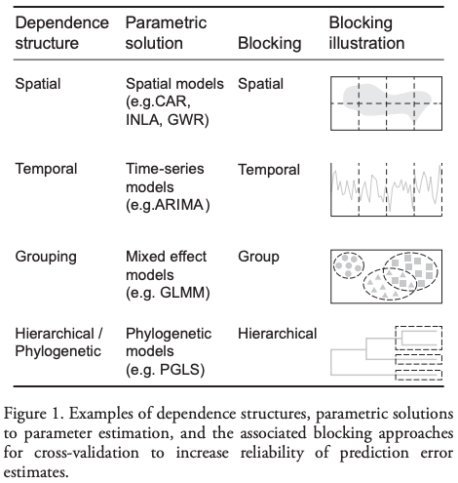
Evaluation - Methodology
In-sample
Out of sample
Multiple Out-of-sample (Hold-out) Splits
Cross Validation
Leave one out (LOO)
K fold
Holdouts Using Structure of Data
Temporal
Spatial, Hierarchical, etc.

Slide 55
Temporal Holdouts
Data
2002 2017
Train
Validate
2002 2007 2008
Train
Validate
2002 2008 2009
Train
Validate
2002 2009 2010

Slide 56
Training - Time splits
Train
Validate
2002 2009 2010
Train
We only use this time
to get outcomes
2002 2009

Slide 57
Discussion Question
What would be some potential strategies for integrating considerations around fairness in the process of model evaluation and selection?

Slide 58
Reminders
This week:
Wednesday team check-ins
Coming up next week:
Monday: Update 7 (on Canvas): ML Results Over Time and Model Selection
Tuesday: Feedback Form

Slide 59
Reminders
This week:
Wednesday team check-ins
Coming up next week:
Monday: Update 4 (on Canvas): v0 ML Results and Planned Model Grid
Tuesday: Feedback Form
Midterm Update Presentations (Tuesday and Thursday in class)

