Slide 1

Triage Overview + Q&A
Rayid Ghani and Kit Rodolfa

Slide 2
Plan For Today
Defining Features in Triage
Quick Tour of Triage Outputs
General Q&A

Slide 3
Defining Features in Triage
Motivating example:
Historical project fraction funded for a given
teacher in the donors choose setting

Slide 4
Features in triage: Collate
All features are temporal aggregates, reflecting nature of data
Need to specify what you’re using and when it was known
Need to specify how you’ll handle missingness explicitly
YAML structure can take a little getting used to, but powerful for specifying many aggregations over many time frames in compact format

Slide 5
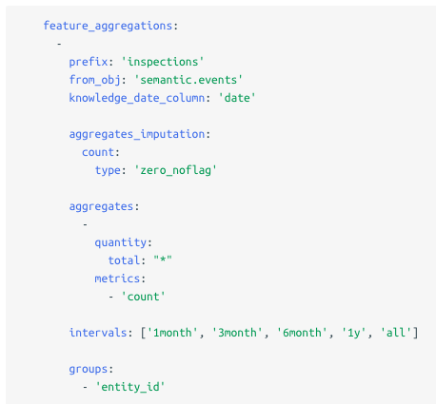
Features in triage: Collate
Table or SQL snippet
Several options for missing data
Column or SQL snippet
and aggregation function
Time frames for aggregation

Slide 6
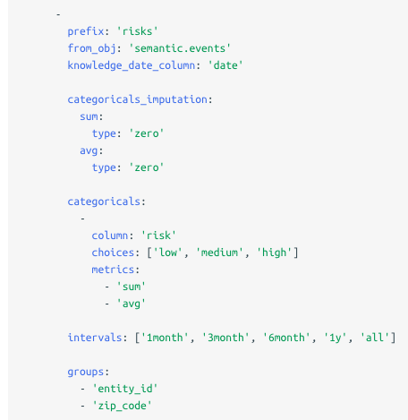
Features in triage: Collate
Similar structure for categoricals
Specify categorical values by hand or query

Slide 7
Collate: Naming Conventions
For aggregates:
{prefix}_entity_id_{interval}_{quantity}_{metric}
For categoricals:
{prefix}_entity_id_{interval}_{quantity}_{value}_{metric}

Slide 8
Collate: Naming Conventions
For aggregates:
{prefix}_entity_id_{interval}_{quantity}_{metric}
For categoricals:
{prefix}_entity_id_{interval}_{quantity}_{value}_{metric}
Important note:
Even categoricals need to be aggregated over time!

Slide 9
Collate: Some Examples
Days between inspection cases in San Jose
Vaccine History and Categoricals from CSF
Case Info from LA (multiple aggregates)
Days since last event in LA (using collate date)

Slide 10
Collate: Some Considerations
No built-in way to do “most recent value” (might need to pre-compute)
Single/identical values still considered aggregates (can just take “max”)
Categoricals get aggregated, too (one-hot encoded first)
Postgres column length limits / truncation
Need to specify imputation strategy for all features (can do at aggregate-level)
May want to pre-compute especially computationally expensive features

Slide 11
Triage Outputs
What’s on disk?
Log Files (very useful!)
Model Objects
Matrices
What’s in the database
Metadata about runs, model groups, models
Cohort and label tables
Features and matrix (entity/date) tables (warning: not persistent!)
Aggregated results
Individual-level predictions (when using save_predictions=True)

Slide 12
Triage Outputs
triage_metadata schema
on disk
model objects
triage_runs
run_hash
experiment_models
maps from experiments
to models
experiment_hash
joblib pickles of trained
model objects
info about every
time you run triage
model_hash
models
models trained on a
specific training set
experiments
model_group_id
train_matrix_uuid
matrices
model_groups
a model type +
hyperparameter +
other params (e.g.,
features, training
history, etc)
stores your full
config + parameters
csv files +
yaml metadata

Slide 13
Triage Outputs
features schema
on disk
matrices
triage_runs
entity_id +
as_of_date
triage_runs
triage_runs
triage_runs
matrix_uuid
*_aggregation_imputed
[uuid]_matrix_entity_date
csv files +
yaml metadata
separate tables
for each feature prefix
separate tables
for each matrix
Note: the features tables may get recreated if the config or underlying data changes,
so can’t be relied upon as the historical record of what features were used for a given
model (use the matrices on disk for this instead!)

Slide 14
Triage Outputs
train/test_results schema
triage_metadata
models
aggregated evaluation
metrics (e.g., prec@100)
evaluations
model_id
model_id
entity-level model scores
from each model
predictions
model_id
on disk
standard / built-in feature
importances (in the
train_results schema)
feature_
importances
matrix_uuid
model_id
matrices
matrix_uuid
additional metadata
about predictions
prediction_
metadata
csv files +
yaml metadata

Slide 15
General Q&A

