Slide 1

Bias and Fairness in ML
Rayid Ghani

Slide 2
Plan for the week
What you should be discussing with your team this week
Relevant fairness metrics and attributes that you should care about
What you should be building this week
Models: Finishing up any additions to your model grid & selection and doing sanity checks
Fairness Audit: Looking at bias metrics for your selected model(s)

Slide 3
Scope
Data
Exploration
Modeling
Get Data
Store Data
Link Data
Rows
Features
Labels
Model Selection
Train-Test Splits
Performance Metrics
Model Interpretation
Entities
temporal
Spatial
…
Models
Dealing with Bias and Fairness
Field Trial Design
Deployment
Monitoring
Goals, Actions, Data, Analysis, Ethics

Slide 4
For more details…
Today is an overview of this topic
There are many more resources for in-depth coverage
Tutorial with hands-on colab notebooks

Slide 5
Common misconceptions in the real world
If I don’t use race in my analysis/models, then my analysis/models can’t be racist
If I use race in my models, then models are always racist
If my actions aren’t happening on individuals, then I don’t need to worry about bias

Slide 6
How we design ML systems
What values should the ML system be designed to achieve?
How do we build it to achieve those values?
How do we validate and monitor that it continues to achieve those values?
Notes:
AI/ML systems are heavily dependent on humans to determine a wide range of aspects of their design, development, and use

Slide 7
Data and AI Ethics Issues
Privacy
Data Ownership
Bias, Equity, & Fairness
Transparency
Trustworthiness and Accountability

Slide 8
Data and AI Ethics Issues
Privacy
Data Ownership
Bias, Equity, & Fairness
Transparency
Trustworthiness and Accountability

Slide 9
The focus should not just be on making the ML model fair but rather on making the overall system and outcomes fair
Define (desired fairness or equity goals)
Understand (root causes of bias)
Improve (fairness of AI systems)
Measure and Detect (bias)
Mitigate (the impact through adjusting interventions)
Monitor & Evaluate

Slide 10
The focus should not just be on making the ML model fair but rather on making the overall system and outcomes fair
Define (desired fairness or equity goals)
Understand (root causes of bias)
Improve (fairness of AI systems)
Measure and Detect (bias)
Mitigate (the impact through adjusting interventions)
Monitor & Evaluate

Slide 11
What would it mean to be fair?

Slide 12
Many Bias Measures: How do we select what we design for?
Do we allocate equal resources to every group?
Do we allocate resources proportional to need?
Do we make sure we don’t miss people with of a certain group disproportionately?
Do we make sure we don’t have disproportionate false positives from a particular group?
...

Slide 13
Many Bias Measures: How do we select what we care about?
Statistical/Demographic Parity
Impact Parity
False Discovery Rate Parity
False Omission Rate Parity
False Positive Rate Parity
False Negative Rate Parity
...

Slide 14
Why do we have to choose?

Slide 15
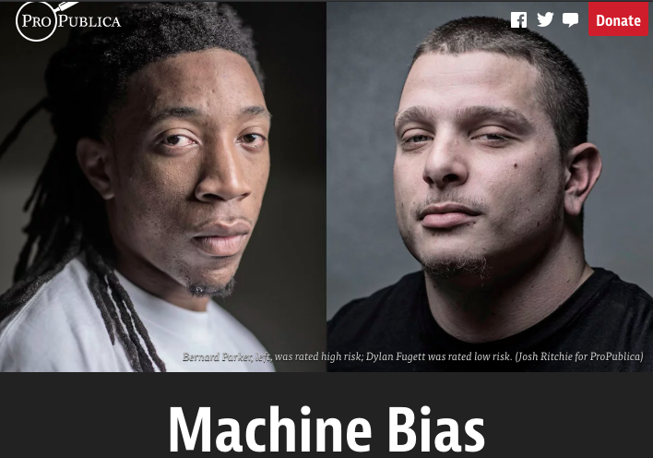
Incompatibility Between Fairness Metrics

Slide 16
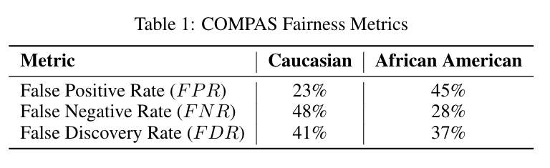
Incompatibility Between Fairness Metrics

Slide 17
Incompatibility Between Fairness Metrics
ProPublica identified considerable disparities:
The algorithm was twice as likely to incorrectly predict black individuals were at high risk of recidivating (FPR)
It was also nearly twice as likely to incorrectly predict white individuals were at low risk of recidivating (FNR)

Slide 18
Incompatibility Between Fairness Metrics
However, the creator of the algorithm pointed out that the algorithm is well-
balanced across races on precision (equivalently, FDR), claiming this is the
correct measure of fairness in this context.

Slide 19
Incompatibility Between Fairness Metrics
Who is right?
Is the COMPAS algorithm biased?
Can’t the algorithm achieve both measures of fairness at the same time?

Slide 20
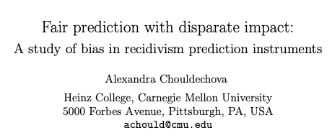
Incompatibility Between Fairness Metrics

Slide 21
Incompatibility Between Fairness Metrics

Slide 22
Incompatibility Between Fairness Metrics
False Positive Rate
Among all actual 0’s,
fraction predicted to be 1
False Negative Rate
Among all actual 1’s,
fraction predicted to be 0
Prevalence
Fraction of
actual 1’s in
population
False Discovery Rate
Among all predicted 1’s,
fraction that are actual 0’s
=(1 – precision)

Slide 23
Incompatibility Between Fairness Metrics
If prevalence is
unequal across
groups...

Slide 24
Incompatibility Between Fairness Metrics
If prevalence is
unequal across
groups...
…and FDR (or precision)
is equal across groups...

Slide 25
Incompatibility Between Fairness Metrics
If prevalence is
unequal across
groups...
…and FDR (or precision)
is equal across groups...
…then either FPR or FNR can be equal across groups, but not both

Slide 26
So… what does this mean?

Slide 27
So… what does this mean?
Unfortunately, we can’t ensure parity across all metrics at the same time…
But this also doesn’t mean fairness is unachievable or we shouldn’t bother.
Instead, it means we have to carefully consider and choose the appropriate fairness metrics for our context

Slide 28
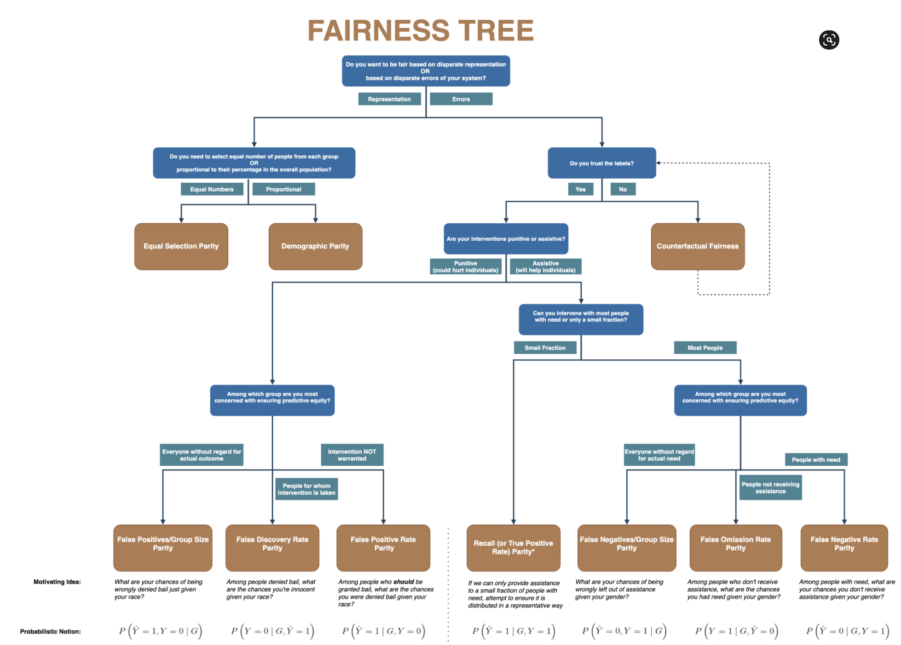
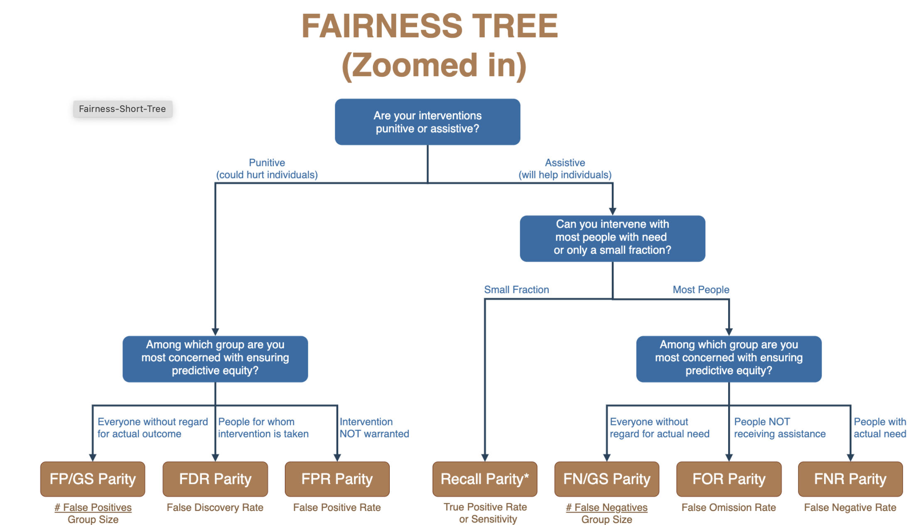

Slide 29
Is the fairness tree “the answer”?
No… but it’s intended as a starting point to help guide a conversation between ML experts, policy makers, and those affected by the decisions.
Ultimately, the choice of fairness metric(s) is highly dependent on context and stakeholder values.

Slide 30
The focus should not just on making the ML model fair but rather on making the overall system and outcomes fair
Define (desired fairness or equity goals)
Understand (root causes of bias)
Improve (fairness of AI systems)
Measure and Detect (bias)
Mitigate (the impact through adjusting interventions)
Monitor & Evaluate

Slide 31
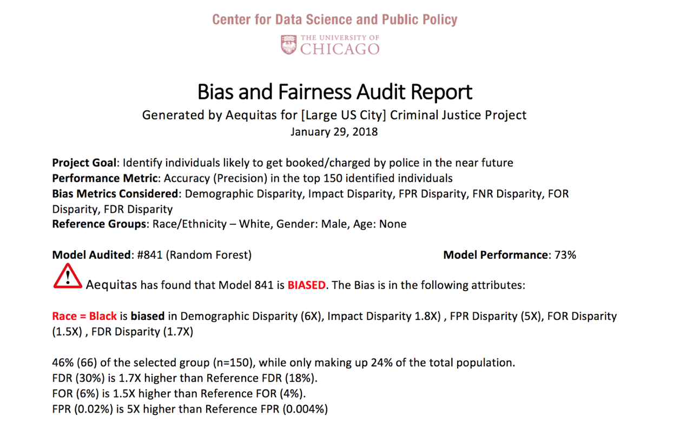
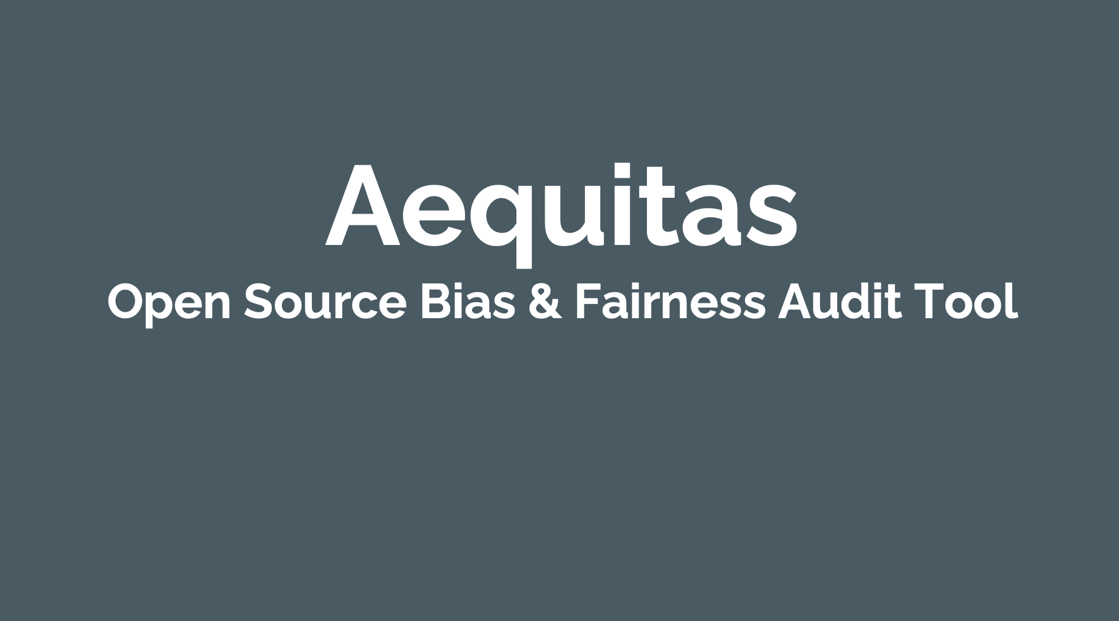
Aequitas: Bias Audit Tool
http://datasciencepublicpolicy.org/aequitas

Slide 32
The focus should not just on making the ML model fair but rather on making the overall system and outcomes fair
Define (desired fairness or equity goals)
Understand (root causes of bias)
Improve (fairness of AI systems)
Measure and Detect (bias)
Mitigate (the impact through adjusting interventions)
Monitor & Evaluate

Slide 33
Diagnosing the root causes of bias in AI/ML Systems
World
AI Pipeline
Actions
Data
Disparity in Outcomes
Bias and disparity (in outcomes) can come from any of these four components
Sample Bias
Measurement Bias
Label Bias
System Developers
Complexity or flaws
Design Choices

Slide 34
Bias can be introduced in every step of the ML pipeline
Get Data
Store and Link Data
Process Data
Explore Data
Modeling
Communicate
Maintain
Deploy
Evaluate & Select
Test

Slide 35
The focus should not just on making the ML model fair but rather on making the overall system and outcomes fair
Define (desired fairness or equity goals)
Understand (root causes of bias)
Improve (fairness of AI systems)
Measure and Detect (bias)
Mitigate (the impact through adjusting interventions)
Monitor & Evaluate

Slide 36
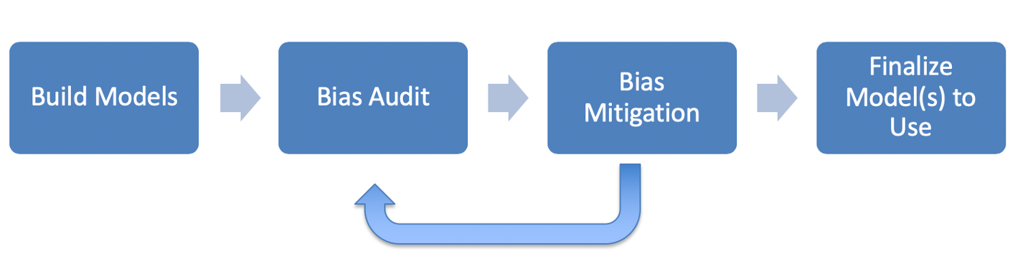
ML Fairness Workflow

Slide 37
How can we reduce bias in ML models?
Fix the world
Pre-Processing: Fix the input data
Remove sensitive attributes (and correlated ones)
Resample and/or reweight protected groups
In-Processing: Optimize for fairness in model training
Post-Processing
Choose fair models during model selection
Post-hoc adjustments to ‘de-bias’ model scores

Slide 38
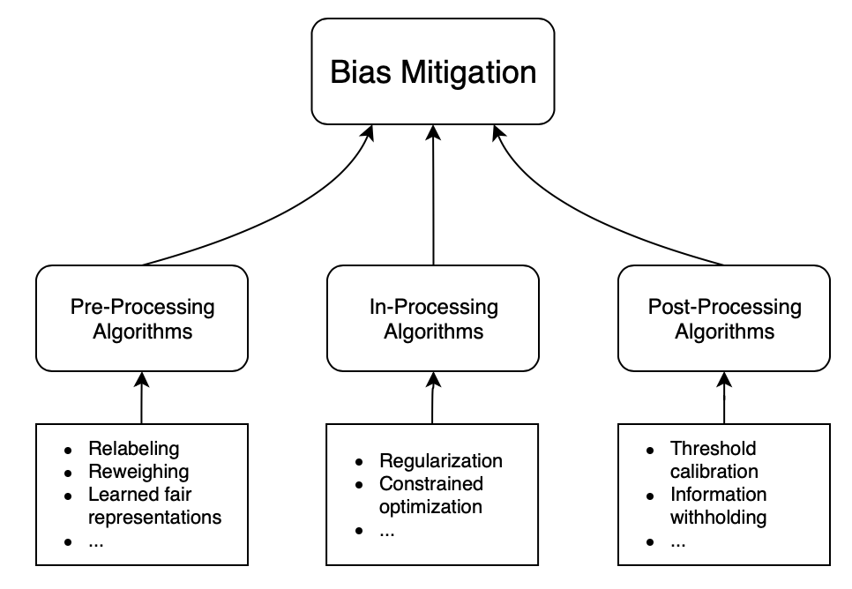
How can we reduce bias in ML models?

Slide 39
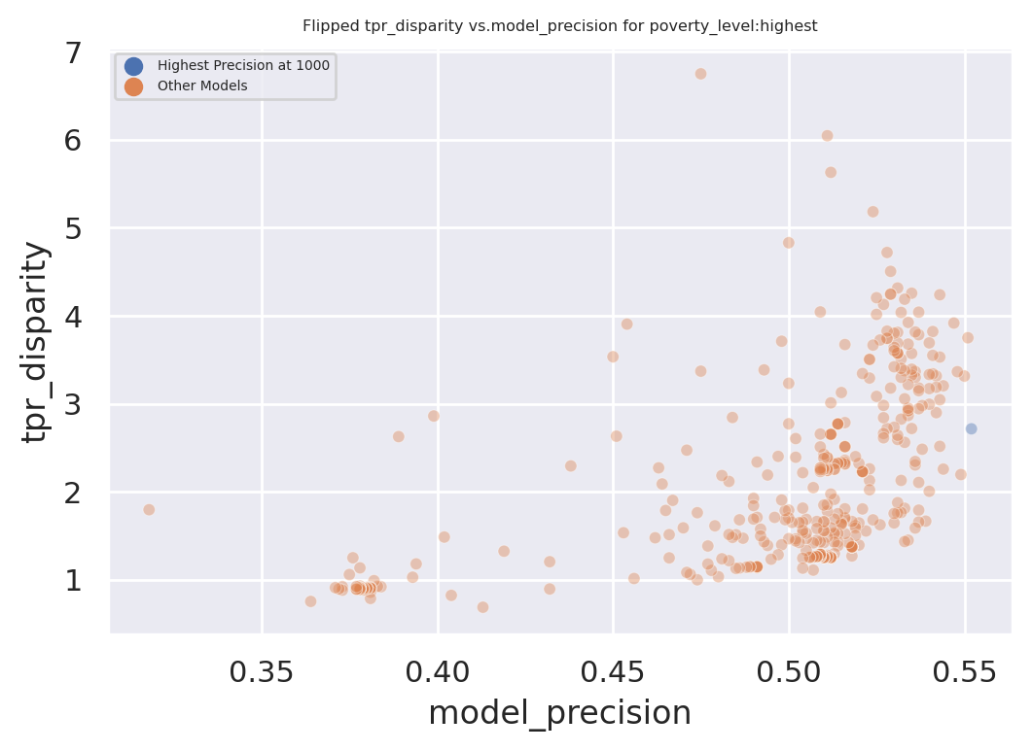
Exploring Trade-Offs
Each point is a different
model specification
Disparity
Precision@k

Slide 40
Exploring Trade-Offs
Each point is a different
model specification
Points further to the right
are more accurate
Disparity
Precision@k

Slide 41
Exploring Trade-Offs
Each point is a different
model specification
Points further to the right
are more accurate
Points closer to 1 on the
y-axis are more fair
Disparity
Precision@k

Slide 42
Exploring Trade-Offs
Disparity
“Best” model just based
on top k precision
Precision@k

Slide 43
Exploring Trade-Offs
Disparity
Pareto Frontier
Precision@k

Slide 44
Exploring Trade-Offs
Disparity
Our hope:
Fairness-improving
methods can expand this
frontier by adding new
points
Precision@k

Slide 45
Some Motivating Case Studies
Assessing damage from natural disasters via social media
Bank loan denial decisions based on default risk
Prioritizing housing inspections based on risk of lead poisoning

Slide 46
Legal and Social Principles
Choices about fairness and equity are implicit in any decision process but being made explicit by the growing use of algorithmic decision support.

Slide 47
Legal and Social Principles
Choices about fairness and equity are implicit in any decision process but being made explicit by the growing use of algorithmic decision support. What implicit choices about fairness are encoded when we say…
Beyond a reasonable doubt? (e.g., criminal court)
The preponderance of evidence? (e.g., civil court)
Probable cause? (e.g., indictment by grand jury)
Innocent until proven guilty?

Slide 48
Legal Perspectives and Challenges
Title VII of US Civil Rights Act – Job Discrimination
Disparate Treatment (intentional discrimination)
Disparate Impact (regardless of intention)
14th Amendment
Equal Protection (under laws and government actions)
“Strict Scrutiny” Standard: compelling state interest, narrowly tailored, and least restrictive means
Notes:
14th Amendment often interpreted to prohibit racial classification in most cases (that is, taking race into account in state decision-making) as well as racial intentions/discriminatory purpose

Slide 49
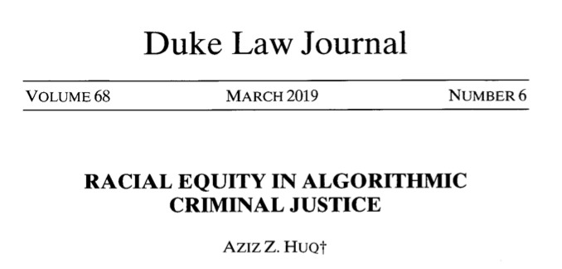
Legal Perspectives and Challenges

Slide 50
Legal Perspectives and Challenges
What Challenges Does Huq Identify Applying Current Legal Standards to Algorithmic Decision Making?

Slide 51
Legal Perspectives and Challenges
What Challenges Does Huq Identify Applying Current Legal Standards to Algorithmic Decision Making?
Expanded scale and reach of state power
Durability of errors – need for special skills to update/fix problems
What does “discriminatory intent” mean in this context?
Unclear how to apply “anticlassification” standard of equal protection

Slide 52
Legal Perspectives and Challenges
Difficulties with Equal Protection’s “Anticlassification” Standard:
Simply omitting race as a feature doesn’t ensure an algorithm is “colorblind” – too much correlated information in other features
Accounting for race may in fact be needed to decrease disparities

Slide 53
Legal Perspectives and Challenges
Drug Possession Rates
 | Black | White
Baseball Cap | 0% | 100%
No Cap | 2% | 2%

Slide 54
Legal Perspectives and Challenges
Drug Possession Rates
 | Black (25% of Pop.) | White (75% of Pop.)
Baseball Cap | 0% | 100%
No Cap | 2% | 2%
Race-Blind Policy:
75% Precision
Many Needless Searches of Minorities

Slide 55
Legal Perspectives and Challenges
Drug Possession Rates
 | Black (25% of Pop.) | White (75% of Pop.)
Baseball Cap | 0% | 100%
No Cap | 2% | 2%
Race-Aware Policy:
100% Precision
No Needless Searches of Minorities

Slide 56
Legal Perspectives and Challenges
How does Huq suggest modifying our criteria for assessing discrimination in this new context?

Slide 57
Legal Perspectives and Challenges
“Rather than asking about abstract definitions of fairness, a criminal justice algorithm should be evaluated in terms of its long-term, dynamic effects on racial stratification… [and] focus on the net burden thereby placed on the racial minority.”

Slide 58
Three Concepts of Fairness in ML
We’ve focused here on the concept of group fairness – balancing aggregate metrics across groups
Some also study the concept of individual fairness – that similar individuals should be treated similarly
An important related line of work concerns counterfactual fairness – how would your prediction if you were a member of a different group?

Slide 59
Practical Challenges with Individual Fairness
How do you measure “similarity”? Over what distance metric and what features?
Individual fairness doesn’t guarantee group fairness (but also vice-versa)
In the light of existing or historical discrimination, the protected attribute / group membership might be an important measure of dissimilarity in itself

Slide 60
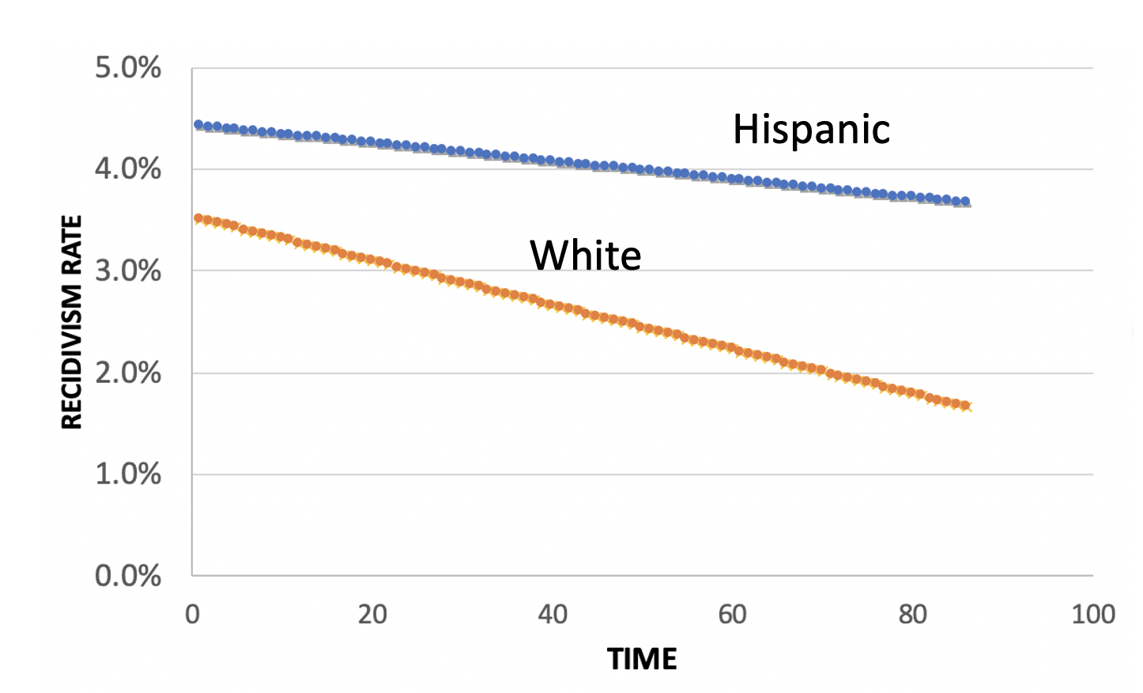
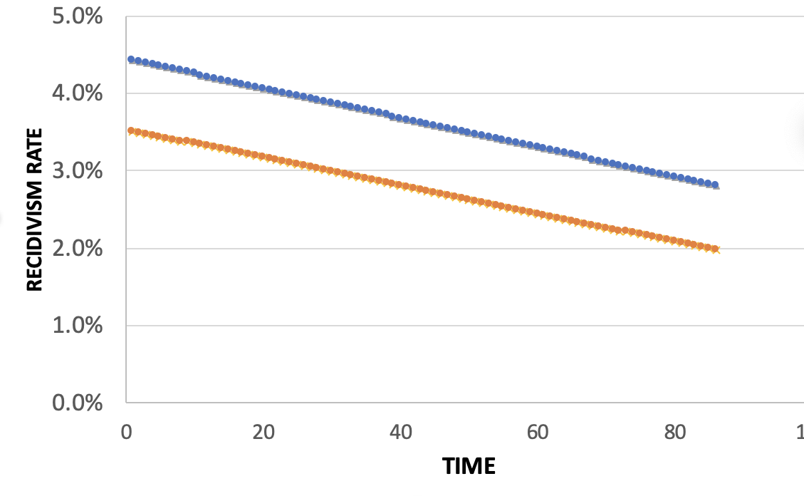
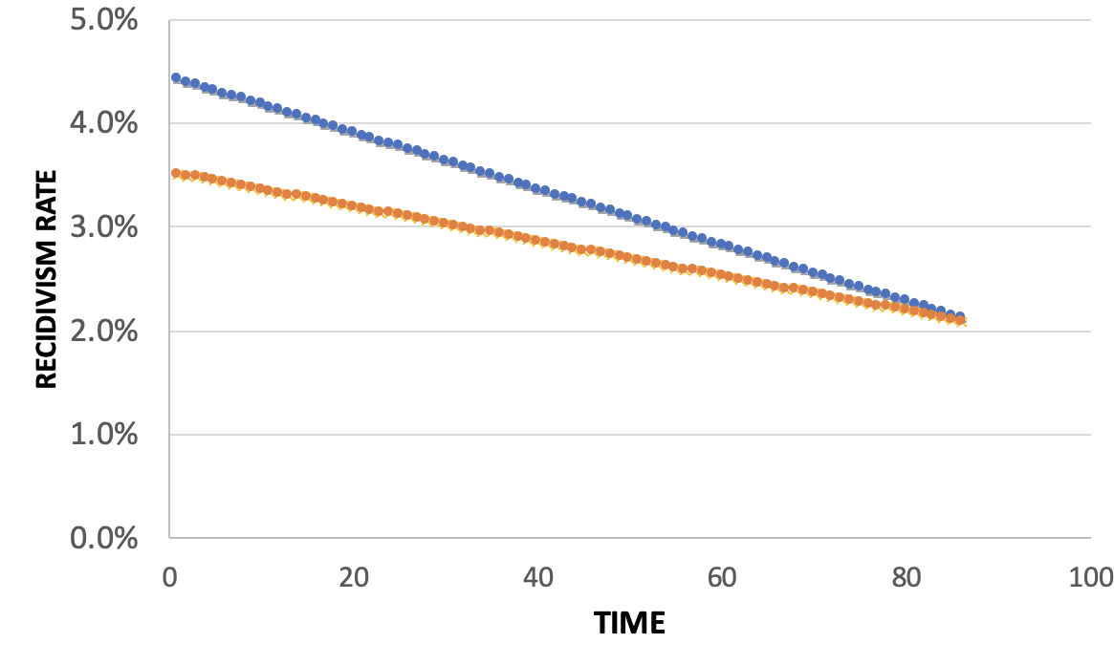
Policy Menu
Designing for Efficiency
72.7% Efficient
Equality
Additional Cost: 2%
Equity
Additional Cost: 2%

Slide 61
Calculating Fairness Metrics for Your Models: aequitas
Triage can calculate various fairness metrics and disparities automatically for you using the aequitas bias audit tool
Specify a bias_audit_config in your triage config
Re-run your models using replace=False
Results can be found in test_results.aequitas

Slide 62
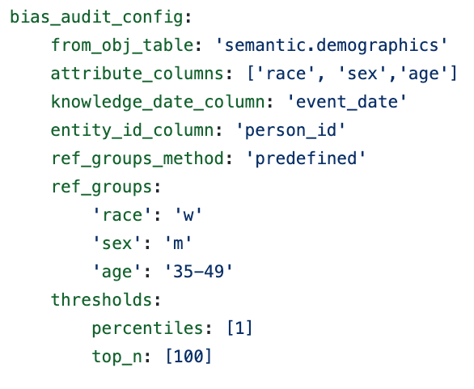
Calculating Fairness Metrics for Your Models: aequitas

Slide 63
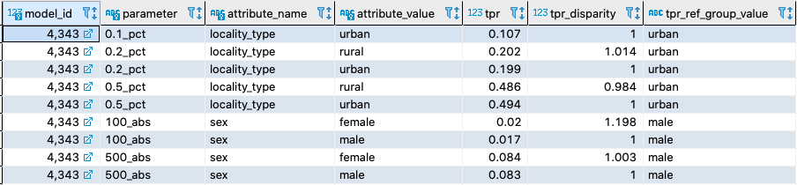
Calculating Fairness Metrics for Your Models: aequitas

Slide 64
Some common practitioner perceptions
There is always a tradeoff between fairness and accuracy
I have to satisfy all measures of bias in order to be fair
I have to eliminate all bias in order to use/deploy an ML system
Not using race in my models makes by models not racist
Using race in my models makes my models racist
A fair ML model = Fair and equitable outcomes
Bias comes from and can be fixed by “fixing” the data
Bias reduction methods actually reduce bias

Slide 65
Reminders
This week:
Project check-ins on Wednesday (reverse order)
Coming up next week:
Due Monday: update assignment (bias and fairness of your models)
No class/check-ins on Wednesday/Thursday but schedule time on Monday or Tuesday to do a final review of models and features

