Slide 1

Model Selection (and Validation)
Part I
Rayid Ghani

Slide 2
Reminders
This week:
Friday: Triage Tech Session
Coming up next week:
Reading for Tuesday (“cross-validation” strategies)
Project check-in
First Project Assignment due Monday – posted on Canvas

Slide 3
Plan for the week
What you should be discussing this week within your team
  Your analytical formulation and baselines to compare against
  Evaluation Metrics
What you should be building this week
  How to operationalize the formulation
    Cohort and label logic
  Baserates and baselines calculations
  Learning triage configuration and parameters

Slide 4
Scope
Data
Exploration
Modeling
Get Data
Store Data
Link Data
Rows
Features
Labels
Model Selection
Train-Test Splits
Performance Metrics
Model Interpretation
Entities
temporal
Spatial
…
Models
Dealing with Bias and Fairness
Field Trial Design
Deployment
Monitoring
Goals, Actions, Data, Analysis, Ethics

Slide 5
How to solve a prediction problem
Define and Create Rows (unit of prediction)
Define and Create Label (outcome/target variable – what event and when?)
Define and Create Features (features/predictors)
Create Training and Validation/Test Sets
Train model(s) on Training Set(s)
Validate model(s) on Validation/Test Set(s)
Select “best” model

Slide 6
Do not edit
How to change the design
what does the best model supposed to be good at?
The Slido app must be installed on every computer you’re presenting from

Slide 7
What is the goal of model selection?
You’ve run a large number of different types of models varying …
You need to understand what types of models are effective under what circumstances, and
You need to decide which one(s) to use in the future

Slide 8
What do we need our selected model to do?

Slide 9
What do we need our selected model to do?
Perform well
  What metric?
  Compared to what?
Generalize
  To what?

Slide 10
Do not edit
How to change the design
You're working for a non-profit and a vendor is trying to sell you a donation propensity model that is validated to have 98% accuracy. Is this model good enough for your organization to purchase?
The Slido app must be installed on every computer you’re presenting from

Slide 11
You're working for a non-profit and a vendor is trying to sell you a donation propensity model that is validated to have 98% accuracy. Is this model good enough for your organization to purchase?
sli.do #94889
sli.do/94889

Slide 12
Performance Metrics

Slide 13
Score Distribution on the Test Set
# of people
Score

Slide 14
Evaluation - Metrics
Predictions are often scores between 0 and 1
We need to first turn them into 0 or 1 by selecting a threshold
Predicted Class
 | Yes | No
Yes | True Positives (TP) | False Negatives (FN)
No | False Positives (FP) | True Negatives (TN)
Actual Class

Slide 15
Evaluation – Metrics (at a threshold k)
Accuracy = (TP + TN) / (TP + TN + FP + FN)
Precision (or PPV) = TP / (TP + FP)
Recall (or Sensitivity) = TP / (TP + FN)
Specificity = TNR
Predicted
 | Yes | No
Yes | True Positives (TP) | False Negatives (FN)
No | False Positives (FP) | True Negatives (TN)
Actual

Slide 16
How to communicate these metrics to policy audiences?

Slide 17
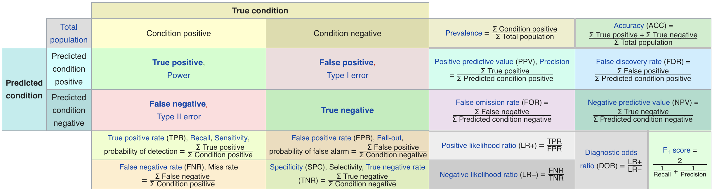
Metric Cheatsheet
Source: https://en.wikipedia.org/wiki/Sensitivity_and_specificity

Slide 18
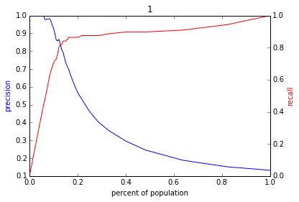
Varying the Threshold
Score
1 .9 .8 .7 .6 .5 .4 .3. .2 .1
| | | | | | | | | |
Baseline

Slide 20
ROC Curve
Receiver Operator Characteristic Curve

Slide 21
AUC (Area Under Curve)
Overall measure of performance
  1 if all 1s are ranked above all 0s
  0 if all 0s are above all 1s

Slide 22
AUC – Area Under Curve
If you care about the entire space

Slide 23
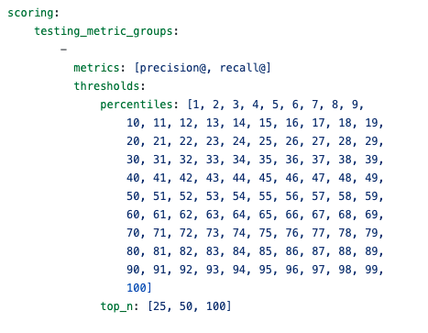
Evaluation – triage configuration

Slide 24
Metric Derivation

Slide 25
Discussion Question
What would be some potential strategies for integrating considerations around fairness in the process of model evaluation and selection?

Slide 26
Reminders
This week:
Friday: Triage Tech Session
Coming up next week:
Reading for Tuesday (“cross-validation” strategies)
Project check-in
First Project Assignment due Monday – posted on Canvas

