Slide 1

Model Selection (and Validation)
Part I
Rayid Ghani and Kit Rodolfa

Slide 2
Teamwork Question
How’s teamwork going?
sli.do #94889
sli.do/94889

Slide 3
Reminders
This week:
Wednesday: Using triage for ML pipelines session (no prep assignment) - GHC 8102 (same room as last week)
Thursday: Project Work Time (no class meeting)
Sunday: Proposal Peer Evaluations Due (See Email for assignments)
Coming up next week:
Reading for Tuesday (“cross-validation” strategies)
Project check-in on Wednesday (we’ll slack with times & rooms)
Temporal Validation “whiteboard” session Thursday
Project Assignment due on Friday – we’ll post on Canvas

Slide 4
Plan for the week
What you should be discussing this week within your team
Your analytical formulation and baselines to compare against
Evaluation Metrics
What you should be building this week
Exploring triage configuration and parameters
Cohort and label logic

Slide 5
Scope
Data
Exploration
Modeling
Get Data
Store Data
Link Data
Rows
Features
Labels
Model Selection
Train-Test Splits
Performance Metrics
Model Interpretation
Entities
temporal
Spatial
…
Models
Dealing with Bias and Fairness
Field Trial Design
Deployment
Monitoring
Goals, Actions, Data, Analysis, Ethics

Slide 6
How to solve a prediction problem
Define and Create Rows (unit of prediction)
Define and Create Label (outcome/target variable – what event and when?)
Define and Create Features (features/predictors)
Create Training and Validation/Test Sets
Train model(s) on Training Set(s)
Validate model(s) on Validation/Test Set(s)
Select “best” model

Slide 7
What is the goal of model selection?

Slide 8
What is the goal of model selection?
You’ve run a large number of different types of models varying …
You need to understand what types of models are effective under what circumstances, and
You need to decide which one(s) to use in the future

Slide 9
What do we need our selected model to do?

Slide 10
What do we need our selected model to do?
Perform well
What metric?
Compared to what?
Generalize
To what?

Slide 11
You're working for a non-profit and a vendor is trying to sell you a donation propensity model that is validated to have 98% accuracy. Is this model good enough for your organization to purchase?
sli.do #94889
sli.do/94889

Slide 12
Performance Metrics

Slide 13
Score Distribution on the Test Set
# of people
Score

Slide 14
Evaluation - Metrics
Predictions are often scores between 0 and 1
We need to first turn them into 0 or 1 by selecting a threshold
Predicted Class
 | Yes | No
Yes | True Positives (TP) | False Negatives (FN)
No | False Positives (FP) | True Negatives (TN)
Actual Class

Slide 15
Evaluation – Metrics (at a threshold k)
Accuracy = (TP + TN) / (TP + TN + FP + FN)
Precision (or PPV) = TP / (TP + FP)
Recall (or Sensitivity) = TP / (TP + FN)
Specificity = TNR
Predicted
 | Yes | No
Yes | True Positives (TP) | False Negatives (FN)
No | False Positives (FP) | True Negatives (TN)
Actual

Slide 16
How to communicate these metrics to policy audiences?

Slide 17
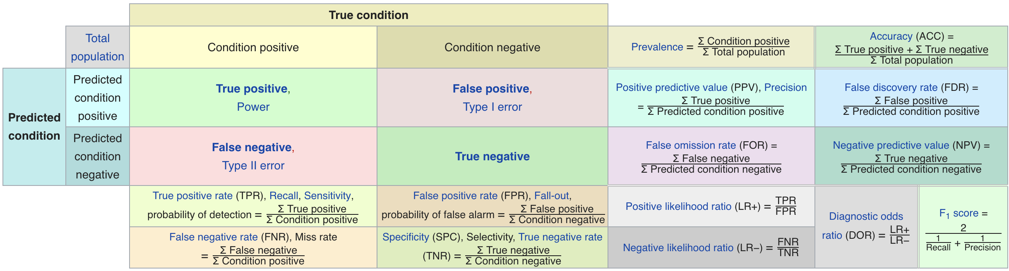
Metric Cheatsheet
Source: https://en.wikipedia.org/wiki/Sensitivity_and_specificity

Slide 18
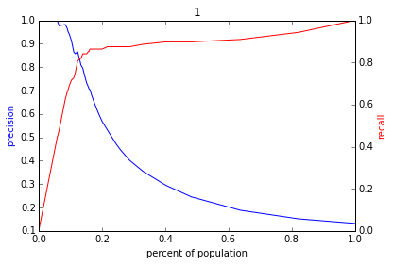
Varying the Threshold
Score
1 .9 .8 .7 .6 .5 .4 .3. .2 .1
| | | | | | | | | |
Baseline

Slide 20
ROC Curve
Receiver Operator Characteristic Curve

Slide 21
AUC (Area Under Curve)
Overall measure of performance
1 if all 1s are ranked above all 0s
0 if all 0s are above all 1s

Slide 22
AUC – Area Under Curve
If you care about the entire space

Slide 23
Evaluation - Baselines
Random (predict most frequent class)
Simple heuristics
Expert heuristics (what may be in use today)

Slide 24
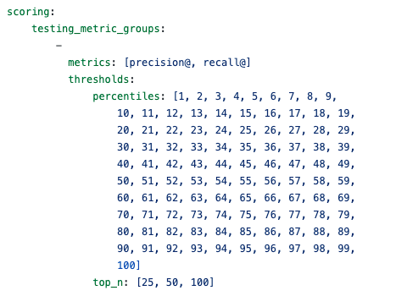
Evaluation – triage configuration

Slide 25
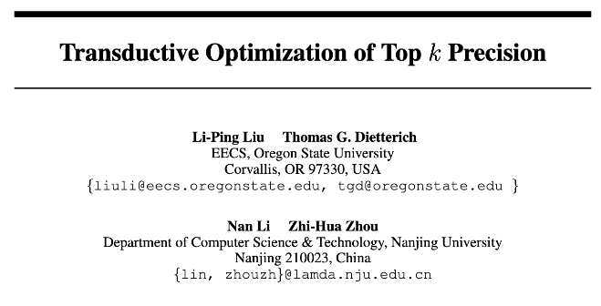
Some Open Research Questions

Slide 26
Some Open Research Questions
The SVM loss function will find the “best” separating hyperplane overall, but perhaps we could draw a better hyperplane to separate just k positive examples?
Transductive method: needs to be aware of the test set without labels to select just k test examples.
Modified gradient descent procedure to project gradient direction for L2-regularized SVM loss onto a “feasible solution cone” such that no more than k test examples will be predicted positive after the step.

Slide 27
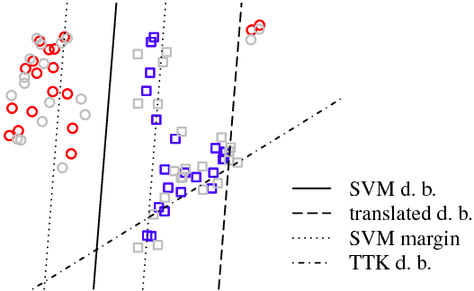
Some Open Research Questions

Slide 28
Some Open Research Questions
Paper shows improvements on synthetic examples and some “standard” datasets, but still more to investigate:
Can be slow to converge on larger datasets
“At most” k examples can yield many fewer than the desired k, particularly for rare events (why doesn’t the algorithm target exactly k?)
Although creating a “top k” boundary, still penalizes false positives and false negatives equally during optimization
Can we do better at the top, even if we don’t have access to the test list?

Slide 29
Discussion Question
What would be some potential strategies for integrating considerations around fairness in the process of model evaluation and selection?

Slide 30
Reminders
This week:
Wednesday: Using triage for ML pipelines session (no prep assignment) - GHC 8102 (same room as last week)
Thursday: Project Work Time (no class meeting)
Friday: Proposal Peer Evaluations Due (Email)
Coming up next week:
Reading for Tuesday (cross validation strategies)
Project check-in on Wednesday (we’ll slack with times & rooms)
Temporal Validation “whiteboard” session Thursday
Project Assignment due on Friday – we’ll post on Canvas

