Slide 1

Model Selection Part III
Rayid Ghani

Slide 2
Reminders
Coming up next week:
Monday: Update 6: ML Results over time
Tuesday: Feedback Form

Slide 3
Plan for the week
What you should be discussing this week within your team
Modifying your configuration file for more extensive model runs
Plans for model selection
What you should be building this week
Additional features
Larger model run with a more extensive model + hyperparameter grid
Code to generate results and graphs

Slide 4
Scope
Data
Exploration
Modeling
Get Data
Store Data
Link Data
Rows
Features
Labels
Model Selection
Train-Test Splits
Performance Metrics
Model Interpretation
Entities
temporal
Spatial
…
Models
Dealing with Bias and Fairness
Field Trial Design
Deployment
Monitoring
Goals, Actions, Data, Analysis, Ethics

Slide 5
Train models
Temporal splits
Cohort and label
Features
Hyperparameters
Training Set
Validation Set
2020
Model
Hyperparameters
Training Set
2021
Validation Set
Hyperparameters
Hyperparameters
Training Set
2022
Validation Set
Model
Hyperparameters
Hyperparameters
Training Set
2023
Validation Set
Hyperparameters
Training Set
2024
Model
Validation Set
Hyperparameters
Hyperparameters
Predict

Slide 6
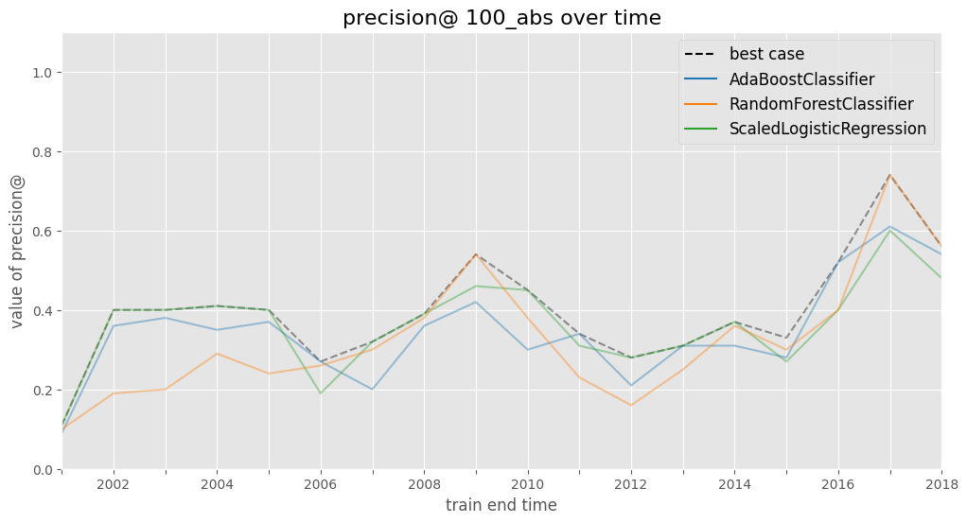
Baseline – rank by X
Logistic Regression C=.01 L2
RF n_trees=10000 max depth=50

Slide 7
Why do we need to do model selection?
You’ve run a large number of different types of models varying …
You need to understand what types of models are effective under what circumstances, and
You need to decide which one(s) to use in the future

Slide 8
What is the output from your model selection process?

Slide 9
The wonderful for loop
For train-test splits (CV or temporal)
For subsets of Feature Sets (Demographic only, Behavior only, Temporal only, etc.)
For Classifiers (RFC, SVM, DT, NN, Logit, GB, Boosting)
For parameters (cross products of different parameters)
Fit
Predict
Evaluate

Slide 10
Results
Classifier | Param 1 | Param 2 | Validation Split | Feature Subsets used | Accuracy | Prec @ 1% | AUC

Slide 11
Analyzing the results
K Fold CV
?
Temporal
?

Slide 12
Analyzing the results
K Fold CV
Average metric value?
Equal weight to all validation examples
Maybe look at variance?
Temporal
Average metric value?
Robustness to distribution shifts?
Care about recency more? How much more?
May not weigh every validation example equally

Slide 13
Analyzing the results
Which approaches work best?
Which classifiers?
Which parameters?
Over which metrics?
Value of different features/feature sets?
Variance in performance over time?
Highest average?
Lowest variance?
Getting better over time?

Slide 14
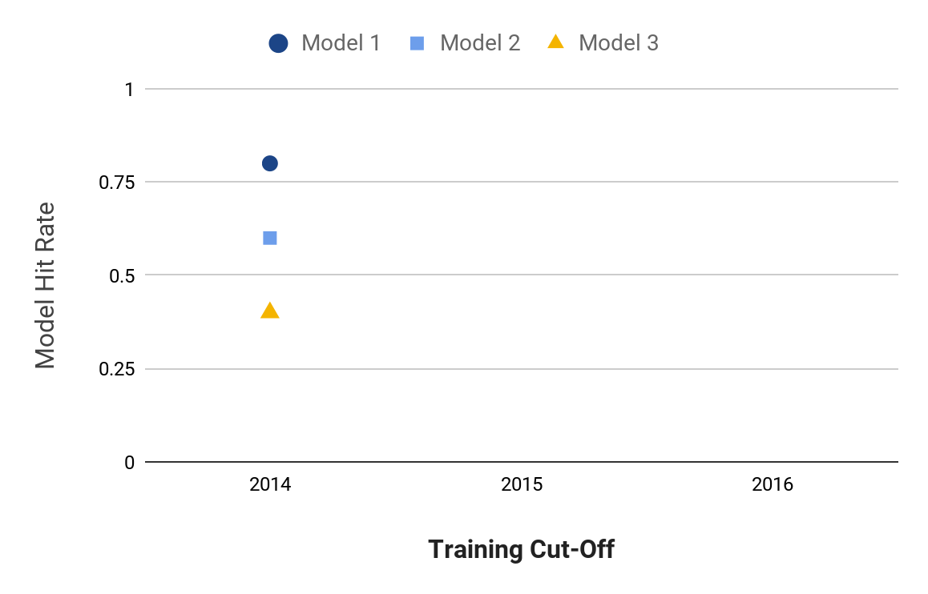
Model Selection
Notes:
Jane

Slide 15
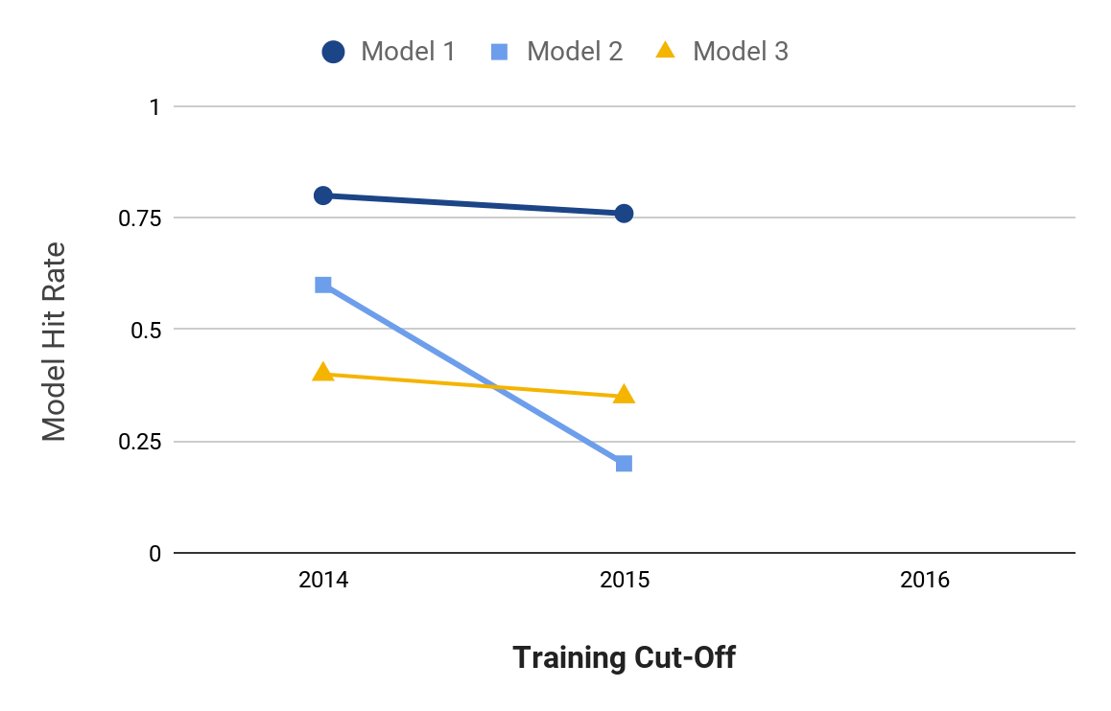
Model Selection
Notes:
Jane

Slide 16
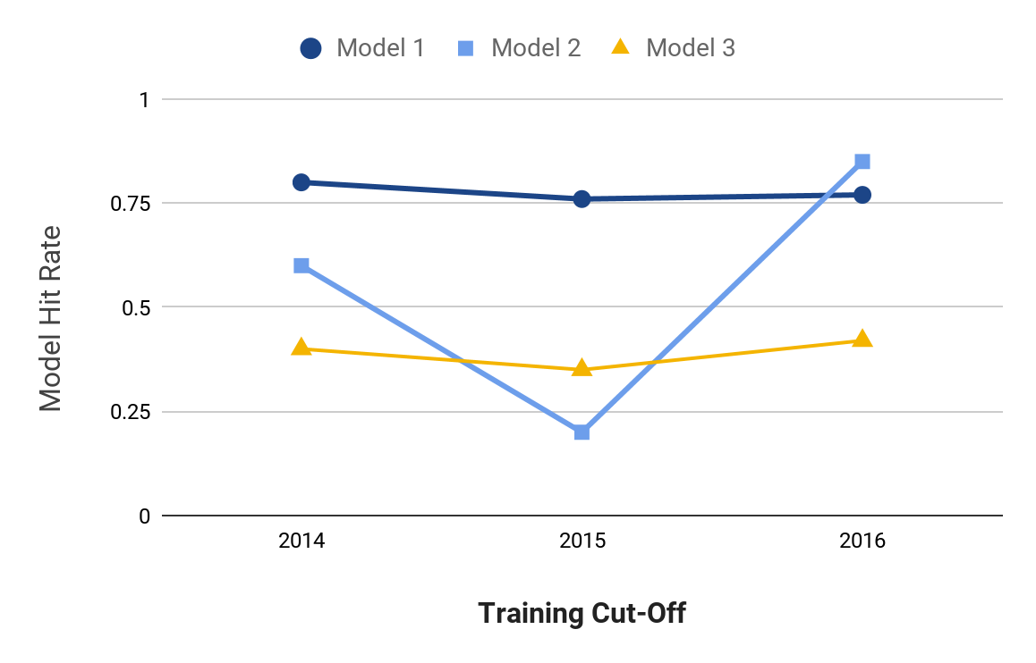
Model Selection
Notes:
Jane

Slide 17
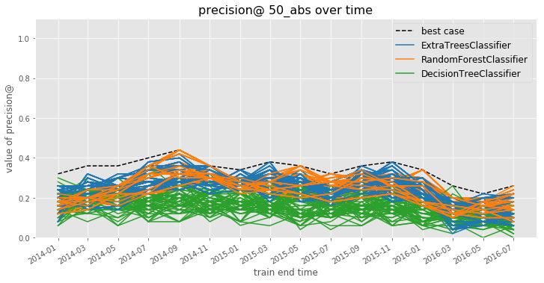
Model Selection
Notes:
Jane

Slide 18
Model Selection
How can you narrow hundreds or thousands of model specifications down to a handful of the best-performing ones?
How do you balance performance and stability?
mean performance?
balancing mean and variance?
recency-weighted mean?
What is the “regret” in subsequent time periods from using different strategies for choosing a model to deploy?
Notes:
Jane

Slide 19
Model Selection
Comparing Model Selection Strategies:
Use validation set performances up to a given point in time to do model selection using each strategy
On the subsequent validation set, calculate a regret for the model selection strategy as the difference between the performance of the model specification that strategy chooses and the best-performing model specification on this new validation set
Notes:
Jane

Slide 20
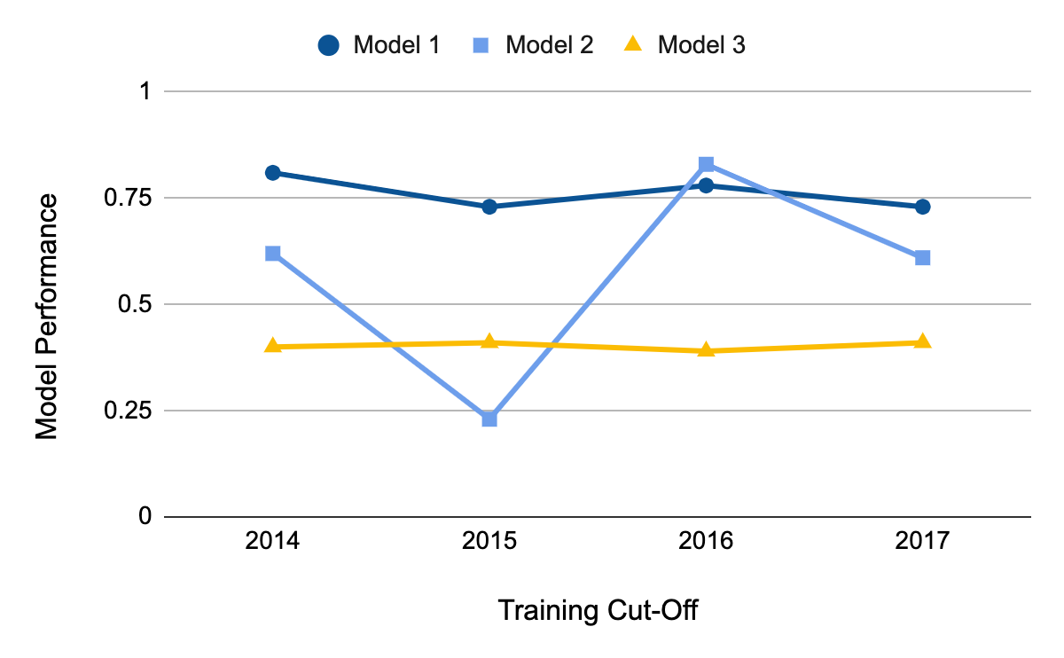
Model Selection
Apply model selection strategies to validation set performance through 2016
Notes:
Jane

Slide 21
Model Selection
Apply model selection strategies to test set performance through 2016
Calculate regret based on 2017 validation set performance
Notes:
Jane

Slide 22
Model Selection
Best Recent Perf:
Model 2
Best Average Perf:
Model 1
Lowest Variance: Model 3
Notes:
Jane

Slide 23
Model Selection
Best Model in 2017:
Model 1
Perf = 0.73
Notes:
Jane

Slide 24
Model Selection
Best Recent Perf:
Model 2
Regret:
0.73 – 0.61 = 0.12
}
Notes:
Jane

Slide 25
Model Selection
Best Average Perf:
Model 1
Regret:
0.73 – 0.73 = 0.00
}
Notes:
Jane

Slide 26
Model Selection
Lowest Variance: Model 3
Regret:
0.73 – 0.41 = 0.32
}
Notes:
Jane

Slide 27
Model Selection
Strategy | Best Model Through 2016 | Regret in 2017
Best Recent Perf. | Model 2 | 0.12
Best Average Perf. | Model 1 | 0.00
Lowest Variance | Model 3 | 0.32
Notes:
Jane

Slide 28
Model Selection
Strategy | Best Model Through 2016 | Regret in 2017
Best Recent Perf. | Model 2 | 0.12
Best Average Perf. | Model 1 | 0.00
Lowest Variance | Model 3 | 0.32
Notes:
Jane

Slide 29
Questions about model selection strategies?

Slide 30
Model Selection
Strategy | Best Model Through 2016 | Regret in 2017
Best Recent Perf. | Model 2 | 0.12
Best Average Perf. | Model 1 | 0.00
Lowest Variance | Model 3 | 0.32
Notes:
Jane

Slide 31
Model Selection
Strategy | Best Model Through 2016 | Regret in 2017
Best Recent Perf. | Model 2 | 0.12
Best Average Perf. | Model 1 | 0.00
Lowest Variance | Model 3 | 0.32
Will “Best Average Performance” always work best?
How should we evaluate this?
Notes:
Jane

Slide 32
Model Selection
Notes:
Jane

Slide 33
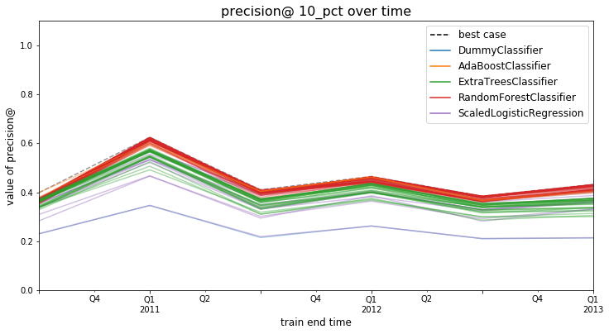
Examples

Slide 34
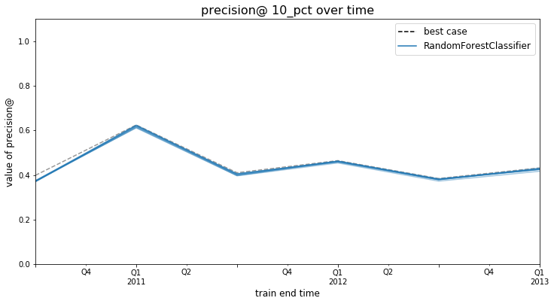
Examples

Slide 35
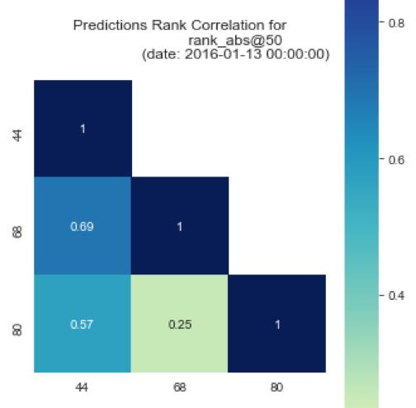
Model Selection
May not be obvious which strategy / model specification is “best”
Among good candidates, may be instructive to ask how similar or different the lists each strategy would produce are
May ultimately want to deploy (or at least test) a strategy that combines across several specifications
Notes:
Jane

Slide 36
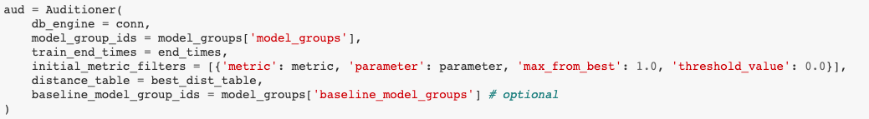
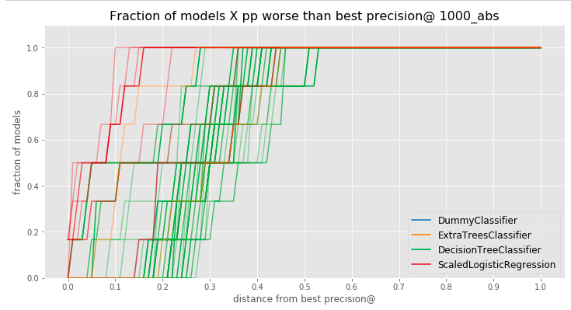
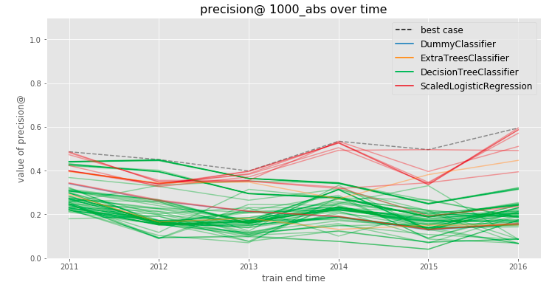
Model Selection in Triage: Audition

Slide 37
Model Selection in Triage: Audition
Audition Notebook:
https://github.com/dssg/triage/blob/master/src/triage/component/audition/Audition_Tutorial.ipynb
Also see the Model Selection section of the colab tutorial

Slide 38
Reminders
Coming up next week:
Monday: Update 6 (on Canvas): ML Results over time
Tuesday: Feedback Form

