Slide 1

Class Wrap-Up,
Causal Inference, and ML Experiments
Rayid Ghani and Kit Rodolfa

Slide 2
Reminders
This week:
Project Presentations on Thursday
No group meetings on Wednesday
Coming up next week:
Final Reports due on Wednesday

Slide 3
Things to cover today
Quick Review and Wrap-Up
Causal Inference 001
With Observational Data
Methods
Examples
Experiments
Standard Randomized Controlled Trials
Trial Design
Examples
Validating ML models/systems
Trial Design
Examples

Slide 4
Final Reports
https://canvas.cmu.edu/courses/31334/assignments/515888

Slide 5
Project checklist
Train Test Splits – make sure you’re using all of them
Features – make sure you have relevant features
Imputation
scaling
Models
Make sure you have an appropriately large grid and model types
Model Selection
Initial metric (sanity check with PR-k curve), and selection metric over time
Interpretability
Feature importances, Cross-Tabs
Bias
Protected Group and Bias Metric

Slide 6
Wrap-Up and Review

Slide 7
Scope
Data
Exploration
Modeling
Get Data
Store Data
Link Data
Rows
Features
Labels
Model Selection
Train-Test Splits
Performance Metrics
Model Interpretation
Entities
temporal
Spatial
…
Models
Dealing with Bias and Fairness
Field Trial Design
Deployment
Monitoring
Goals, Actions, Data, Analysis, Ethics

Slide 8
Recap so far
Scope: Goals, Actions, Data, Analysis, Ethics
Data: Getting, storing, linking, exploring, and understanding
Formulation: Rows, Labels, Time, Metric, Baselines
Pipeline: Rows, Labels, Features, Train-Validation Pairs, Metrics, Models + hps
Model Selection:
Run Experiments
Analyze results to choose best model
Iterate

Slide 9
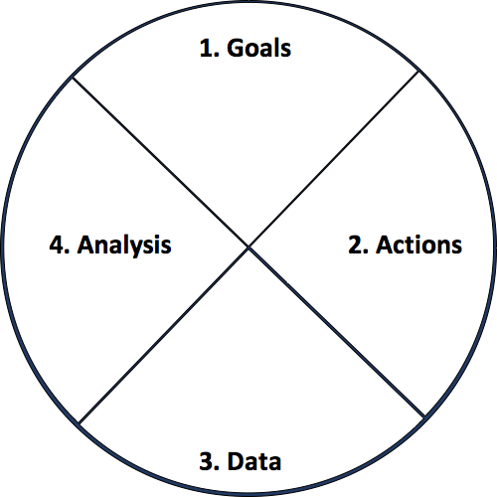
Actionable and Goal-Driven Project Scope
Goals: Define the goal(s) of the project
Actions: What actions/interventions will you inform?
Data: What data do you have internally? What data do you need? What can you augment from external and public sources?
Analysis: What analysis needs to be done? How will it be validated?
Ethics
dsapp.uchicago.edu
Center for Data Science and Public Policy University of Chicago

Slide 10
Analytical Formulation Examples
How often is the recommendation/decision being made?
On the first of every month, for all the individuals who have been released from Johnson County Jail during the past 2 years and have demonstrated mental health needs, can we identify the 200 highest risk individuals who are likely to return to jail in the next 6 months to prioritize for proactive mental health interventions?
Who/what is included in the cohort?
What is the output?
What outcome are you predicting/estimating?
For what purpose?

Slide 11
Baseline Options
Common Sense
What they do today
What they could do today easily (without any or very simple ML involved)
Prior/Base Rate
What expected value would you get if you just choose at random (based on the data distribution)?

Slide 12
Train Validation Pairs
 | Train Set |  |  |  | Validation Set
Train-Validation Pair ID | Earliest project submission date | Latest project submission date | Start date for labels | End date for labels | Start date for rows | End date for rows | Start date for labels | End date for labels
1
2
3 (most recent)
Train-Validation Pair 1
Training Examples
Label Buffer
Validation Examples
Label Buffer
Train-Validation Pair 2
Training Examples
Label Buffer
Validation Examples
Label Buffer

Slide 13
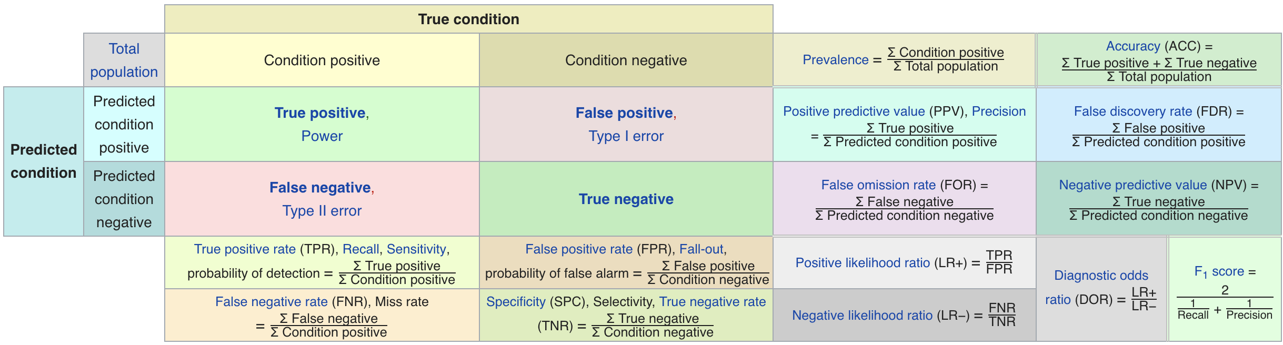
Confusion Matrix-based Metrics Cheatsheet
Source: https://en.wikipedia.org/wiki/Sensitivity_and_specificity
How to create a metric that makes sense for your problem and describing these metrics to non-ML people in their own terms

Slide 14
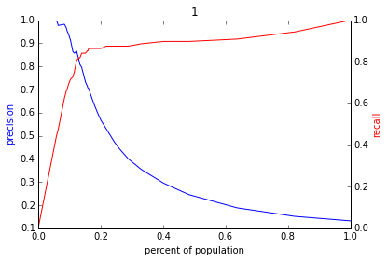
Varying the Threshold – Policy Menu
Score
1 .9 .8 .7 .6 .5 .4 .3. .2 .1
| | | | | | | | | |
Baseline

Slide 15
Feature Generation
Categorical to Binary (Dummies)
Features for missing values
Discretization
Date/Time Features
Scaling/Normalizing
Transformations
Aggregations (space, time, space and time)
Relative (compared to the average…)
Interactions

Slide 16
config.yaml
Pipeline Runner
Orchestration + Config Parameters
Time Splitter
Cohort Creator
Label Creator
Feature Creator
Matrix Creator
Model Trainer
Database
Score Predictor
Model Evaluator

Slide 17
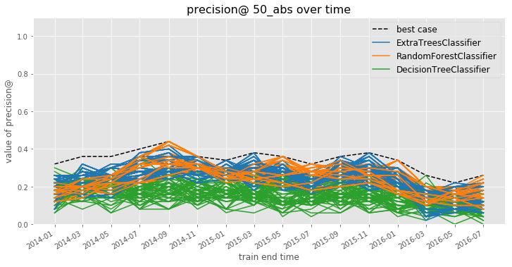
Model Selection
Notes:
Jane

Slide 18
Model Selection
Notes:
Jane

Slide 19
Explainability Use Cases
Use Case | User | Goal | Global or Local
Debugging | ML Developer | Sanity check | Both
Improving performance | Action- taker | Decide to agree or override | Local
Trust | Policymaker/Action-Taker | Model use => better outcomes | Both
Interventions | Action-Taker | Improve outcomes | Local
Recourse | Individual affected | Recourse | Local

Slide 20
Initial Interpretability checklist
For “smaller” models, print it out
Feature importances (or “feature group” importances)
Cross-tabs on your predicted list

Slide 21
Data and AI Ethics Issues
Privacy
Data Ownership
Bias, Equity, & Fairness
Transparency
Trustworthiness and Accountability

Slide 22
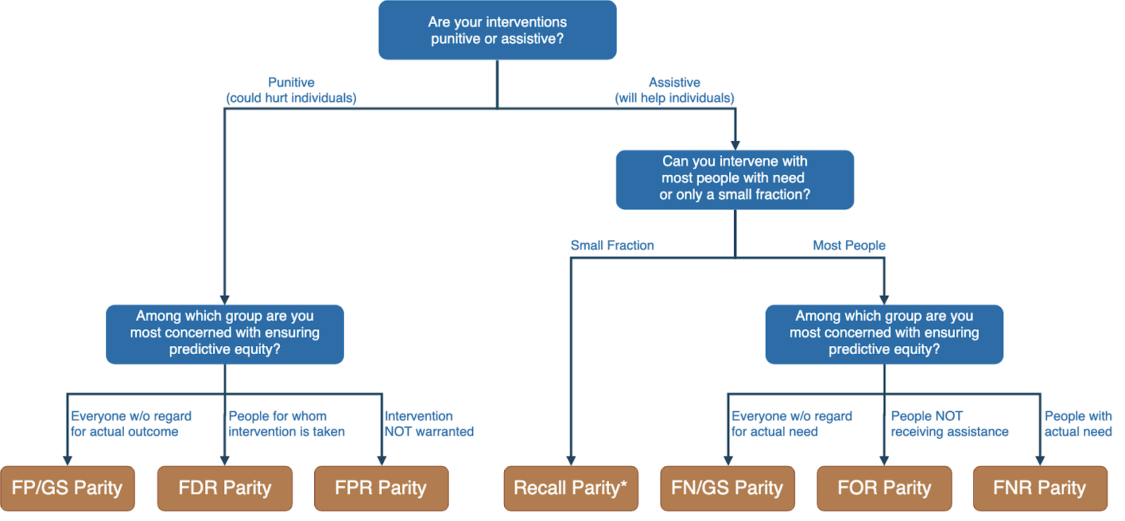
Translating policy goals to fairness metrics

Slide 23
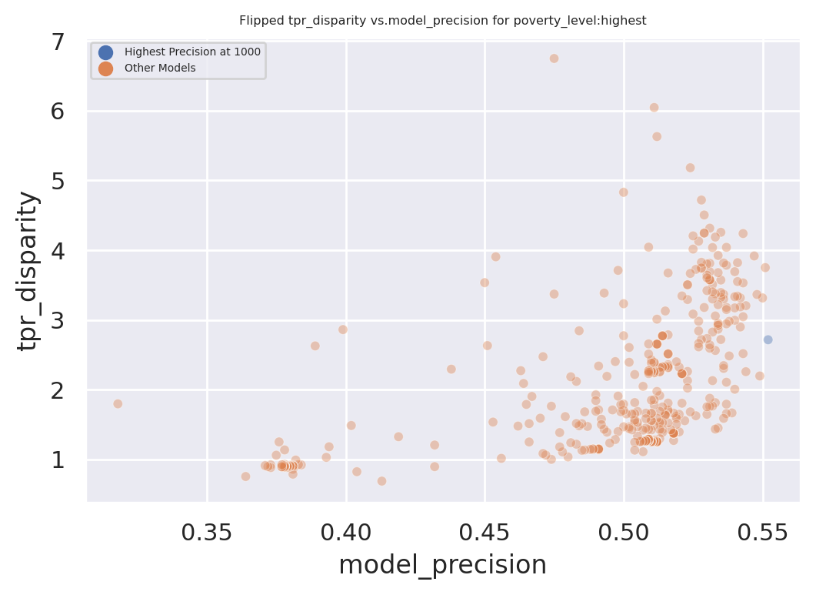
Dual Goals: Fairness and Accuracy
Disparity
Our hope:
Fairness-improving
methods can expand this
frontier by adding new
points
Precision@k

Slide 24
Class Recap
Scoping
Data Acquisition
Data Storage
Data Linkage
Data Exploration
Analytical Formulation
Modeling
Evaluation Metrics
Train Test Splits
Feature Generation
Baselines
ML Pipelines
Model Selection
Interpretability
Bias/Fairness
Field Trials
Deployment
Maintenance & Monitoring

Slide 25
Causal Inference
and Field Trials

Slide 26
What is the purpose of doing field validation?

Slide 27
Field Validation: Beyond A/B Testing
How well does the model perform in the real world?
Validation on truly unseen future data; only way to ensure against leakage
What key assumptions in our formulation need to be tested?
Are we intervening with the “right” people?
Are we intervening in the best way possible?
Impact of historical decision making / selective labels?
Most importantly: how well does the ML system we’re building help the organization realize its goals?

Slide 28
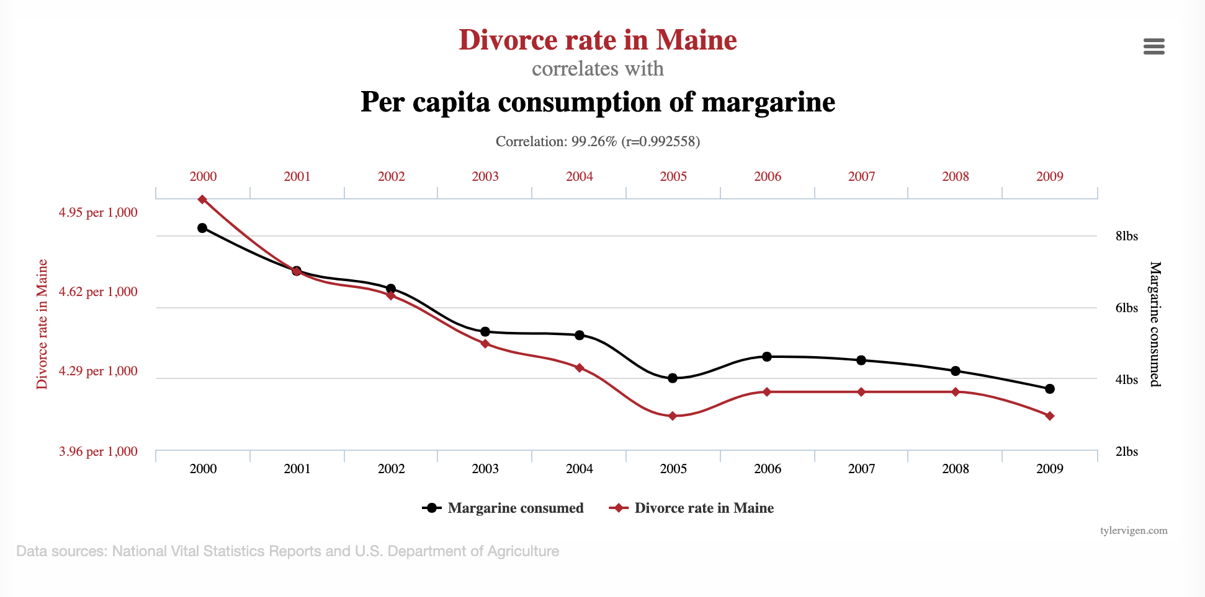
Goals of Causal Inference

Slide 29
Do sports programs affect school graduation rates?
sports programs
?
graduation

Slide 30
Do sports programs affect school graduation rates?
sports programs
Confounders
?
graduation

Slide 31
Do sports programs affect school graduation rates?
sports programs
Confounders
?
graduation
Examples?

Slide 32
Causal Research Design
Experiments
Quasi-experiments
Observational studies

Slide 33
Experiment
sports programs
Confounders
?
graduation
Researcher randomly assigns sports programs

Slide 34
Quasi-Experimental
sports programs
Confounders
?
graduation
Nature/World randomly assigns sports programs

Slide 35
Observational Study
sports programs
Confounders
graduation
Include confounders in regression

Slide 36
CASE STUDY: Mental Health and Incarceration
Cycle of Incarceration
UNMET
NEEDS
MISDEMEANOR
ARREST
JAIL
worsening or failing to improve

Slide 37
CASE STUDY: Mental Health and Incarceration
Breaking the Cycle
UNMET
NEEDS
X
MISDEMEANOR
ARREST
JAIL
MENTAL HEALTH OUTREACH

Slide 38
CASE STUDY: Mental Health and Incarceration
Return to Jail Risk
Released From Jail
In Past 3 Years
ID | SCORE
27 | 0.95
13 | 0.93
1 | 0.89
93 | 0.89
53 | 0.82
23 | 0.75
59 | 0.72
64 | 0.65
20 | 0.61
18 | 0.59
46 | 0.52
82 | 0.48
49 | 0.37
56 | 0.22
17 | 0.12
Mental
Health
Outreach
Model
X
…With History of
Mental Health
Needs
Return to
Jail

Slide 39
CASE STUDY: Mental Health and Incarceration
Return to Jail Risk
Released From Jail
In Past 3 Years
ID | SCORE
27 | 0.95
13 | 0.93
1 | 0.89
93 | 0.89
53 | 0.82
23 | 0.75
59 | 0.72
64 | 0.65
20 | 0.61
18 | 0.59
46 | 0.52
82 | 0.48
49 | 0.37
56 | 0.22
17 | 0.12
Mental
Health
Outreach
Model
X
…With History of
Mental Health
Needs
Return to
Jail
What would you want to learn
through a field trial?

Slide 40
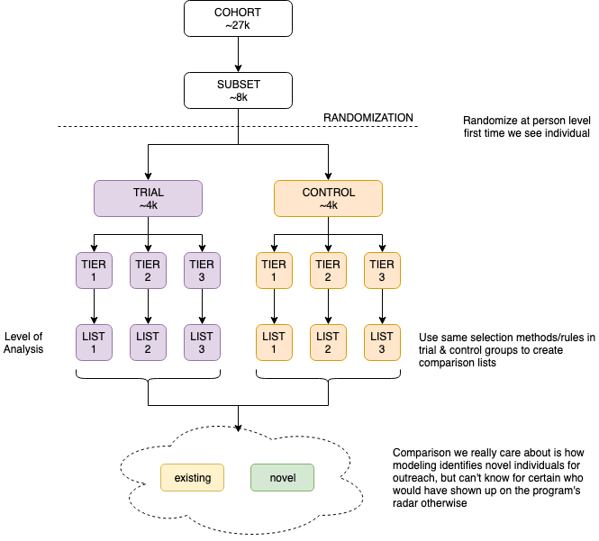

Slide 41
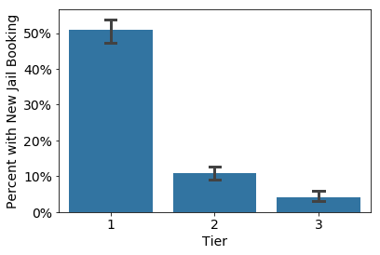
Q1: Is the Model Predictive?

Slide 42
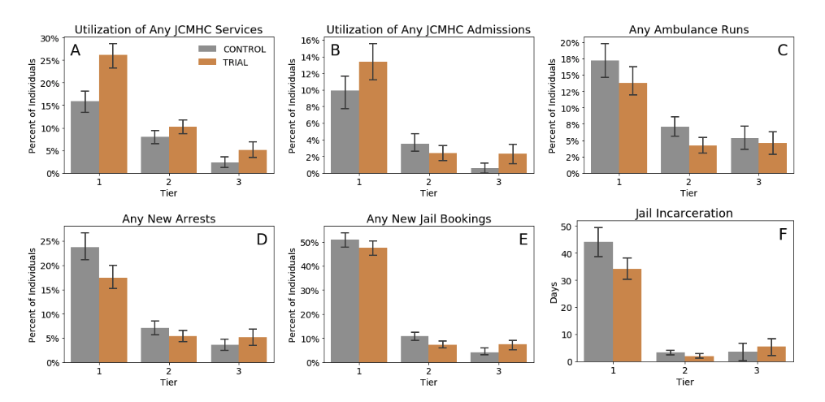
Q2: Does Model+Intervention Affect Outcomes? For Whom?

Slide 43
Methods for causal inference
Using Observational Data
Using Experiments

Slide 44
Causal inference with observational data
Matching
Difference-in-Difference (DID)
Regression Discontinuity Design (RDD)
Instrumental Variables
Limitations?

Slide 45
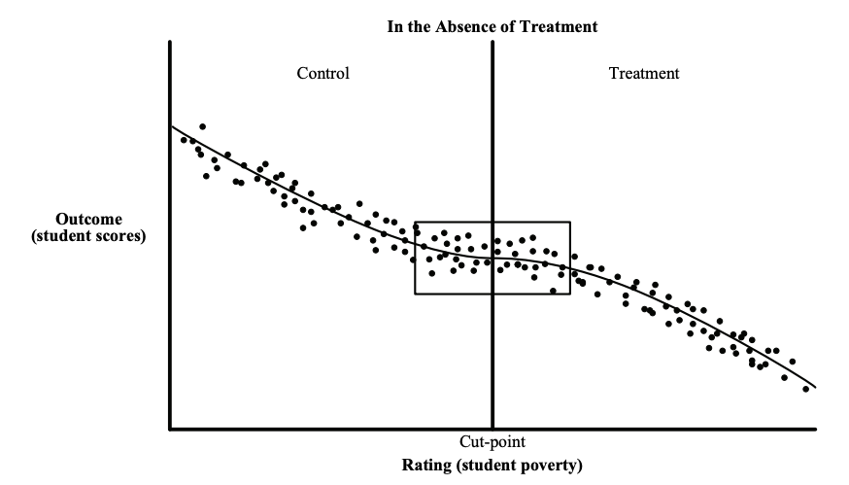
Causal inference with observational data
https://www.mdrc.org/sites/default/files/RDD%20Guide_Full%20rev%202016_0.pdf

Slide 46
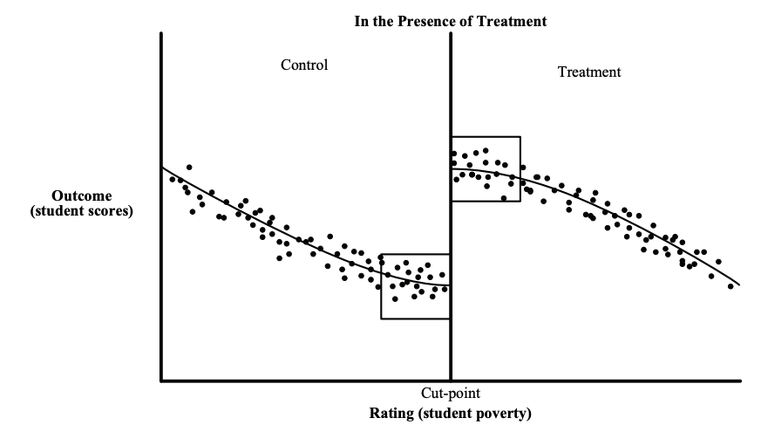
Causal inference with observational data
https://www.mdrc.org/sites/default/files/RDD%20Guide_Full%20rev%202016_0.pdf

Slide 47
Causal inference with experiments
Standard “Randomized Controlled Trials”
Trial Design
Outcome
Sample size
Power
Randomization
Ethical Concerns

Slide 48
Some things to keep in mind
Sample Size
Power Effect Size Significance Level
Effect size > what is practically useful and significant
Significance Level ~ cost of implementing the new system/model

Slide 49
Designing Trials to Validate ML Systems
What can we do with historical data?
Model Selection
Performance Estimation
How do we select the model to deploy?
Compare shortlisted models against baseline
How do we validate whether our ML system will work when deployed?

Slide 50
Designing an experiment
What are we trying to test?
How do we create different arms of the experiment?
How we do we run the experiment?
What do we measure?
How do we evaluate?

Slide 51
What are we testing in an experiment?
Lift?
Classification?
Probability estimates?
Ranking?
How does the experiment design change?

Slide 52
How many [students, inspections, projects] should we include in our trial?
Doing a trial over [y] years with [n] students every year will give us a [p%] chance to detect an [e%] increase in [outcome] with a statistical significance of [s%]

Slide 53
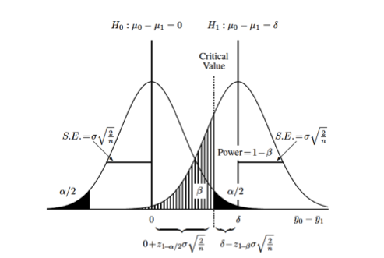
How many [students, inspections, projects] should we include in our trial?
https://clincalc.com/stats/samplesize.aspx

Slide 54
How would you design a trial to validate what you’ve built this semester?

Slide 55
Some Readings
References on causal inference
The seven tools of causal inference, with reflections on machine learning by Pearl, J. Comm ACM. 2019
Elements of Causal Inference by Peters et al. MIT Press. (Open Access Text)
Counterfactuals and Causal Inference: Methods and Principles for Social Research by Morgan and Winship. Cambridge University Press.
Data Analysis Using Regression and Multilevel/Hierarchical Models by Gelman and Hill. Cambridge University Press.

Slide 56
Reminders
This week:
Project Presentations on Thursday
No group meetings on Wednesday
Coming up next week:
Final Reports due on Wednesday

