Slide 1

Case Studies: ML Meets Public Policy
Rayid Ghani and Kit Rodolfa

Slide 2
Things to remember
VSCode setup from tech session
For Next Week:
Tuesday: Weekly Review
Readings for Thursday (Obermeyer; Passi & Barocas)
Make sure you can access project data and repo
Get familiar with your group
Following week:
Project Proposal (Friday, Sep 23)

Slide 3
Project Info
GitHub Repos: https://github.com/dssg/mlpolicylab_fall22_{team_name}
Bills Project
Mental Health Outreach Project

Slide 4
Working with Your Project Team
Teams designed to balance skills, backgrounds, and experiences
Spend some time up front figuring out how to work as a team and work styles
Everyone should participate in all aspects of project
No individual should do the majority of the python coding, SQL writing, report writing
However, you should divide up different pieces of the work
For instance, working on different parts of the pipeline code in parallel or splitting up sections of the report

Slide 5
Working with Your Project Team
We’re providing class time to make it easier to coordinate with your group and get feedback from peers and instructors, but you won’t be able to complete the project just in this allotted time
Tools for coordination:
Slack: we’ve created group-level channels. Additionally, feel free to use group DMs and video calls with your group to coordinate as well.
Many good free options for task tracking/management: github issues or project boards, trello, etc.

Slide 6
Working with Your Project Team
Active participation in the group work throughout the entire semester is required by all the team members, and a very large component of your grade
Collaboration is encouraged, both within and across teams! Learning from each others’ strengths is a big benefit of group work, and you should feel free to discuss strategies and approaches with other teams (i.e., it’s not a competition)
Pacing your work is important. You won’t be able to do everything the week before the final report, and if everyone tries to, you’ll break the server.

Slide 7
DISCUSSION QUESTION
Past experiences with project groups or questions/feedback about this semester?

Slide 8
Scope
Data
Exploration
Modeling
Get Data
Store Data
Link Data
Rows
Features
Labels
Model Selection
Train-Test Splits
Performance Metrics
Model Interpretation
Entities
temporal
Spatial
…
Models
Dealing with Bias and Fairness
Field Trial Design
Deployment
Monitoring
Goals, Actions, Data, Analysis, Ethics

Slide 9
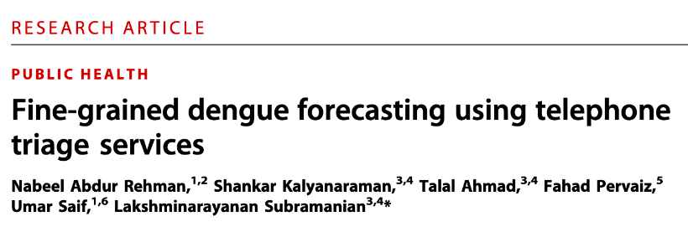
Case Study
https://docs.google.com/document/d/1AGXQTwd9A0AOiaIzJhi85BSFgaku5lxrqiwMpmpfxQw/edit#

Slide 10
Case Study
If you were scoping the project described here, how would you describe the overall goal?

Slide 11
Case Study
How well does the paper address
the goal you defined above?
slido.com #1341886

Slide 12
Case Study
How well does the paper address the goal you defined above? What evidence do they provide in this regard?

Slide 13
Case Study
What actions can the public health officials take to achieve that goal?

Slide 14
Case Study
In what ways did the model change the actions or decisions that public health officials are taking in terms of when, where, and how to act?

Slide 15
Case Study
What ethical or fairness considerations might be relevant here?
slido.com #1341886

Slide 16
Case Study
What ethical or fairness considerations might be relevant here? How were these addressed in the paper?

Slide 17
Creating a more equitable society
How do we define equity?
How do we detect inequity?
How do we increase equity?

Slide 18
Data and AI Ethics Issues
Privacy
Data Ownership
Bias, Equity, & Fairness
Transparency
Trustworthiness and Accountability

Slide 19
Things to remember
VSCode setup from tech session
For Next Week:
Tuesday: Weekly Review
Readings for Thursday (Obermeyer; Passi & Barocas)
Make sure you can access project data and repo
Get familiar with your group
Following week:
Project Proposal (Friday, Sep 23)

