Slide 1

Data Exploration
Rayid Ghani

Slide 2
Please Sit with
Your Project Teams

Slide 3
Things to remember
Let us know if you can’t access your project data or github repo
Wednesday session tomorrow: Github
Short Pre-session assignment on canvas
Readings for next week
Make sure to read project proposal assignment on canvas (due next Friday)

Slide 4



Do not edit How to change the design
Have you already started exploring your project data?
The Slido app must be installed on every computer you’re presenting from

Slide 5
Data Exploration Overview

Slide 6
Scope
Data
Exploration
Modeling
Get Data
Store Data
Link Data
Rows
Features
Labels
Model Selection
Train-Test Splits
Performance Metrics
Model Interpretation
Entities
temporal
Spatial
…
Models
Dealing with Bias and Fairness
Field Trial Design
Deployment
Monitoring
Goals, Actions, Data, Analysis, Ethics

Slide 7
Why is data exploration important?

Slide 8
Why is data exploration important?
Sanity Check the data you were given
Understanding the problem and domain
Problem Formulation
Debugging
Feature Generation/Selection
Interpretation of results

Slide 9
Simple task for data exploration
Write a SQL query that takes a “id” (e.g., student, voter, facility, bill, person, entity, etc) and gives you everything you know about that entity/person.
Add a date parameter to it to give you everything about that entity up to that date

Slide 10
Some tips for exploring your project data
Tables: identify the database tables that are most relevant to your problem
Entities: How can you identify the primary entities from your project? What are some basic/relevant characteristics about them? How have those changed over time?
Fields: Most projects have a lot of different data fields, but don’t feel like your initial exploration needs to understand everything
Label: Think about how you might define your label? What can you say about its distribution and how it’s changed over time?
Based on what you know of the context, what information would you expect to be important in modeling? Is this available? How well does it correlate with your label?

Slide 11
Typical data exploration tasks
Distributions of different variables
Correlations between variables – correlation matrix and turn it into a heatmap
Changes and trends over time – how does the data and the entities in the data change over time?
Missing values – are there lots of missing values? Is there any pattern there? How/why are they missing?
Outliers – this can be done using clustering but also by plotting distributions.
Labels/Outcomes – distribution and patterns
Cross-tabs (if you’re looking at multiple classes/labels), describing how the positive and negative classes are different without doing any machine learning.

Slide 12
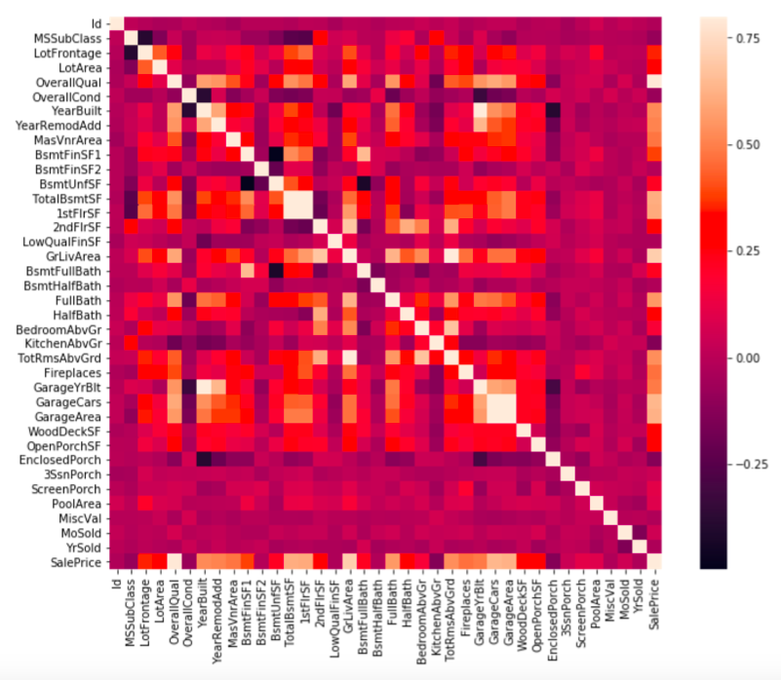

Slide 13
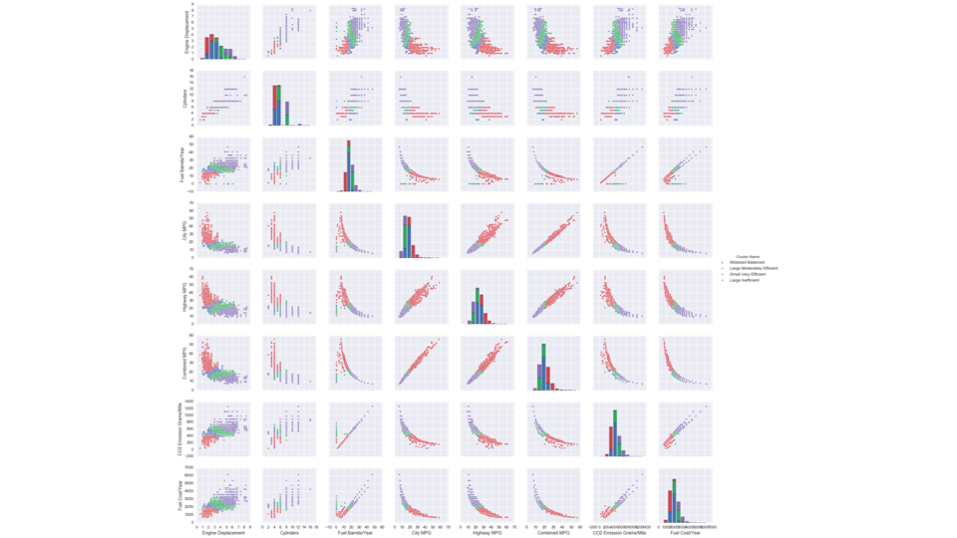

Slide 14
Tools
SQL (directly and through python – psycopg2)
Python (matplotlib, seaborn, altair,...)
Pandas (if you have to)
Tableau

Slide 15
Project Work:
Team Coordination & Data Exploration

Slide 16
What do we want you to use this time for?
Get to know each other
Discuss how you’re going to work together
Schedule times to work on the project proposal over the next week
Spend some time starting to explore your project data

Slide 17
Reminders: What to look at in this time
Tables: identify the database tables that are most relevant to your problem
Entities: How can you identify the primary entities from your project? What are some basic/relevant characteristics about them? How have those changed over time?
Fields: Most projects have a lot of different data fields, but don’t feel like your initial exploration needs to understand everything
Label: Think about how you might define your label? What can you say about its distribution and how it’s changed over time?
Based on what you know of the context, what information would you expect to be important in modeling? Is this available? How well does it correlate with your label?

Slide 18
Things to remember
Let us know if you can’t access your project data or github repo
Wednesday session tomorrow: Github (short assignment before the session)
Readings for next week
Make sure to read project proposal assignment on canvas

