Slide 1
Machine Learning Pipelines
Rayid Ghani and Kit Rodolfa

Slide 2
Things to remember
Due Friday: Project Proposal
Remainder of this week:
Wednesday: tech session on using Python + SQL
Time for group meetings/project work on Thursday (no lecture)
Coming up next week:
Weekly review (before class on Tuesday)
Transductive Top-k Reading (for Tuesday)
Wednesday tech session: triage for machine learning
Due Friday: Proposal peer reviews

Slide 3
Finishing Up
Formulation & Baselines

Slide 4
Formulation: Decisions we need to make
What type of analysis are you doing?
What are the relevant entities? How do you identify the cohort?
How do you define the outcome/label that you care about?
How far into the future are you trying to predict?

Slide 5
Structuring the Analytical Formulation
How often is the recommendation/decision being made?
On the 15th of every month, for all households with children under 3 months old, can we identify the 50 highest risk households who are likely to be affected by lead hazards to prioritize for inspection and remediation of lead sources in the following month?
Who/what is included in the cohort?
What is the output?
What outcome are you predicting/estimating?
For what purpose?

Slide 6
Structuring the Analytical Formulation
How often is the recommendation/decision being made?
On the 15th of every month, for all households with children under 2 years old, can we identify the 50 highest risk households who are likely to be affected by lead hazards to prioritize for inspection and remediation of lead sources in the following month?
Who/what is included in the cohort?
What is the output?
What outcome are you predicting/estimating?
For what purpose?
Where did these values come from?

Slide 7
Analytical Formulation Examples

Slide 8
Analytical Formulation Examples
How often is the recommendation/decision being made?
On the first of every month, for all the individuals who have been released from Johnson County Jail during the past 2 years and have demonstrated mental health needs, can we identify the 200 highest risk individuals who are likely to return to jail in the next 6 months to prioritize for proactive mental health interventions?
Who/what is included in the cohort?
What is the output?
What outcome are you predicting/estimating?
For what purpose?

Slide 9
Analytical Formulation Examples
How often is the recommendation/decision being made?
At every primary care appointment, for all patients over the age of 25, can we identify the individuals at least 80% likely to develop diabetes in the next 3 years to prioritize for early screening?
Who/what is included in the cohort?
What is the output?
What outcome are you predicting/estimating?
For what purpose?

Slide 10
Analytical Formulation Examples
How often is the recommendation/decision being made?
Every Monday, for current Netflix subscribers, can we identify the 10 pieces of content with highest expected revenue to prioritize for suggested viewing in the following week?
Who/what is included in the cohort?
What is the output?
What outcome are you predicting/estimating?
For what purpose?

Slide 11
Analytical Formulation
When and How often is the recommendation / decision being made?
On the 1st of every month, for all individuals who have interacted with MyRC sources in the last 3 years, can we identify the 100 (JoCo) and 30 (DoCo) individuals who are at highest risk to die by suicide or overdose in the next 6 months to recommend for proactive behavioral health outreach?
Who/what is included in the cohort?
What is the output?
What outcome are you predicting/estimating?
For what purpose?

Slide 12
Analytical Formulation
When and How often is the recommendation / decision being made?
Every year, when new aerial data arrives, for all blocklots in Baltimore City, can we identify 1,000 blocklots with a “high” level of roof damage to prioritize for demo or stabilization inspection in the next year?
Who/what is included in the cohort?
What is the output?
What outcome are you predicting/estimating?
For what purpose?

Slide 13
Analytical Formulation
When and How often is the recommendation / decision being made?
Every day, for all first time defendants with low-level, nonviolent ordinance violation cases, can we identify the top 5% of people at highest risk of not completing their probation terms to restructure their terms in order to support better outcomes and prevent new cases.
Who/what is included in the cohort?
What is the output?
What outcome are you predicting/estimating?
For what purpose?

Slide 14
Analytical Formulation
When and How often is the recommendation / decision being made?
Every time ACDHS gets eviction filing data (weekly), for all individuals who have interacted with ACDHS in the 12 months who are not currently homeless and have had an eviction filing in the last 4 months, can we identify the 50 individuals at highest risk of entering into homelessness in the next 12 months to prioritize for distribution of rental assistance?
Who/what is included in the cohort?
What is the output?
What outcome are you predicting/estimating?
For what purpose?

Slide 15
Analytical Formulation - Top level
When and How often is the recommendation / decision being made?
For every time the doctor finishes taking notes during a patient visit, for all adult patients who come through the ED, can we identify up to 10 possible ICD-10 categories* that correspond to the patient’s condition to provide appropriate and timely interventions
*Categories are the first three characters of the ICD-10 code.
Who/what is included in the cohort?
What is the output?
What outcome are you predicting/estimating?
For what purpose?

Slide 16
Baselines
What is the appropriate comparison
for your ML model?

Slide 17
Baseline Options
Common Sense
What they do today
What they could do today easily (without any or very simple ML involved)
Prior/Base Rate
What expected value would you get if you just choose at random (based on the data distribution)?
Good baselines should provide an ordering to sort the entities
Heuristic rules (or shallow decision trees) might reflect current practice, but can yield a small number of unique scores with lots of ties

Slide 18
For the Netflix example, what would be a reasonable baseline method that doesn't require using any ML?
sli.do #94889
sli.do/94889

Slide 19
Baseline Considerations
How much better than baselines does our system need to be in order to deploy?
Important to compare performance against the base rate/prior, but this prior rarely represents a “common sense” baseline
Good baselines should provide an ordering to sort the entities
Heuristic rules (or shallow decision trees) might reflect current practice, but can yield a small number of unique scores with lots of ties
In many real-world problems, a good baseline can be difficult to beat

Slide 20
Baseline Examples

Slide 21
Machine Learning
Pipelines

Slide 22
Scope
Data
Exploration
Modeling
Get Data
Store Data
Link Data
Rows
Features
Labels
Model Selection
Train-Test Splits
Performance Metrics
Model Interpretation
Entities
temporal
Spatial
…
Models
Dealing with Bias and Fairness
Field Trial Design
Deployment
Monitoring
Goals, Actions, Data, Analysis, Ethics

Slide 23
Things we will cover
What is an ML Pipeline?
Why should we build ML pipelines?
What components should it have?
Best Practices
Good Examples

Slide 24
What is an ML Pipeline?
Supports end-to-end workflow for an ML project/system
Modular
Reconfigurable

Slide 25
Why build a pipeline?
Reusable across projects
Test new ideas, components, hypothesis easily
Reduce bugs/errors
Allows reproducibility of analysis and results

Slide 26
What makes a pipeline?
Inputs
Components
(Intermediate and final) outputs

Slide 27
Pipeline Flow & Components

Slide 28
Pipeline Flow
Get Data
Integrate Data
Prep for Modeling
Process Data
Explore Data
label generation
train-test sets
feature generation
matrix generation
Modeling
train, test, generate metrics
Model Selection
(Field) Evaluation
Deployment
Maintenance/Update

Slide 29
What components does a pipeline have?
Read/Load Data (from csv, db, api)
Integrate Data (dedupe, link)
Process Data (cleaning)
Explore Data (descriptive stats, correlations, outliers, over time, clustering)
Modeling Prep
Create training and test sets
Missing values (fill/impute, create dummy)
Transformations (scale/normalize, log, square, root)
Feature Generation
Label Generation
Define metric(s)
Modeling
Build model(s) on training sets
Apply model(s) on test sets
Calculate metric(s)
Model Selection
Field Trial
Deploy
Maintain

Slide 30
Things to keep in mind about each component
Processing
Modular, extensible functions
Inputs
Data structures/format?
Parameters/Configuration?
Outputs
Data structures/format?
Store to disk/db?

Slide 31
Components: Data Acquisition & Integration
Get Data
API, CSV, Database
Store Data
Database
Integrate Data
Record Linkage

Slide 32
Components: Explore and Prepare data
Data Exploration
Distributions
Missing Values
Correlations
Other Patterns
Pre-Processing
Leakage
Deal with Missing values
Scaling
Data errors

Slide 33
Components: Feature Creation
Data comes with fields or columns (if it’s even structured), not features
Common Features
Discretization
Transformations
Interactions/Conjunctions
Disaggregation
Aggregations
Temporal
Spatial
How are you handling imputation of missing values?

Slide 34
Components: Method Selection
Select pool of methods applicable for task
For loop over a large number of methods
For loop over parameters

Slide 35
Components: Validation
Using historical data
Methodology
Metric
Field Experiment
Methodology
Metric

Slide 36
Deployment
Model monitoring
Re-training
How often?
Re-select methods?
Scoring

Slide 37
What types of variations do you want to test using your pipeline?
Different models
Model parameters
Different Labels/Outcomes
Different Deployment Settings
Different Feature (Groups)
Different Metrics

Slide 38
Best Practices
Draw a diagram of the pipeline:
What function runs each step? What are the inputs? What are the outputs?
Config files (yaml, json, py)
Make each step modular and extensible so it can easily be re-used
Build a simple, end-to-end version first, then add more functionality
Think about how you’ll store outputs:
Store models as pickles
Store predictions in databases
Store evaluation metrics in databases
Sample results schema

Slide 39
Config file example
https://github.com/dssg/san_jose_housing/blob/master/example_experiment_config.yaml (San Jose Housing – Private Repo)
https://github.com/dssg/direccion_trabajo_inspections/blob/master/experiments/test.yaml (Chile Workplace Inspections - Public Repo)

Slide 40
Get Started by building a simple pipeline
Build a simple, modular, extensible, machine learning pipeline with functions to do the following:
ETL and exploration
Load Data
Explore data
Pre-process data
Cohort Creation
Create rows
Create labels for each row
Create one feature
Train Test Set Creation
Generate one training set
Generate one validation set
Modeling
Build 1 classifier on training set
Run the 1 classifier on the validation set
Calculate one metric

Slide 41
Timesplitter
Input: start time, end time, update time, prediction time
Output: pairs of <train start time, train end time, test start time, test end time>
CohortCreator
Input: timesplitter output, cohort definition,[entity_ids, as of date]
Output: cohort matrix <entity_id, as_of_date>
LabelCreator
Input: pairs <entity_id, as_of_date>, label definition
Output: matrix <entity_id, as_of_date, label>
FeatureCreator
Input: pairs <entity_id, as_of_date>, feature definition(s)
Output: matrix <entity_id, as_of_date, feature(s)>
ModelTrainer
Input: model definition, matrix, feature columns, label column
Output: model object (stored), model definition
Scorer
Input: model object, matrix, feature columns
prediction scores
Evaluator
Prediction scores, label column, metric(s)

Slide 42
Progression
Determine Input/outputs for each component
Example of code for each component
python file that imports each component and builds a pipeline for 1 train test set, 1 model, 1 metric, etc.
Loop over additional variations
Move parameters from python file to external config file
SQL and python

Slide 43
Things to remember
Due Friday: Project Proposal
Remainder of this week:
Wednesday: tech session on using Python + SQL
Time for group meetings/project work on Thursday (no lecture)
Coming up next week:
Weekly review (before class on Tuesday)
Transductive Top-k Reading (for Tuesday)
Wednesday tech session: triage for machine learning
Due Friday: Proposal peer reviews

Slide 44
Appendix:
Slides from Previous Tech Session

Slide 45
Train Examples
Labels
Validate Examples
Labels

Slide 46
Features Data
Train Examples
Labels
Validate Examples
Labels

Slide 47
Time Splitter

Slide 48
Time Splitter
Cohort Creator
Database

Slide 49
Time Splitter
Cohort Creator
Label Creator
Database

Slide 50
Time Splitter
Cohort Creator
Label Creator
Feature Creator
Database

Slide 51
Time Splitter
Cohort Creator
Label Creator
Feature Creator
Matrix Creator
Database

Slide 52
Time Splitter
Cohort Creator
Label Creator
Feature Creator
Matrix Creator
Model Trainer
Database

Slide 53
Time Splitter
Cohort Creator
Label Creator
Feature Creator
Matrix Creator
Model Trainer
Database
Score Predictor

Slide 54
Time Splitter
Cohort Creator
Label Creator
Feature Creator
Matrix Creator
Model Trainer
Database
Score Predictor
Model Evaluator

Slide 55
config.yaml
Pipeline Runner
Orchestration + Config Parameters
Time Splitter
Cohort Creator
Label Creator
Feature Creator
Matrix Creator
Model Trainer
Database
Score Predictor
Model Evaluator

Slide 56
config.yaml
Pipeline Runner
Orchestration + Config Parameters
Time Splitter
Cohort Creator
Label Creator
Feature Creator
Matrix Creator
Python + SQL
Model Trainer
Database
Python
Score Predictor
Model Evaluator

Slide 57
config.yaml
Pipeline Runner
Orchestration + Config Parameters
Time Splitter
Cohort Creator
Label Creator
Feature Creator
Matrix Creator
Model Trainer
Database
Score Predictor
Model Evaluator

Slide 58
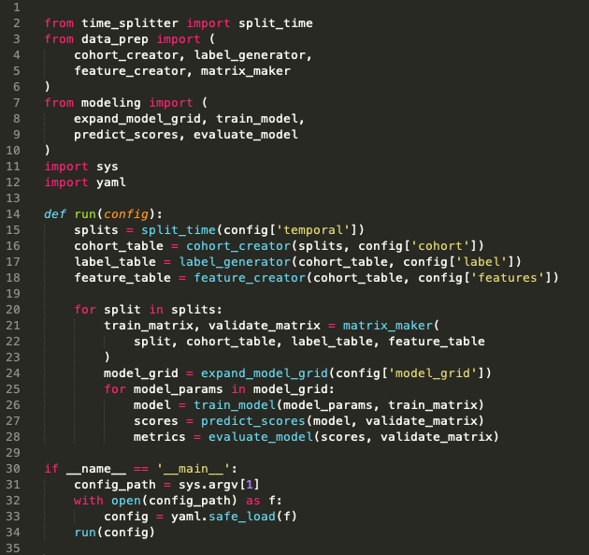
Pipeline Runner

Slide 59
config.yaml
Pipeline Runner
Orchestration + Config Parameters
Time Splitter
Cohort Creator
Label Creator
Feature Creator
Matrix Creator
Model Trainer
Database
Score Predictor
Model Evaluator

Slide 60
Time Splitter
Features Data
Train Examples
Labels
Validate Examples
Labels

Slide 61
Time Splitter
Features Data
Train Examples
Labels
Validate Examples
Labels
Features Data
Train Examples
Labels
Validate Examples
Labels
Features Data
Train Examples
Labels
Validate Examples
Labels
Features Data
Train Examples
Labels
Validate Examples
Labels
•
•
•

Slide 62
Time Splitter
INPUTS
Temporal Parameters:
Beginning of time
End of time
Label Window
Example History
Update Frequency
OUTPUTS
Paired train/validate sets of dates:
[
(train_start_1, train_end_1),
(test_start_1, test_end_1)
],
[
(train_start_2, train_end_2),
(test_start_2, test_end_2)
], …
Note: Not splits of the data!
(you still need the full history for features)

Slide 63
config.yaml
Pipeline Runner
Orchestration + Config Parameters
Time Splitter
Cohort Creator
Label Creator
Feature Creator
Matrix Creator
Model Trainer
Database
Score Predictor
Model Evaluator

Slide 64
Cohort Creator
INPUTS
Train/validate split dates
Cohort logic
(e.g., SQL snippet in config)
Cleaned data
OUTPUTS
Sets of entities at a given time that will define rows in training/validation matrices:
entity_id, time

Slide 65
config.yaml
Pipeline Runner
Orchestration + Config Parameters
Time Splitter
Cohort Creator
Label Creator
Feature Creator
Matrix Creator
Model Trainer
Database
Score Predictor
Model Evaluator

Slide 66
Label Creator
INPUTS
Train/validate split dates
Cohort ids+dates
Label definition logic + window
(e.g., via SQL snippet in config)
Cleaned data
OUTPUTS
Label values for each entity/date pair in the cohort:
entity_id, date, label(s)

Slide 67
config.yaml
Pipeline Runner
Orchestration + Config Parameters
Time Splitter
Cohort Creator
Label Creator
Feature Creator
Matrix Creator
Model Trainer
Database
Score Predictor
Model Evaluator

Slide 68
Feature Creator
INPUTS
Train/validate split dates
Cohort ids+dates
Feature definition logic + windows
(e.g., via SQL snippets in config)
Cleaned data
OUTPUTS
Feature values for each entity/date pair in the cohort:
entity_id, date, feature cols
Note: often useful to group related features together for testing, etc.

Slide 69
config.yaml
Pipeline Runner
Orchestration + Config Parameters
Time Splitter
Cohort Creator
Label Creator
Feature Creator
Matrix Creator
Model Trainer
Database
Score Predictor
Model Evaluator

Slide 70
Matrix Creator
INPUTS
Train/validate split dates
Cohort ids+dates
Label values
Feature values
OUTPUTS
Pairs of train + validation matrices
(np.array, pd.DataFrame, scipy.csr_matrix, etc.)
Note: all this needs to do at this point is join the cohorts, labels, and features together for each set of dates

Slide 71
config.yaml
Pipeline Runner
Orchestration + Config Parameters
Time Splitter
Cohort Creator
Label Creator
Feature Creator
Matrix Creator
Model Trainer
Database
Score Predictor
Model Evaluator

Slide 72
Model Trainer
INPUTS
Train Matrix
(and associated temporal metadata)
Model type + parameters
(from config)
OUTPUTS
Trained model object
(downstream + to disk)
Model metadata to database
model type, hyperparameters,
training dates, model_id
Note: Helpful to keep track of sets of models with the same parameters (type, features, hyperparameters, label definition, etc) trained on different time splits

Slide 73
config.yaml
Pipeline Runner
Orchestration + Config Parameters
Time Splitter
Cohort Creator
Label Creator
Feature Creator
Matrix Creator
Model Trainer
Database
Score Predictor
Model Evaluator

Slide 74
Score Predictor
INPUTS
Validation Matrix
(and associated temporal metadata)
Trained model object
(and associated model_id)
OUTPUTS
Predicted scores
Note: Helpful to persist to the database for downstream analyses, but can get large, so be sure to index (and may want to make storage optional, especially during initial debugging)

Slide 75
config.yaml
Pipeline Runner
Orchestration + Config Parameters
Time Splitter
Cohort Creator
Label Creator
Feature Creator
Matrix Creator
Model Trainer
Database
Score Predictor
Model Evaluator

Slide 76
Model Evaluator
INPUTS
Validation Matrix (Actual Labels)
(and associated temporal metadata)
Predicted Scores
Metric definition(s)
(from config)
OUTPUTS
Model performance on metrics:
model_id, validation_date, metric,
parameter, value
examples:
108, 2015-03-14, precision, 500_abs, 0.62
108, 2015-03-14, recall, 15_pct, 0.25
108, 2015-03-14, recall, 0.8_thresh, 0.42
Note: Helpful to persist to the database for downstream analyses

Slide 77
config.yaml
Pipeline Runner
Orchestration + Config Parameters
Time Splitter
Cohort Creator
Label Creator
Feature Creator
Matrix Creator
Model Trainer
Database
Score Predictor
Model Evaluator

Slide 78
Database
raw data
cleaned data

Slide 79
Database
raw data
cleaned data
model_prep schema
cohort
labels
features_ demo
features_ history
. . .
id, time
id, time, label(s)
id, time, feat1,…
id, time, feat1,…

Slide 80
Database
raw data
cleaned data
model_prep schema
cohort
labels
features_ demo
features_ history
. . .
id, time
id, time, label(s)
id, time, feat1,…
id, time, feat1,…
results schema
model_sets
models
predictions
evaluations
model_set_id,
type, params
model_set_id,
model_id, time
model_id, id,
time, score, label
model_id, time,
metric, value

Slide 81
config.yaml
Pipeline Runner
Orchestration + Config Parameters
Time Splitter
Cohort Creator
Label Creator
Feature Creator
Matrix Creator
Model Trainer
Database
Score Predictor
Model Evaluator

Slide 82
config.yaml
Pipeline Runner
Orchestration + Config Parameters
Time Splitter
Cohort Creator
Label Creator
Feature Creator
Matrix Creator
All the project-
specific details!
Model Trainer
Database
Score Predictor
Model Evaluator

Slide 83
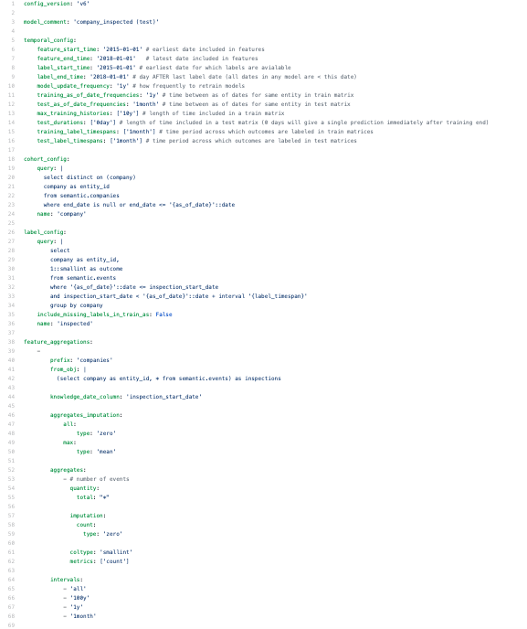
config.yaml
https://github.com/dssg/direccion_trabajo_inspections/blob/master/experiments/test.yaml

