Slide 1

Interpretability:
Understanding ML Models and their Predictions
Rayid Ghani

Slide 2
Scope
Data
Exploration
Modeling
Get Data
Store Data
Link Data
Rows
Features
Labels
Model Selection
Train-Test Splits
Performance Metrics
Model Interpretation
Entities
temporal
Spatial
…
Models
Dealing with Bias and Fairness
Field Trial Design
Deployment
Monitoring
Goals, Actions, Data, Analysis, Ethics

Slide 3
Going forward
Features and models (including baselines and baserate) over time
Select a few high-performing models (Due Nov 21st) - helper notebook
Understand what the models are doing (Due Nov 28th)
What features are important
What people/bills are they prioritizing
Are these models similar or different?
Audit for Bias (Due Dec 5th)
Presentations (Dec 7th)
Final Report (Dec 14th)

Slide 4
Reminders
This week:
Wednesday team check-ins
Thursday: Class Session in GHC 6115
Coming up next week:
Monday: Update 7 (on Canvas): Model selection and ML Results Over Time
Tuesday: Feedback Form
Readings for Tuesday: Bias and Fairness
No Wednesday meetings (Thanksgiving) but happy to meet on Tuesday (or Wednesday) if any teams want to

Slide 5
Plan for the week
What you should be discussing this week within your team
Any Additional models and features you want to build
Making sure you can look at results across time and on different evaluation metrics
What you should be building this week
“Final” set of high priority features
Running a grid of larger models + hyperparameters across all time splits
Doing a first pass over plotting the results over time and doing simple model selection

Slide 6
What we’ll cover today
Why we want ML models to be interpretable?
Types of Interpretability
Global
Individual
Methods to understand models and predictions

Slide 7
Why do we want Interpretability?

Slide 8
Why do we want Interpretability?
Debugging the Model
Improving the performance of the system
Creating and increasing trust and adoption
Selecting appropriate actions/interventions
Legal Recourse

Slide 9
Global Vs Local
Use Case | User | Goal | Global or Local
Debugging
Improving performance
Trust
Interventions
Recourse

Slide 10
Global Vs Local
Use Case | User | Goal | Global or Local
Debugging | ML Developer | Sanity check | Both
Improving performance | Action- taker | Decide to agree or override | Local
Trust | Policymaker/Action-Taker | Model use => better outcomes | Both
Interventions | Action-Taker | Improve outcomes | Local
Recourse | Individual affected | Recourse | Local

Slide 11
What we do want from a global explanation?

Slide 12
Understanding what the model is doing
Look at the model itself
Look at score distributions and calibration (to assess uncertainty)
Look at Feature Importances (and know what that means for different models)
Look at contributions of groups/sources of features
Look at the predictions of the model
Who/what does the model prioritize?
How are the top k predictions different than the rest? (cross-tabs on top k vs rest)
Look at where the models makes mistakes

Slide 13
Case Study
Childhood Vaccination in Mexico

Slide 14
How to interpret specific models
Decision Trees
KNN
SVMs
RFs
NNs

Slide 15
Feature Importances

Slide 16
Understanding Predictions
Score Distributions
Cross-Tabs

Slide 17
Characterizing the top k predicted entities
Optional (only available for historical data)
entity_id | score | true_label
582 | 0.99 | 1
882 | 0.91 | 1
471 | 0.85 | 0
094 | 0.84 | 1
... | ... | ...

Slide 18
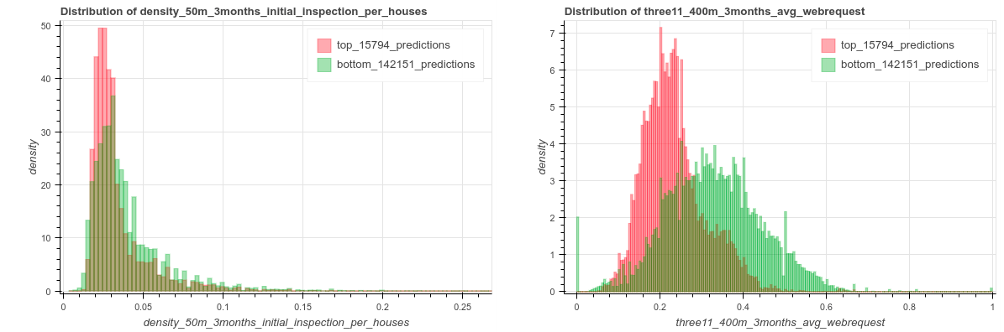

Slide 19
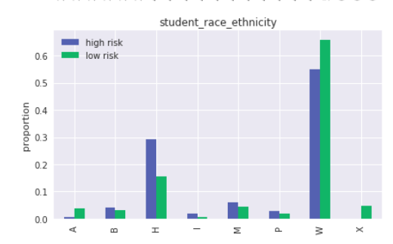
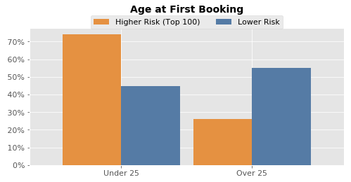
Cross-Tabs

Slide 20
Cross-Tabs
Continuous Variables
T-Test
Null-Hypothesis: The feature mean in the high-risk group is the same as in the low-risk group
KS-Test
Null-Hypothesis: The feature distribution in the high-risk group is the same as in the low-risk group.
Categorical Variables
Chi-Square Test / Fisher’s Exact Test
Null Hypothesis: The high-risk and low-risk groups have the same feature distribution.

Slide 21
Sparse Models
Sparse models
interpretable models – Ustun and Rudin. Learning Optimized Risk Scores from Large-Scale Datasets.KDD 2017
Additive models – Caruana et al. "Intelligible models for healthcare: Predicting pneumonia risk and hospital 30-day readmission." KDD 2015)

Slide 22
Words you will run into and what you should think about
Interpretable models: can you get both interpretability and “accuracy”? For what definition of interpretability andf accuracy?
Examples: Risk-SLIM, GAM, Decision Rule Lists, Decision Trees, Logistic Regression
Local explanations: Given a prediction by a model, can you understand why it made that prediction. What does it mean to explain the prediction of a model?,
Examples: LIME, SHAP, Maple, DICE, NICE, Protodash, …

Slide 23

Evaluating Explainable ML Methods
There are A LOT of proposed explainable ML methods and papers that suggest this is a solved problem, but very little evidence these methods actually improve outcomes in practical use cases.

Slide 24
Evaluating Explainable ML Methods
How easy is the method to apply to a new setting (either with an existing implementation or from the description in the paper)?
Are there parameters you need to choose? If so, how do you find good values and how sensitive are the results to these choices?
Do the explanations “make sense”? Are they internally consistent? Do they seem consistent with what you know about the context and the data?
Are the explanations useful? Would they actually improve outcomes for the given use case?
Do you have to make any trade-offs to improve interpretability (e.g., computational time, model accuracy?)

Slide 25
Specialized “Interpretable” Models
Risk-SLIM – Ustun and Rudin. Learning Optimized Risk Scores from Large-Scale Datasets.KDD 2017
Generalized Additive Model (GAM): Additive models – Caruana et al. "Intelligible models for healthcare: Predicting pneumonia risk and hospital 30-day readmission." KDD 2015)

Slide 26
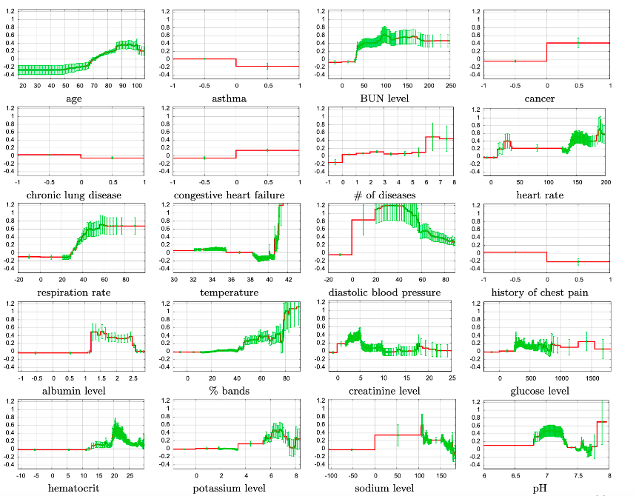

Slide 28
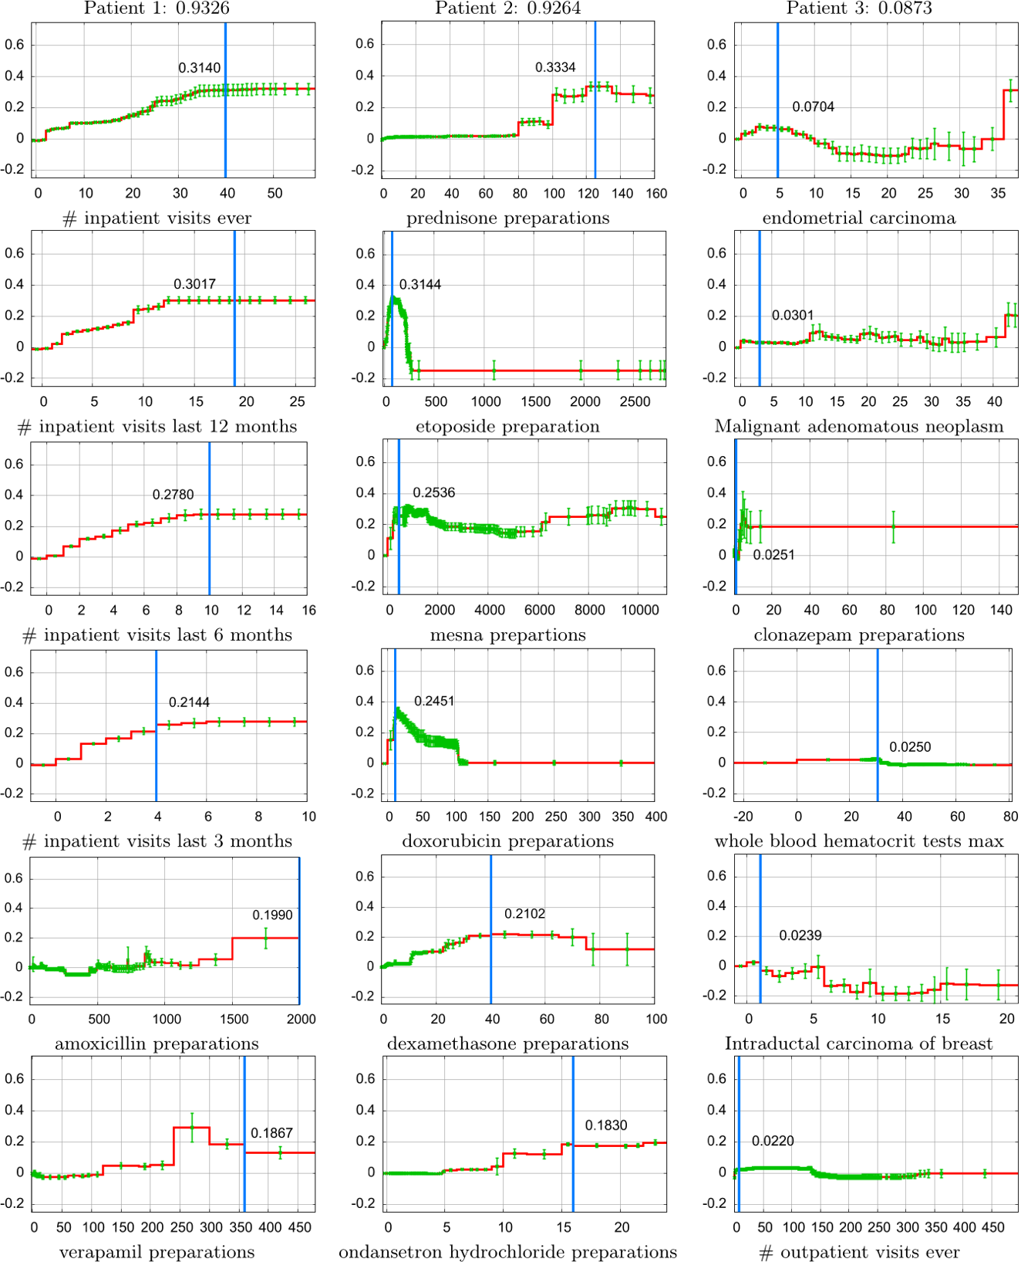

Slide 29
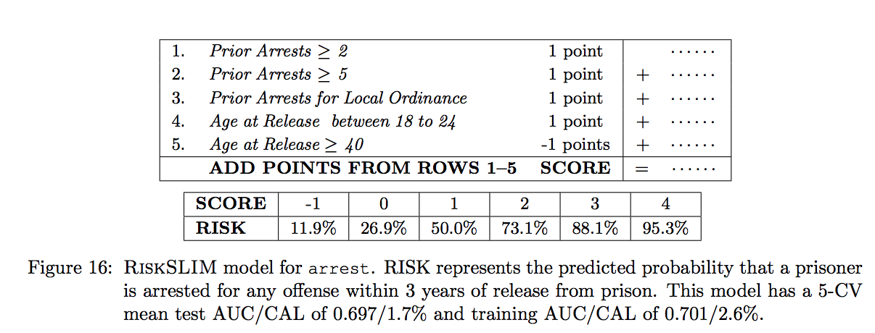
Sparse Models (RiskSLIM)

Slide 30
Reminders
This week:
Wednesday team check-ins
Thursday: Class Session in GHC 6115
Coming up next week:
Monday: Update 7 (on Canvas): Model selection and ML Results Over Time
Tuesday: Feedback Form
Readings for Tuesday: Bias and Fairness
No Wednesday meetings (Thanksgiving) but happy to meet on Tuesday (or Wednesday) if any teams want to

