Slide 1

Case Studies: ML Meets Public Policy
Rayid Ghani

Slide 2
Things to remember
Friday session on remote workflows and accessing project data
Focus for this week is getting to know:
Your team
Your project
Your data
Make sure to set up a time with Logan or me (office hours) to go over the project this week (as a team)
Following week:
Project Proposal (Tuesday, Sep 15)

Slide 3
Plan for today
Quick note on project and teamwork
Finish up Scoping
Discuss Dengue case study (reading)

Slide 4
Project Info
GitHub Repos: https://github.com/dssg/mlpolicylab_fall26_{team_name}
mlpolicylab_fall26_jail_mh1,2
mlpolicylab_fall26_bills1,2
Database (same server, different db name)
bills_passage_bills1, bills_passage_bills2, johnson_county_ddj_jail_mh1, johnson_county_ddj_jail_mh2
Project directory on server
Private Slack channel

Slide 5
Working with Your Project Team
Spend some time up front figuring out how to work as a team and work styles
Everyone should participate in all aspects of project
No individual should do the majority of the python coding, SQL writing, report writing
However, you should divide up different pieces of the work
For instance, working on different parts of the pipeline code in parallel or splitting up sections of the report

Slide 6
Working with Your Project Team
We’re providing class time to make it easier to coordinate with your group and get feedback from peers and instructors, but you won’t be able to complete the project just in this allotted time
Tools for coordination:
Slack: we’ve created group-level channels. Additionally, feel free to use group DMs and video calls with your group to coordinate as well.
Many good free options for task tracking/management: github issues or project boards, trello, etc.

Slide 7
Working with Your Project Team
Active participation in the group work throughout the entire semester is required by all the team members, and a very large component of your grade
Collaboration is encouraged, both within and across teams! Learning from each others’ strengths is a big benefit of group work, and you should feel free to discuss strategies and approaches with other teams (i.e., it’s not a competition)
Pacing your work is important. You won’t be able to do everything the week before the final report, and if everyone tries to, you’ll break the server.

Slide 8
DISCUSSION QUESTION
Past experiences with project groups or questions/feedback about this semester?

Slide 9
Scope
Data
Exploration
Modeling
Get Data
Store Data
Link Data
Rows
Features
Labels
Model Selection
Train-Test Splits
Performance Metrics
Model Interpretation
Entities
temporal
Spatial
…
Models
Dealing with Bias and Fairness
Field Trial Design
Deployment
Monitoring
Goals, Actions, Data, Analysis, Ethics

Slide 10
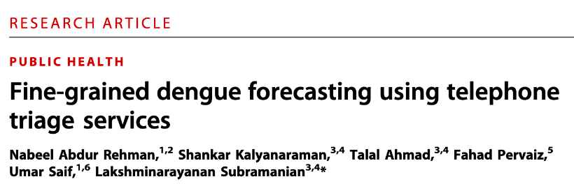
Case Study
Notes:
https://docs.google.com/document/d/1AGXQTwd9A0AOiaIzJhi85BSFgaku5lxrqiwMpmpfxQw/edit#

Slide 11
Case Study
If you were scoping the project described here, how would you describe the overall goal?
Notes:
Goals : weak. The goal is stated as early detection to enable containment, but never operationalized. There's no success metric: cases averted, deaths averted, response time reduced, coverage of high-burden areas. In practice, correlation with observational data becomes the implici goal - not a policy goal. this is a resource-allocation problem but an outcome goal is never specified

Slide 12
Do not edit How to change the design
If you were scoping the project described here, how would you describe the overall goal?
The Slido app must be installed on every computer you’re presenting from

Slide 13
Case Study
How well does the paper address the goal we defined above?

Slide 14
Do not edit How to change the design
How well does the paper address the goal we defined above?
The Slido app must be installed on every computer you’re presenting from

Slide 15
Case Study
How well does the paper address the goal you defined above? What evidence do they provide in this regard?

Slide 16
Case Study
What actions can the public health officials take to achieve that goal?
Notes:
Actions - well-chosen but under-specified: actions exist (spraying, source reduction, targeted awareness, hospital bed preparation), but the capacity of the action is never stated. How many towns can be treated in a week? How many teams? Without that number we can't choose k, can't choose a metric, and can't tell whether a ranking is good enough. Similarly, the 2–3 week horizon appears to be chosen because it's what the data supports. The question is how long mobilization actually takes, and whether a 1-week or 4-week horizon would serve the action better.

Slide 17
Case Study
In what ways did the model change the actions or decisions that public health officials are taking in terms of when, where, and how to act?

Slide 18
Case Study
What ethical or fairness considerations might be relevant here? How were these addressed in the paper?

Slide 19
Bonus questions to consider (after class)
Using the scoping guide, which step is weakest in this paper?
Problem understanding
Goals
Actions
Data
Analysis
Ethics

Slide 20
Bonus questions to consider (after class)
Validation: The model was validated with 5-fold cross-validation, with folds assigned randomly across town-weeks. What is the most serious consequence?
Reported accuracy overstates forward performance
Feature importances are unreliable
Towns can't be compared to each other
No real problem, since the model is retrained weekly anyway

Slide 21
Bonus questions to consider (after class)
Metrics: The system reports a correlation of 0.85. You have to send field teams to 3 of 10 towns each week. What number do you actually need?
Correlation per town
RMSE on the original case scale
Precision at 3 towns
Cases averted versus sending teams at random

Slide 22
Bonus questions to consider
Impact: Cases in Lahore fell from 21,000 to 257 the year the system launched. How much of that drop should the forecasting system get credit for?
Essentially none
Some, but the paper can't tell us how much
Most of it
Impossible to say without a control

Slide 23
Bonus questions to consider
Feedback loops: Field teams spray the towns the model flags. What does that do to next year's training data?
Nothing important
Makes flagged towns look falsely low-risk
Makes flagged towns look falsely high-risk
Depends on whether spraying works

Slide 24
Bonus questions to consider
Ethics and incentives: Officials in flagged towns must report to a weekly meeting chaired by the head of the provincial government. What is the most likely effect on the data?
None, accountability improves reporting
Fewer suspected cases recorded in flagged towns
Reduced promotion of the hotline in flagged towns
Both of the last two

Slide 25
Bonus questions to consider
Equity: Call volume comes from people who know the hotline exists and can afford to call. Which is the better fix?
Train separate models per town, as the authors suggest
Add socioeconomic covariates
Change the metric to require equal performance across towns
Don't fix the model, fix the hotline's reach

Slide 26
Things to remember
Friday lab session on remote workflows
Focus for this week is getting to know:
Your team
Your project
Your data
Following week:
Project Proposal (Tuesday, Sep 15)

Slide 27
Things to remember
Friday session on remote workflows and accessing project data
Focus for this week is getting to know:
Your team
Your project
Your data
Make sure to set up a time with Logan or me (office hours) to go over the project this week (as a team)
Following week:
Project Proposal (Tuesday, Sep 15)

