Slide 1

Machine Learning / Data Science Project Scoping
Rayid Ghani

Slide 2
Reminders
Today:
Project Preference form
Tomorrow
Lab Session for tech setup
Next Tuesday
Submit weekly review (assignment) before class (canvas)
Required Reading: Dengue Fever Paper (think about scoping here)

Slide 3
Scope
Data
Exploration
Modeling
Get Data
Store Data
Link Data
Rows
Features
Labels
Model Selection
Train-Test Splits
Performance Metrics
Model Interpretation
Entities
temporal
Spatial
…
Models
Dealing with Bias and Fairness
Field Trial Design
Deployment
Monitoring
Goals, Actions, Data, Analysis, Ethics

Slide 4
Why Scoping is Critical
Increases the likelihood of use and impact
Allows everyone to discuss, agree on, and then focus on tangible goals and identify actionable ways to achieve them.
We start with the problem (and not the data) and get to a scope that allows us to connect the data to inform the actions to achieve our goals.
Notes:
Scoping is critical because, without it, you could be solving the wrong problem, or building a tool that no one will use because it does not address a problem they need to solve.

Slide 5
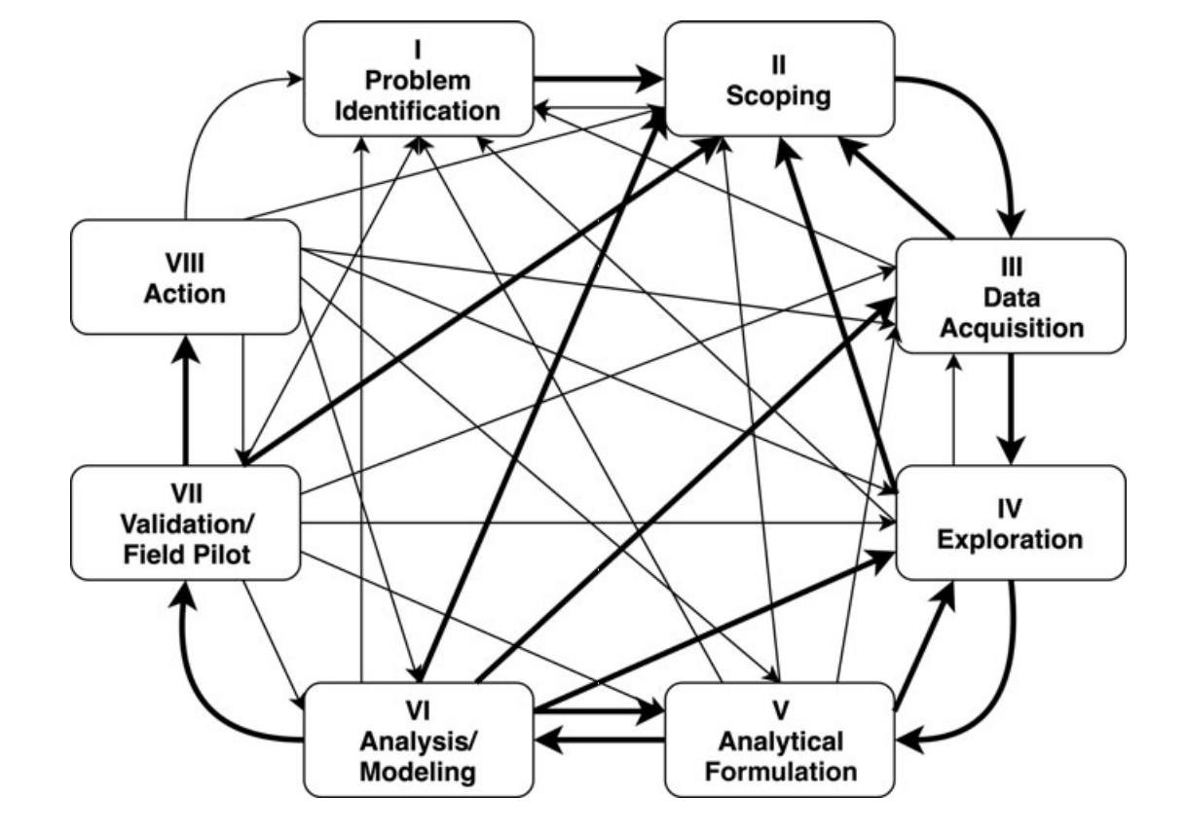
Scoping is an iterative and ongoing process
Involves different types of people
Gets refined over time
Gets modified as a result of later project phases

Slide 6
The goal of this project is to build a dashboard/model/map/…
Doing some type of analysis may be the bulk of what you do during a project but the analysis should never be the goal of the project.
A well-formulated/scoped project will have the analysis inform a follow-up action and help achieve intended policy goals

Slide 7
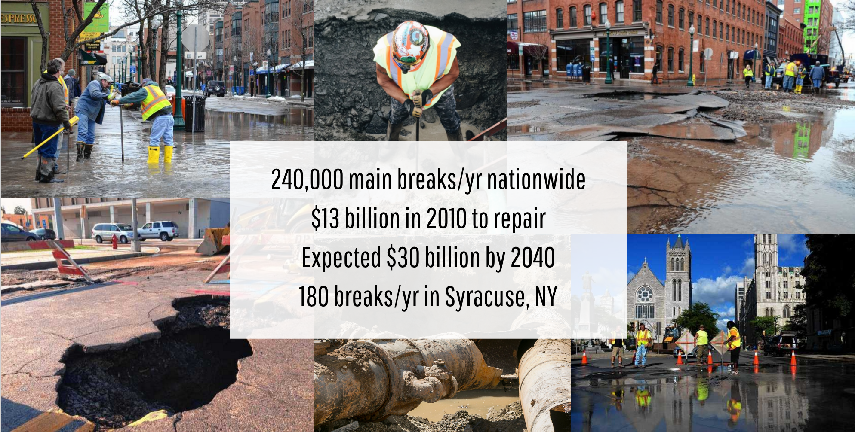
Case Study
240,000 main breaks/yr in US
$13 billion in 2010 to repair
Expected $30 billion by 2040
180 breaks/yr in Syracuse, NY

Slide 8
Case Study: Discussion Question
Describe in one sentence the goal of the
case study we read for today's class

Slide 9
Do not edit How to change the design
Join at slido.com #94889
The Slido app must be installed on every computer you’re presenting from

Slide 10
Do not edit How to change the design
Case Study
The Slido app must be installed on every computer you’re presenting from

Slide 11




Actionable and Goal-Driven Project Scoping Process
Scoping Process
Actions
to achieve goals
Problem Statement
Project Scope
Ethical
considerations
Goals
of the project
Analyses
to inform actions
Data
for Analyses
Iterative
Takes place over days/weeks/months

Slide 12
From Problem Statement to Outcomes
Formulation, Data, Analysis, Evaluation, Deployment, Monitoring
Problem Statement
Project Scope
Outcomes

Slide 13

Conversations begin with problems an organization are facing
Can we build an early warning system for water infrastructure issues?
Can we improve the public works infrastructure?
We repaved a road last year. Since then we’ve had 7 water incidents there. Could that have been prevented?
Water mains breaks are disruptive and expensive. Can we reduce the disruption and cost?

Slide 14
Scoping Process and its Outputs
Goals
Actions
Analysis
Data
What data do we need for the Analysis?
What data do we have? How do we fill the gaps?
What do we want to achieve?
How do we define success?
What actions can we take (or interventions we have) to achieve the goals?
What analyses should we perform to inform the actions?
Ethical Considerations
What ethical issues do we need to consider during scoping, design, development, and deployment?
Notes:
fill out the animation with goals, actions, analysis, data, …for acdhs

Slide 15
Example Project Scope
Goals
Data
Minimize homelessness among tenants facing eviction
Efficiency: Maximize allocation of resources to individuals who will be homeless
Effectiveness: Minimize homelessness rate
Equity: Minimize disparities in homelessness rate across demographic groups
Analysis
Actions
Individual level administrative data from the County’s data warehouse:
Demographics, eviction cases, homeless services, mental & behavioral health and other county, state, federal programs and service usage
Predict which tenants facing eviction are most likely to interact with the homeless system in the near future.
Predict which tenants facing eviction are most likely to remain stably housed with rental assistance
Proactively conduct outreach and provide rental assistance funds
Ethical Considerations
Transparency: Engaging Frontline workers & impacted communities about the new RA program
Data limitations: Does not capture non-court enforced evictions and does not capture individuals experiencing homelessness without interacting with county homelessness system
Analysis: Errors in model predictions can lead to assistance not reaching vulnerable individuals
Data Protection: Sensitive information about County residents needs to be protected
Discrimination/ Equity: Groups that are disproportionately affected by housing crises need to be considered
Trade–offs across Goals: Efficiency vs Equity

Slide 16
Understanding the Problem

Slide 17



Before Scoping: Initial Screening
Would solving it positively impact society?
Can data play a role in the solution?
Is the organization committed?
Is the problem real and significant?
Solving the problem is a priority, data is available, willing to allocate resource to integrate the solution into their processes and assess its impact
High homelessness rates, low vaccination rates leading to adverse health outcomes, high prevalence of behavioral health crises
Can help decision making with additional information

Slide 18
Understanding the Problem
What problem is the organization facing, and why is it a priority?
What is the size of the problem: Who or what is affected? How much are they affected?
How has the organization tackled the problem in the past/present?
Who are the stakeholders inside and outside of the organization, and how should they be involved?
Policymakers/Problem or Program Leads
Data Team
Users
Impacted Community members
Notes:
During the scopeathon, focus on 2 and 3.
have student leaders prefill this part of the scoping sheet and have students discuss the answers with the partner
So step 0, or step prime, is understanding the problem. We can't go any further until we've completed this step.
You'll want to organization to describe the problem they're facing and why it's a priority now.
You'll also want to understand how the organization currently tackles this problem
You'll also want to know the scope of the problem, in other words, who or what is affected by the problem and how much they're affected.
Finally, you'll want to know the stakeholders inside and outside of the organization and how they need to be involved, including, but not limited to, policymakers, leadership, data owners, and community members.

Slide 19
Questions to discuss during this phase
The organization (and people)
The problem and why it’s important
Who does it impact and how much does it impact them?
How (if) are they solving this problem today?
Are there any big ethical issues that they know of right away that need to be considered?

Slide 20
Defining the Goals

Slide 21
Step 1: Determine Goals
Goals need to be measurable and concrete
What outcomes would change if this project was successful?
What constraints do you face in achieving these goals?
What are the relative priorities and tradeoffs for each goal?
The Goal is NOT to build a model, make a prediction, build a dashboard, do some analysis, etc.
Notes:
There are other important aspects of goals we need to consider.
Our goals need to be measurable and concrete. Frequently, it will take several iterations to get from an abstract goal to a measurable, concrete goal.
We need to know the relative priorities of different goals, including effectiveness, efficiency, and equity.
We also need to know the constraints or limitations the organization faces trying to achieve these goals.
But it’s especially important to keep in mind that the goal is never to build a model or make a prediction, it’s to solve a problem.

Slide 22
Syracuse Goals
Notes:
Goal Categories
Tradeoffs - iterative - provide menu options
Constraints

Slide 23



Step 1: Define Goals
Efficiency
Effectiveness
Equity/Fairness
Focused on allocation of resources
Focused on outcomes
Focused on people not getting left behind
Notes:
The next step is to define your goals.
When it comes to goals, they usually fall into one of these three buckets: effectiveness, efficiency, and equity.
But in addition to being effective and efficient, we also want to be equitable. For example, perhaps there are certain communities that are disproportionately impacted by high drop out rates. It may be our goal to not only improve graduation rates but to close the gap in graduation rates between communities. There’s not always a trade-off between these goals, but there can be, and it’s important to define these goals early on so we know what we’re working towards. Otherwise, our solution may not address all the goals of the organization. A rising tide doesn't always raise all boats, unless we design it to.

Slide 24
Pop Quiz: Which of these are reasonable goals for a project?
Improve education quality in Pittsburgh Public Schools
Teach students how to scope data science projects
Minimize wait time for patients visiting ER
Minimize change in average transit time for people getting to work from their homes
Maximize the number of people who can get to a covid vaccine within 15 minutes

Slide 25
Scoping Checklist for Identifying Goals
Make sure the goal is about outcomes and impact vs about doing something (building a dashboard or model or visualization or map)
Think about if the project was successful, how would the world change (for the people impacted)? What would improve?
Is the goal concrete and measurable vs improving some high level aim (such as education)?
Have you made a list of constraints (limited resources for example)?
Do you have explicit efficiency, effectiveness, and equity goals? Have you discussed ethical issues around your goals?

Slide 26
Actions

Slide 27
Goals
Actions

Slide 28
We achieve our goals (and positively impact society) only if we take actions.
The role of the data science/AI/ML system we may build is to inform those actions/interventions
Notes:
Call out that

Slide 29





What are some examples of actions?
Health department inspecting homes for lead hazards
A school system enrolling students in after-school programs
City government doing preventative maintenance of water mains
A nonprofit sending targeted emails to potential donors
County mental health center conducting mental health outreach

Slide 30
Each action connects to a goal
Health department inspecting homes for lead hazards to prevent lead poisoning
A school system enrolling students in after-school programs to support them graduate on time
City government doing preventative maintenance of water mains to prevent breaks
A nonprofit sending targeted emails to potential donors to raise funds
County mental health center conducting mental health outreach to prevent crises

Slide 31
Identifying actions that help achieve the goal
Enumerate the interventions the organization has access to
Identify how those actions/interventions impact the identified goals
Get deeper into each action
Who is taking the action?
Is this something they already do? or setting up something new?
Who is impacted by the action?
Are there any resource constraints?
Ethical issues?
Notes:
The next step is to identify the actions that the organization can take to achieve its goals.
You should ask the organization what actions it has done, is doing, or can do to achieve its goals.
You should also ask what the organization would do differently if it had more information or knew where there interventions would be most effective.
In addition to figuring out what actions can be taken, you should consider who will take those actions, and who will be affected by them. It's important to know exactly who your analysis will be informing.
In addition to this, you should consider how the action will be delivered. For example, in the case of outreach, you may use various channels like phone calls, SMS, emails, or even door-to-door canvassing. The method of your outreach can affect how the information from your analysis will be used.

Slide 32

Let’s revisit our rental assistance example
Goals
Data
Prevent homelessness among tenants facing eviction
Efficiency: Maximize allocation of resources to individuals who will be homeless
Effectiveness: Minimize homelessness rate
Equity: Minimize disparities in homelessness rate across demographic groups
Who is taking the action: ACDHS and their partner organizations
Existing/New: Rental assistance program is existing, but proactive outreach will be new
Who is impacted: Individuals with eviction cases
Goals: Connects to all three goals
Constraints: Resources to reach ~30 individuals every week, Limited funds, no control over eligibility criteria
Ethical considerations: Not reaching individuals at risk of homelessness, how to help at-risk individuals who are not eligible for rental assistance?
Analysis
Actions
Proactively conduct outreach and provide rental assistance funds
Ethical Considerations
Notes:
Their existing action was – people call a hotline and apply for RA, they would get funds

Slide 33


Checklist to identify relevant actions
Is the action concrete?
Who/What is it performed on? What granularity? (e.g., performed on homes – individual homes vs all homes on a street)
Go beyond – understand, identify, strategize, plan, observe…
Does it connect to a goal?
Have you considered ethical issues?
e.g., any adverse consequences of acting on someone who do not need this intervention? Issues around excluding someone who needs the intervention?
Who is taking the action? Does the org have control/influence over it? What information, if you gave it to the person taking the action, will improve the impact/goal?
Notes:
Examples of – understanding, look at, strategize, plan,
Try to get to the most concrete form of the action.
We are a
There are several other things to consider.
We want the actions to be concrete.
It does not matter if the actions are new or existing actions, however, it can be best to inform an action that organizations already take as a part of their operations. Adding new actions can require additional resources that can be difficult to commit.
Consider the granularity of the action. For example, are we deciding which students should be enrolled in an after-school tutoring program, or are we deciding which after-school program each student should be assigned to. These are different actions that require different information.
It’s also crucial to understand how many and how frequently actions can be taken and how far out they need to be planned. This will help with the design and automation of the analysis.
This is also an important ethical crossroads. We should consider the impact of the proposed action, and whether it will be helpful or detrimental to the person receiving it. For example, if you’re predicting people at-risk of rearrest so they can be diverted from the criminal justice system with behavioral health services, that’s a positive for them. But if you’re predicting them for additional surveillance that could lead to arrest, that’s a negative. These questions should be taken into consideration before moving forward with the project.

Slide 34
Data

Slide 35
Goals
Actions
Data

Slide 36
What data do we have access to?
How do we identify and fill any gaps?
What data do we need?

Slide 37



What data do you have?
How far back does historical data go?
What is the granularity of the data?
How is the data collected and updated? With what frequency?
Our water pipes example
?
Notes:
Types of data:
Program Level
Transactional
Spatial
Text
Images/Audio/Video

Slide 38
What data do you need?
Data to inform Goals
Sufficient reliable historical data
Captures relevant outcomes
Identifies the cohort
Data to inform Actions
Refreshed at least as frequently as the action is taken
Covers the same granularity as the proposed action

Slide 39
Identifying Data Gaps and Readiness
Do we have enough to move forward, or do we need to focus on getting additional data?
Do we have enough historical data?
Is it reliable going back?
Is it at the right level of granularity to inform the actions?
Are different pieces of data linkable? unique identifiers for people, places, etc.
Do we have the right data to measure outcomes (based on the goals)?
Notes:
Data is never perfect – is it useful enough to improve over status quo?
Can you augment with external data? Public data? Partner with other organizations that have supplementary data?

Slide 40
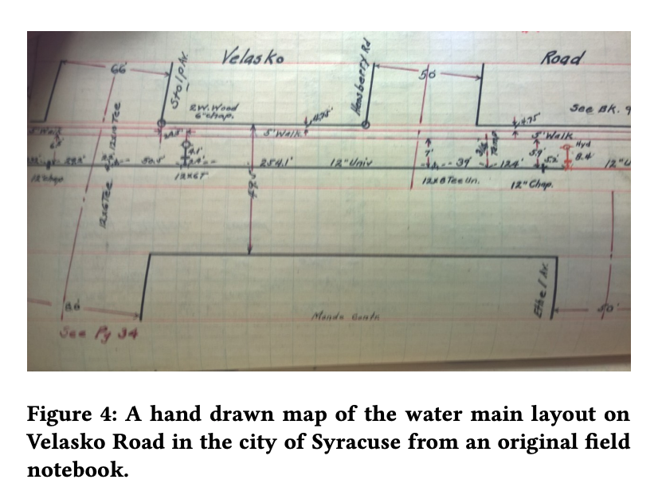
Example: preventing water main breaks in Syracuse
Key information about pipe age, diameter, and material was only available in 100-year-old handwritten notebooks of installation diagrams
Strategically digitizing these records enabled us to more accurately predict whether a water main would break

Slide 41
Returning to the rental assistance example
Goals
Data
Minimize homelessness among tenants facing eviction
Efficiency: Maximize allocation of resources to individuals who will be homeless
Effectiveness: Minimize homelessness rate
Equity: Minimize disparities in homelessness rate across demographic groups
Analysis
Actions
Predict which tenants facing eviction are most likely to interact with the homeless system in the near future.
Predict which tenants facing eviction are most likely to remain stably housed with rental assistance
Proactively conduct outreach and provide rental assistance funds to 30 individuals every week
What data do we need to take the action?
Ethical Considerations
Transparency: Engaging Frontline workers & impacted communities about the new RA program
Data limitations: Does not capture non-court enforced evictions and does not capture individuals experiencing homelessness without interacting with county homelessness system
Analysis: Errors in model predictions can lead to assistance not reaching vulnerable individuals
What data do we need to evaluate the goals?
Data Protection: Sensitive information about County residents needs to be protected
Discrimination/ Equity: Groups that are disproportionately affected by housing crises need to be considered
Trade–offs across Goals: Efficiency vs Equity
Notes:
“can we identify who becomes homeless”: need homelessness services usage on an individual level AND be able to tie this to other information, can we link homelessness data to eviction records and to other service usage data?
In some sense the ACDHS data is a best case scenario: many years of data, connected to multiple services, data from state and local programs, prisons, hospital systems, etc etc, and they have already done the work of linking identities across data sources. However, we will still run into unexpected setbacks:

Slide 42



Ethical issues to consider
Data Privacy: What legal and security requirements govern how this data is used? What additional ethical considerations apply?
Data ownership and transparency: Are the people whose data it is (and is about) aware that their data is being used and how it affects them?
Bias, equity, and fairness: Are there biases in the data sources? Is the data equally accurate and available about everyone?

Slide 43
Scoping Checklist for Data
Have you explored data sources that you think are sufficient to tackle this problem?
Do you know the level of detail, history, and format of the data?
Have you explored ethical issues with each data source?
Have you identified any data gaps?

Slide 44
Analysis

Slide 45
What analyses should we do to inform actions that in turn achieve our goals?
Goals
Actions
Analysis
Data
What analyses should we do to inform actions that in turn achieve our goals?
Notes:
Remind them that;
Most of the time in the project would be spent here
Doing this first does not make sense

Slide 46
Types of Analyses
Description - Understanding the past
Detection - Identifying a pattern/characteristic of the present state
e.g., Which zip codes have the most eviction cases? How many students failed to graduate on time last year?
e.g., Detecting fraudulent credit card transactions, identifying unsafe traffic patterns from CCTV cameras
Optimization - Allocate/assign/schedule resources/$/people/assets
Prediction - Predicting a future state
e.g., Predicting the likelihood of becoming homeless in the next year, Predicting the crop yield for the next harvest
e.g., Where place ambulances to minimize response time? Out of the people who need help, who will most benefit from the help?
Behavior change - Intervention effectiveness, behavior changes
e.g., which after-school program would be most beneficial to a particular student? Which email version would persuade a potential donor to donate money?
Notes:
Animate these
Here are some broad types of analyses that we usually take on:
Description is a largely retrospective exercise that helps an organization understand what has happened in the past to make inferences and decisions about what should happen next.
Detection is more focused on the present and looks at current trends or anomalies to detect and inform immediate actions. Good examples are fraud detection or labeling legislative bills.
Prediction focuses on predicting future behaviors or events. For example, we may want to predict whether a student will graduate or whether a bill was pass into law.
Optimization takes the outputs of another analysis, like description or prediction, and uses them to allocate resources. A good example is locating ambulances to reduce response times.
Finally, Behavior Change focuses on causing a change in an outcome. Typically, this analysis uses methods from causal inference or social science, such as randomized controlled trials.

Slide 47
Typically requires additional data
Description (Understand the past)
Detection (Anomalies, events, patterns, current state)
Prediction (Predict the future)
Optimization (Allocate/assign/schedule resources/$/people/ assets)
Behavior Change (Causal inference)
Descriptions - Understanding the past states
Detection - Identifying a pattern/characteristic of the present state
e.g., Which zip codes have the most eviction cases? How many students failed to graduate on time last year?
e.g., Detecting fraudulent credit card transactions, identifying unsafe traffic patterns from CCTV cameras
Optimization - Allocate/assign/schedule resources/$/people/assets
Prediction - Predicting a future state
e.g., Predicting the likelihood of becoming homeless in the next year, Predicting the crop yield for the next harvest
e.g., Where to place ambulances to minimize response time? Out of the people who need help, who will most benefit from the help?
Behavior change - Intervention effectiveness, behavior changes
e.g., which after-school program would be most beneficial to a particular student? Which email version would persuade a potential donor to donate money?
Notes:
Optimization takes the outputs of another analysis, like description or prediction, and uses them to allocate resources. A good example is locating ambulances to reduce response times.
Typically, the observational data that we have readily access to may not be sufficient
We can use outputs of other analyses – descriptives, predictions to, and use them to
Finally, Behavior Change focuses on causing a change in an outcome. Typically, this analysis uses methods from causal inference or social science, such as randomized controlled trials.

Slide 48
Similar data, but different purposes
Description (Understand the past)
Detection (Anomalies, events, patterns, current state)
Prediction (Predict the future)
Optimization (Allocate/assign/schedule resources/$/people/ assets)
Behavior Change (Causal inference)
Descriptions - Understanding the past states
Detection - Identifying a pattern/characteristic of the present state
e.g., Which zip codes have the most eviction cases? How many students failed to graduate on time last year?
e.g., Detecting fraudulent credit card transactions, identifying unsafe traffic patterns from CCTV cameras
Optimization - Allocate/assign/schedule resources/$/people/assets
Prediction - Predicting a future state
e.g., Predicting the likelihood of becoming homeless in the next year, Predicting the crop yield for the next harvest
e.g., Where place ambulances to minimize response time? Out of the people who need help, who will most benefit from the help?
Typically, a project involves multiple analyses
Causal Inference - Intervention effectiveness, behavior changes
e.g., which after-school program would be most beneficial to a particular student? Which email version would persuade a potential donor to donate money?
Notes:
Most common types of analyses we begin a project with

Slide 49

Identifying analyses that inform actions
Start with the action
Identify what additional information can improve the action
Identify analyses that can provide this information
This can be a combination of several analyses
What are the ethical issues with the analyses?
e.g., could your analysis be “more wrong” about historically marginalized groups? Will acting on this analysis output worsen outcomes for some groups?

Slide 50
Let’s revisit our Syracuse example
Detection
Actions
Information needed:
Send a team to do preventative maintenance
Which pipes are currently broken
Prediction
Which pipes are going to break in the near future?
What’s the optimal allocation of limited preventative maintenance funds to balance the goals of efficiency, effectiveness, and equity?
Optimization

Slide 51
Scoping checklist for identifying analyses
Is the analysis informing an action?
What type of analysis is it? Description Detection Prediction Behavior Change Optimization/Allocation
Do we have access to relevant data to perform the analysis and validate it?
What are the ethical issues?
e.g., what happens when the analysis produces ‘wrong’ information? Will acting on this analysis output worsen outcomes for some groups? How can we mitigate disproportionate impacts?

Slide 52
Ethics

Slide 53
Ethical Considerations
Ethical issues are embedded continuously and in each part of the scoping process
We want to revisit them here and make sure we have identified the key ones that need to be discussed early on

Slide 54
Ethical Considerations
Privacy & Confidentiality
Are you working with personal and/or sensitive data that is individually identifiable?
How are you protecting the data?
Data Ownership
Do the people who “own” the data know you’re using it?
Do you have their permission? How was it obtained?
How will/Can they opt out of their data being used?

Slide 55
Ethical Considerations
Transparency
Which aspects of the project do different stakeholders (policymakers, frontline workers, people who will be affected by the actions, the general public) need to be informed about?
Do the people who “own” the data know you’re using it?
Do the people you’re “targeting” know why and if they’re being “targeted”?
What recourse do they have to challenge a decision that comes from your analysis?

Slide 56
Ethical Considerations
Discrimination/Equity
Are there any specific groups for whom you want to ensure equity of outcomes?
How do you define, detect, and increase equity in outcomes?
Accountability
Who are the people responsible and accountable for all the things above?
Social License
Would it make the front page of the national newspaper if they found out what you’re doing?

Slide 57
Scoping Checklist for Identifying Ethical Issues
We don’t need to have all the answers but it’s important to list out the questions that need to be discussed
Have you identified who needs to be involved in these discussions during the scoping process and the project?
Have you considered how the project scope changes based on the answers to these questions?
What about implications of people impacted downstream and what can be done now to understand and manage them?

Slide 58
Wrap-Up

Slide 59
A Few Things to Remember
Don’t be afraid to ask naïve questions
We need to make sure that we tackle these problems responsibly and ethically
Spend time discussing goals and metrics – don’t forget equity as a goal
Understand what the current process or solution is
Communication is critical – before, during, and after
Data and technology does not solve problems, people do.
Notes:
Don’t be afraid to ask naïve questions, it’s the only way they’ll get answered. You’re new to this problem, no one expects you to be an expert.
Make sure to spend time discussing goals and metrics, and don’t forget that equity is a goal.
Make sure you understand what the current process or solution is. This can be a benchmark for the performance of your new solution.
Communication is critical all throughout the process.
Make sure you’re tackling problems responsibly and ethically.
And data and technology do not solve problems, people do. All we’re doing is building tools.

Slide 60
Useful Resources
Scoping guide: https://datasciencepublicpolicy.org/our-work/tools-guides/data-science-project-scoping-guide/
Scoping worksheet: https://datasciencepublicpolicy.org/wp-content/uploads/2021/09/ProjectScopingWorksheetBlank.pdf

Slide 61
Reminders
Today:
Project Preference form
Tomorrow
Lab Session for tech setup
Next Tuesday
Submit weekly review (assignment) before class (canvas)
Required Reading: Dengue Fever Paper (think about scoping here)

