Slide 1

Feature Engineering and Imputation
Rayid Ghani and Kit Rodolfa

Slide 2
Reminders
This week:
Tomorrow: Wednesday Group Check-Ins
Thursday: Time for group work (no lecture)
Coming up after fall break:
Monday: Project Update 3
Tuesday: Weekly Feedback Form
Tuesday: Readings on Practical ML

Slide 3
Plan for the week
What you should be discussing this week within your team
Validation strategy & temporal parameters
Initial brainstorming features you’d like to build
What you should be building this week
Temporal Validation Parameters
Updated Cohort & Label Queries

Slide 4
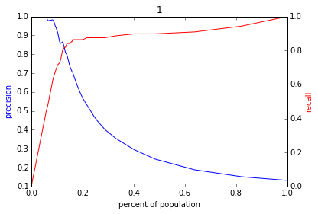
Reminder: The PR-k Curve
Score
1 .9 .8 .7 .6 .5 .4 .3. .2 .1
| | | | | | | | | |
Base rate

Slide 5
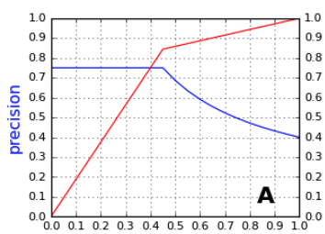
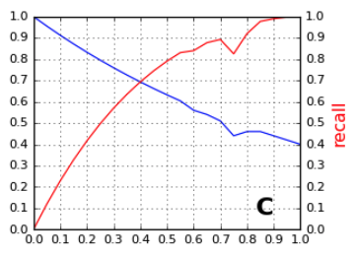
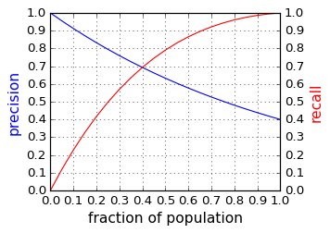
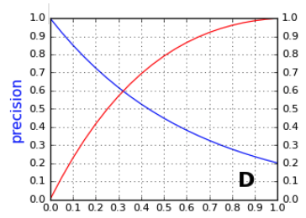
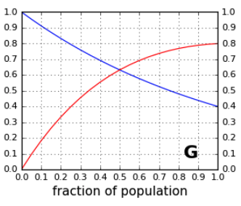
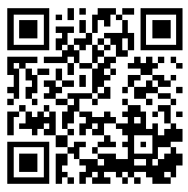
slido.com/94889 Which of these is a possible PR-k curve on the same dataset as the one outlined?
A
B
C
D
E. None of these

Slide 6
PR-k Curve example
For this example, what would the PR-k curve from a random model look like? What about from a perfect model?

Slide 7
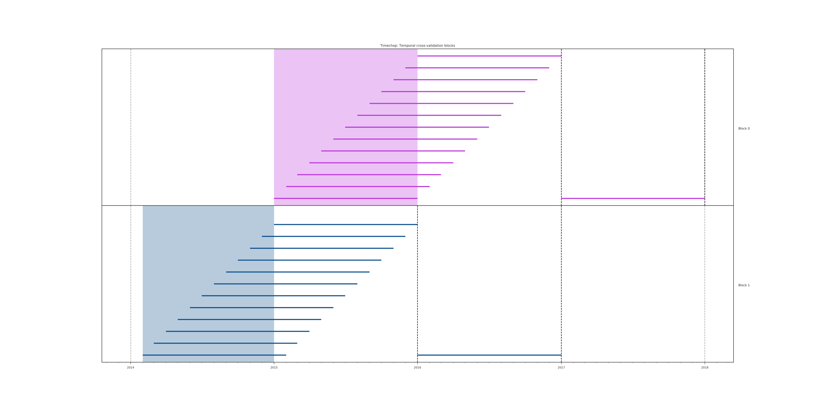
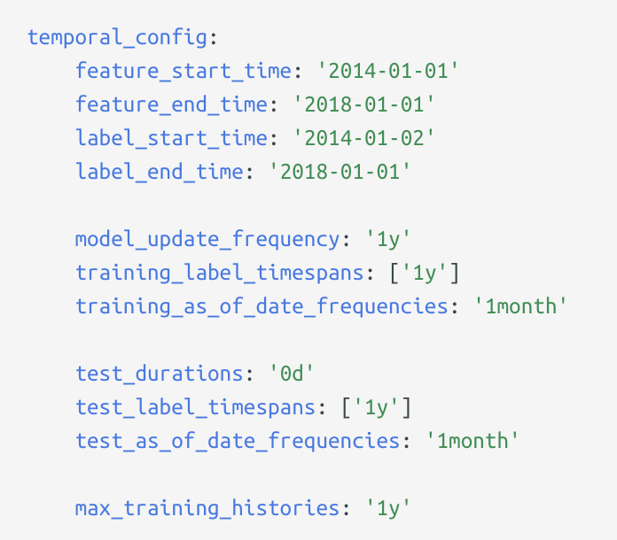
Reminder: Splitting Time with Triage
2014 2015 2016 2017 2018

Slide 8
Scope
Data
Exploration
Modeling
Get Data
Store Data
Link Data
Rows
Features
Labels
Model Selection
Train-Test Splits
Performance Metrics
Model Interpretation
Entities
temporal
Spatial
…
Models
Dealing with Bias and Fairness
Field Trial Design
Deployment
Monitoring
Goals, Actions, Data, Analysis, Ethics

Slide 9
What We’ll Cover Today
Feature Creation/Engineering
Introducing Bias in Feature Development
Dealing with Missing Data

Slide 10
Why do we care?
Features are hints/rules of thumb you give your model
Encoding domain knowledge and context for the model to use
Feature generation is a critical part of the machine learning modeling process, especially with structured data.
Complexity in features may allow us to use less complex models that are faster to run, easier to understand and easier to maintain.

Slide 11
Practical Pointers
When generating a feature, what did you know and when did you know it?
You can only create features from information available before the “training” date for a given row
Domain/expert knowledge and prior research in the field can help a lot!

Slide 12
Feature development is an iterative process
Start simple: build a couple features (from each data source) you think are most important and expand from there
Come up with Feature Ideas
Implement Features
Test Results in ML Pipeline
Discard or Keep

Slide 13
Bias in Feature Development: Mechanisms
Is your feature directly measuring what you want it to or a proxy? Is it an equally good proxy across groups?
Is measurement error correlated to group membership?
How does predictiveness of your feature vary by group?
Does missingness vary across groups?

Slide 14
Bias in Feature Development: Examples
Inferring age/gender from name
Creating "other" categories, e.g., multi-racial or non-binary gender
How are race and ethnicity collected? Self-reported? Recorded by third party? Inferred from other data?
Geocoding for distance or geographic features –– how are homeless and more mobile populations handled?

Slide 15
Discussion Question
In the class project, what are two ways bias might
be introduced in your feature development?

Slide 16
Feature Generation: Practical Pointers
Historical aggregations (especially of outcomes) are often the most predictive features (and give the model plenty of variations)
Aggregate outcomes for similar entities (for various definitions of “similar” are often very useful as well)
So are features that tell you how the current entity compares to the population
Make sure you handle missing data, and do so thoughtfully (DON’T throw away the records)
Remember to scale your features when necessary
Notes:
Only reviewed briefly in class – should pick back up here + slido + collate

Slide 17
Is Scaling Important for…
Decision Trees?
k-Nearest Neighbors?
Random Forest?
Logistic Regression?
Neural Nets?
slido.com
#94889

Slide 18
Feature in triage: Collate
All features are temporal aggregates, reflecting nature of data
Need to specify what you’re using and when it was known
Need to specify how you’ll handle missingness explicitly
YAML structure can take a little getting used to, but powerful for specifying many aggregations over many time frames in compact format

Slide 19
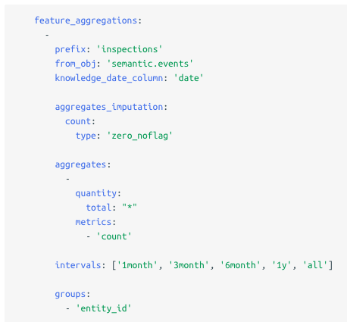
Feature in triage: Collate
Table or SQL snippet
Several options for missing data
Column or SQL snippet
and aggregation function
Time frames for aggregation

Slide 20
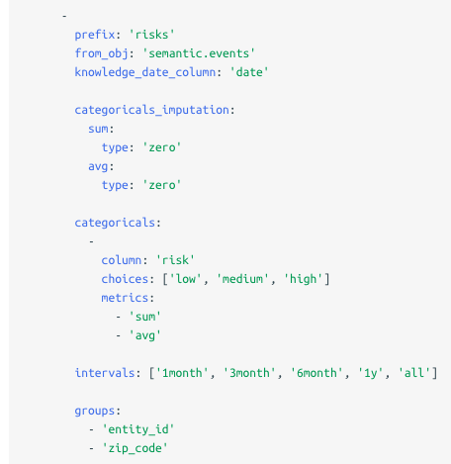
Feature in triage: Collate
Similar structure for categoricals
Specify categorical values by hand or query

Slide 21
Feature Generation – A Deeper Look
Categorical to Binary (Dummies)
Features for missing values
Discretization
Date/Time Features
Scaling/Normalizing
Transformations
Aggregations (space, time, space and time)
Relative (compared to the average…)
Interactions

Slide 22
Categorical to Binary
One vs All (Dummy Variables)
Groups
Presence vs Absence

Slide 23
Discretization
Equal width bins
Equal size bins
Entropy-based bins
Domain-Specific bins to incorporate domain specific discontinuities
Age in general
Education/school data
High school data
Infant mortality

Slide 24

Feature Scaling
Usually a good idea to scale features to have similar range: [-1,1] or [0,1] for example
Be careful with outliers
Standardize/Normalize
Zero mean and unit variance
Sklearn.preprocessing.normalize

Slide 25
Is Scaling Important for…
Decision Trees?
k-Nearest Neighbors?
Random Forest?
Logistic Regression?
Neural Nets?

Slide 26
Feature Transformations
Non-linear
Log (decreasing marginal utility)
(Square) Root
Squared

Slide 27
Aggregations
Date differences (# of days since…)
Aggregates over different time periods
min, max, avg, stdev
Avg spend in the past 3 months
Relative aggregates
1.5x avg spend
Distances
Aggregates over different distances
Seasonality

Slide 28
Feature Interactions
Generate features for combination of features
Age x gender
Allows you to use linear models but still model non linear relationships
Random Forests are one way of discovering useful interactions

Slide 29
Features are also model-dependent
Linear models may need … ?
Non-linear models may need …?

Slide 30
Missing Values
Impute (Fill in) missing values based on why you think they may be missing and what you want the model to do with those missing values
Missing Completely at Random
Missing at Random
Missing Not at Random
Typically, also add binary feature (dummy) for missing vs not missing in case “missingness” is predictive of the outcome

Slide 31
Imputing Missing Values: Some Options
Nothing?
Central Tendency: Mean / Median / Mode
ML methods that handle missing data (e.g., xgboost)
Others
Regression
k-Nearest Neighbor
Multiple Imputation

Slide 32
Imputing – Central Tendency
Simple to calculate and computationally fast
Often a reasonable starting point
May be able to capture more nuance by using other, correlated data to help fill in missing values
Under-represents variance/covariance of data

Slide 33
Imputing – ML Methods with Missing Data Handling
Some models have built-in handling of missing data, such as xgboost (which decides which direction to send missing values at each split)
May not be the best modeling method for your problem, don’t want to be locked into certain type of model
Nevertheless, worth exploring performance of other imputation methods even when using these models as well

Slide 34
Imputing – Regression
Make use of information in correlated features, more flexible than central tendency
However, may not be flexible enough to capture complex relationships or interactions
May be somewhat more computationally expensive
Generally will still underestimate variation in data

Slide 35
Imputing – k-Nearest Neighbor
More flexible option, capture more complexity in relationships in data
Difficult to choose appropriate distance metric, value of k
More computationally expensive than other methods of imputation
Requires entire training set to calculate imputed values for new examples

Slide 36
Imputing – Multiple Imputation
Create multiple “complete” datasets with different values using different regression models
Helps analyze sensitivity to handling of missing values
Much more computationally expensive, both for imputation and downstream modeling
Can provide better representation of variability in data

Slide 37
Missing Value Tips
Do not remove rows or columns with missing values (unless there is a really really really good reason)
Missingness can be a useful predictor: create a flag even if you impute a value
Data can be missing for different reasons and missingness for each row/column/cell may need to be handled differently
Only use data from the past for imputation

Slide 38
How can imputation introduce bias in your models?

Slide 39
Reminders
This week:
Tomorrow: Wednesday Group Check-Ins
Thursday: Time for group work (no lecture)
Coming up after fall break:
Monday: Project Update 3
Tuesday: Weekly Feedback Form
Tuesday: Readings on Practical ML

