Slide 1

Model Selection (and Validation)
Part II
Rayid Ghani

Slide 2
Reminders
This week:
Project check-ins on Wednesday (GHC 8023)
Project-work time on Thursday
Coming up next week:
Project Assignment – Triage cohort and labels due Monday – see template slides and canvas assignment

Slide 3
Group Checkins – Wednesdays Going Forward

Slide 4
Plan for the week
What you should be discussing this week within your team
  Validation strategy & temporal parameters
  Metrics
What you should be building this week
  Getting comfortable running triage and looking at what it produces
  Cohort Query
  Label Query
  Evaluation Metrics

Slide 5
Scope
Data
Exploration
Modeling
Get Data
Store Data
Link Data
Rows
Features
Labels
Model Selection
Train-Test Splits
Performance Metrics
Model Interpretation
Entities
temporal
Spatial
…
Models
Dealing with Bias and Fairness
Field Trial Design
Deployment
Monitoring
Goals, Actions, Data, Analysis, Ethics

Slide 6
What do we need our selected model to do?
Perform well
  What metric?
  Compared to what?
Generalize
  To what?

Slide 7
What is the goal of model selection?
You’ve run a large number of different types of models
  You need to understand what types of models are effective under what circumstances, and
  You need to decide which one(s) to use in the future

Slide 8
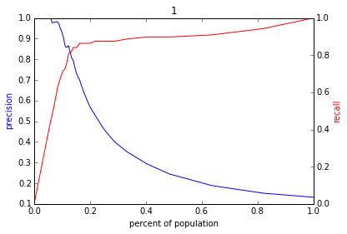
Reminder: The PR-k Curve
Score
1 .9 .8 .7 .6 .5 .4 .3. .2 .1
| | | | | | | | | |
Baserate

Slide 9
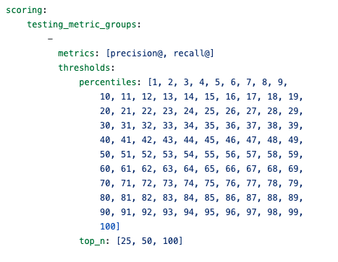
Evaluation – triage configuration

Slide 10
What should the model we select work well on?

Slide 11
What do need to know to perform model selection
Deployment scenario
  Model selection Methodology
  Metric(s) (need to match your policy goals)
Comparison with baselines (to know if you’re effective)

Slide 12
How do we select a model that does that?

Slide 13
Model Selection - Methodology
In-sample
Out of sample
Multiple Out-of-sample (Hold-out) Splits
Cross Validation
  Leave one out (LOO)
  K fold
Temporal Holdouts
Spatial Holdouts
Other Holdouts?

Slide 14
Scenario 1 – Hospital Readmissions
The setting: A hospital model scores every patient at discharge for the risk of being readmitted within 30 days. A care transitions team has capacity to follow up with about 30 patients a week: a home visit, a medication review, a scheduled follow-up appointment.
What should this model work well on/generalize to?
What is a training set fore this model?
What is the corresponding validation set?

Slide 15
Scenario 2 – Crop Detection
The setting: A satellite-based system classifies what crop is growing in each field, for yield forecasting and food security early warning. It was built using ground-truth field surveys in three countries. A ministry in a fourth country, where no such surveys exist, wants to use it for next season.
What should this model work well on/generalize to?
What is a training set fore this model?
What is the corresponding validation set?

Slide 16
Scenarios
1: We want to track news coverage of epidemic related topics. We have tagged a small corpus (n=1000) of news articles from Jan 2019 to September 2026 and now have a stream of new incoming articles every day. We want to deploy a system that tells us something about intensity of coverage by media outlet going forward.
What should our model generalize to?
What is a training set?
What is the corresponding validation set?

Slide 17
Scenarios
2: We want to track news coverage of epidemic related topics. We have tagged a small corpus (n=1000) of news articles from Jan 2019 to September 2025 and now have a stream of new incoming articles every day. We want to deploy a system that tells us something about intensity of coverage by media outlet over the last 6 years as well as going forward.
What should our model generalize to?
What is a training set?
What is the corresponding validation set?

Slide 18
Underlying principle: match methodology to match deployment time
How does the potential test-time distribution differ from training?
  No shift: training data is IID, test data will be IID from same distribution
  Time series setting: data is not IID, future will not look like resampled present
  Cluster structure, e.g. students within classrooms within schools. Test-time might be better modeled at a higher cluster level (generalizing to new schools) than within clusters (generalizing to new students within a school we’ve seen)

Slide 19
Scenarios
3: We want to predict whether there will be an increase in epidemic related articles in the media during the next week.
What should our model generalize to?
What is a training set?
What is the corresponding validation set?

Slide 20
Scenarios
4: We want to predict whether there will be an increase in epidemic related articles in the media during the next month.
What should our model generalize to?
What is a training set?
What is the corresponding validation set?

Slide 21
Parameters
How far back to go when training models? (max training history)
  To the beginning of time (expanding training window)?
  Fixed history (rolling training window)?
  Something else?
  How far back do you get your features from?
How much to move forward from train-validation pair 1 to train-validation pair 2?
  A day?
  A month?
  Something else?

Slide 22
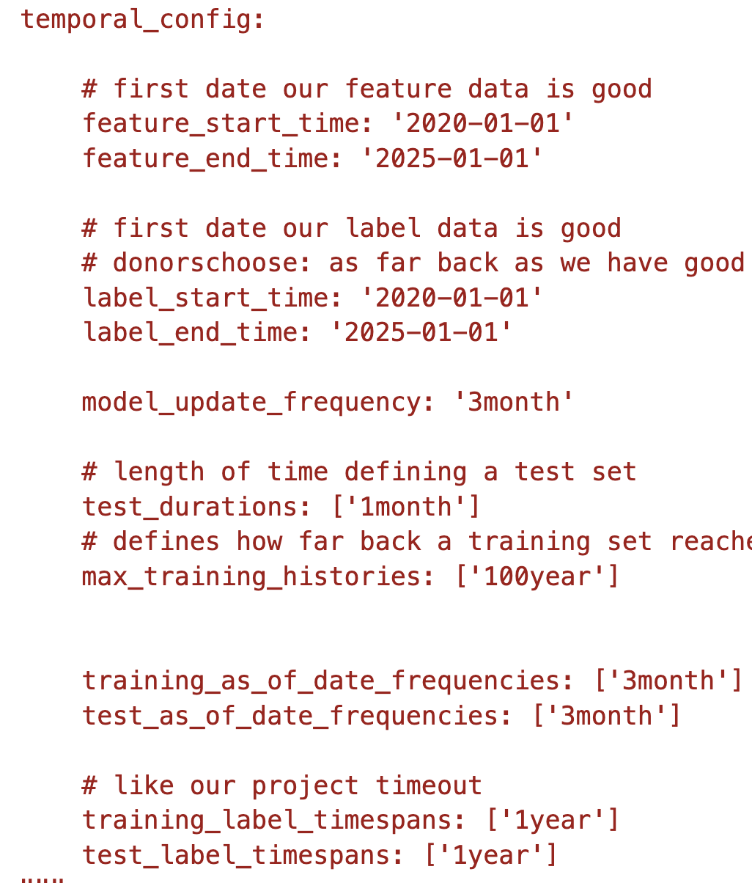
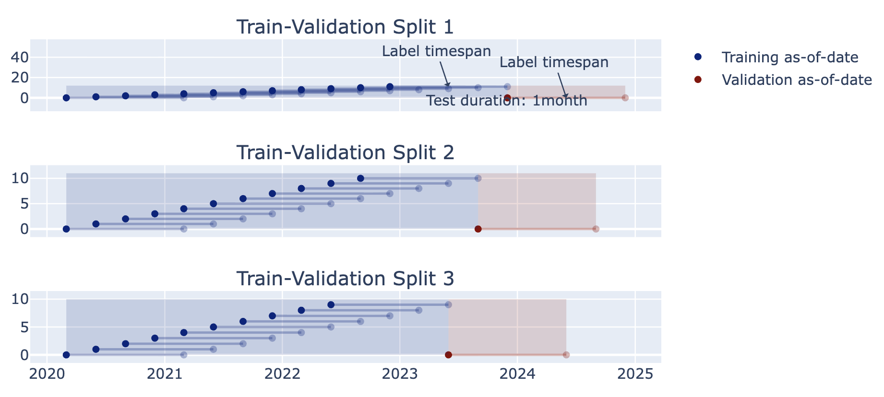
2014 2015 2016 2017 2018

Slide 23
Other considerations
If making repeated predictions about the same entity at different times, how often should an entity be repeated in the training data?
  In an event-based deployment setup?
  In a “take action at regular-ish intervals” deployment?
What about in the validation set?

Slide 24
Some tips
Set up validation set(s) to match deployment scenarios (and constraints)
Set up training set(s) any way we want but match data (both features and labels) available at training time
  Making sure labels are not censored based on label period
  Sampling (if helpful)
  Data collection and update lag

Slide 25
Train Validation Pairs
 | Train Set |  |  |  | Validation Set
Train-Validation Pair ID | Earliest project submission date | Latest project submission date | Start date for labels | End date for labels | Start date for rows | End date for rows | Start date for labels | End date for labels
1
2
3 (most recent)
Train-Validation Pair 1
Training Examples
Label Buffer
Validation Examples
Label Buffer
Train-Validation Pair 2
Training Examples
Label Buffer
Validation Examples
Label Buffer

Slide 26
Temporal Holdouts
Data
2002 2017
Train
Validate
2002 2007 2008
Train
Validate
2002 2008 2009
Train
Validate
2002 2009 2010

Slide 27
Training - Time splits
Train
Validate
2002 2009 2010
Train
We only use this time
to get outcomes
2002 2009

Slide 28
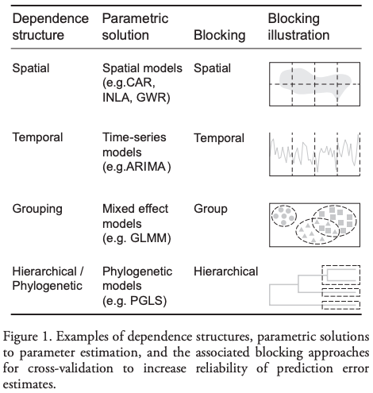
Evaluation - Methodology
In-sample
Out of sample
Multiple Out-of-sample (Hold-out) Splits
Cross Validation
  Leave one out (LOO)
  K fold
Holdouts Using Structure of Data
  Temporal
  Spatial, Hierarchical, etc.

Slide 29
Reminders
This week:
Project check-ins on Wednesday (GHC 8023)
Project-work time on Thursday
Coming up next week:
Project Assignment – Triage Cohort and Labels due Monday – see template slides and canvas assignment

