Slide 1

Case Studies: ML Meets Public Policy
Rayid Ghani and Kit Rodolfa

Slide 2
Things to remember
Due Today: Data Loading Exercise
Project Groups

Slide 3
Scope
Data
Exploration
Modeling
Get Data
Store Data
Link Data
Rows
Features
Labels
Model Selection
Train-Test Splits
Performance Metrics
Model Interpretation
Entities
temporal
Spatial
…
Models
Dealing with Bias and Fairness
Field Trial Design
Deployment
Monitoring
Goals, Actions, Data, Analysis, Ethics

Slide 4
Creating a more equitable society
How do we define equity?
How do we detect inequity?
How do we increase equity?

Slide 5
Data and AI Ethics Issues
Privacy
Data Ownership
Bias, Equity, & Fairness
Transparency
Trustworthiness and Accountability

Slide 6
Levels of control
Collection Control
Access Control
Inference Control (Not inferring something about me)
Action Control (Not taking actions on me)

Slide 7
Data Ethics Questions
Are you using data for purposes it’s intended for?
How are you protecting the data?
Do the people who “own” the data know you’re using it?
Do you have their permission? How was it obtained?
What actions are you taking on individuals based on this data?
Do the people you’re targeting know why and if they’re being targeted?
What recourse do they have?
Would it make the front page of the national newspaper if they found out what you’re doing?

Slide 8
A Few Things to Remember
Don’t be afraid to ask naïve questions
Spend time discussing goals and metrics – don’t forget equity as a goal
Understand what the current process/solution is
Communication is critical – before, during, and after
We need to make sure that we tackle these problems responsibly and ethically
Data and ML does not solve problems, people do. Is what you’re doing helping solve the problem?

Slide 9
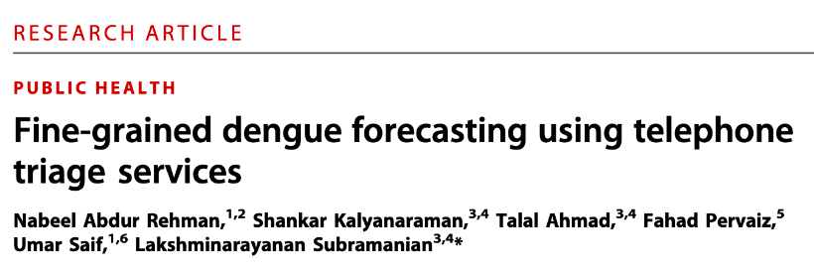
Case Study
https://docs.google.com/document/d/1AGXQTwd9A0AOiaIzJhi85BSFgaku5lxrqiwMpmpfxQw/edit#

Slide 10
Case Study
If you were scoping the project described here, how would you describe the overall goal?

Slide 11
Case Study
How well does the paper address the goal you defined above? What evidence do they provide in this regard?

Slide 12
Case Study
How well does the paper address
the goal you defined above?
slido.com #1341886

Slide 13
Case Study
What actions can the public health officials take to achieve that goal?

Slide 14
Case Study
In what ways did the model change the actions or decisions that public health officials are taking in terms of when, where, and how to act?

Slide 15
Case Study
What ethical or fairness considerations might be relevant here? How were these addressed in the paper?

Slide 16
Discussion Topic for Thursday
What are some potential downstream ethical issues when dealing with errors in record linkage?

Slide 17
Things to remember
Due Today: Data Loading Exercise
Project Groups

