Slide 1

Machine Learning for Public Policy Lab
Rayid Ghani and Kit Rodolfa

Slide 2
What we want you to learn from this class
How to responsibly and effectively solve real-world problems using ML (with a focus on public policy and social good problems)
Understand the *entire* Machine Learning process (and get hands-on experience doing most of it)
Build (and use) reusable ML pipelines
Learn how to use ML methods (that you have covered in earlier classes) in the context of a real problem

Slide 3
Pre-requisites
Caring about the world
Interest in working with other people
Python (pandas, sklearn, matplotlib)
Machine Learning methods and process
SQL
Ideally: experience with command line (bash), git(hub), working on remote servers

Slide 4
How is this course different than a typical ML class?
We’ll assume everyone knows most of the methods and focus on everything else

Slide 5
Skills needed to solve real-world problems with ML
Computer Science &
Programming
Statistics
Classes
Social Sciences

Slide 6
Skills needed to solve real-world problems with ML
Computer Science &
Programming
Problem
Formulation
Statistics
Communication
REAL
WORLD
Social Sciences
Ethics &
Legal Issues
Experimental
Design
Notes:
For ML students, previous iterations of this class probably involved some readings and assignments in each of these areas. This semester, we’re taking a more hands-on project-focused approach.

Slide 7
Scope
Data
Exploration
Modeling
Get Data
Store Data
Link Data
Rows
Features
Labels
Model Selection
Train-Test Splits
Performance Metrics
Model Interpretation
Entities
temporal
Spatial
…
Models
Dealing with Bias and Fairness
Field Trial Design
Deployment
Monitoring
Goals, Actions, Data, Analysis, Ethics

Slide 8
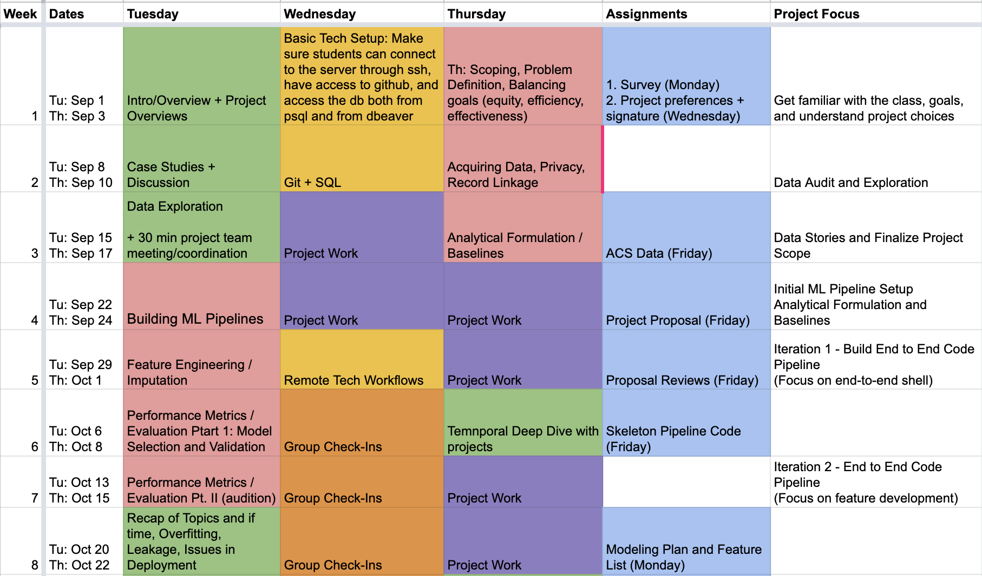
Class Schedule

Slide 9
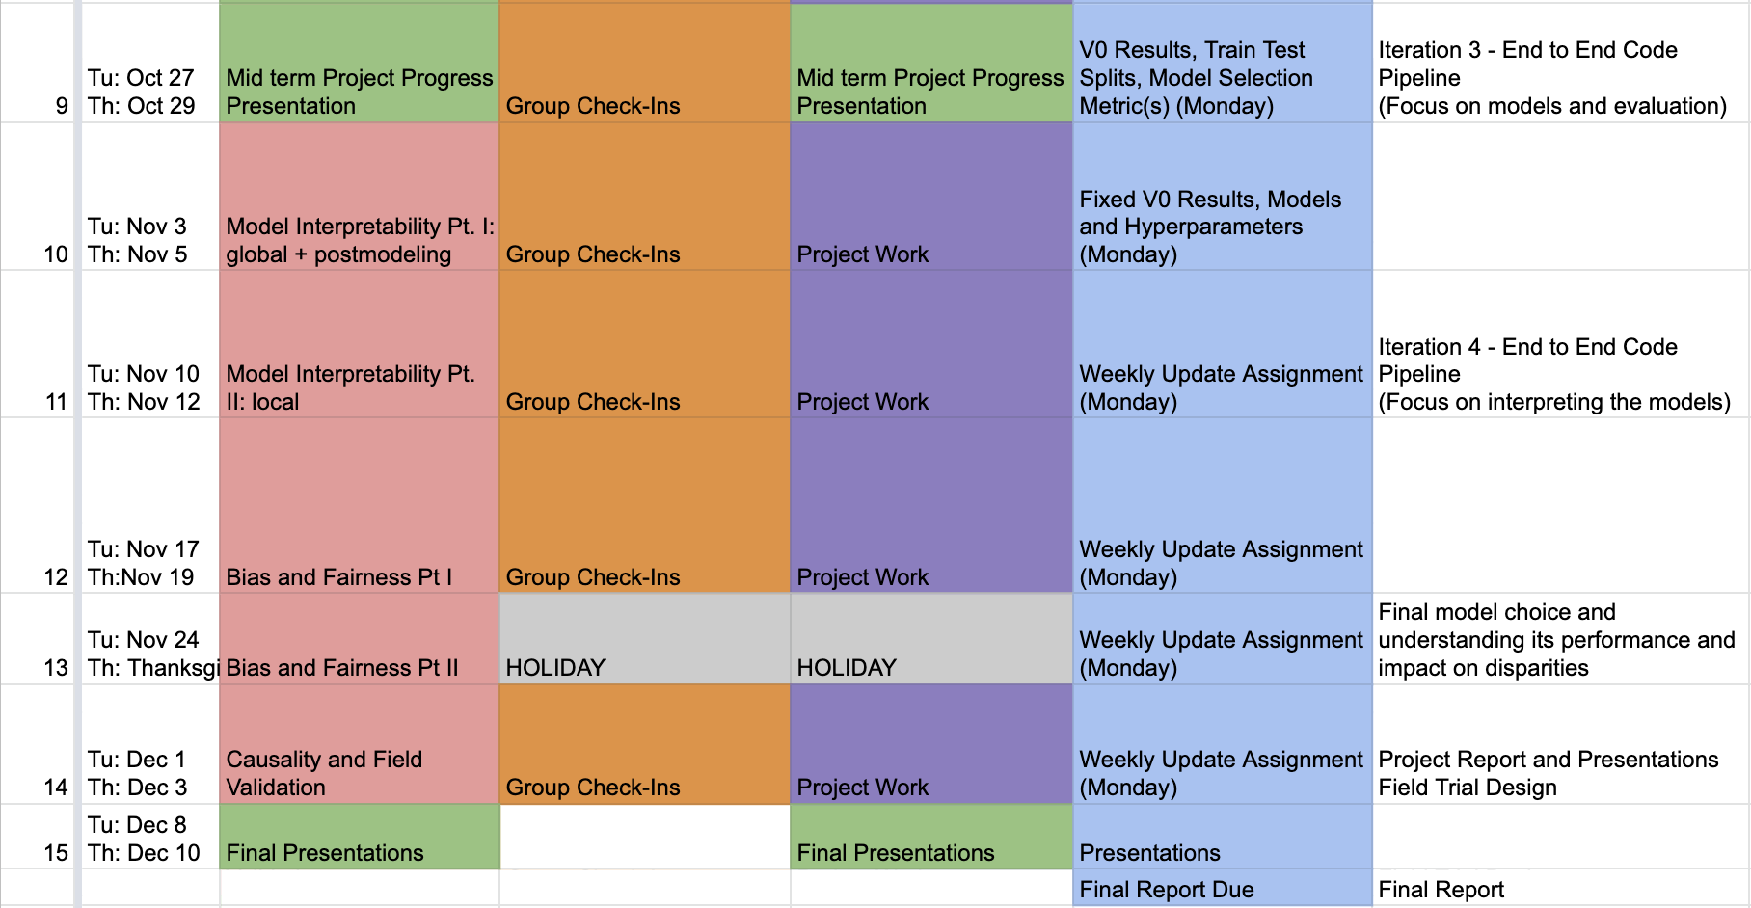
Class Schedule

Slide 10
Different components of the class
Group Projects – solving end to end (public policy) problems
Lectures
Tech Sessions
Readings/Videos
Student Presentations
Discussions
Assignments (mostly project-related)

Slide 11
Due Next Tuesday: Data Loading Assignment
Help us understand where everyone is with technical prerequisites
Help you understand the tools and skills you’ll need for this class
Assignment is a bit vague intentionally
Note it’s a different database than we’ll use for the projects
Grading won’t be too granular, focus on initial check

Slide 12
Logistics
Attendance (is not optional)
Platforms:
Latest content will be on github
Canvas (for assignment submissions)
Slack for communications and project and teamwork
Wednesday sessions
Office hours
Weekly Reviews (due before class every Tuesday)
TAs

Slide 13
Project Teams
Make sure to fill out the survey by Wednesday 6pm
We need this get you set up on the infrastructure and form teams
If you didn’t include a public SSH key, email it to us ASAP!
We’ll make 3-4 person teams at the end of this week to balance your preferences, experience, and background
We might need to adjust based on people dropping the class so don’t get too attached to your team and project
If you’re going to drop this class, drop now (before we make teams)
Notes:
If you think you’re likely to drop, please let us know sooner rather than later so we can balance teams

Slide 14




Projects
Reducing hazardous waste violations by prioritizing environmental inspections
Identifying students who are at risk of not graduating high school on time and need extra support
Identifying state bills that are likely to pass to support advocacy efforts
Increasing civic participation by identifying voters unlikely to vote to support voter turnout efforts

Slide 15
The data you’re working with is confidential and needs to be kept secure
Do not download or copy any data from the server on your local machine *
Keep your credentials secure and do not commit them to github
Tell us immediately if you suspect that any data you had access to may be compromised
Return the signed data confidentiality form

Slide 16
Tech Setup
Make sure you have the following things set up:
ssh (to connect to the server) server.mlpolicylab.dssg.io
dbeaver and psql (to connect to the database) database.mlpolicylab.dssg.io
Github (to collaborate, share code with your team, and submit code) github.com/dssg/mlforpublicpolicylab
Get familiar with:
Postgresql (to analyze and query data)
*nix command line
Git
Remote server workflow
We’ll have tech sessions tomorrow to help with setup
We’ll have tech sessions over the next few weeks to help

Slide 17
Prep for next class
Tech setup (tomorrow)
Remember to bring your laptop!
Readings (for Thursday): Available on Class Github Repo
Project Scoping guide
Example case study
Assignments: See Canvas
Due Wednesday: Project Preferences
Due Next Tuesday: Data Loading Exercise
Notes:
We’ll be creating accounts on Wednesday and send around instructions about connecting to the course infrastructure once they’re ready for you to log on

