Slide 1

Data Exploration
Rayid Ghani and Kit Rodolfa

Slide 2
Please Sit with
Your Project Teams

Slide 3
Things to remember
Let us know if you can’t access your project data or github repo
Wednesday session tomorrow: Github
Readings for Thursday
Make sure to read project proposal assignment on canvas (due next Friday)

Slide 4
Reminder: Office Hours
Instructor Office Hours (course content, general questions, etc)
Rayid (in GHC 8023): Tuesdays 12-1, Wednesdays 2-3
Kit (in GHC 8018): Wednesdays 11-12, Thursdays 12-1
Infrastructure and Tech Setup Office Hours with the TAs:
Riyaz (8th floor GHC, by printers): Mondays 12-1, Fridays 10-11
Abhishek (8th floor GHC, by printers): Mondays 11-12, Fridays 2-3

Slide 5
Plan for today
Working with your team
Team meeting: planning for working together (~10 minutes)
Data exploration overview and helpful tips
Time to work on data exploration with your group (~30 minutes at the end of class)

Slide 6
Working With Your Team

Slide 7
Working with Your Project Team
Teams designed to balance skills, backgrounds, and experiences
Spend some time up front figuring out how to work as a team and work styles
Everyone should participate in all aspects of project
No individual should do the majority of the python coding, SQL writing, report writing
However, you should divide up different pieces of the work
For instance, working on different parts of the pipeline code in parallel or splitting up sections of the report

Slide 8
Working with Your Project Team
We’re providing class time to make it easier to coordinate with your group and get feedback from peers and instructors, but you won’t be able to complete the project just in this allotted time
Tools for coordination:
Slack: we’ve created group-level and project-level channels.
Many good free options for task tracking/management: github issues or project boards, trello, etc.

Slide 9
Working with Your Project Team
Active participation in the group work throughout the entire semester is required by all the team members, and a very large component of your grade
Collaboration is encouraged, both within and across teams! Learning from each others’ strengths is a big benefit of group work, and you should feel free to discuss strategies and approaches with other teams (i.e., it’s not a competition)
Pacing your work is important. You won’t be able to do everything the week before the final report, and if everyone tries to, you’ll break the server.

Slide 10
Project Team Meeting / Coordination
(10 minutes)

Slide 11
What do we want you to use this time for?
Get to know each other
Discuss how you’re going to work together
Schedule times to work on the project proposal over the next week and a half

Slide 12
Data Exploration Overview

Slide 13
Scope
Data
Exploration
Modeling
Get Data
Store Data
Link Data
Rows
Features
Labels
Model Selection
Train-Test Splits
Performance Metrics
Model Interpretation
Entities
temporal
Spatial
…
Models
Dealing with Bias and Fairness
Field Trial Design
Deployment
Monitoring
Goals, Actions, Data, Analysis, Ethics

Slide 14
Why is data exploration important?
Sanity Check the data you were given
Understanding the problem and domain
Problem Formulation
Debugging
Feature Generation/Selection
Interpretation of results

Slide 15
Some tips for exploring your project data
Tables: identify the database tables that are most relevant to your problem
Entities: How can you identify the primary entities from your project? What are some basic/relevant characteristics about them? How have those changed over time?
Fields: Most projects have a lot of different data fields, but don’t feel like your initial exploration needs to understand everything
Label: Think about how you might define your label? What can you say about its distribution and how it’s changed over time?
Based on what you know of the context, what information would you expect to be important in modeling? Is this available? How well does it correlate with your label?

Slide 16
Typical data exploration tasks
Distributions of different variables
Correlations between variables – correlation matrix and turn it into a heatmap
Changes and trends over time – how does the data and the entities in the data change over time?
Missing values – are there lots of missing values? Is there any pattern there? How/why are they missing?
Outliers – this can be done using clustering but also by plotting distributions.
Labels/Outcomes – distribution and patterns
Cross-tabs (if you’re looking at multiple classes/labels), describing how the positive and negative classes are different without doing any machine learning.

Slide 17
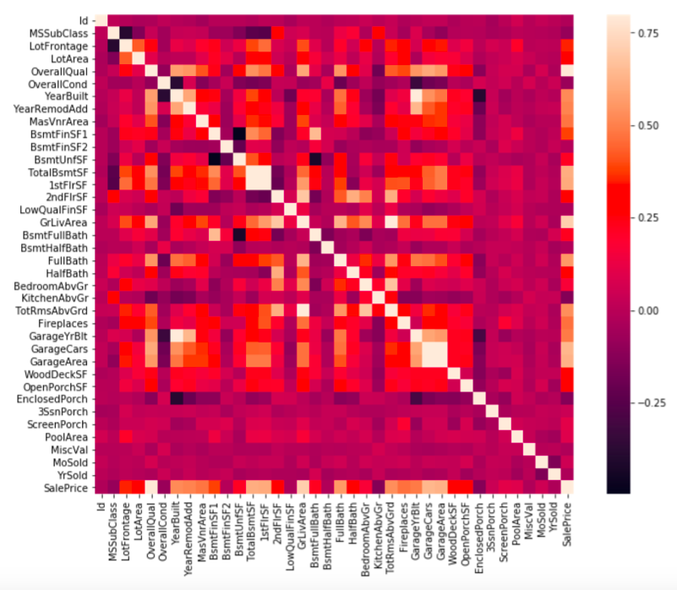

Slide 18
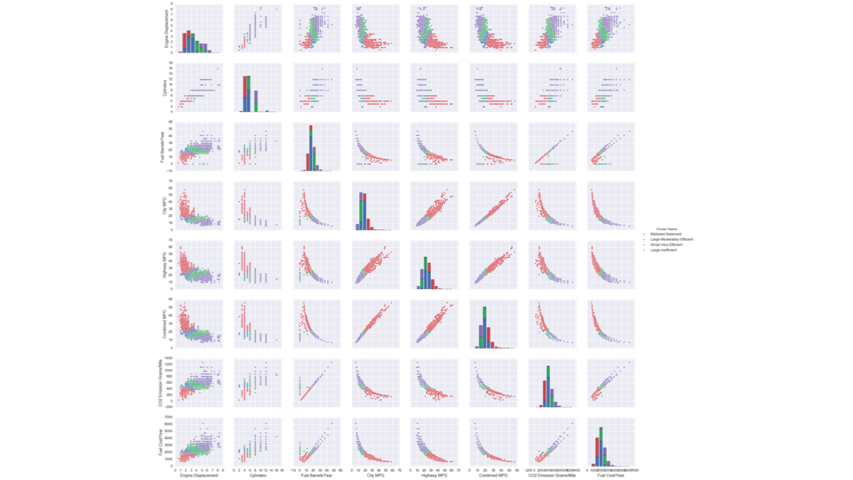

Slide 19
Tools
SQL (directly and through python – psycopg2)
Python (matplotlib, seaborn, altair,...)
Pandas(if you have to)
Tableau

Slide 20
Simple task for data exploration
Write a SQL query that takes a “person id” (e.g., student, voter, facility, entity, etc) and gives you everything you know about that person.
Add a date parameter to it to give you everything about that entity up to that date

Slide 21
Data Exploration Example:
Mental Health Interventions
to Reduce Jail Re-Incarceration

Slide 22
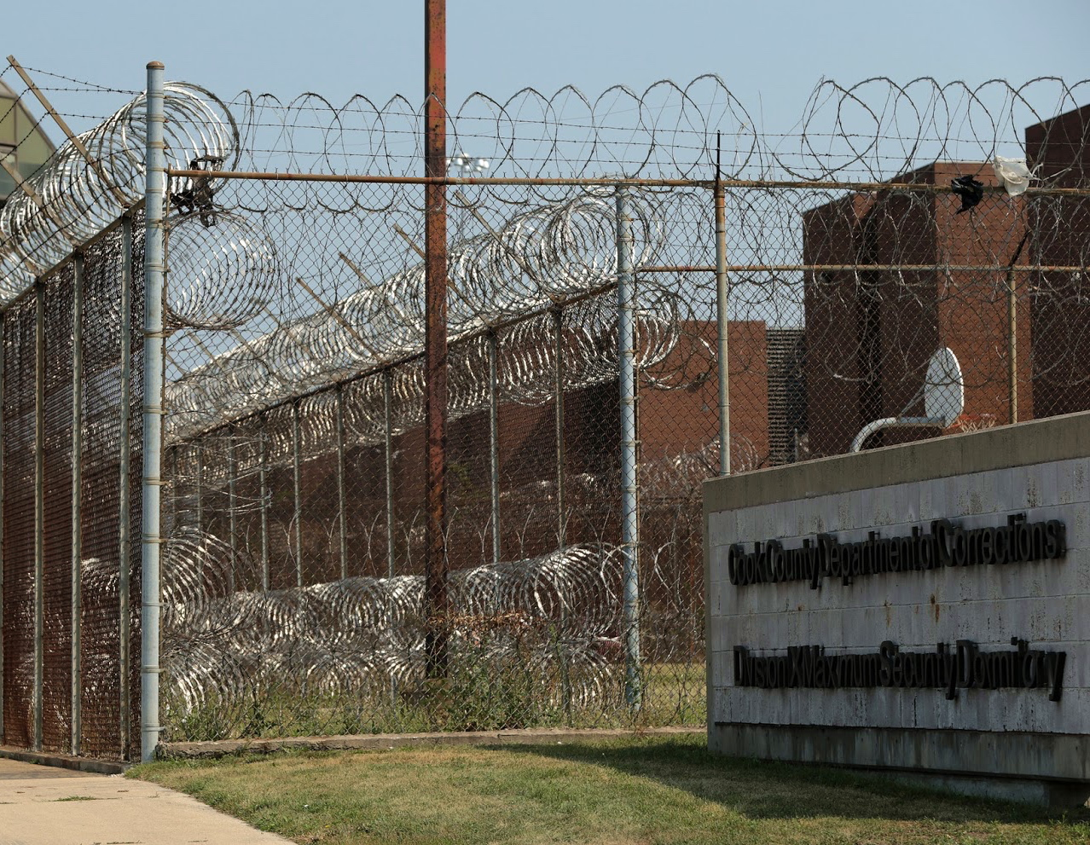
Reducing number of people going to Jail (Johnson County, KS)
Reducing Incarceration through Prioritized Interventions. Bauman et. Al. ACM COMPASS 2018
11 MILLION
Cycle of Incarceration
people move through 3,100 Jails
$22 BILLION
in cost
UNMET
NEEDS
ARREST
JAIL
64%
suffer from mental illness
68%
have a substance abuse disorder
worsening or failing to improve
44%
suffer from chronic health problems

Slide 23
Things to remember
Let us know if you can’t access your project data or github repo
Wednesday session tomorrow: Github
Readings for Thursday
Make sure to read project proposal assignment on canvas (due next Friday)

Slide 24
Project Work: Data Exploration

Slide 25
Reminders: What to look at in this time
Tables: identify the database tables that are most relevant to your problem
Entities: How can you identify the primary entities from your project? What are some basic/relevant characteristics about them? How have those changed over time?
Fields: Most projects have a lot of different data fields, but don’t feel like your initial exploration needs to understand everything
Label: Think about how you might define your label? What can you say about its distribution and how it’s changed over time?
Based on what you know of the context, what information would you expect to be important in modeling? Is this available? How well does it correlate with your label?

