Slide 1

Interpretability Part II:
Global and Local Methods
Rayid Ghani and Kit Rodolfa

Slide 2
Short Quiz

Slide 3
Reminders
This week:
Project check-ins on Wednesday/Thursday
Coming up next week:
Due Mon/Tues: update assignment (model selection, feature importances, crosstabs)
Readings for Tuesday: algorithmic bias and fairness

Slide 4
Plan for the week
What you should be building this week
Models: Finalized model grid and features
Model selection: Use the temporal validation sets to select “best” model(s)
Interpretability: Feature importances and crosstabs (on top k versus the population)

Slide 5
Scope
Data
Exploration
Modeling
Get Data
Store Data
Link Data
Rows
Features
Labels
Model Selection
Train-Test Splits
Performance Metrics
Model Interpretation
Entities
temporal
Spatial
…
Models
Dealing with Bias and Fairness
Field Trial Design
Deployment
Monitoring
Goals, Actions, Data, Analysis, Ethics

Slide 6
Recap: Use Cases for Global & Local Explainability
Use Case | User | Goal | Global or Local
Debugging | ML Developer | Sanity check | Both
Improving performance | Action- taker | Decide to agree or override | Local
Trust | Policymaker/Action-Taker | Model use => better outcomes | Both
Interventions | Action-Taker | Improve outcomes | Local
Recourse | Individual affected | Recourse | Local

Slide 7
Initial Interpretability checklist
For ”smaller” models, print it out
Feature importances (or “feature group” importances)
Cross-tabs on your predicted list

Slide 8
What we’ll cover this week
Globally Interpretable Models
RiskSLIM
GA²M
Methods for Local Explainability
SHAP
LIME
MAPLE

Slide 9
Specialized “Interpretable” Models
Generalized Additive Model (GAM): Additive models – Caruana et al. "Intelligible models for healthcare: Predicting pneumonia risk and hospital 30-day readmission." KDD 2015)
Risk-SLIM – Ustun and Rudin. Learning Optimized Risk Scores from Large-Scale Datasets.KDD 2017

Slide 10
Generalized Additive Models
Motivating Example: Pneumonia Prognosis
Proposed Method
What makes these models “interpretable”?

Slide 11
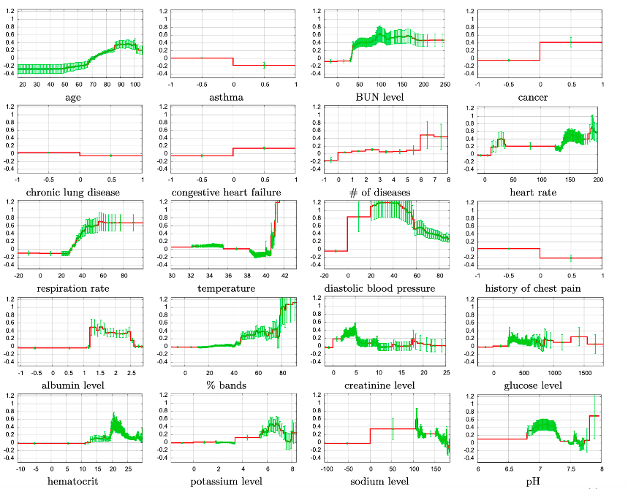

Slide 13
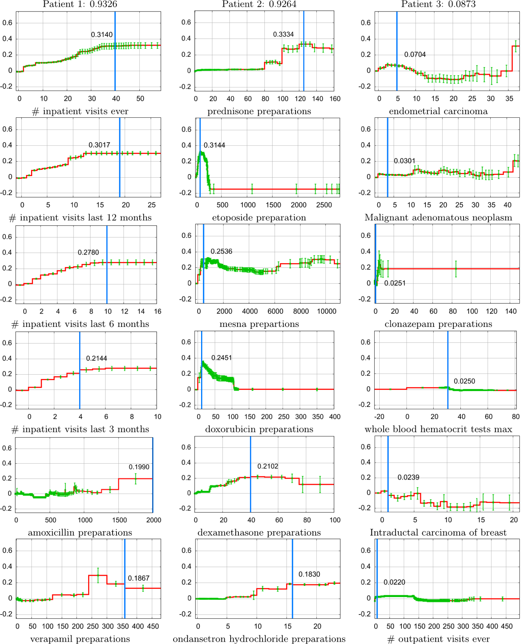

Slide 14
Generalized Additive Models
Potential Limitations?
Pros and cons in application to your project?

Slide 15
RiskSLIM
Motivating Example: Recidivism Prediction
Proposed Method
What makes these models “interpretable”?

Slide 16
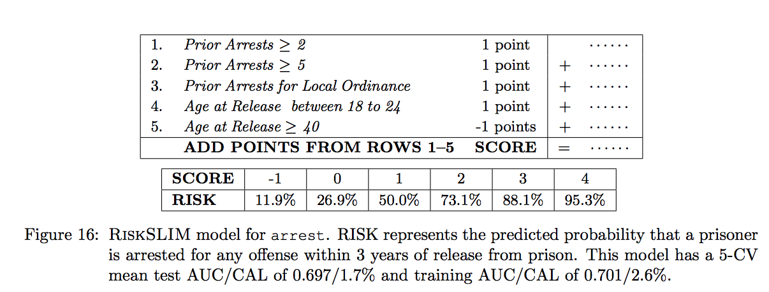
Sparse Models (RiskSLIM)

Slide 17
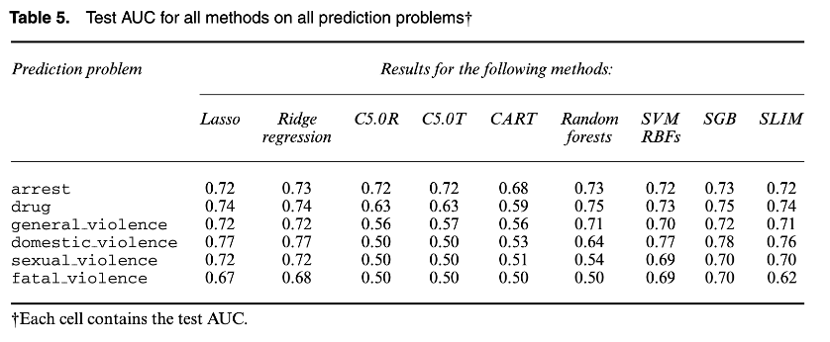
Sparse Models (RiskSLIM)

Slide 18
RiskSLIM
Potential Limitations?
Pros and cons in application to your project?

Slide 19
Local Interpretability
Why did a given example end up with the modeled score it has?
“Local” here means understanding the model in the region of feature space near a given example (for some definition of “near”)
This can help you…
Decide when the model might be wrong and should be ignored on a case-by-case basis
Understand the contributions to a given entity’s score and choose an appropriate action or intervention
Identify problematic features and issues with model predictions, like leakage
Provide an avenue for recourse for people affected by the model (e.g. credit scores)

Slide 20
A Few Methods for Local Interpretability
SHAP Values: Explainable machine-learning predictions for the prevention of hypoxaemia during surgery by Lundberg, SM, Nair, B, et al. Nature Biomed. Eng. 2018.
Local Interpretable Model Explanations (LIME): Why Should I Trust You? Explaining the Predictions of any Classifier by Ribeiro, MT, Singh, S, and Guestring, C. KDD 2016.
Model Agnostic Supervised Local Explanations (MAPLE): Model Agnostic Supervised Local Explanations by Plumb, G, Molitor, D, and Talwalkar, AS. NIPS 2018.

Slide 21
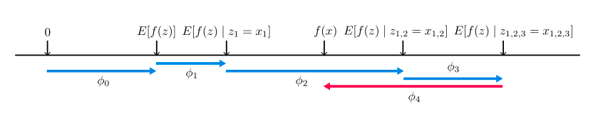
SHAP Values
The Basic Idea:
Calculate additive feature contributions with desirable properties
that sum up to the entity’s predicted value/score.

Slide 22

SHAP Values

Slide 23
SHAP Values
All Features

Slide 24
SHAP Values
All Features
All Subsets EXCLUDING Feature i

Slide 25
SHAP Values
All Features
Difference in prediction for x between models trained with and without Feature i
All Subsets EXCLUDING Feature i

Slide 26
SHAP Values
COMBINATORIALLY LARGE!

Slide 27
SHAP Values
SHAP seeks to approximate these values using simplified inputs and achieving three desirable properties:
Local Accuracy: The explanation should match the original model at the specific input value x
Missingness: Features missing in the original input should have no impact on the prediction
Consistency: If a model changes such that an input’s contribution increases or stays the same, the explanation should not decrease

Slide 28
SHAP Values
Application: Preventing Hypoxaemia During Surgery
Low arterial blood oxygen tension
Good predictions would allow anesthesiologists to take preventative measures during surgery
User study comparing predictive performance of humans and models

Slide 29
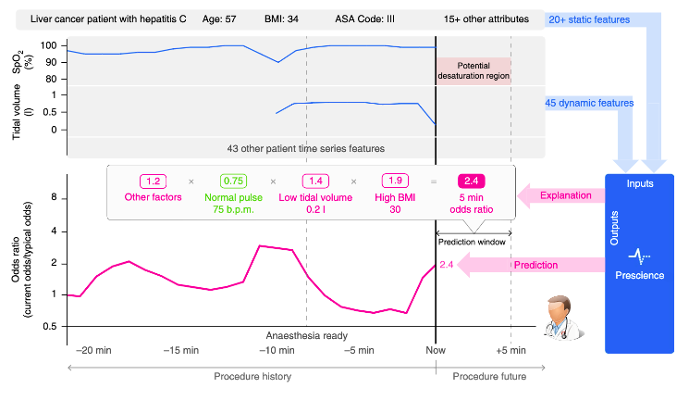
SHAP Values

Slide 30
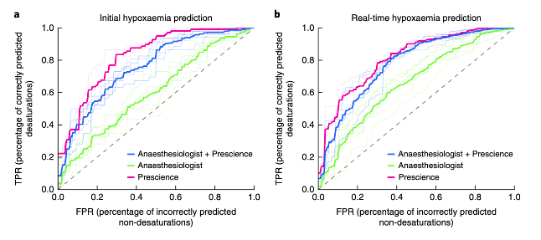
SHAP Values

Slide 31
SHAP Values
What can we say about the explanations’ ability to improve the performance of the humans?
Potential Limitations?
Pros and cons in application to your project?

Slide 32
LIME
Proposed Method
How does the method work?
In what way are the explanations “local”?
Motivating Applications: Improving Diagnoses and Model Debugging

Slide 33
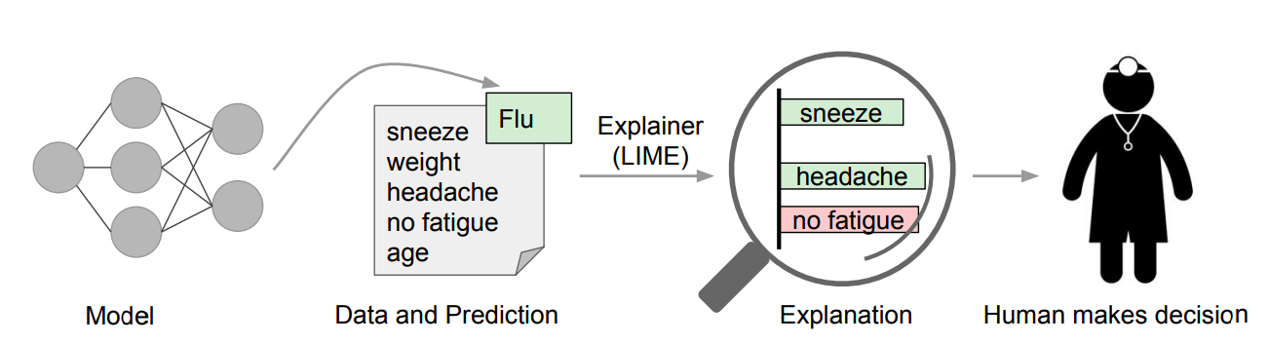
LIME

Slide 34
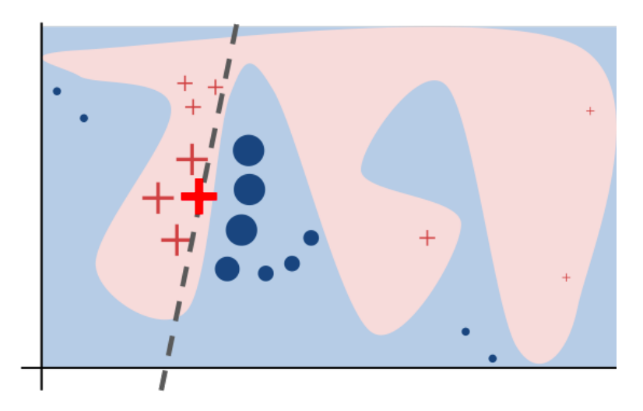
LIME

Slide 35
LIME
Example
being
explained

Slide 36
LIME
Local Explanation Model
Example
being
explained

Slide 37
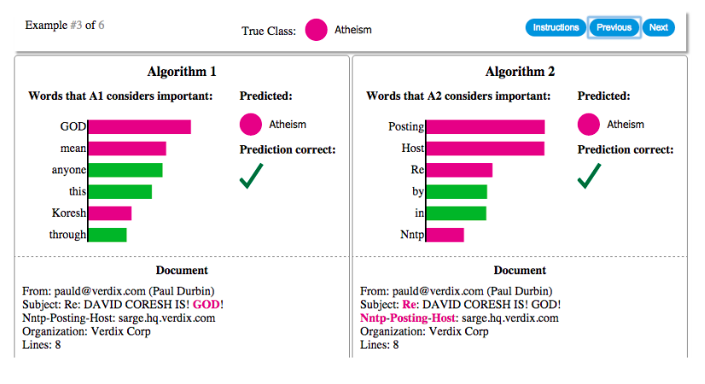
LIME

Slide 38
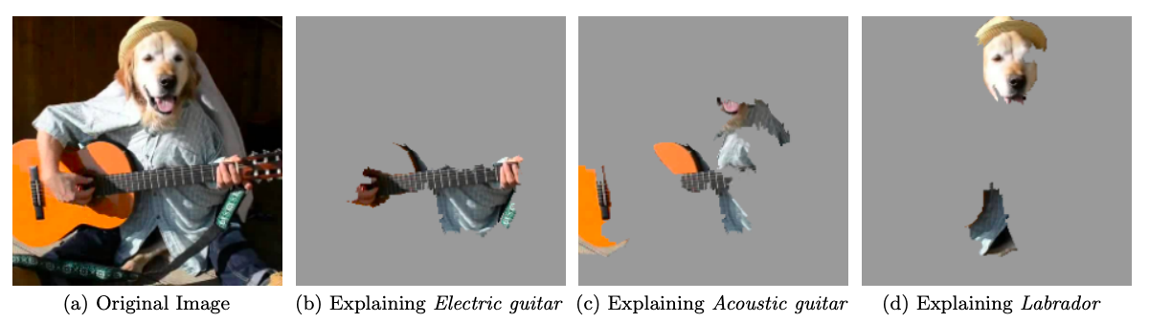
LIME

Slide 39
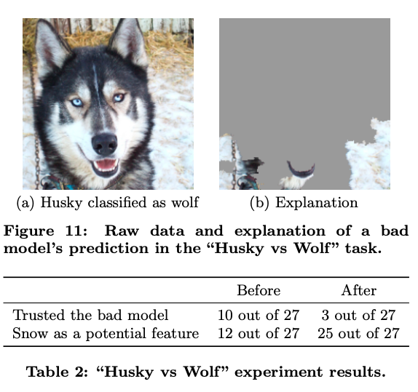
LIME

Slide 40
LIME
Assumptions and Potential Limitations?
Pros and cons in application to your project?

Slide 41
Reminders
This week:
Project check-ins on Wednesday/Thursday
Coming up next week:
Due Mon/Tues: update assignment (model selection, feature importances, crosstabs)
Readings for Tuesday: bias and fairness

