Slide 1

Data Acquisition, Storage, and Linkage
Rayid Ghani

Slide 2
Things to remember
Make sure and check that you can access your project data today
What’s coming next week:
Monday: quick assignment to check database connection (should take 1 minute)
Tuesday: weekly feedback form
Tuesday: Data Exploration + Teamwork
Make sure to read project proposal preparation guidelines (on canvas)

Slide 3
Scope
Data
Exploration
Modeling
Get Data
Store Data
Link Data
Rows
Features
Labels
Model Selection
Train-Test Splits
Performance Metrics
Model Interpretation
Entities
temporal
Spatial
…
Models
Dealing with Bias and Fairness
Field Trial Design
Deployment
Monitoring
Goals, Actions, Data, Analysis, Ethics

Slide 4
What data do we have access to?
How do we identify and fill any gaps?
What data do we need?

Slide 5



What data do you have?
How far back does historical data go?
What is the granularity of the data?
How is the data collected and updated? With what frequency?
Our water pipes example
?
Notes:
Types of data:
Program Level
Transactional
Spatial
Text
Images/Audio/Video

Slide 6


What data do you need?
Data to inform and measure progress on Goals
Sufficient reliable historical data
Captures relevant outcomes
Identifies the cohort
Data to inform Actions
Refreshed at least as frequently as the action is taken
Covers the same granularity as the proposed action

Slide 7
Identifying Data Gaps and Readiness
Do we have enough to move forward, or do we need to focus on getting additional data?
Do we have enough historical data?
Is it reliable going back?
Is it at the right level of granularity to inform the actions?
Are different pieces of data linkable? unique identifiers for people, places, etc.
Do we have the right data to measure outcomes (based on the goals)?
Notes:
Data is never perfect – is it useful enough to improve over status quo?
Can you augment with external data? Public data? Partner with other organizations that have supplementary data?

Slide 8
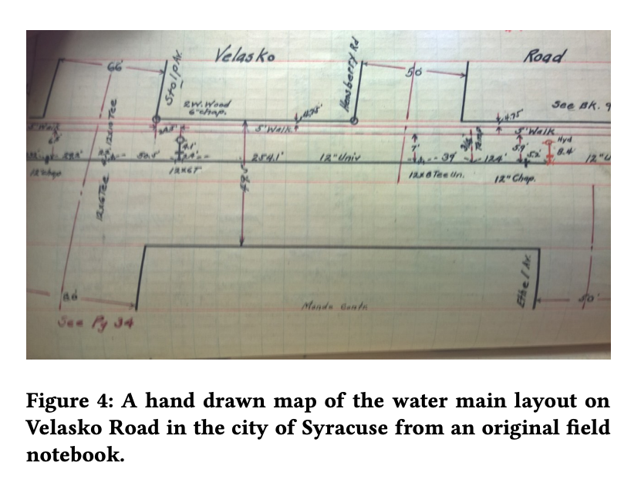
Example: preventing water main breaks in Syracuse
Key information about pipe age, diameter, and material was only available in 100-year-old handwritten notebooks of installation diagrams
Strategically digitizing these records enabled us to more accurately predict whether a water main would break

Slide 9
Challenges with getting (access), storing, and linking data
Political
Internal Awareness
Legal and/or Contractual
Ethical
Technical

Slide 10
Scenarios
Internal to an organization
Partnering with external organization – researcher, consultant, etc.

Slide 11
Political Challenges
Understanding the stakeholders and value for them
May lead to getting subsets
Notes:
Police data
School data

Slide 12
Internal Awareness Challenges
Most organizations don’t know what data they have internally

Slide 13
Legal and Contractual Challenges
Some of the issues will be legitimate, but some will be excuses and lack of awareness
Be aware of all the legal acronyms
HIPPA
FERPA
HIPAA
HIPPAA
GDPR

Slide 14
Technical challenges (in data acquisition/access)
How should you get data?
API access
Flat files
Database dumps
How much should it be processed before you get it to use in downstream ML tasks?
How do you build a repeatable data acquisition pipeline? Where do you start?
When do you collect new data?
Notes:
New data collection for causa leffects?

Slide 15



Ethical issues to consider
Data Privacy: What legal and security requirements govern how this data is used? What additional ethical considerations apply?
Data ownership and transparency: Are the people whose data it is (and is about) aware that their data is being used and how it affects them? What does consent look like?
Bias, equity, and fairness: Are there biases in the data sources? Is the data equally accurate and available about everyone?

Slide 16
Data Maturity Assessment
Link

Slide 17
Data Storage
Use Databases whenever possible
Types of databases
Deidentification when dealing with confidential/sensitive identifiable data
hashing

Slide 18
Linkage: Goals
Determine if pairs of records describe the same entity
Main applications:
Joining two different data sources
Removing duplicates from a single data source

Slide 19
Record Linkage: Synonyms
(data) matching
merge/purge
duplicate detection
de-duping
reference matching
co-reference/anaphora resolution

Slide 20
Common reasons for mismatches
Case (capital, lower case, etc.)
Nicknames
Prefixes
Suffixes
Initials
Punctuation
Spaces
Digits
Transpositions
Abbreviations

Slide 21
Discussion Topic
What are downstream impacts (generally) of a false positive in record linkage? What about a false negative?

Slide 22
Discussion Topic
What types of common mismatch errors might affect groups differently, resulting in downstream fairness impacts?

Slide 23
Factors to consider
Deduping or Linkage
1-1 or 1-many or many-1
Rule-based or ML based
Do you have labeled training data?
Domain specific or generic similarity metrics?
Evaluation metric
Precision or recall
Task-specific - Implications on future analysis (bias for example)

Slide 24
Approaches
Exact matching
Rule-based
Probabilistic linkage

Slide 25
When are two records about the same entity?
Examples of possible similarity metrics
Edit distance
Soundex

Slide 26
“Fuzzy” Matching System
Apply set of cascading rules
Assign confidence score based on which rules fire

Slide 27
How do we not compare every pair?
How do we avoid looking at |A| * |B| pairs?
Blocking: choose a smaller set of pairs that will contain all or most matches.
Simple blocking: compare all pairs that “hash” to the same value (e.g., same Soundex code for last name, same birth year)
Extensions (to increase recall of set of pairs):
Block on multiple attributes (soundex, zip code) and take union of all pairs found.
Windowing: Pick (numerically or lexically) ordered attributes and sort (e.g., sort on last name). The pick all pairs that appear “near” each other in the sorted order.

Slide 28
Machine Learning based Record Linkage
Generate training data
Label pairs as match/no match
Generate features over each pair
Distance metrics over different attributes (fname, lname, dob, etc.)
Tfidf scores
Build and evaluate classifiers

Slide 29
One-off versus recurring matching
Unique identifiers: persistence?
What do we do with new or changed pairs?

Slide 30
Implications for your project
Do you have enough data?
Do you need to get additional data?
Which parts of the data should you prioritize looking at and understanding?
What do you need to do now that will be harder to do later?

Slide 31
Things to remember
Make sure and check that you can access your project data today
What’s coming next week:
Monday: quick assignment to check database connection
Tuesday: weekly feedback form
Tuesday: Data Exploration + Teamwork
Make sure to read project proposal preparation guidelines

