Slide 1

Measuring Sentiment of Recessions Using News Articles and NLP
Dylan Saez

Slide 2

Overview
Problem Statement
Relevant Literature
Data Acquisition
Pre-Processing
Encoding
ML Algorithms
Testing Set
Conclusions

Slide 3

Problem Statement
Measuring the sentiment of recession-based news articles may help to indicate market-based perceptions of such terms and anticipate a recession or downturn of the economy
Using a batch of news articles from the GFC (Global Financial Crisis, 2007-2009) and a batch from 2020-2022* we can record sentiment fluctuations amongst articles

Slide 4
Literature Review – Main Ideas
Measuring Social Unrest Using Media Reports (Barret, Appendino, Nguyen, de Leon Miranda, 2021)
The Macroeconomic Impact of Social Unrest (Hadzi-Vaskov, Pienknagura, Antonio Ricci, 2020)
Measuring Economic Policy Uncertainty (Baker, Bloom, Davis, 2016)
Notes:
Journal where these are published
Are they working papers? IMF

Slide 5
Data Acquisition
Dow Jones’ Factiva News Aggregator
Sentiment Positive News (English) and Negative News (English)
Articles published by major English-language newspapers (cross-section of three main papers):
Identifiers: Domestic/Foreign Markets, Mortgage Refinancing, Mortgage Planning, Market Research, Small/Medium Businesses, Asset Backed Securities, economic growth/recession
Post COVID-19 Inflation
01/01/2019 to 04/30/2022
490,483 articles
GFC
01/01/2006 to 12/31/2010
298,589 articles
TRAINING SET
Los Angeles Times | Boston Globe | New York Times | Wall Street Journal | Chicago Tribune
Washington Post | ABC Network | CBS Network | NBC Network | USA Today
Miami Herald | San Francisco Chronicle | The Dallas Morning News
Notes:
Mentioning syntax – how I acquired the original corpus

Slide 6
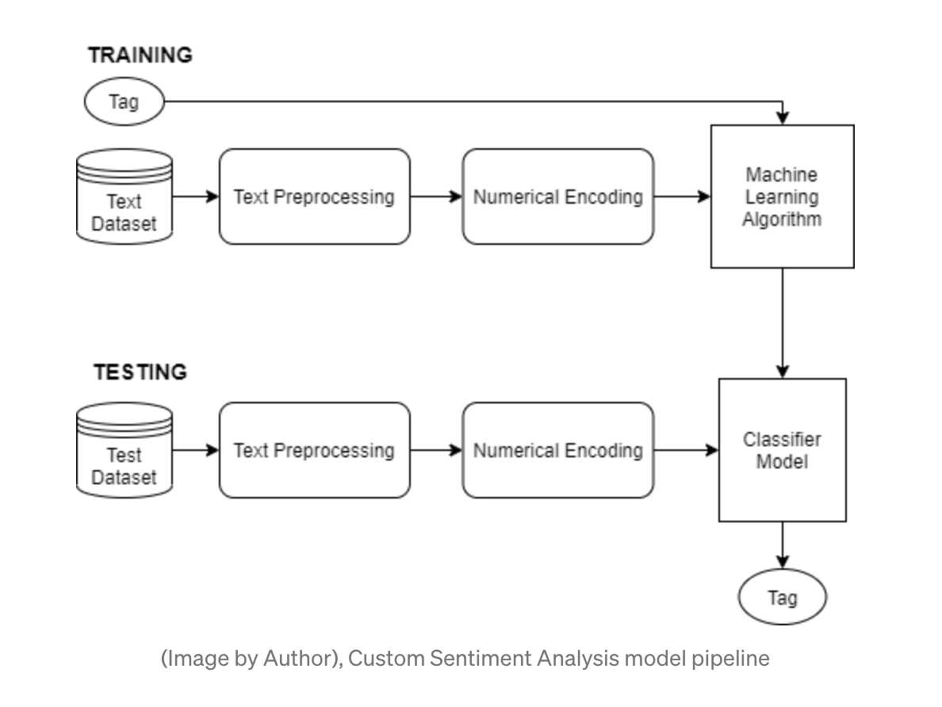
Overview of Process
Collecting Raw, Labelled Data
Preprocessing
Numerical Encoding of Text
ML Algorithms
Hyper-tuning and Training of ML Models
Prediction

Slide 7
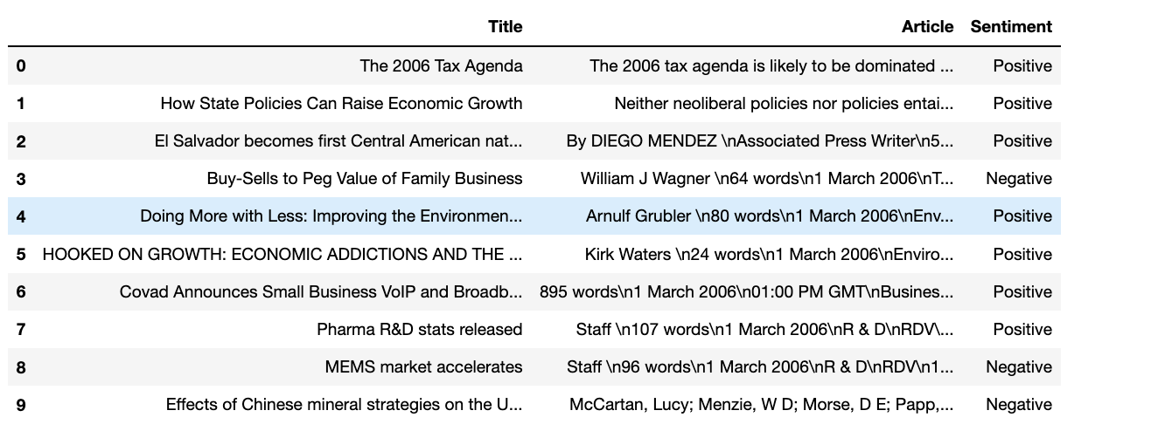
Training Data
GFC
Positive, Negative
SMOTE oversampling added positive

Slide 8
Pre-Processing
Lower Case
Remove punctuation
Remove unnecessary items: URLs, Author Names, etc.
Remove stopwords
Lemmatization
Notes:
By example token, lemma

Slide 9
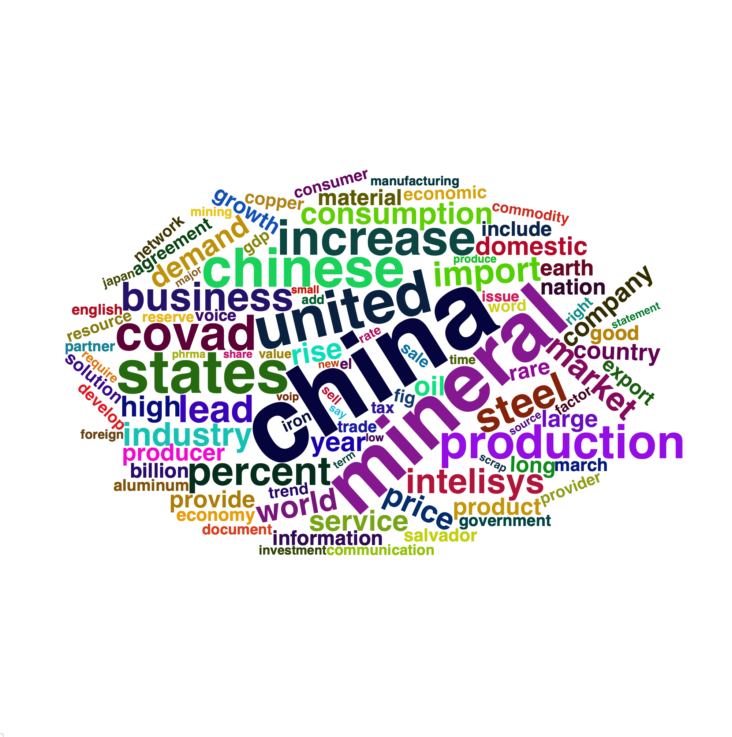
Numerical Encoding of Text & Wordclouds
TF-IDF
Most frequent words from batch in training set
Covad*

Slide 10
Recession-Based Words: GFC Sentiment
2006 | Keywords | Sentiment
 | Economy | Positive
 | Credit Market | Positive
 | Mortgage-Lending | Positive
 | Housing Market | Positive
 | Bear Sterns | Positive
2008 | Keywords | Sentiment
 | Economy | Negative
 | Credit Market | Negative
 | Mortgage-Lending | Negative
 | Housing Market | Negative
 | Bear Sterns | Negative
2007 | Keywords | Sentiment
 | Economy | Positive
 | Credit Market | Positive
 | Mortgage-Lending | Positive
 | Housing Market | Positive
 | Bear Sterns | Positive
2009 | Keywords | Sentiment
 | Economy | Negative
 | Credit Market | Negative
 | Mortgage-Lending | Negative
 | Housing Market | Negative
 | Bear Sterns | Negative

Slide 11
Recession-Based Words: GFC Sentiment (2)
2010 | Keywords | Sentiment
 | Economy | Negative
 | Credit Market | Negative
 | Mortgage-Lending | Negative
 | Housing Market | Negative
 | Bear Sterns | Negative

Slide 12
ML Algorithms
LSTM
Accuracy: 60.09%
SVM
from sklearn import svm
Accuracy: 60.81%
Naïve Bayes*
Multinomial NB()
Different n-grams: bi-grams, tri-grams
Accuracy: 62.97%, 63.48%

Slide 13
Recession-Based Words: COVID Sentiment
2019 | Keywords | Sentiment
 | Economy | Positive
 | Credit Market | Positive
 | Mortgage-Lending | Positive
 | Housing Market | Positive
2021 | Keywords | Sentiment
 | Economy | Negative
 | Credit Market | Positive
 | Mortgage-Lending | Positive
 | Housing Market | Positive
2020 | Keywords | Sentiment
 | Economy | Positive
 | Credit Market | Negative
 | Mortgage-Lending | Positive
 | Housing Market | Positive
2022 (present) | Keywords | Sentiment
 | Economy | Negative
 | Credit Market | Positive
 | Mortgage-Lending | Negative
 | Housing Market | Negative

Slide 14
GFC – COVID19
Economy: negative by the end of both recession events
Credit Market: positive by the end of post-covid
Mortgage Lending: negative by the end of both recession events
Housing Market: negative by the end of both recession events
Different Reasons
Policies
Scale of measurements

Slide 15
Overall Conclusions
By training the algorithms on only the GFC batch first, we can see the change of article/word sentiment (averages) by the post-covid batch
These words are commonly used within news articles when discussing the economy
Future Improvements
Smaller Batches
Different algorithms
Economic Consequence or Economic Factor?

Slide 16
References
https://colah.github.io/posts/2015-08-Understanding-LSTMs/
https://monkeylearn.com/sentiment-analysis/
https://towardsdatascience.com/a-guide-to-encoding-text-in-python-ef783e50f09e
https://www.aiperspectives.com/twitter-sentiment-analysis/
https://medium.com/@vasista/sentiment-analysis-using-svm-338d418e3ff1#:~:text=Sentiment%20Analysis%20is%20the%20NLP%20technique%20that%20performs%20on%20the,positive%2C%20negative%2C%20or%20neutral.
https://www.analyticsvidhya.com/blog/2021/06/natural-language-processing-sentiment-analysis-using-lstm/
https://www.analyticsvidhya.com/blog/2021/07/performing-sentiment-analysis-with-naive-bayes-classifier/
https://monkeylearn.com/blog/what-is-tf-idf/
Others in Report

