Slide 1


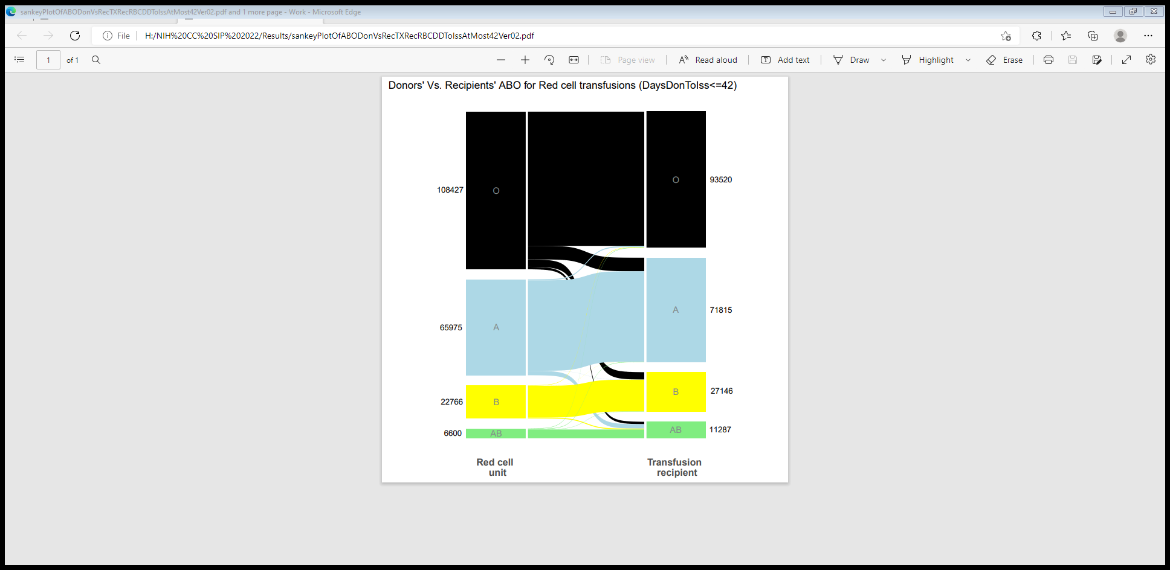
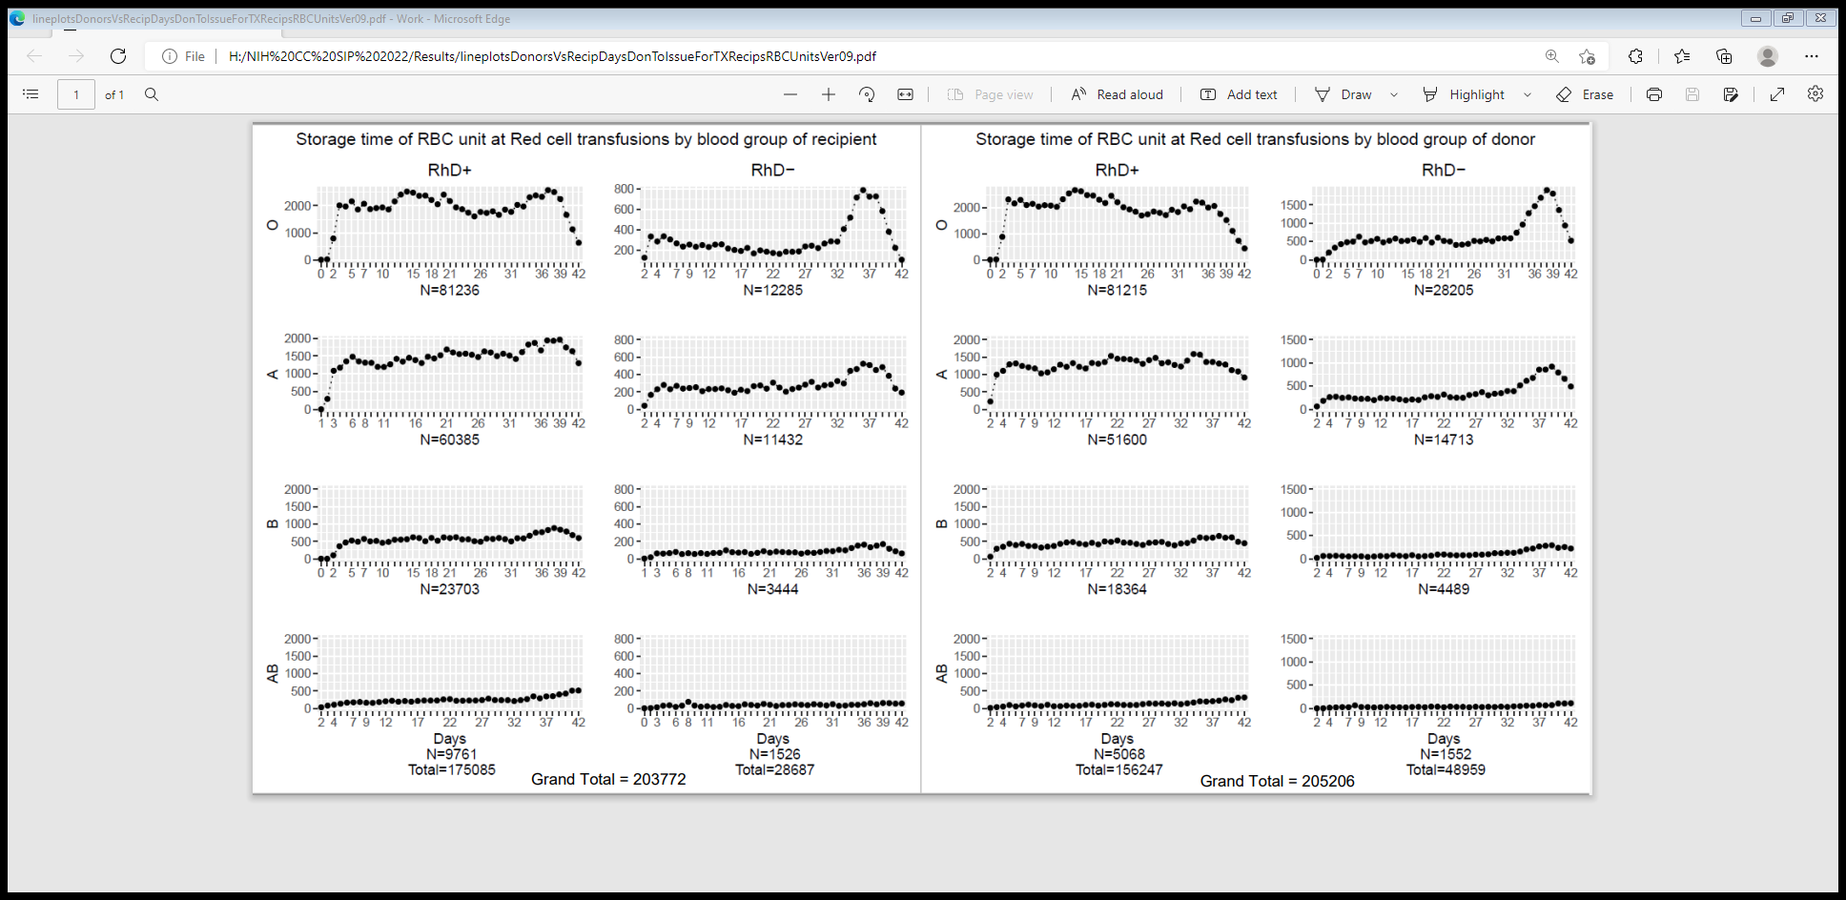
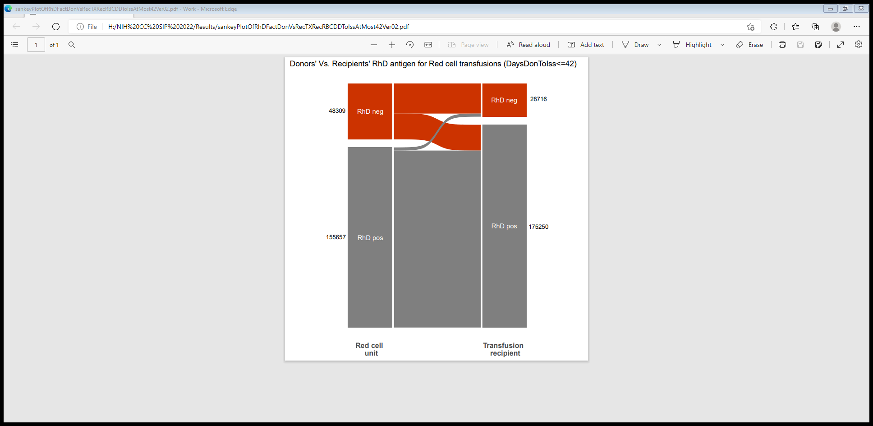
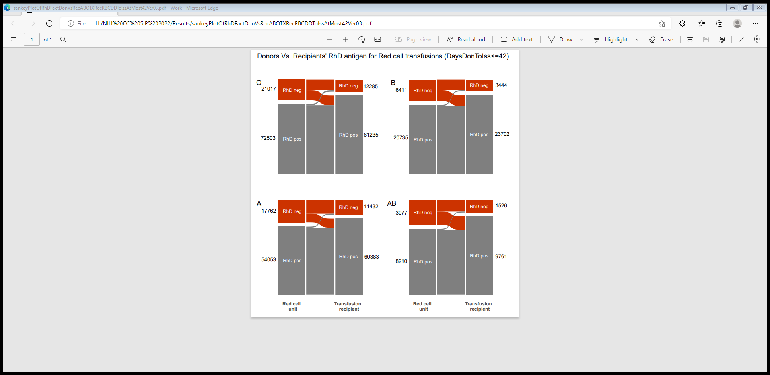


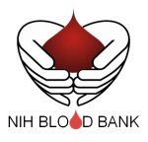
Red cell transfusion patterns among 1.5 million research subjects
in the public REDS-III database
David Perez-Suarez^{1,2}, Kshitij Srivastava¹, Willy A. Flegel¹
¹Department of Transfusion Medicine, NIH Clinical Center, National Institutes of Health, Bethesda, MD
²Department of Statistics, University of Virginia, Charlottesville, VA.
Introduction
Goals
Figures
Results
Red cell units have a typical shelf life of up to 42 days in the US.
Despite more than 10 million red cell transfusions per year, little has recently been published on the age of red cell units at transfusion (age distribution).
This age distribution may depend on red cell unit availability and the blood supply based on blood group antigen, such as ABO and RhD.
Most of the large database centered clinical transfusion medicine studies utilize primary data with linked research subjects, such as patient and blood donors.
We wanted to compile data on the red cell distribution using the unlinked REDS-III database, publicly available since Aug. 2019.
The Recipient Epidemiology and Donor Evaluation Study (REDS-III) database, developed and validated by NHLBI, consists of data collected from 4 geographically diverse blood centers across the US from mid-2012 to the end of 2016.
Consists of a linked, donor-component, transfusion-recipient database that includes data from
  blood donors and their donations,
  the components made from these donations, and
  electronic medical records of the recipients of these components.
Blood group O, A, B, and AB red cell unit use in blood group O, A, B, and AB recipients.
RhD-positive and RhD-negative red cell unit use in RhD-positive and RhD-negative recipients.
Analyze the storage time of red cell unit at transfusion based on ABO and RhD factor.
Figure 1. Sankey plot of red cell transfusion pattern between Donors vs. Recipients based on ABO
Figure 3. Storage time of red cell unit at red cell transfusion between Donors and Recipients based on ABO and RhD factor
1.22% of red cell units of blood groups A, B, and AB were transfused to patients with blood group O while 46.76% of red cell units of blood groups O, A and B were transfused to patients with blood group AB (Fig. 1)
46.12% of the RhD-negative red cell units were transfused to RhD-positive patients (Fig. 2). Similar patterns were observed for each of the 4 ABO blood types
Storage time for red cell units was longest for blood group O and shortest for blood group AB (Fig. 3)
Methods
Conclusions
Used the R statistical package to perform descriptive data analysis including the demographics, line plots and Sankey plots.
Transfusion recipients with blood group O receiving A and B red cell units may be due to them being transplanted (patients initially blood group O and after bone marrow transplant became blood group A or B).
Some RhD-negative recipients (1.73%) received RhD-positive red cell units possibly due to them being trauma patients.
Data
Figure 2. Sankey plot between Donors vs Recipients based on ABO and RhD factor
Out of the total 747,994 patients,118,648 patients receiving transfusion were analyzed.
Out of the total 767,664 donors, 649,131 donors were able to successfully donate.
65,368 patients were available with information about the product transfused.
* The analysis can be refined based on inclusion and exclusion criteria which may change the final numbers.
Future work
The analysis will be refined based on inclusion and exclusion criteria.
Analyze hemoglobin increment after transfusion based on ABO, RhD factor and age of red cell unit.

