Slide 1
Media Planning Exercise
David Perez-Suarez

Slide 2
Overview
Introduction
Linear Regression
Random Forest
Results/Recommendation
Future Work

Slide 3
Introduction
In media buying, we’re tasked with allocating funds across a number of different choices from publishers and ad sizes to targeting strategies and audiences
There are a lot of variables that can help with such a task

Slide 4
Introduction
Media Cost
  Amount spent on advertising
Impressions
  Number of times the ad displayed
Clicks
  Number of times the ad was clicked
Click Rate
  measures the percentage of people who clicked on an ad compared to the number of people who viewed it

Slide 5
Introduction
Active View: Viewable Impressions
  Total number of ad impressions that were actually viewable by users.
Active View: Measurable Impressions
  Total number of eligible impressions where viewability was measurable
Active View: Eligible Impressions
  Total number of ad impressions that were eligible to be measured for viewability
PageViews
  Total number of times that a web page is viewed by users
EmailCapture
  Process of collecting email addresses from users or visitors on a website

Slide 6
Introduction
Transactions
Creative_Type
  Format or style of an ad’s creative content used in a campaign
Placement_CostModel
  Determines how advertisers are charged for the placement of their ads on specific platforms, websites, or apps
Placement_TargetingStrategy
  Determines where ads will be shown and to whom
AdSize

Slide 7
Linear Regression
Fit a model between y and X
Y = revenue
X = [Media Cost, Impressions, Clicks, Click Rate, Active View: Viewable Impressions, Active View: Measurable Impressions, Active View: Eligible Impressions, PageViews, EmailCapture, Transactions, Creative_Type, Placement_CostModel, Placement_TargetingStrategy, AdSize]

Slide 8
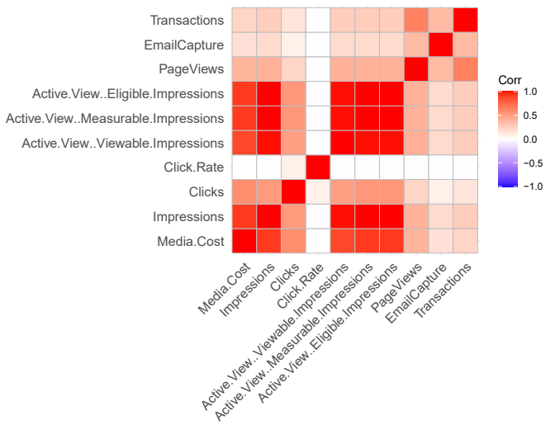
Multicollinearity

Slide 9
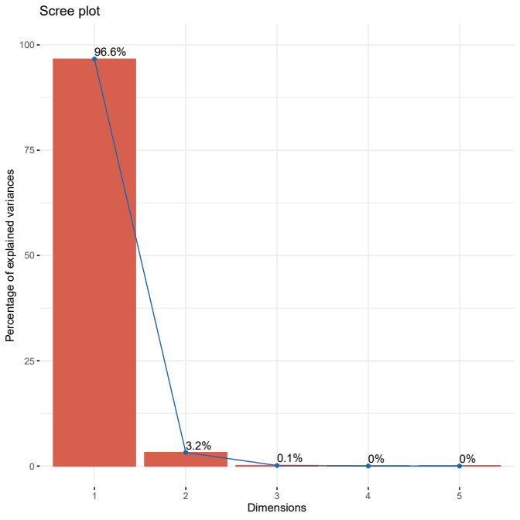
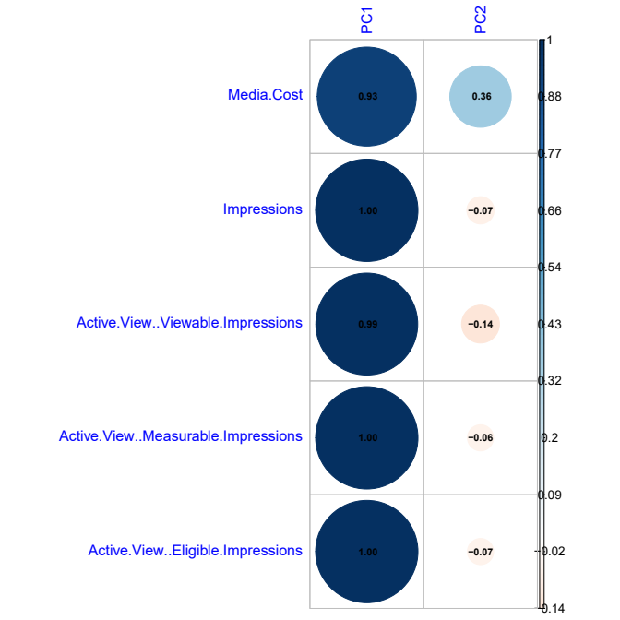
Principal Component Analysis

Slide 10
Linear Regression
Fit a model between y and X
y = Revenue
X = [Clicks, Click Rate, PageViews, EmailCapture, Transactions, Creative_Type, Placement_CostModel, Placement_TargetingStrategy, AdSize, PC1, PC2]

Slide 11
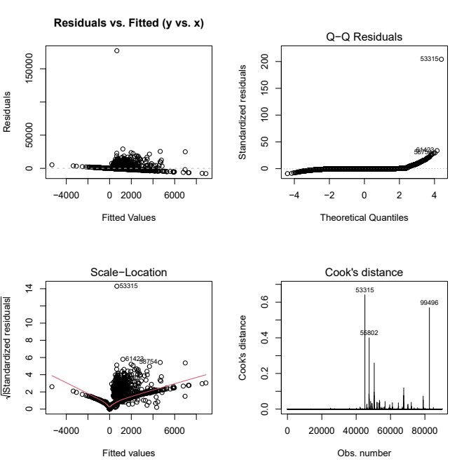
Linear Regression

Slide 12
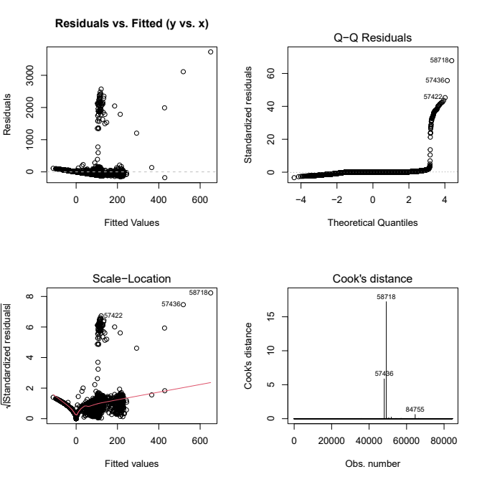
Linear Regression
Calculate Cook’s Distance, Leverage and Studentized Residuals to get rid of the influential points and outliers

Slide 13
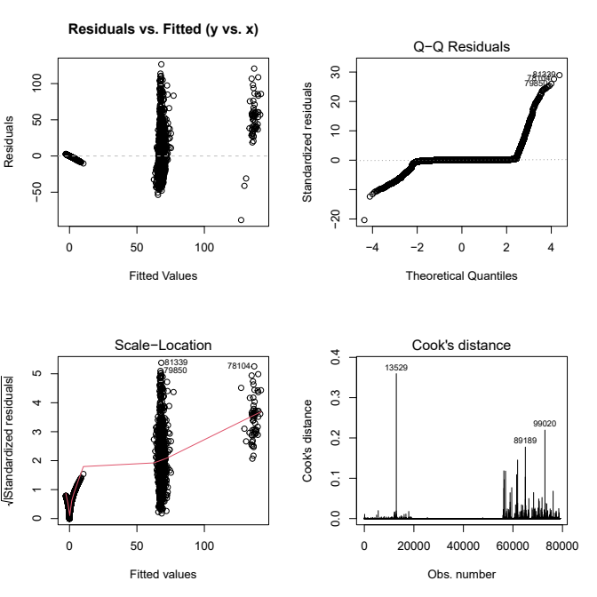
Linear Regression
Calculate Cook’s Distance, Leverage and Studentized Residuals again to get rid of the influential points and outliers

Slide 14
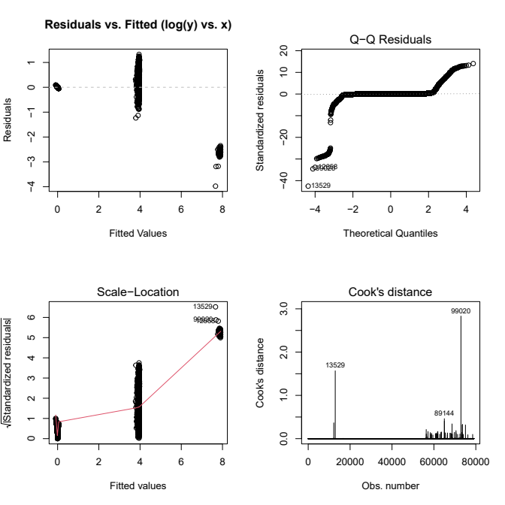
Linear Regression
Fit a model between log(y) and X

Slide 15
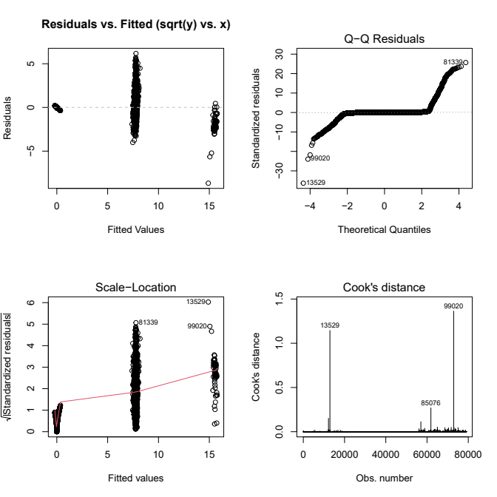
Linear Regression

Slide 16
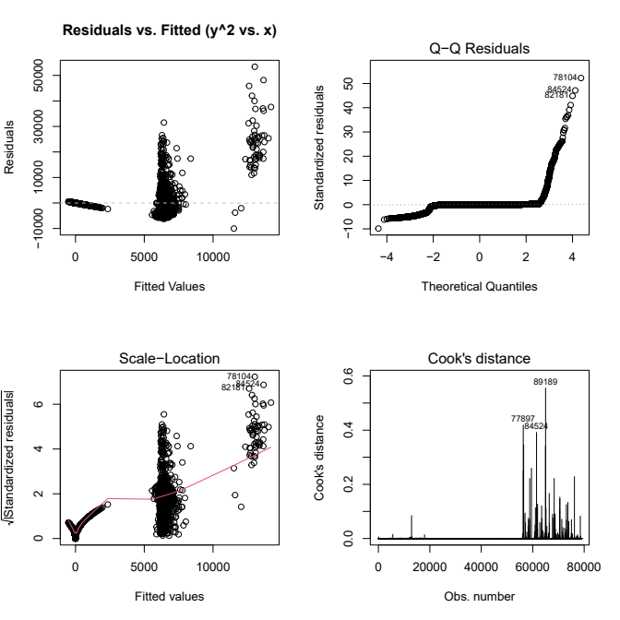
Linear Regression
Fit a model between y² and X

Slide 17

Linear Regression
Fit a model between y² and X²

Slide 18
Random Forest
Fit a model between y and X
Choose the optimal mtry
  Smaller mtry:
    Increases diversity between trees, reducing the risk of overfitting but might slightly decrease accuracy
  Larger mtry:
    Leads to the most predictive variables chosen at each split, which can improve accuracy but lead to overfitting
Choose the optimal ntree
  Larger ntree
    Reduces variance in the model’s predictions and increases stability/accuracy up to a certain point

Slide 19
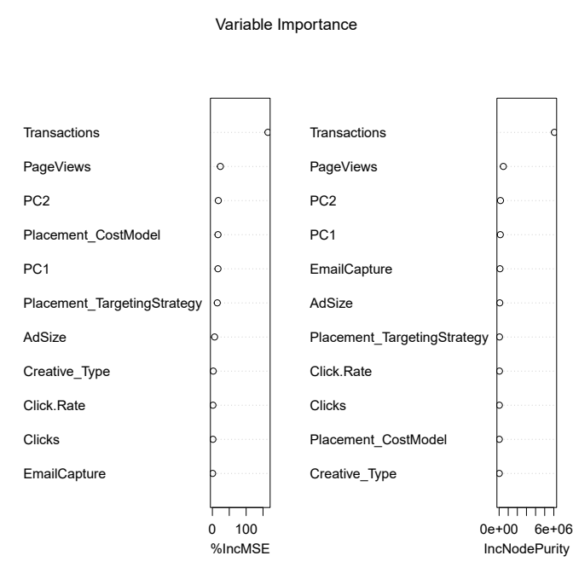
Random Forest
%IncMSE IncNodePurity
Clicks 1.4974038 26242.37
Click.Rate 1.5942568 35987.78
PageViews 23.5893222 462381.52
EmailCapture 0.6704977 93748.71
Transactions 164.5249096 6066479.48
PC1 16.4678314 128803.84
PC2 17.4955524 146740.68
Creative_Type 2.4502916 16140.23
Placement_CostModel 16.5181586 18709.91
Placement_TargetingStrategy 14.4613878 40970.11
AdSize 6.4966858 70019.64
Median(%IncMSE) = 14.4614

Slide 20
Random Forest
Fit a model between y and X
y = Revenue
X = [PageViews, Transactions, PC1, PC2 Placement_CostModel]

Slide 21
Random Forest
$−RMSE=\sqrt{\sum{{\left(y_{i}−\hat{y_{i}}\right)}^{2}}}=4.1094$
$−R^{2}=1−\sum{{\left(y_{i}−\hat{y_{i}}\right)}^{2}}\sum{{\left(y_{i}−\bar{y}\right)}^{2}}=0.8876$
$−MAE=\left(1/n\right)\sum{\left|y_{i}−\bar{y}\right|}=0.4868$
$−0.20∗\bar{y}=0.3485$
$−0.20∗range\left(y\right)=49.73$

Slide 22
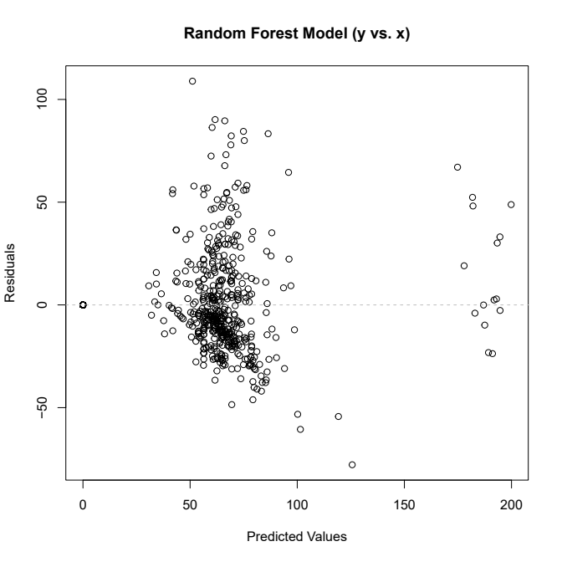
Random Forest

Slide 23
Random Forest
Fit a model between log(y) and X
log(y) = natural logarithm of the revenue
X = [Clicks, Click Rate, PageViews, EmailCapture, Transactions, Creative_Type, Placement_CostModel, Placement_TargetingStrategy, AdSize, PC1, PC2]

Slide 24
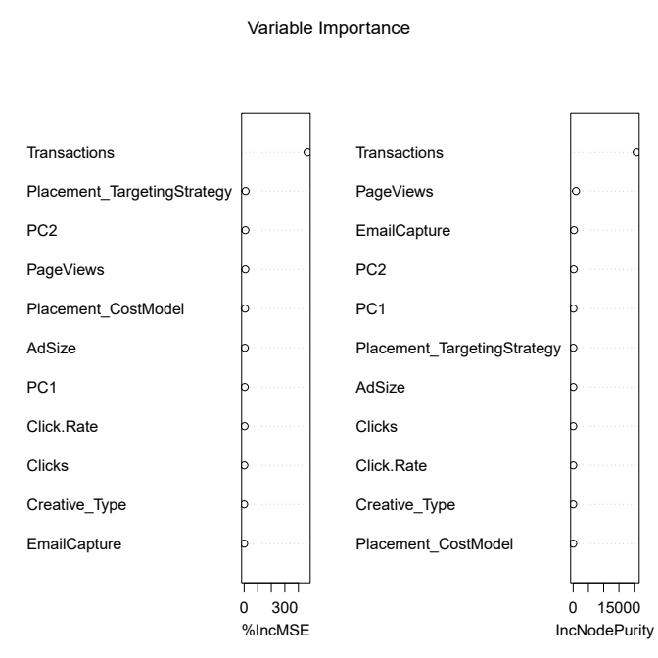
Random Forest
%IncMSE IncNodePurity
Clicks 1.58601975 18.318042
Click.Rate 3.19571821 17.218011
PageViews 8.75391476 928.364593
EmailCapture 0.06093398 265.656300
Transactions 468.20633439 20807.813769
PC1 4.25494995 85.820986
PC2 9.16841991 172.754388
Creative_Type 0.16858884 7.100893
Placement_CostModel 6.58180945 6.553663
Placement_TargetingStrategy 10.36774469 49.767963
AdSize 4.90210013 38.596809
Median(%IncMSE) = 4.9021

Slide 25
Random Forest
Fit a model between log(y) and X
log(y) = natural logarithm of Revenue
X = [PageViews, Transactions, PC2, Placement_CostModel, Placement_TargetingStrategy]

Slide 26
Random Forest
$−RMSE=\sqrt{\sum{{\left(log\left(y_{i}\right)−log\left(\hat{y_{i}}\right)\right)}^{2}}}=0.055$
$−R^{2}=1−\sum{{\left(log\left(y_{i}\right)−log\left(\hat{y_{i}}\right)\right)}^{2}}\sum{{\left(log\left(y_{i}\right)−\bar{log\left(y\right)}\right)}^{2}}=0.9929$
$−MAE=\left(1/n\right)\sum{\left|log\left(y_{i}\right)−\bar{log\left(y\right)}\right|}=0.0069$
$−0.20∗\bar{log\left(y\right)}=0.0208$
$−0.20∗range\left(log\left(y\right)\right)=1.104$

Slide 27
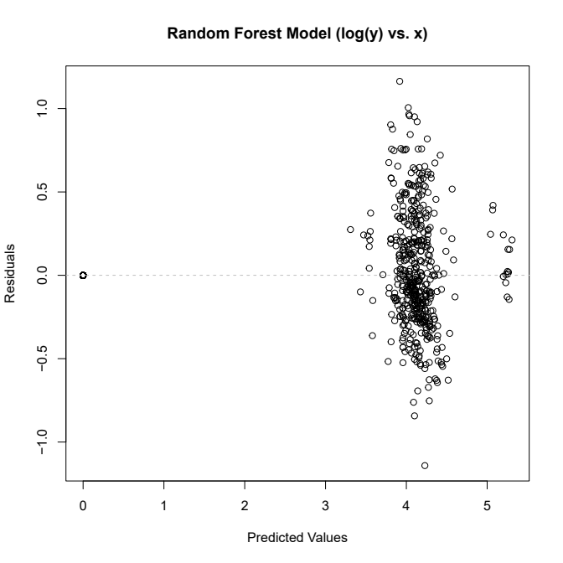
Random Forest

Slide 28
Random Forest
By the end, it was found that PageViews, Transactions, PC2, Placement_CostModel and Placement_TargetingStrategy affected the Revenue
It is recommended to create an advertisement that highlights key metrics such as the number of visits, associated transactions, its placement and associated cost, and the target audience. These factors will help guide the investment of $250K over the next month.

Slide 29
Future Work
Add other variables of interest such as Creative_Color to see if the linear regression model improves
Fit other machine learning models such as Neural Network, Gradient Boosting, etc. to see if the RMSE improves

