Slide 1
Type 2 Diabetes Mellitus Metabolomics
Machine Learning Project
By: David Perez-Suarez

Slide 2
Introduction
Type 2 diabetes mellitus (T2DM) is driven by complex, system‑wide metabolic changes that ordinary clinical markers capture only partially.
Targeted metabolomics can reveal these changes, but the resulting data sets are high‑dimensional, method‑specific, and riddled with missing values—making unbiased, reproducible modeling a challenge.

Slide 3
Introduction
Resulting data sets are:
  high-dimensional because there are many metabolites per sample where there are few samples present
  method-specific because instrumentation, ionization, and assay design define which metabolites (and how) are measured.

Slide 4
Introduction
This project uses the Metabolomics Workbench study ST003390 by Shurong, Ma (Laboratory of Integrative Medicine, Dalian Medical University (Dalian, Liaoning, China)) to build an end‑to‑end, publishable machine‑learning pipeline that:
  Unifies six Liquid Chromatography–Mass Spectrometry (LC‑MS) acquisition methods (M1–M6).
  Links metabolite profiles to clinical phenotype.
  Handles real‑world data issues.
  Trains and cross‑validates three complementary models
  Ranks and interprets discriminatory metabolites.
  Maps statistical hits to biology.

Slide 5
Questions to answer
Can we build a metabolite-based model that discriminates T2DM from healthy controls?
Which individual metabolites and pathways drive that discrimination?
Can we derive an interpretable risk-score that generalises to external datasets?

Slide 6
Information
Independent variables are the metabolites (1187 metabolites identified by LC-MS)
Response variable is whether the individual belonged to T2DM or Healthy group (100 individuals with T2DM, 200 healthy individuals)

Slide 7
Data Cleanup
Sample-wise median normalization was applied to the metabolite intensities to account for differences in sample loading/injection amount
These metabolite intensities were pareto-scaled because:
  To balance the influence of variables with different concentration ranges.
  ideal for metabolomics datasets where intensities vary but relationships among metabolites must remain interpretable.

Slide 8
Methods
Elastic Net
  Provides interpretable, sparse feature selection
Random Forest
  Produces a nonlinear, robust baseline
XGBoost
  Gives highest accuracy and SHAP interpretability

Slide 9
Methods
All three methods produce linear and non-linear signals
All three methods are used because n<p
If all three methods point to the same metabolites, confidence is high

Slide 10
Methods not used
SVM
  No interpretability; unstable with correlated metabolites
PCA + LDA/QDA
  PCA loses biologically relevant features; LDA requires equal covariance
Naive Bayes
  Assumes feature independence
Neural Networks
  Need 10x more samples; no benefit over XGBoost
PLS-DA
  Overused, high FP risk, poor reproducibility

Slide 11
Elastic Net
is a statistical method used in regression that combines two types of penalties, L1 (from Lasso) and L2 (from Ridge), improving model accuracy and stability, especially when dealing with many correlated predictors
Key Features:
  Balances feature selection and shrinkage: Retains groups of correlated metabolites while eliminating noise variables.
  Prevents overfitting: The regularization term penalizes overly large coefficients.
  Interpretable and stable: Produces a sparse model with directly interpretable coefficients (β).
  Ideal for metabolomics (n < p): Handles thousands of metabolites with limited samples.

Slide 12
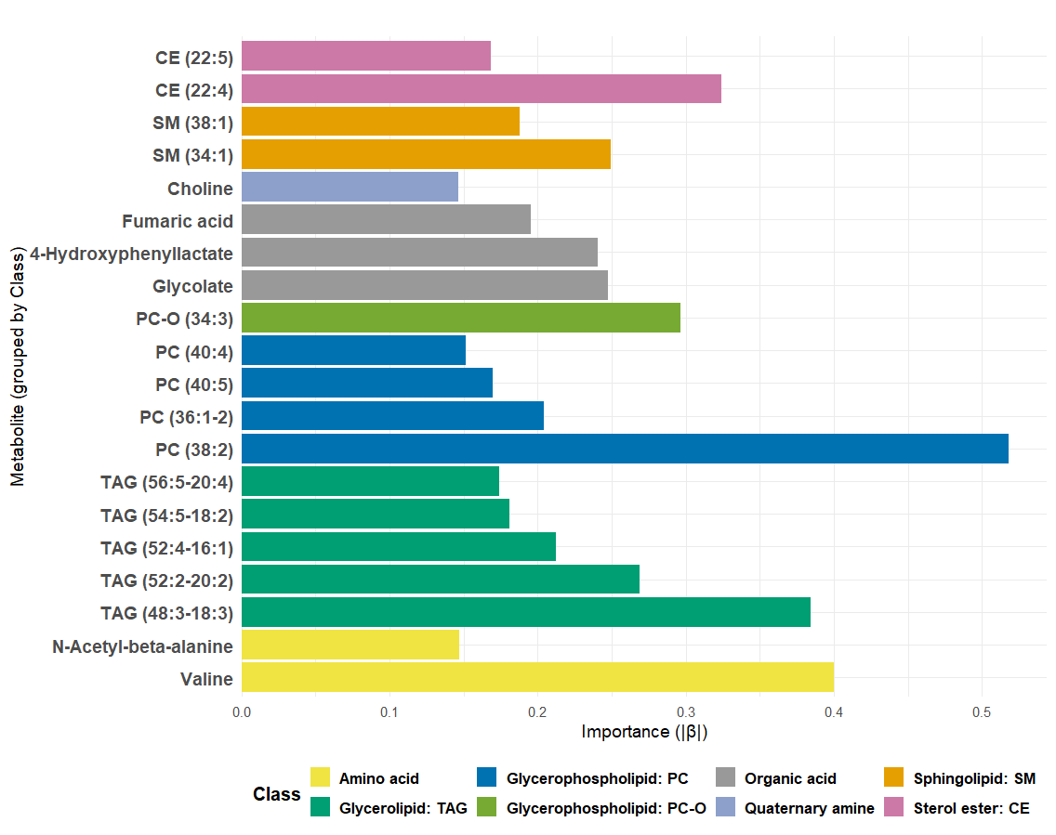
Elastic Net variable importance
Top 20 metabolites ranked by absolute coefficient values ∣β∣ (x-axis), which represent the importance of each metabolite, measured by the magnitude of the corresponding regression coefficient, while the y-axis lists the metabolite names.
p-value = 0.2866, i.e., the most important metabolites tend not to be highly abundant overall.

Slide 13
SHapley Additive exPlanations
Tells you how much each feature contributes to the model’s prediction – positively or negatively – for each individual observation
SHAP is based on Shapley values from cooperative game theory.
  In a “game” (the prediction), each “player” (feature) contributes some amount. SHAP assigns fair contributions according to each player’s role across all possible combinations (coalitions).
SHAP values go from negative to positive.
  SHAP>0: feature increases the model’s prediction for the outcome i.e., T2DM risk
  SHAP<0: feature decreases the model’s prediction for the outcome
  SHAP=0: feature has no effect on the model’s prediction for the outcome

Slide 14
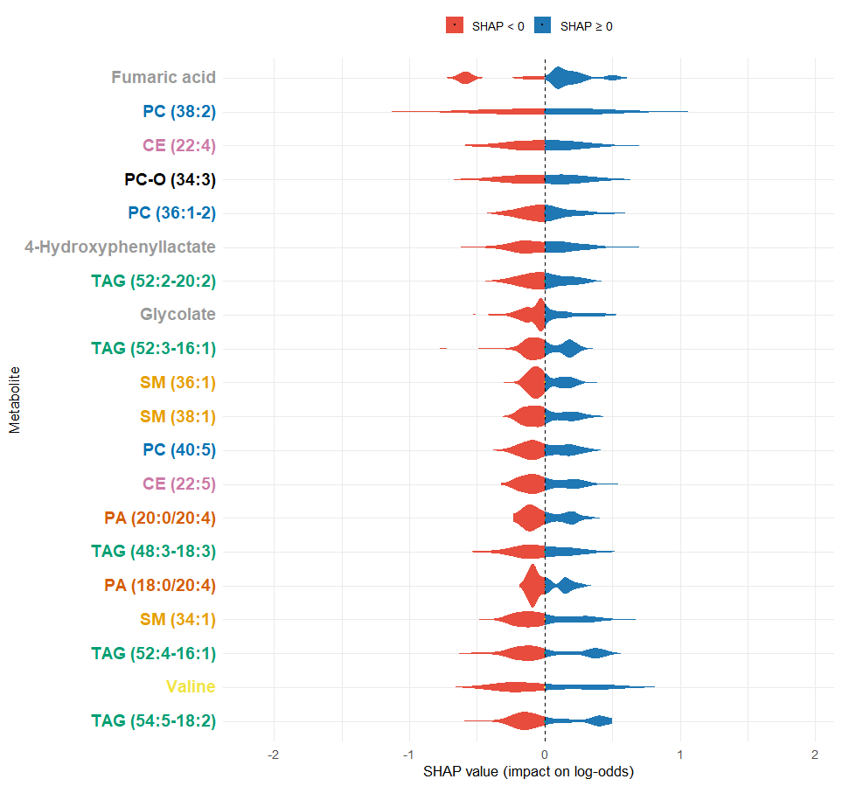
Elastic Net: SHAP values
This is a SHAP (SHapley Additive exPlanations) summary plot showing the distribution of SHAP values for the 20 most impactful metabolites in an elastic-net model. Each violin plot represents the range and density of SHAP values, i.e., how much a feature influences the model prediction in log-odds across all samples.
Valine and Sphingomyelin (SM (38:1)) mostly push the prediction toward T2DM.
Triacylglycerol (TAG (52:3-16:1)) mostly pushes the prediction toward Healthy
Sphingomyelin (SM (36:1)), and phosphatidylcholine (PC (40:5)) push the prediction towards Healthy or T2DM

Slide 15
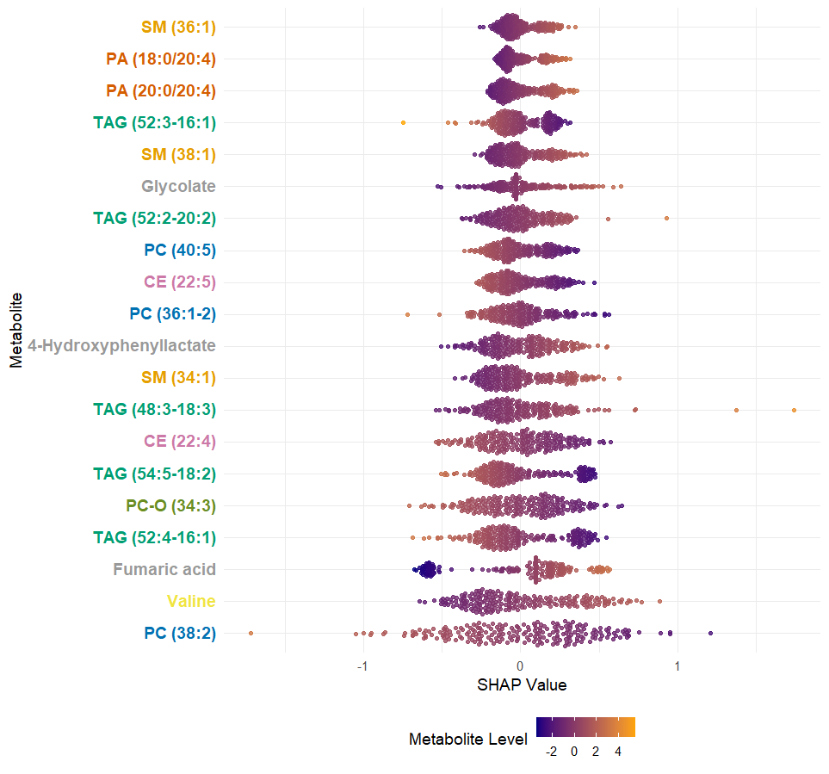
Elastic Net: SHAP Values
Bees-warm plot showing how each metabolite influences the model’s output across all samples.
Fumaric acid, phosphocholine (PC (38:2)), and Valine contribute most to variation in predictions.
For some metabolites, high levels (orange) are on the negative SHAP values — e.g., phosphocholine (PC (38:2)), triacylglyceron (TAG (52:4-16:1)).
For others, high levels (orange) are on the positive SHAP values — e.g., Fumaric acid.
Sphingomyelin (SM (38:1)) and Glycolate show mixed effects

Slide 16
Elastic Net: Differences Between Samples
H0: no difference in SHAP values between Healthy and Type 2 diabetic subjects
HA: difference in SHAP values between Healthy and Type 2 diabetic subjects
p-value < 2.2x10⁻¹⁶, i.e., highly significant difference in SHAP values between Healthy and Type 2 diabetic individuals

Slide 17
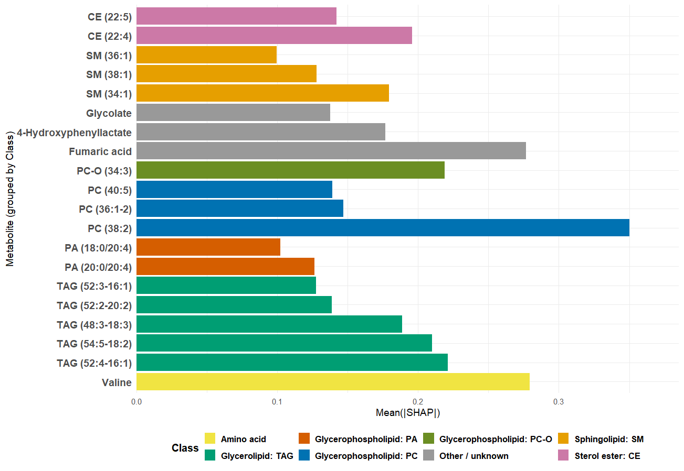
Elastic Net: Mean(|SHAP|)
Bar plot showing the average absolute SHAP value for each metabolite, i.e., its overall importance in the predictive model, regardless of whether its effect increases or decreases the predicted probability.
Phosphocholine (PC (38:2)) is the most influential metabolite in the model’s predictions.
Valine and Fumaric acid are the next most important metabolites.
Phosphatidylcholines (PCs) such as PC-O (34:3), PC (36:1-2), and PC (40:5) show moderate SHAP importance, reinforcing the strong role of glycerophospholipids in metabolic variation.
Glycolate and 4-Hydroxyphenyllactate contribute less to model variance but might represent secondary metabolic pathways.

Slide 18
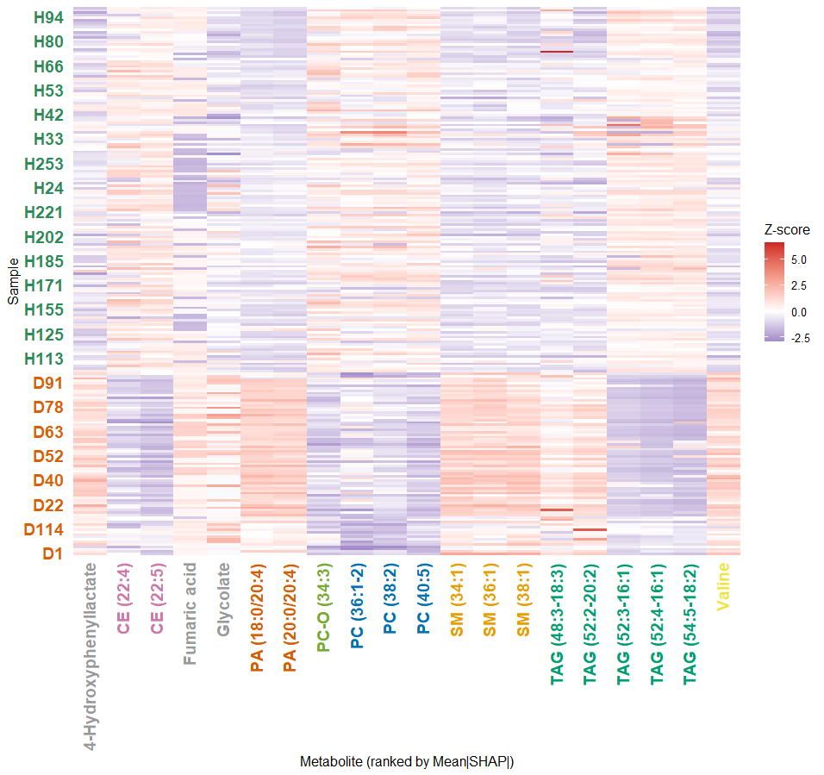
Elastic Net: Mean(|SHAP|)
Heatmap showing the top 20 metabolites ranked by mean absolute SHAP values, with each metabolite’s z-score abundance displayed across individual samples.
Metabolites from Healthy (H) and Diabetic subjects (D) appear to have different z-score profiles, suggesting metabolite shifts between conditions.
The Triacylglycerols cluster together (TAG (52:4-16:1), TAG (54:5-18:2), and TAG (52:3-16:1)) and show consistent shifts, highlighting their joint role in classification.
PAs, and Valine tend to be elevated in diabetic samples. In contrast, PCs are relatively higher in healthy individuals.
Diabetics generally show higher levels of Valine, TAGs, Fumaric acid and PAs, while healthy individuals tend to have higher levels of PCs.

Slide 19
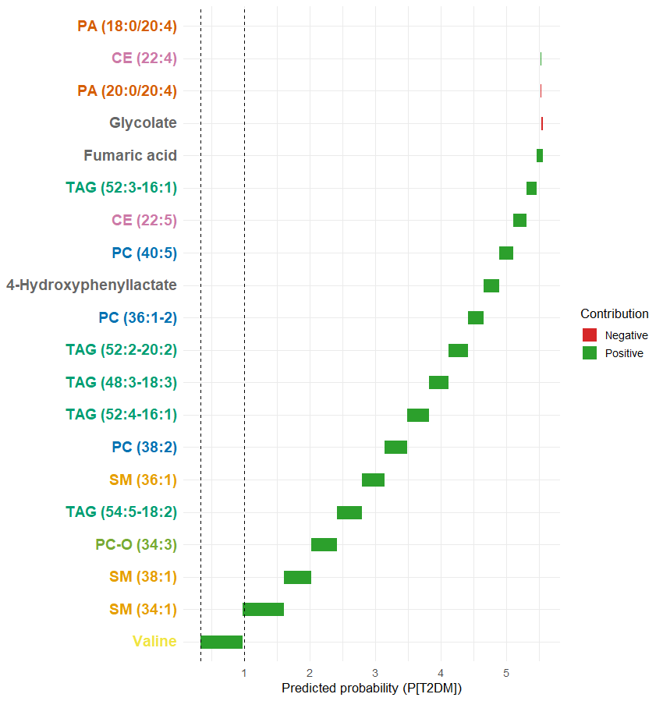
Elastic Net: Predicted Probability (P(T2DM))
Waterfall plot showing the predicted probability for a single individual (D1), and the contribution of specific metabolites to the final prediction for PT2DM (Probable Type 2 Diabetes Mellitus).
Valine, sphingomyelins (SM (34:1), SM (38:1)), phosphocholine (PC-O (34:3)), triacylglycerol (TAG (54:5-18:2)) are the strongest positive contributors.
Sphingomyelin (SM (36:1)), phosphocholine (PC (38:2)), and triacylglycerols (TAG (52:4-16:1), TAG (48:3-18:3)) are moderate positive contributors.
Glycolate and phosphatidic acid (PA (20:0/20:4)) are negative contributors
Final predicted probability for D1 is much higher than the baseline, primarily due to the strong positive influence of certain sphingomyelins (SM), phosphatidylcholines (PC), and triacylglycerols (TAG).

Slide 20
Elastic Net: Conclusions
Phosphatidylcholine (PC (38:2)), Valine, Fumaric acid – together define a triad of lipid, amino acid, and energy metabolism disruption.
Phosphatidylcholines, Triacylglycerols, sphingomyelins, and ceramides are lipids that play central roles, reflecting altered lipid homeostasis in PT2DM.
Valine (amino acid) and Fumaric acid (Trichloroacetic cycle) highlight protein and mitochondrial dysfunction.
These metabolites repeatedly appear as top-ranked, with increased directionality clarified by beeswarm and waterfall plots.
While globally these features dominate, individual heatmaps and waterfalls show heterogeneous contributions, aligning with metabolic heterogeneity among individuals.

Slide 21
Random Forest
is a machine learning algorithm that uses many decision trees to make better predictions where each tree looks at different random parts of the data and their results are combined by voting for classification or averaging for regression
Key Features
  Combines results from many decision trees (ensemble averaging) to improve accuracy.
  Uses bootstrapping and random feature selection for decorrelated trees.
  Handles nonlinear relationships and complex interactions naturally.
  Resistant to noise and overfitting when many trees are used.
  Provides variable importance measures and SHAP interpretability.

Slide 22
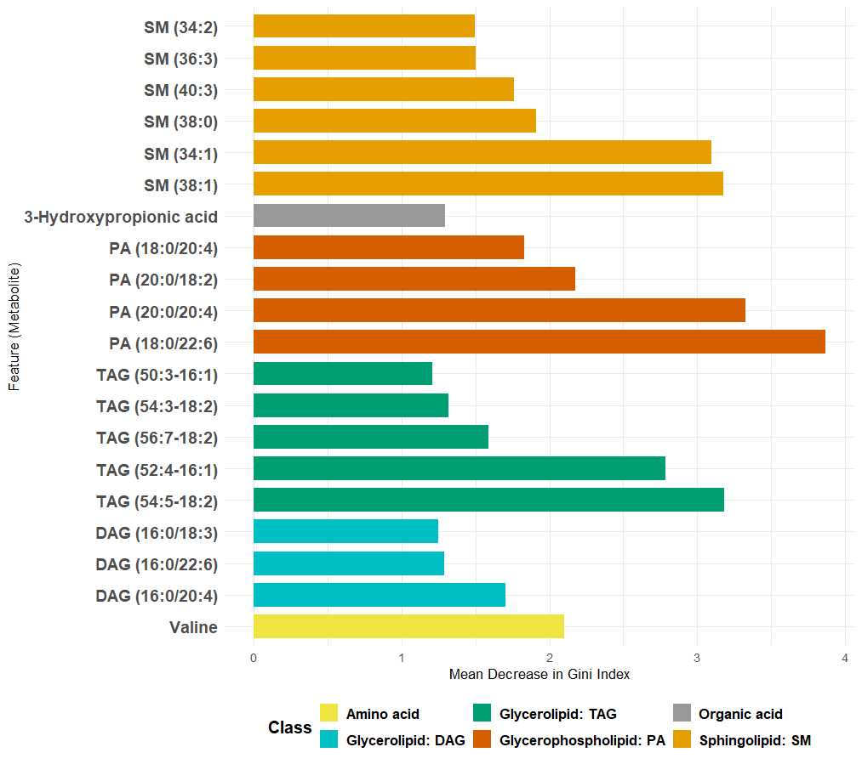
Random Forest: Variable Importance
Top metabolites ranked by their importance in a Random Forest model, measured using the Mean Decrease in Gini Impurity. The x-axis represents the importance score, where higher values indicate greater contribution to the model's ability to split and classify the data accurately.

Slide 23
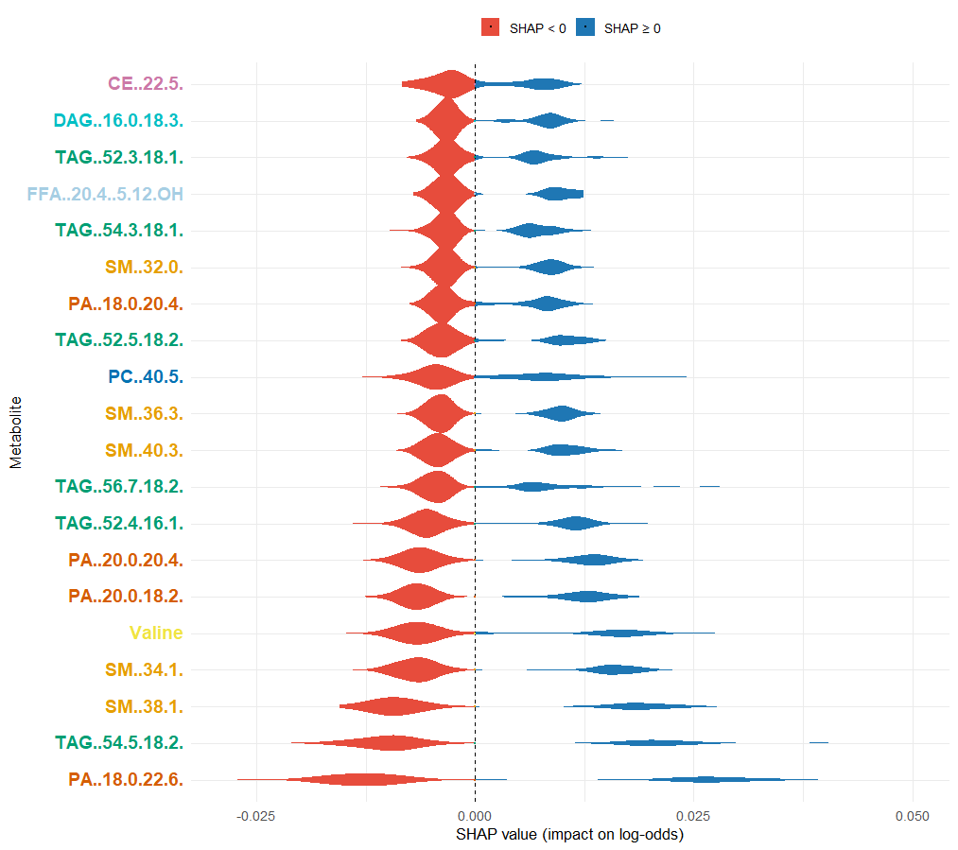
Random Forest: SHAP values
This graph presents a SHAP (SHapley Additive exPlanations) summary plot displaying the distribution of SHAP values (ϕ) for the most influential features identified by a Random Forest model. SHAP values represent the contribution of each feature to the model's output for individual predictions.
Nearly all metabolites mostly push the model’s prediction toward T2DM.
Several TAGs (triacylglycerols) and SMs (sphingomyelins) dominate as top features indicating that lipid metabolism is a major driver.

Slide 24
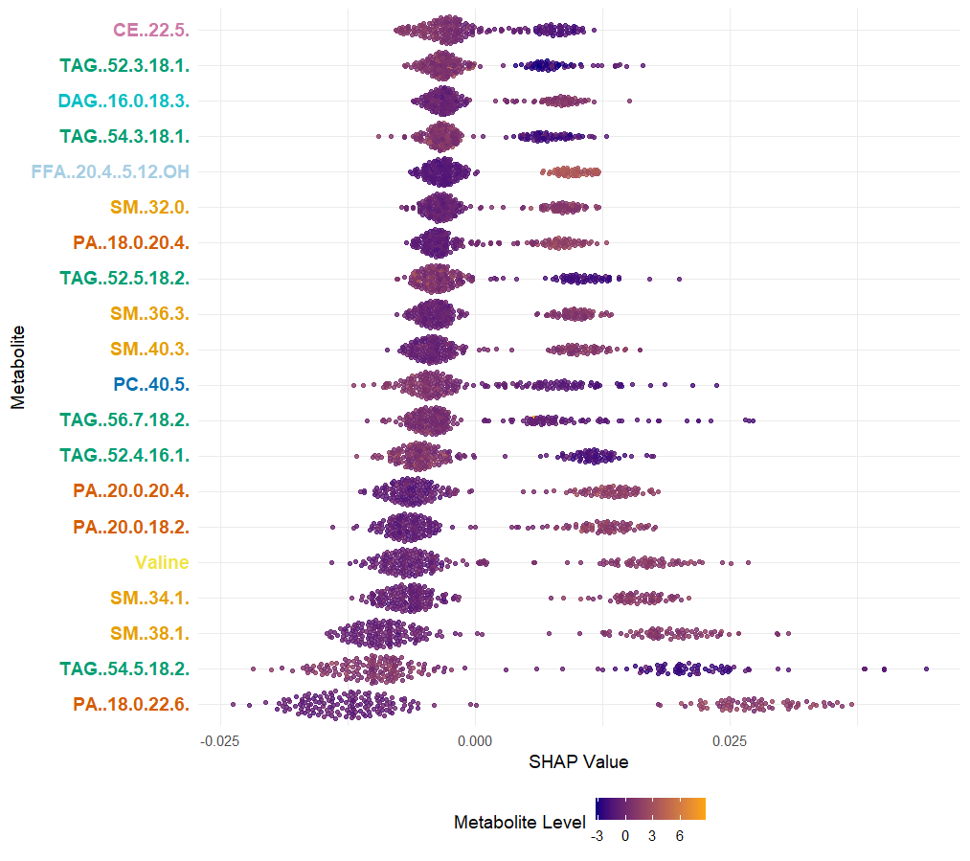
Random Forest: SHAP values
SHAP (SHapley Additive exPlanations) summary plot displaying the distribution of SHAP values (ϕ) for the most influential features identified by a Random Forest model. SHAP values represent the contribution of each feature to the model's output for individual predictions.
Triacylglycerol (TAG (54:5-18:2)), sphingomyelin (SM (38:1)), and phsophatidic acid (PA (18:0/22:6)) exhibit the widest SHAP value ranges and strongest overall impact.
Triacylglycerol (TAG (52:4-16:1)) and Valine also contribute notably, linking branched-chain amino acid metabolism with lipid alterations.
Metabolites such as 4-Hydroxyphenyllactate, diacylglycerol (DAG (14:0/16:0)), and phosphatidylcholine (PC (40:5)) show smaller but consistent effects.
Sphingomyelins (SMs), phosphatidic acids (PAs), and triacylglycerols (TAGs) dominate the SHAP landscape, underscoring dysregulated lipid metabolism as the key differentiator between diabetic and healthy profiles.

Slide 25
Random Forest: Difference Between Groups
H0: no difference in SHAP values between Healthy and Type 2 diabetic people
HA: difference in SHAP values between Healthy and Type 2 diabetic people
p-value < 2.2x10⁻¹⁶, i.e., there is a highly significant difference in SHAP values between Healthy and Type 2 diabetic people

Slide 26
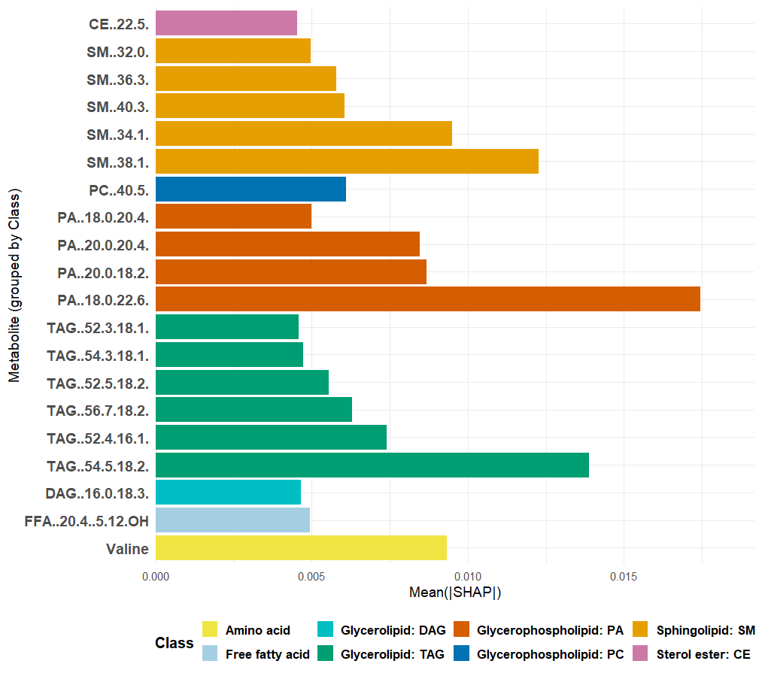
Random Forest: Mean(|SHAP|)
Mean absolute SHAP value for each metabolite for a random forest model, representing its overall importance in the predictive model.
Phosphatidic acid (PA (18.0.22.6)) shows the higher Mean(|SHAP|) value, i.e., it is the most important metabolite for differentiating diabetics from normal individuals, followed by triacylglycerol (TAG (54:5.18:2)) and sphingomyelin (SM (38:1)).
Other phosphatidic acids (PA 20:0/20:4, PA 20:0/18:2) and triacylglycerols (TAG 52:4-16:1, TAG 52:3-16:1) form a mid-tier cluster of lipids with consistent positive contributions.
Valine shows moderate importance, supporting an amino-acid–lipid interaction signal.
Diacylglycerols (DAGs) and phosphatidylcholines (PCs) exhibit smaller Mean(|SHAP|) values, contributing less to discrimination between diabetic and healthy groups.

Slide 27
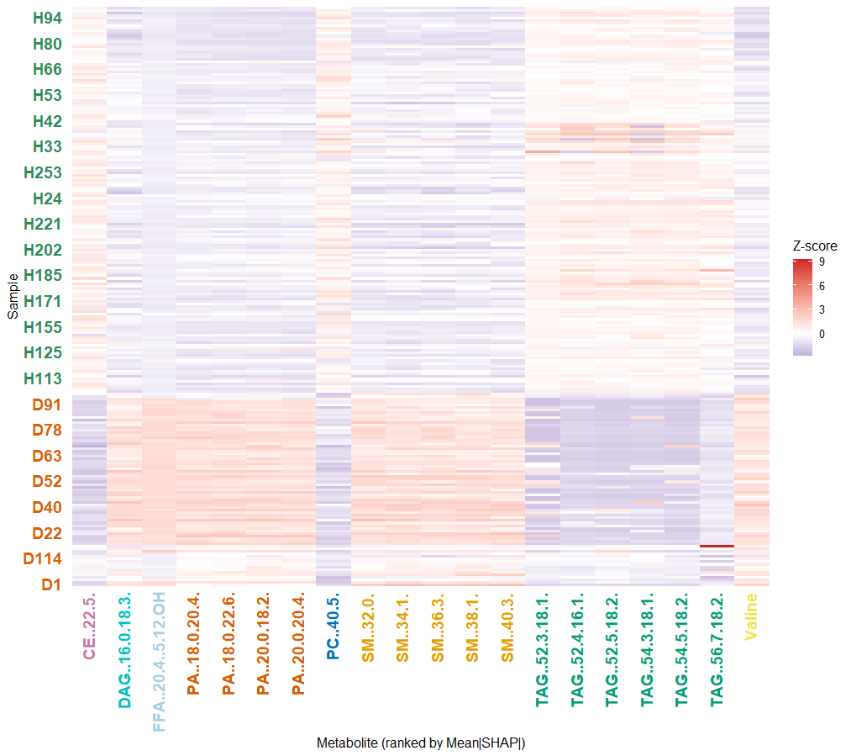
Random Forest: Mean(|SHAP|)
Heatmap shows the top 20 metabolites ranked by mean absolute SHAP values as identified by the Random Forest (RF) model.
Most H (healthy) samples show blue (low) levels of sphingomyelin (SM (34:1)), triacylglycerol (TAG (54:5/18:2)), and phosphatidic acid (PA (18:0/22:6)).
Most D (diabetic) samples show red (high) levels of these same metabolites.
Valine shows a mixed pattern.
While not perfectly distinct, there’s a clear contrast in lipid profiles between diabetic and healthy groups where this pattern supports that dysregulated lipid metabolism (especially TAGs, DAGs, SMs, and PAs) drives model discrimination between T2DM and healthy individuals.

Slide 28
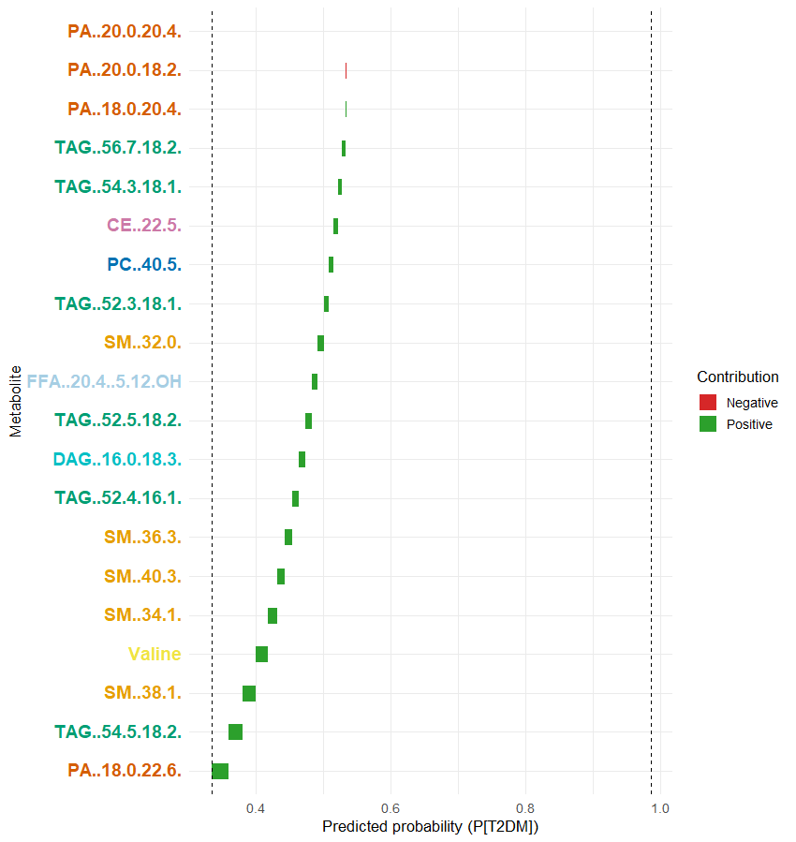
Random Forest: Predicted Probability (P(T2DM))
Waterfall plot that explains how individual metabolite contributions from a Random Forest (RF) model influence the predicted probability for a specific sample (D1) of having the target outcome (likely PT2DM).
Sphingomyelins (SM(34:1), SM(38:1)), triacylglycerol (TAG(54:5-18:2)), phosphatidic acid (PA(18:0/22:6)), and Valine are the top metabolites that contributed most strongly to pushing the probability upward.
For subject D1, the model’s final predicted probability (~0.4) indicates a tendency toward the healthy class, suggesting lipid and amino acid patterns closer to non-diabetic profiles.
Nearly all metabolites exert small positive effects (green), whereas phosphatidic acid (PA (20:0/18:2)) is the only strong negative contributor (red).

Slide 29
Random Forest: Conclusions
Across multiple SHAP-based analyses, the Random Forest model identifies a lipid-centric metabolic signature characterized by elevated sphingomyelins (SMs), triacylglycerols (TAGs), and phosphatidic acids (PAs) as the strongest predictors of disease probability.
Amino acid metabolism (Valine) contributes secondarily, suggesting interconnected lipid–amino acid dysregulation.
The collective evidence supports the notion that perturbations in complex lipid metabolism are major discriminants between the studied groups.

Slide 30
XGBoost
is an advanced machine learning algorithm based on gradient-boosted decision trees.
It builds models sequentially, where each tree corrects the errors of the previous one, leading to high predictive performance and strong generalization.
Key Features
  Ensemble of decision trees that minimize prediction error through gradient descent.
  Incorporates regularization (L1 & L2) to reduce overfitting.
  Handles missing data internally and captures nonlinear feature interactions.
  Highly efficient with parallel computation and tree pruning.
  Provides SHAP values for model interpretability.

Slide 31
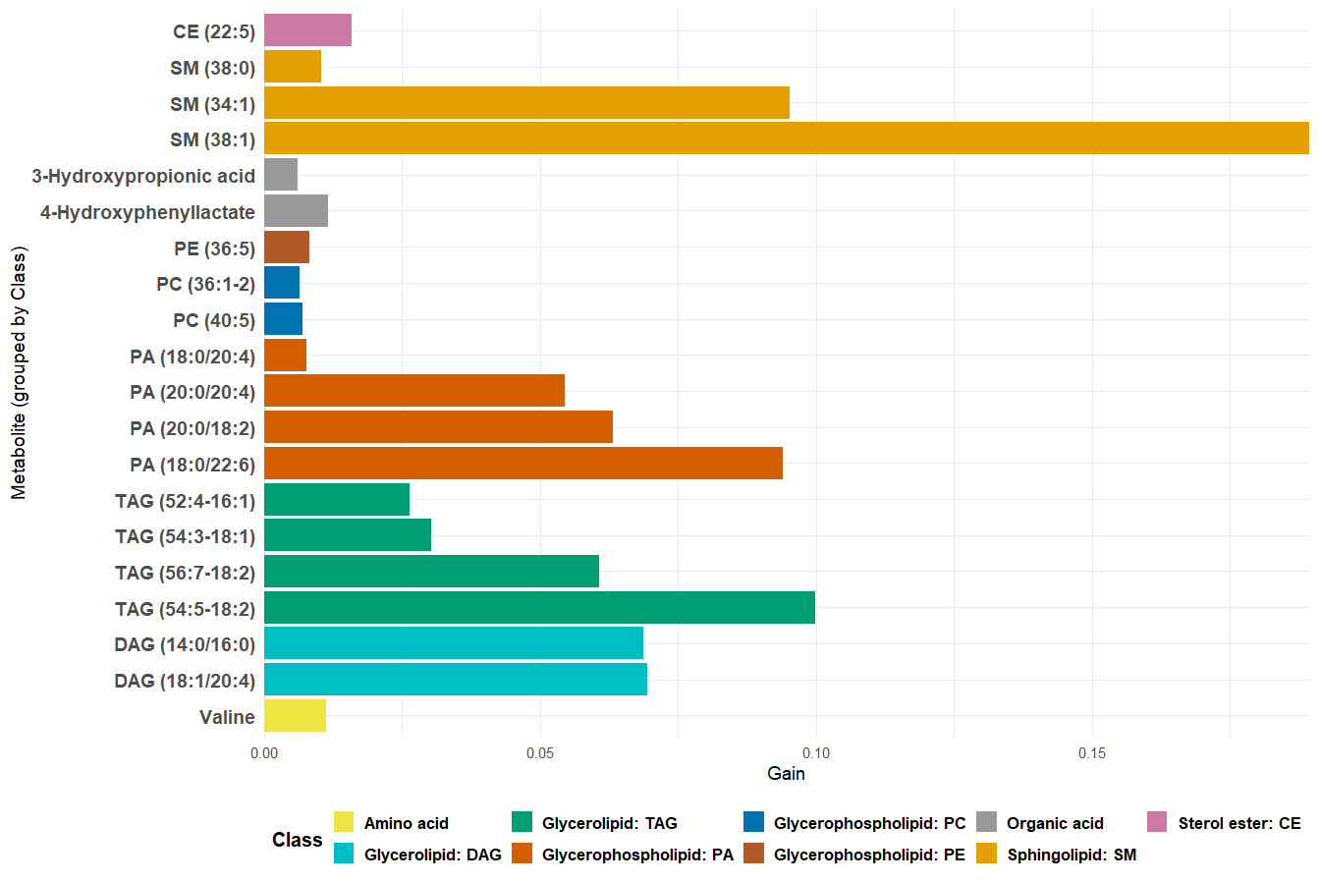
XGBoost: Top 20 metabolites by Gain
This visualizes the most influential features in an XGBoost model based on their gain, which reflects each variable's relative contribution to reducing model error across all decision trees. The x-axis represents the gain score, where higher values indicate a more significant impact on the model’s predictive performance.

Slide 32
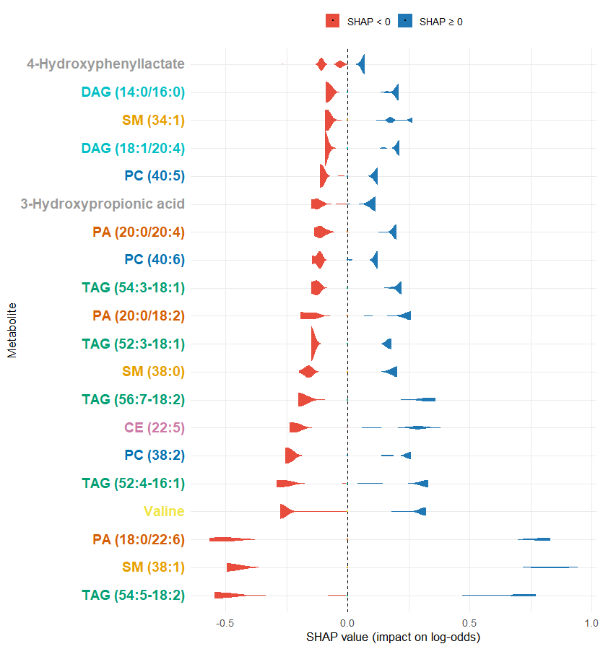
XGBoost: SHAP values
This graph presents a SHAP summary for the top 20 metabolites that most strongly influence the prediction of Type 2 Diabetes Mellitus (T2DM) in an XGBoost model. It uses violin plots to visualize the distribution of SHAP values, which quantify each metabolite's impact on the model's predicted log-odds for T2DM.
4-Hydroxyphenyllactate mostly decreases the predicted probability of T2DM.
Triacylglycerol (TAG (54:5-18:2)), diacylglycerols (DAG (14:0/16:0), DAG (18:1/20:4)), sphingomyelin (SM (34:1)), Valine, and phosphatidic acid (PA (18:0/22:6)) mostly increase the predicted probability of T2DM.
3-Hydroxypropionic acid, phosphatidylcholines (PC (40:5), PC (40:6)) and triacylglycerol (TAG (52:3-18:1)) show a mixed pattern
Many of the impactful metabolites are lipids

Slide 33
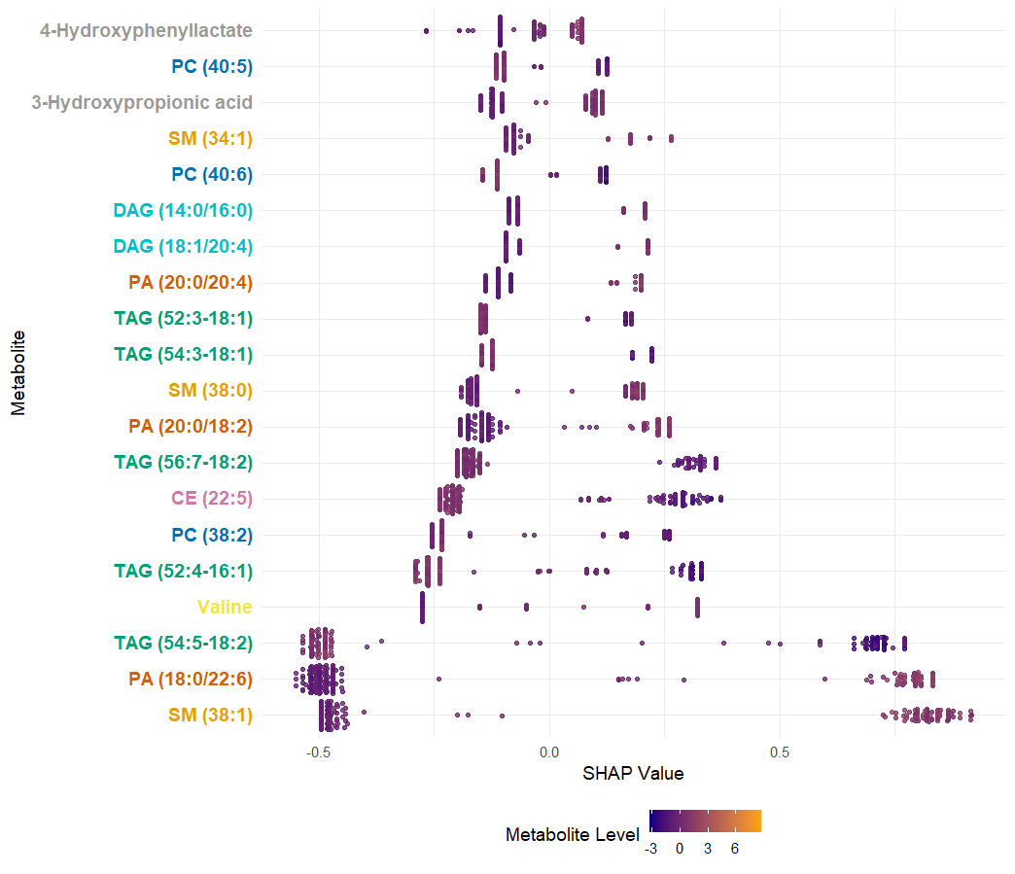
XGBoost: SHAP values
This is a beeswarm SHAP plot for an XGBoost model, showing the contribution of individual metabolites to the model’s predictions.
Sphingomyelin (SM (38:1)), phosphatidic acid (PA (18:0/22:6)) and triacylglycerol (TAG (54:5-18:2)) have the strongest influence on the model’s predictions.
For sphingomyelin (SM (38:1)) and phosphatidic acid (PA (18:0/22:6)), lower metabolite levels (purple) are associated with negative SHAP values.
Triacylglycerol species such as TAG (52:3-18:1) and TAG (56:7-18:2) show both positive and negative SHAP values.
Organic acids (4-Hydroxyphenyllactate and 3-Hydroxypropionic acid) are moderately relevant.

Slide 34
XGBoost: Difference Between Groups
H0: no difference in SHAP values between Healthy and Type 2 diabetic subjects
HA: difference in SHAP values between Healthy and Type 2 diabetic subjects
p-value < 2.2x10⁻¹⁶, i.e., there is a highly significant difference in SHAP values between Healthy and Type 2 diabetic subjects

Slide 35
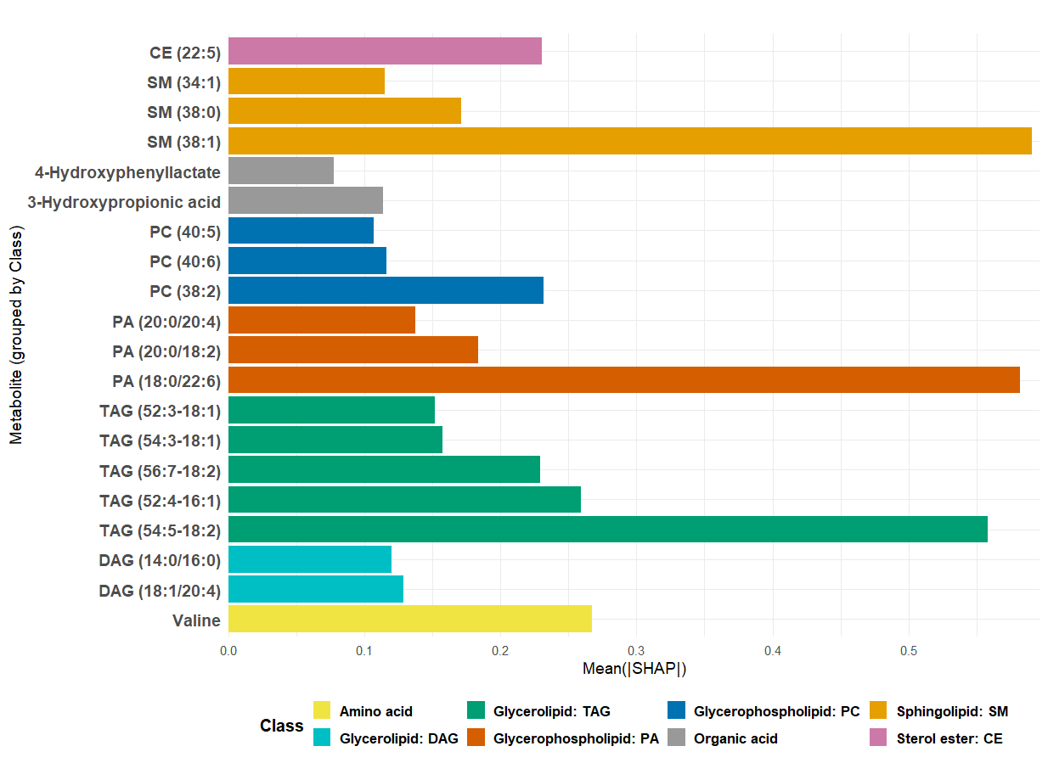
XGBoost: Mean(|SHAP|)
This plot is a bar chart that shows the global importance of metabolites in a predictive model based on the average magnitude of their SHAP (Shapley Additive Explanations) values.
Sphingomyelin (SM (38:1)), phosphatidic acid (PA (18:0/22:6)), and triacylglycerol (TAG (54:5-18:2)) are the most influential metabolites in determining the model’s predictions.
Valine, triacylglycerol (TAG (52:4-16:1)), and phosphatidylcholine (PC (38:2)) also contribute significantly, though less than the top three.
The rest of the metabolites show progressively smaller mean absolute SHAP values.

Slide 36
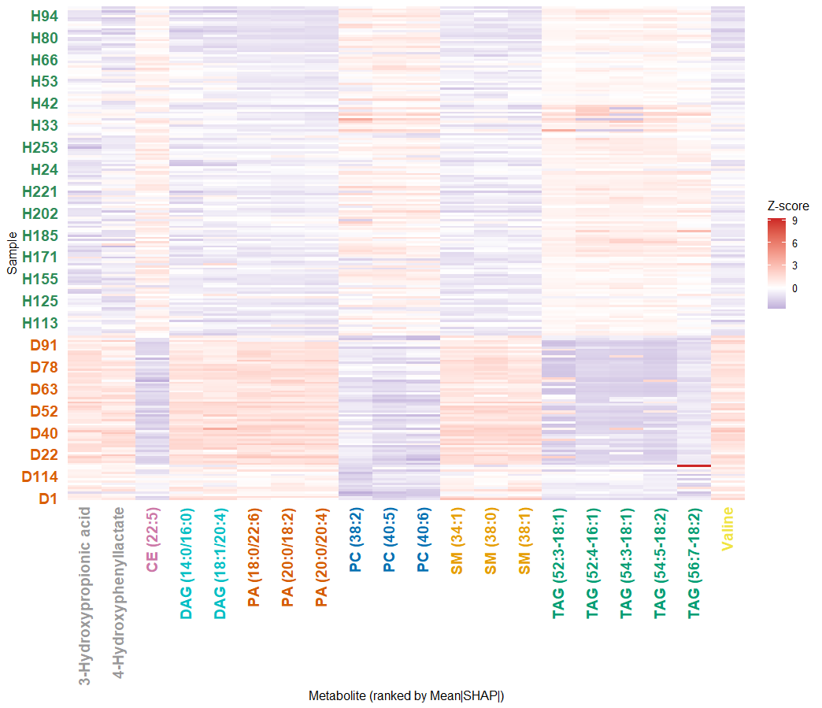
XGBoost: Mean(|SHAP|) per Metabolite
Heatmap that shows the top 20 metabolites ranked by mean absolute SHAP values from the XGBoost (XGB) model.
Sphingomyelin (SM (38:1)), phosphatidic acid (PA (18:0/22:6)), triacylglycerols (TAG (54:5-18:2), TAG (52:4-16:1)), and Valine appear prominently, suggesting strong discriminative power in XGBoost.
Upper samples (H-prefix) tend to show lower z-scores (purple) in some metabolites like sphingomyelin (SM(38:1)), and phosphatidic acid (PA(18:0/22:6)) while lower samples (D-prefix) often show red (higher values) for these same metabolites, and DAG species.
Sphingomyelins (SMs), phosphatidic acids (PAs), and triacylglycerols (TAGs) show coherent variation across groups.
Valine (an amino acid) also emerges as a key marker, reinforcing the role of branched-chain amino acids in T2DM metabolism.

Slide 37
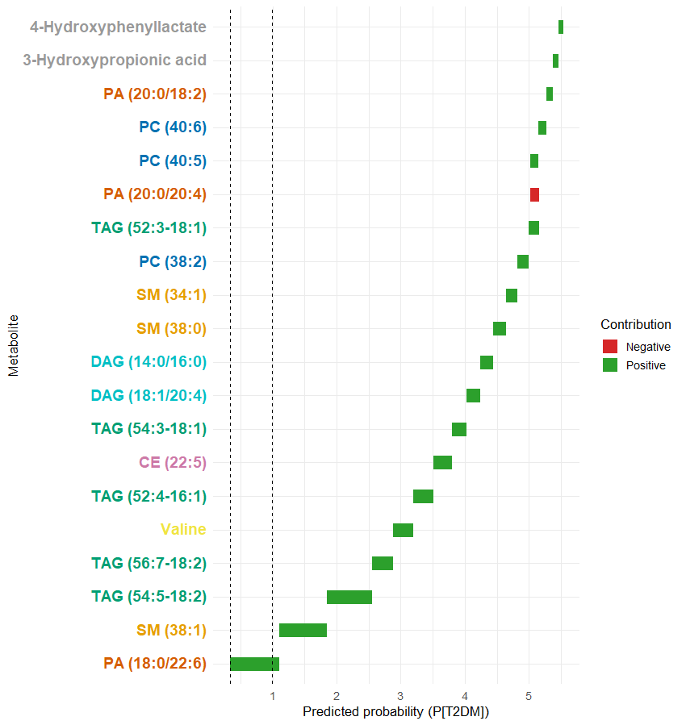
XGBoost: Predicted probability (P(T2DM))
This Waterfall Plot for D1 (XGBoost) visualizes the contribution of individual metabolites to the predicted probability of a specific sample (D1) having PT2DM according to the XGBoost model.
Top positive contributors for this sample are phosphatidic acid (PA (18:0/22:6)), sphingomyelin (SM (38:1)) and triacylglycerol (TAG (54:5-18:2)).
Triacylglycerols (TAG (56:7-18:2), TAG (52:4-16:1)), and Valine have a moderate positive impact.
Small positive contributors include cholesteryl ester (CE (22:5)), triacylglycerol (TAG (54:3-18:1)), and various diacylglycerol, sphingomyelin, and phosphatidylcholine species.
Negative contributors (red bars) are minimal in magnitude for this sample, with phosphatidic acid (PA (20:0/20:4)) having the most notable downward pull.
For sample D1, the XGBoost model’s prediction is strongly driven upward by a handful of lipids—particularly phosphatidic acid (PA (18:0/22:6)), sphingomyelin (SM (38:1)), and triacylglycerol (TAG (54:5-18:2))

Slide 38
XGBoost: Conclusions
Sphingomyelin (SM (38:1)), phosphatidic acid (PA (18:0/22:6)), triaglycerol (TAG (54:5-18:2)), and Valine are the strongest and most consistent drivers of T2DM classification.
High levels of sphingomyelin and phosphatidic acid lipids generally increase predicted T2DM risk; TAGs and amino acids show more nuanced effects.
The metabolites prioritized by SHAP mean importance also dominate in patient-level waterfall plots and cluster in heatmaps, strengthening confidence in their biological relevance.
These metabolites point toward lipid dysregulation and amino acid metabolism—consistent with known metabolic signatures of T2DM.

Slide 39
All three models
All models consistently identify elevated complex lipids (sphingomyelin, triaglycerol, phosphatidic acid, phosphatidylcholine) as increasing predicted disease probability (positive SHAP values), while amino and organic acids often show protective or inverse effects (negative SHAP values).
EN isolates core, directionally consistent biomarkers that linearly scale with disease risk.
RF suggests synergistic lipid effects — combined increases in sphingomyelins and triaglycerols amplify risk.
XGBoost emphasizes sharp threshold effects: once lipid concentrations surpass specific levels, risk probability increases steeply.

Slide 40
All three models
Core lipid species (sphingomyelin, triacylglycerol, phosphatidic acid) remain significant across linear and nonlinear frameworks, confirming biological and statistical robustness.
Tree models (RF, XGB) add nuance—revealing interaction and threshold effects, whereas Elastic Net isolates the baseline linear contribution of each metabolite.
In all models, heatmaps show that disease samples (D group) exhibit higher Z-scores (red) for triacylglycerols, sphingomyelins, and phosphatidic acids, while control samples (H group) show lower or neutral levels (blue).
Waterfall plots for individual D1 demonstrate additive positive contributions from the same metabolites that dominate the global model, confirming local-to-global consistency.

Slide 41
All three models
Dysregulation of lipid metabolism—particularly sphingolipids, phosphatidic acids, and triacylglycerols—is central to the metabolic phenotype.
These patterns reflect lipotoxicity, disrupted membrane signaling, and oxidative stress, consistent with insulin resistance and Type 2 diabetes–related metabolic dysfunction.
Amino acid and organic acid markers (Valine, Fumaric acid, 4-Hydroxyphenyllactate) indicate mitochondrial and redox perturbations, reinforcing the systemic metabolic shift.

Slide 42
All three models
Across XGBoost, Random Forest, and Elastic Net:
  Lipid metabolism dominates prediction, with sphingomyelin (SM (38:1)), triacylglycerol (TAG (54:5-18:2)), and phosphatidic acid (PA (18:0/22:6)) as the most reproducible discriminants.
  Valine and organic acids contribute secondary, but biologically meaningful, information.
  Consistency across algorithms underscores a robust metabolic signature, not model-dependent noise.
  Tree-based models highlight nonlinear thresholds and lipid–lipid interactions, while Elastic Net confirms directional, linear relationships.

Slide 43
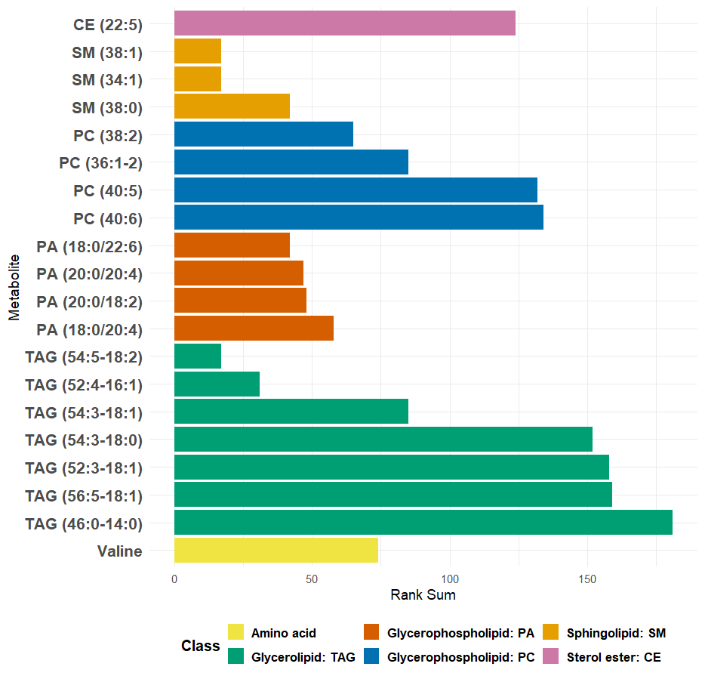
Metabolite Importance Based on Rank Sum
Sphingomyelins (SM(34:1), SM(38:1)) and triacylglycerols (TAG(54:5-18:2), TAG(52:4-16:1)) are the top consensus metabolites
Triacylglycerol (TAG(54:3-18:1)) and phosphatidylcholines (PC (36:1-2), PC (40:5)) are the middle-ranked metabolites
Triacylglycerols (TAG(56:5-18:1), TAG(52:3-18:1)) are the lower consensus metabolites

Slide 44
Model with Covariates added
Age – age of the participant
Gender – sex of the participant (male or female)
BMI – body mass index of the participant
Waistline (cm) – participant’s weight circumference measured in centimeters

Slide 45
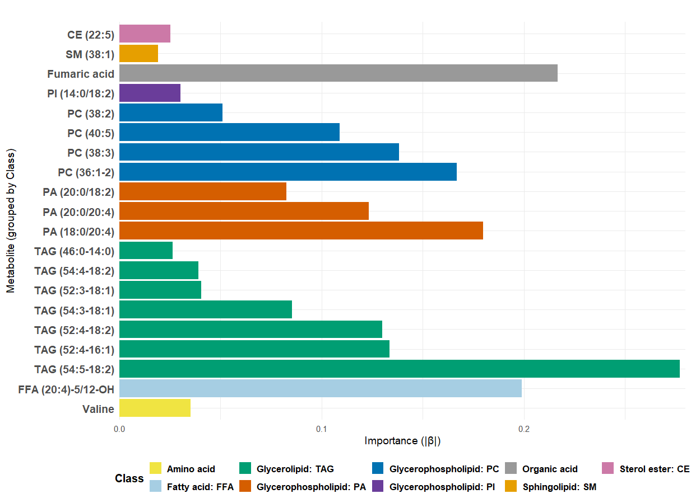
Elastic Net Variable Importance
This displays the top 20 metabolites ranked by their absolute coefficient values ∣β∣ from an elastic net regression model assuming that age, gender, BMI and Waistline (cm) are in the model. The x-axis represents the importance of each variable, measured by the magnitude of the corresponding regression coefficient, while the y-axis lists the metabolite names.
p-value = 0.3535, i.e., the most important metabolites tend not to be highly abundant overall.

Slide 46
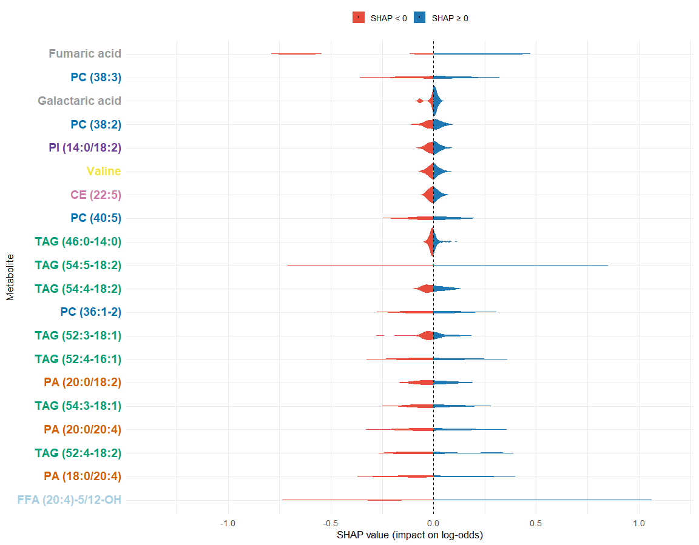
Elastic Net: SHAP Values
This is a SHAP (SHapley Additive exPlanations) summary plot showing the distribution of SHAP values for the 20 most impactful metabolites in an elastic-net model assuming that age, gender, BMI and Waistline (cm) are in the model. Each violin plot represents the range and density of SHAP values, i.e., how much a feature influences the model prediction in log-odds) across all samples.
Fumaric acid, Galactaric acid, and Valine show SHAP distributions centered near zero but slightly skewed negative, suggesting a mild protective association.
Multiple TAG species appear in the plot, many showing SHAP distributions skewed positive (blue)
PA species (phosphatidic acids), such as PA (20:0/18:2) and PA (18:0/20:4), display broader negative SHAP ranges, suggesting these lipids may lower T2DM probability in the model.
The free fatty acid (FFA (20:4)-5/12-OH) has one of the widest SHAP distributions, spanning strongly negative values.

Slide 47
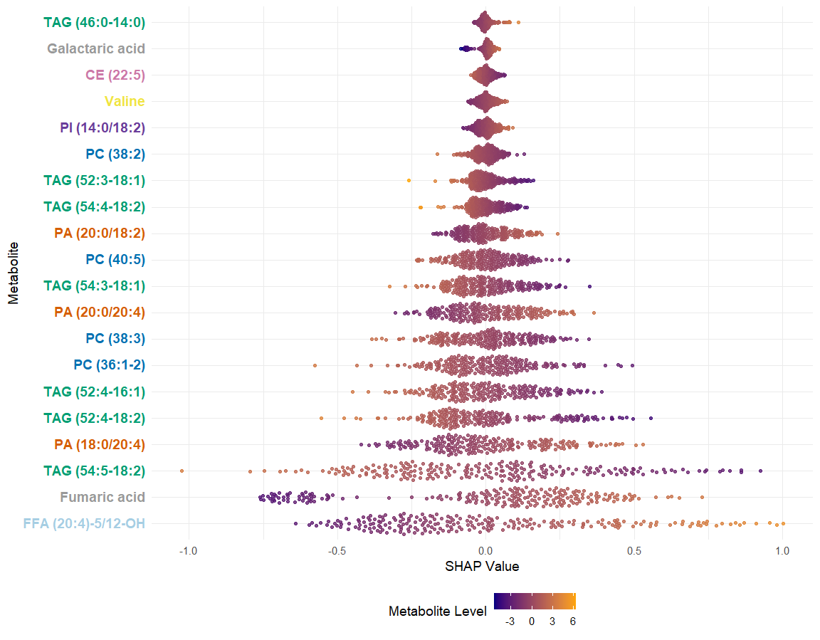
Elastic Net: SHAP Values
Bees-warm plot showing how each metabolite influences the model’s output across all samples.
Several TAG species cluster around positive SHAP values.
Some PC species show both positive and negative SHAP contributions, indicating mixed or context-dependent effects.
PA species often have negative SHAP values.
Organic acids (Fumaric acid, Galactaric acid) generally produce negative SHAP values, meaning higher levels reduce T2DM probability in the model.
The free fatty acid (FFA (20:4)-5/12-OH) has very large spread.

Slide 48
Elastic Net: Difference Between Groups
H0: no difference in SHAP values between Healthy and Type 2 diabetic subjects
HA: difference in SHAP values between Healthy and Type 2 diabetic subjects
p-value < 2.2x10⁻¹⁶, i.e., there is a highly significant difference in SHAP values between Healthy and Type 2 diabetic subjects

Slide 49
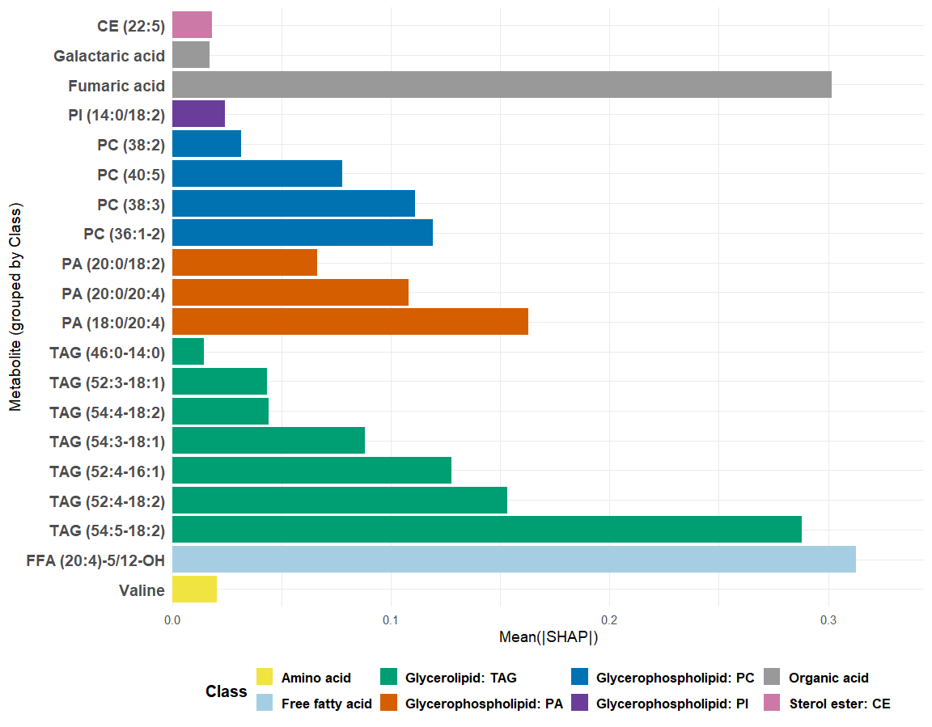
Elastic Net: Mean(|SHAP|)
Bar plot showing the average absolute SHAP value for each metabolite, i.e., its overall importance in the predictive model, regardless of whether its effect increases or decreases the predicted probability.
The fatty acid (FFA (20:4)-5/12-OH) is the single strongest predictor, with the highest Mean(|SHAP|).
Multiple TAG species (e.g., TAG 54:5-18:2, TAG 52:4-18:2) also show high SHAP influence, consistent with known lipid changes in T2DM.
Phosphatidylcholines (PC 36:1-2, PC 38:3, PC 40:5) show intermediate importance.
Organic acids (Fumaric acid, Galactaric acid) appear among the top 20 predictors, though with smaller SHAP values.

Slide 50
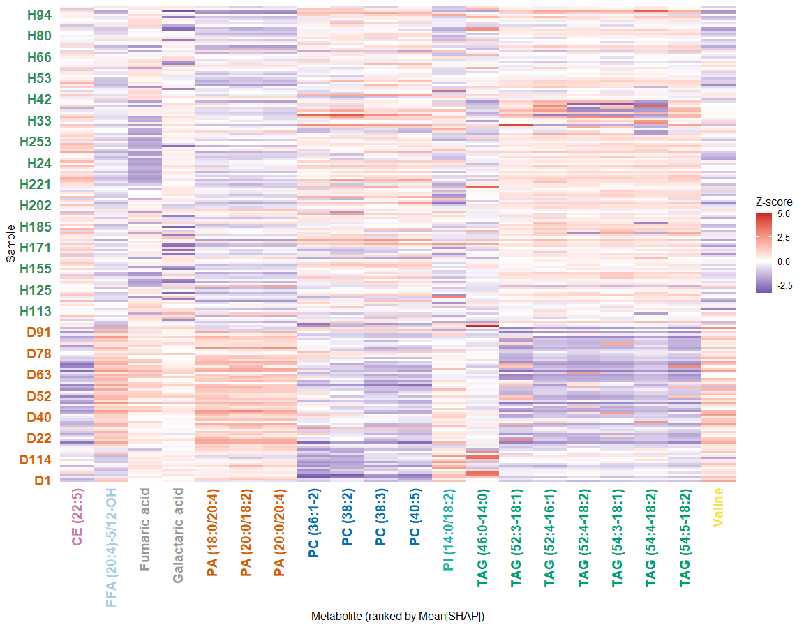
Elastic Net: Mean(|SHAP|) per Metabolite
Heatmap showing the top 20 metabolites ranked by mean absolute SHAP values, with each metabolite’s z-score abundance displayed across individual samples.
Many T2DM samples (bottom) show higher levels (red) of TAGs, phosphatidylinositol (PI (14:0/18:2)), phosphatidic acid (PA (20:0/20:4)) and certain PCs.
Organic acids (e.g., Fumaric acid, Galactaric acid) appear more balanced with milder deviations.
The fatty acid (FFA (20:4)-5/12-OH) shows a very strong red/blue pattern across individuals, reinforcing its high SHAP importance.
Valine (amino acid) shows moderate variation, consistent with known alterations in branched-chain amino acid metabolism in metabolic disease.

Slide 51
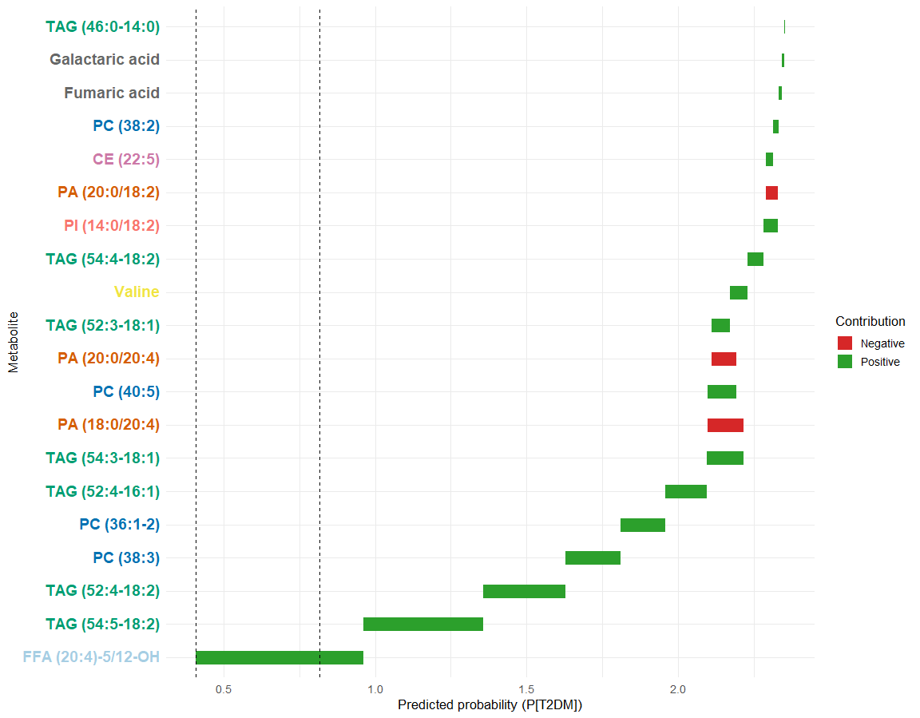
Elastic Net: Predicted Probability (P(T2DM))
Waterfall plot showing the predicted probability for a single individual (D1), and the contribution of specific metabolites to the final prediction for PT2DM (Probable Type 2 Diabetes Mellitus).
The fatty acid (FFA (20:4)-5/12-OH) is the largest positive contributor.
Phosphatidylcholines (PC (36:1-2), PC(38:3)) and , phosphatidic acids (PA(18:0/20:4), PA(20:0/20:4)) are moderate positive contributors.
Negative contributors are Galactaric acid, Fumaric acid, cholesteryl ester (CE (22:5)) and phosphatidic acid (PA (20:0/18:2)).
The plot shows that the model’s prediction for this individual is shaped primarily by elevated FFAs and TAGs, certain glycerophospholipids (PCs, PAs), organic acids and some lipids where by summing these contributions, the model arrives at the patient’s final predicted risk.

Slide 52
Elastic Net: Conclusions
Triacylglycerols (TAGs) account for most of the top SHAP values across all plots where in turn, the model captures dysregulated lipid storage and elevated TAG turnover, a known hallmark of insulin resistance.
The most influential single predictor is the fatty acid (FFA (20:4)-5/12-OH) where hence, elevated FFAs indicate increased lipolysis, impaired insulin action, and mitochondrial stress—all patterns associated with T2DM.
T2DM classification is overwhelmingly driven by disordered lipid metabolism (TAGs → PAs → FFAs), with organic acids acting as strong protective signals.
The Elastic Net model globally predicts Type 2 Diabetes based primarily on a dyslipidemia signature—high triacylglycerols, free fatty acids, and phosphatidic acids increase risk, while organic acids like fumaric and galactaric acid strongly reduce it—reflecting classic metabolic features of insulin resistance and impaired mitochondrial function.

Slide 53
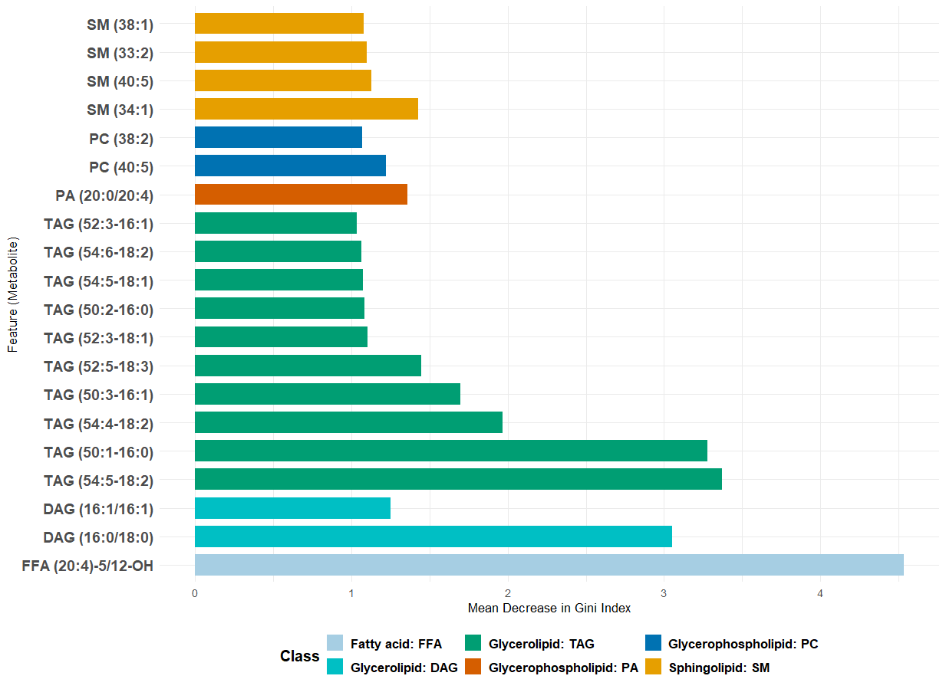
Random Forest Variable Importance
This shows the top metabolites ranked by their importance in a Random Forest model assuming that age, gender, BMI and Waistline (cm) are in the model, measured using the Mean Decrease in Gini Impurity. The x-axis represents the importance score, where higher values indicate greater contribution to the model's ability to split and classify the data accurately.

Slide 54
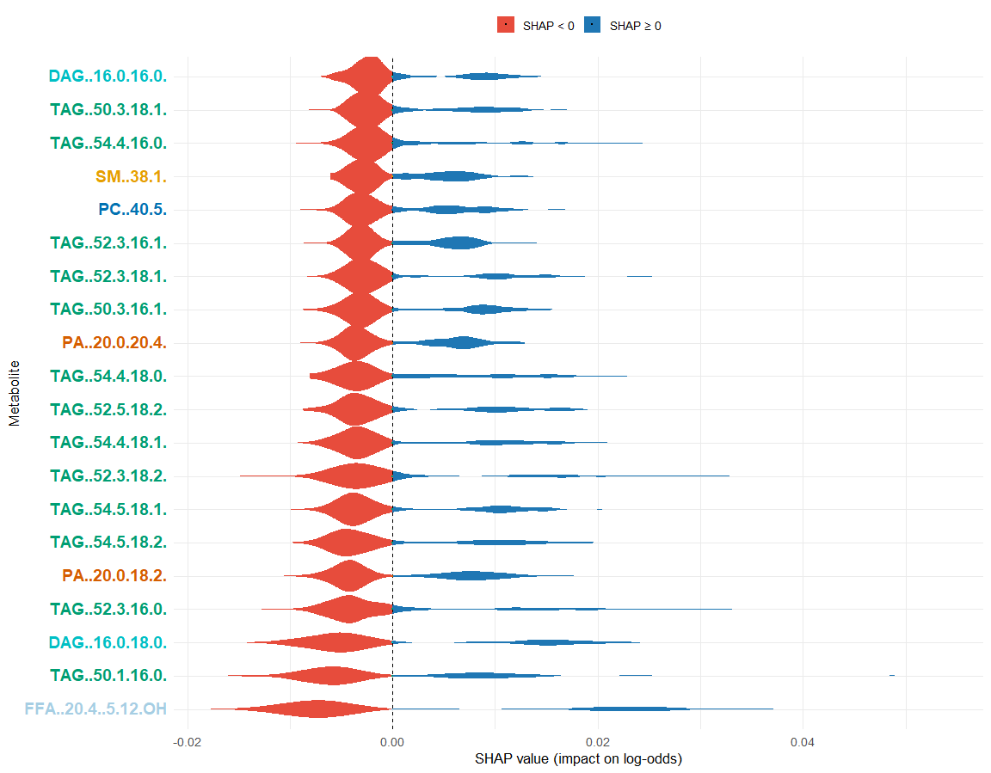
Random Forest: SHAP Values
This graph presents a SHAP (SHapley Additive exPlanations) summary plot displaying the distribution of SHAP values (ϕ) for the most influential features identified by a Random Forest model assuming that age, gender, BMI and Waistline (cm) are in the model. SHAP values represent the contribution of each feature to the model's output for individual predictions.
Free fatty acid (FFA (20:4-5/12-OH)) (bottom of plot) shows the largest positive SHAP values
Several TAG species (e.g., TAG 52:3-18:2, TAG 54:5-18:1, TAG 52:5-18:2) consistently display broad blue violins.
Phosphatidic acids (PA 20:0/20:4 and PA 20:0/18:2) show mixed effects.
Phosphatidylcholines (e.g., PC 40:5) and sphingomyelin (SM 38:1) exhibit moderate but consistent positive SHAP ranges.

Slide 55
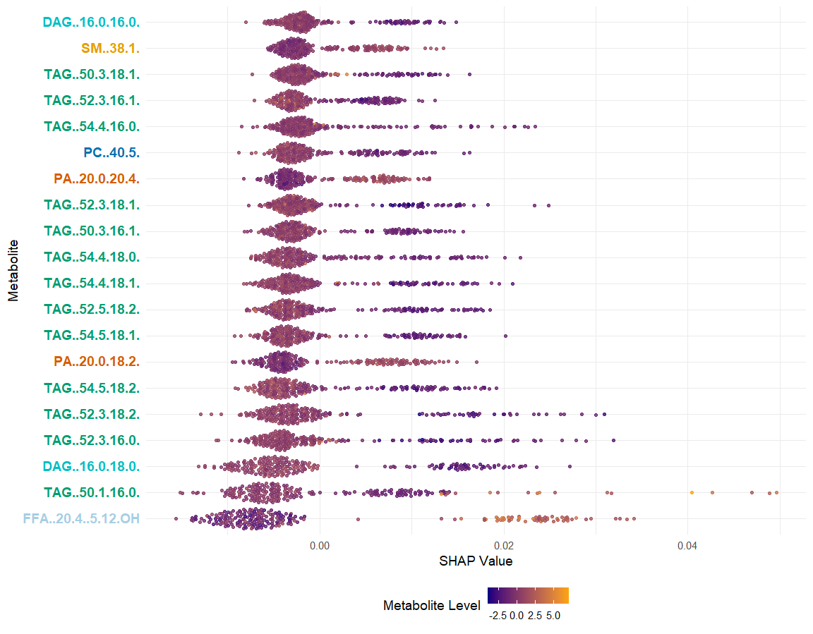
Random Forest: SHAP Values
SHAP (SHapley Additive exPlanations) summary plot displaying the distribution of SHAP values (ϕ) for the most influential features identified by a Random Forest model assuming that age, gender, BMI and Waistline (cm) are in the model. SHAP values represent the contribution of each feature to the model's output for individual predictions.
TAGs form the largest, strongest, and most consistent risk-increasing cluster.
Free fatty acid (FFA (20:4-5/12-OH) has the strongest effect.
PCs, SMs, and DAGs have moderate effects.
The model identifed dysregulated lipid metabolism as the major driver of T2DM risk, with TAGs and FFAs exerting the greatest influence.

Slide 56
Random Forest: Difference Between Groups
H0: no difference in SHAP values between Healthy and Type 2 diabetic subjects
HA: difference in SHAP values between Healthy and Type 2 diabetic subjects
p-value < 2.2x10⁻¹⁶, i.e., there is a highly significant difference in SHAP values between Healthy and Type 2 diabetic subjects

Slide 57
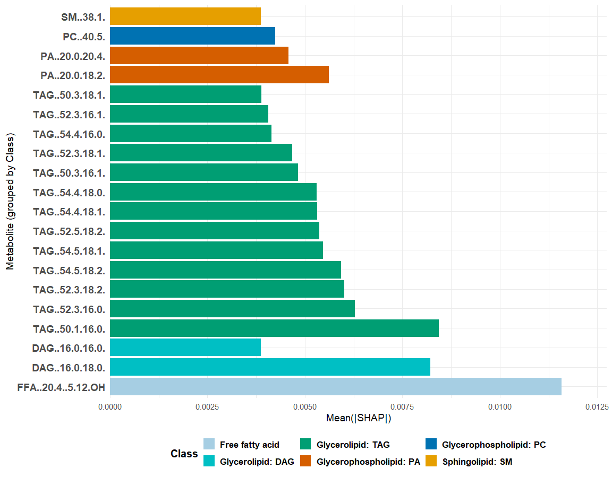
Random Forest: Mean(|SHAP|)
Mean absolute SHAP value for each metabolite for a random forest model, assuming that age, gender, BMI and Waistline (cm) are in the model, representing its overall importance in the predictive model.
The fatty acid (FFA (20:4-5/12-OH)) has the strongest influence.
DAGs and TAGS dominate the importance ranking.
Phosphatidic acids (PAs) show strong but varied effects.

Slide 58
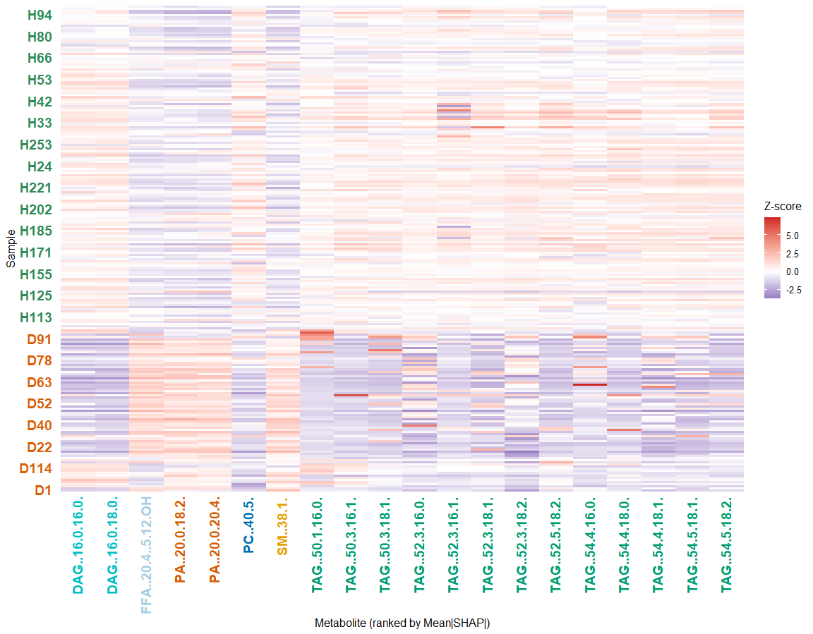
Random Forest: Mean(|SHAP|) per Metabolite
Heatmap shows the top 20 metabolites ranked by mean absolute SHAP values as identified by the Random Forest (RF) model, assuming that age, gender, BMI and Waistline (cm) are in the model.
There is a clear separation between Healthy (H) and Diabetic (D) samples.
High-ranking TAG metabolites show strong group differences (diabetic samples show deep blue regions while healthy samples show lighter red colors)
Phosphatidic acids (PA 20:0/18:2, PA 20:0/20:4) exhibit warmer colors (higher Z-scores) in diabetic samples and more mixed or neutral colors among healthy participants.
DAGs and FFAs show strong patterns aligned with disease status.

Slide 59
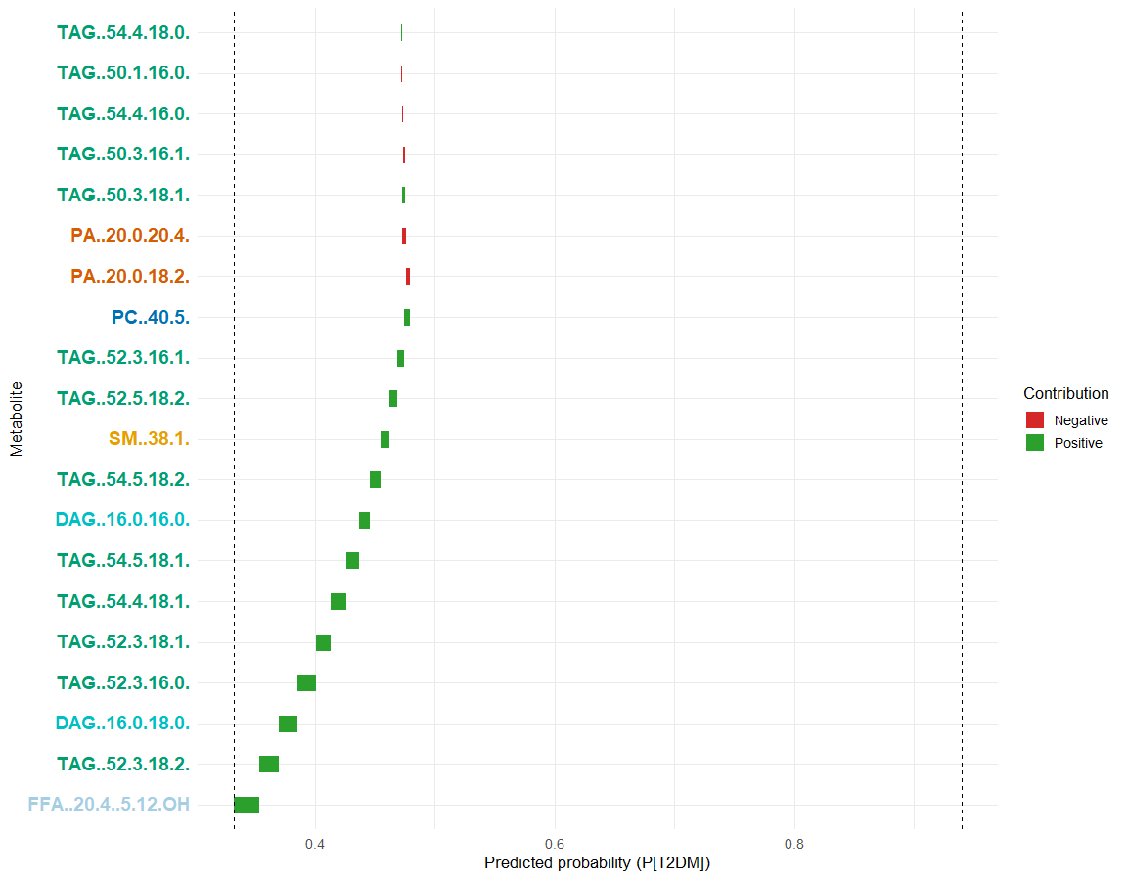
Random Forest: Predicted Probability (P(T2DM))
Waterfall plot that explains how individual metabolite contributions from a Random Forest (RF) model, assuming that age, gender, BMI and Waistline (cm) are in the model, influence the predicted probability for a specific sample (D1) of having the target outcome (likely PT2DM).
The fatty acid (FFA (20:4-5/12-OH)) is the dominant positive driver.
TAG and DAG lipids provide additional positive contributions.
Phosphatidic acids (PA (20:0/20:4) and PA (20:0/18:2)) and some TAG species reduce the probability.
The final predicted probability is moderately above the baseline.

Slide 60
Random Forest: Conclusions
Across all SHAP visualizations, the Random Forest model identifies a robust, biologically meaningful lipid signature that distinguishes T2DM from healthy controls.
Free fatty acids, diacylglycerols, and numerous triacylglycerols collectively form the strongest predictors: high levels consistently push predictions toward T2DM.
The model integrates many small-to-moderate signals from TAG species rather than relying on any single metabolite, capturing the broad dysregulation characteristic of insulin-resistant lipid metabolism.
Random Forest learns a coherent lipotoxic profile: elevated storage lipids and FFAs drive diabetes prediction, while certain membrane lipids exert protective or modulatory effects.

Slide 61
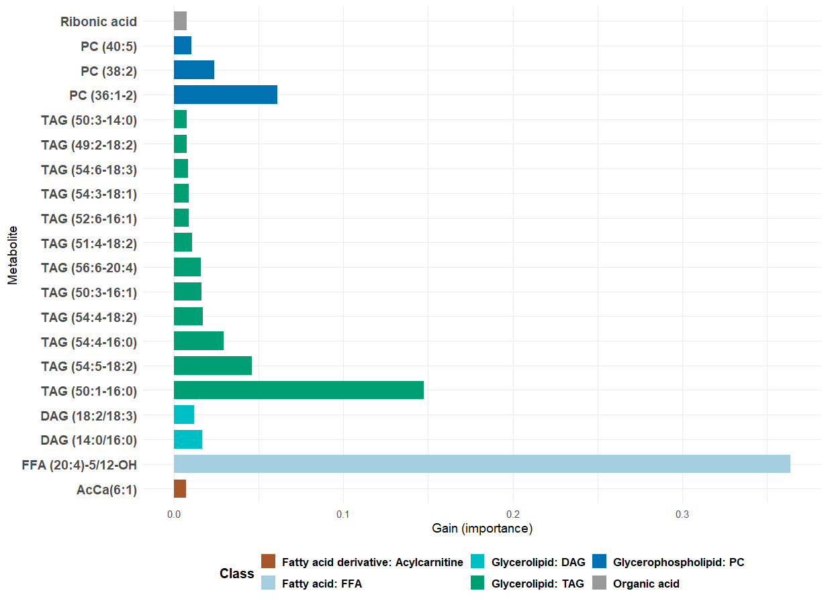
XGBoost: Top 20 metabolites by Gain
This visualizes the most influential features in an XGBoost model assuming that age, gender, BMI and Waistline (cm) are in the model, based on their gain, which reflects each variable's relative contribution to reducing model error across all decision trees. The x-axis represents the gain score, where higher values indicate a more significant impact on the model’s predictive performance.

Slide 62
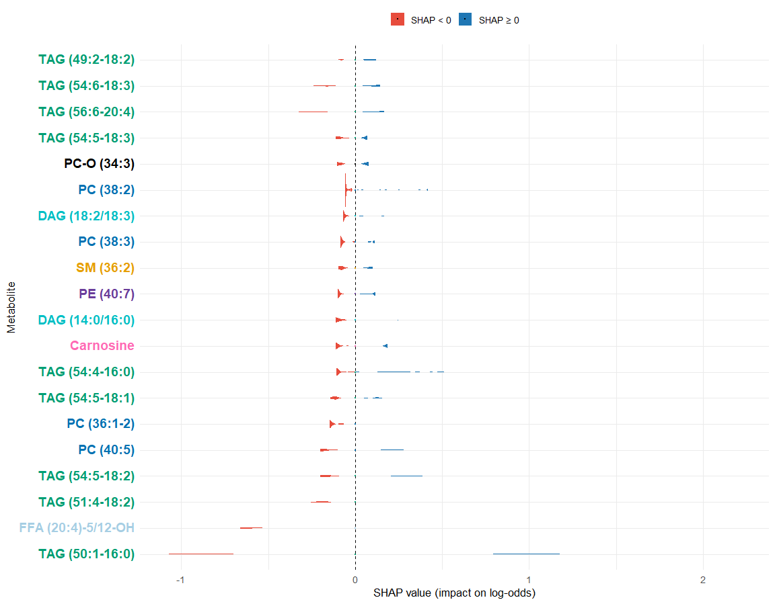
XGBoost: SHAP Values
This graph presents a SHAP summary for the top 20 metabolites that most strongly influence the prediction of Type 2 Diabetes Mellitus (T2DM) in an XGBoost model assuming that age, gender, BMI and Waistline (cm) are in the model. It uses violin plots to visualize the distribution of SHAP values, which quantify each metabolite's impact on the model's predicted log-odds for T2DM.
TAG (TAG (49:2-18:2), TAG (54:6-18:3), TAG (56:6-20:4), TAG (54:5-18:3)) species dominate the model’s prediction.
The strongest positive contributor is the free fatty acid (FFA (20:4–5/12-OH)).
Ether-linked phosphatidylcholine (PC-O 34:3), phoshatidylcholine (PC (38:2), PC (38:3), PC (36:1-2)), PA and DAG species exert mixed or protective effects.
Carnosine and Phoshatidylethanolamine (PE (40:7)) show weaker but noticeable influence.

Slide 63
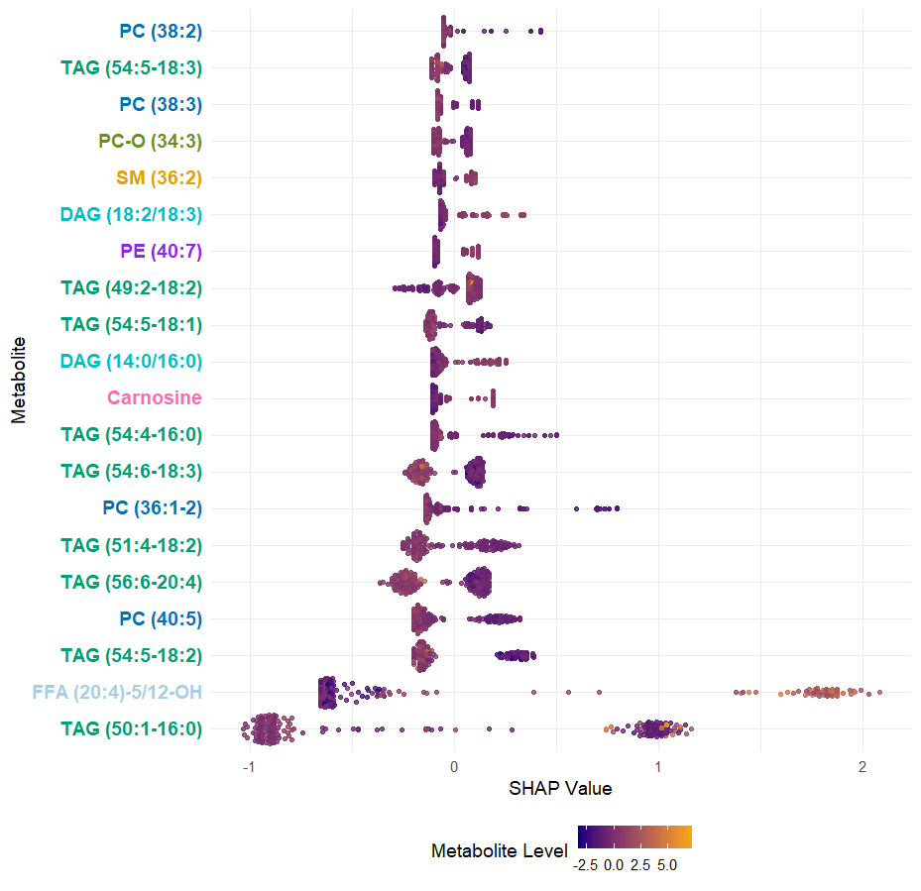
XGBoost: SHAP Values
SHAP (SHapley Additive exPlanations) summary plot displaying the distribution of SHAP values (ϕ) for the most influential features identified by a XGBoost model assuming that age, gender, BMI and Waistline (cm) are in the model. SHAP values represent the contribution of each feature to the model's output for individual predictions.
Triacylglycerols (TAG (54:6-18:3), TAG (51:4-18:2)), phosphatidylcholine (PC (36:1-2)) and Sphingomyelin (SM (36:2)) cluster near 0
Phospholipids (PC (38:2), PC (38:3), PC-O (34:3)) and some DAG (DAG (18:2/18:3)) species show both positive and negative contributions.
The fatty acid (FFA (20:4-5/12-OH)) and triacylglycerol (TAG (50:1-16:0)) show primarily negative SHAP values
Carnosine behaves differently than lipids

Slide 64
XGBoost: Difference Between Groups
H0: no difference in SHAP values between Healthy and Type 2 diabetic subjects
HA: difference in SHAP values between Healthy and Type 2 diabetic subjects
p-value < 2.2x10⁻¹⁶, i.e., there is a highly significant difference in SHAP values between Healthy and Type 2 diabetic subjects

Slide 65
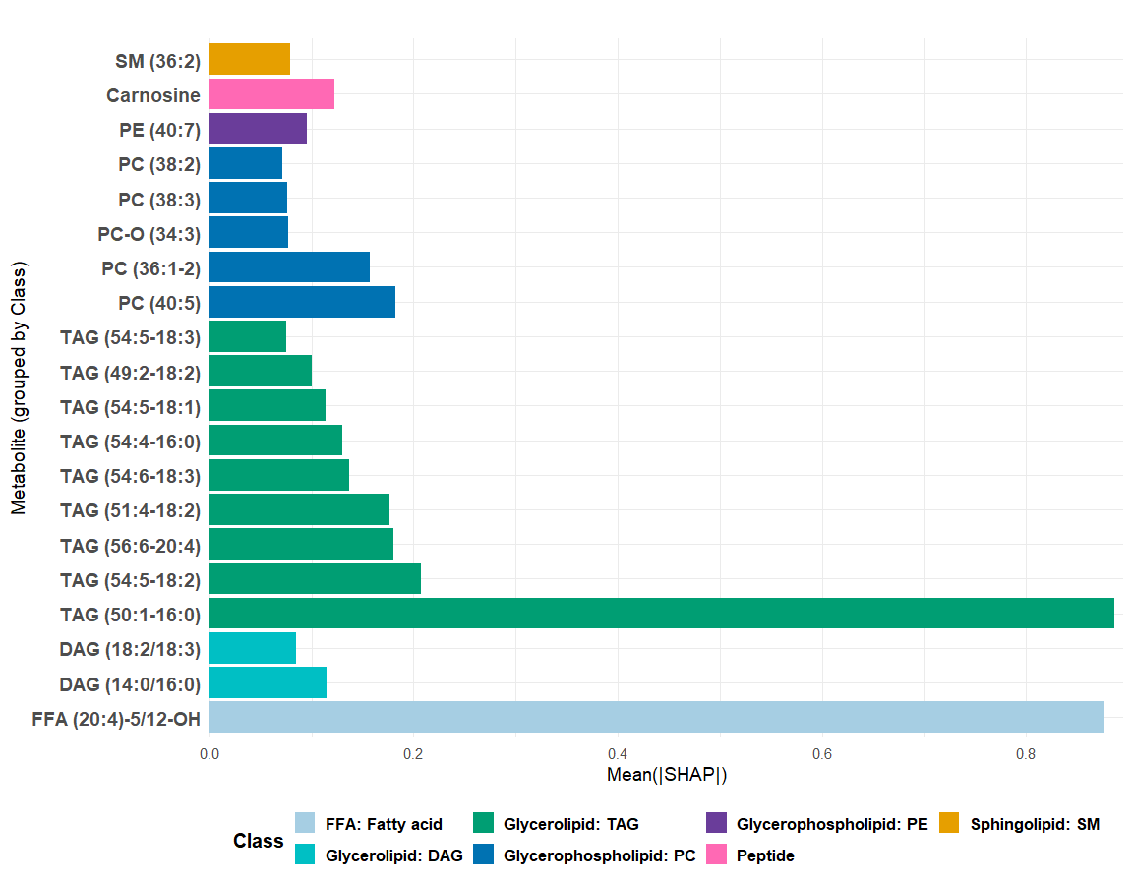
XGBoost: Mean(|SHAP|)
This plot is a bar chart that shows the global importance of metabolites in XGBoost model, assuming that age, gender, BMI and Waistline (cm) are in the model, based on the average magnitude of their SHAP (Shapley Additive Explanations) values.
The free fatty acid (FFA (20:4)-5/12-OH) is the most influential metabolite
TAG (TAG (50:1-16:0), TAG (56:6-20:4), etc.) species dominate the next tier of importance.
DAGs (DAG (18:2/18:3), DAG (14:0/16:0)) also contribute meaningfully.
Phospholipids (PC (40:5), PC (36:1-2), PC-O (34:3), PC (38:3), PC (38:2), PE (40:7)) show moderate importance.
Carnosine and Sphingomyelin (SM (36:2) are lower-impact metabolites.

Slide 66
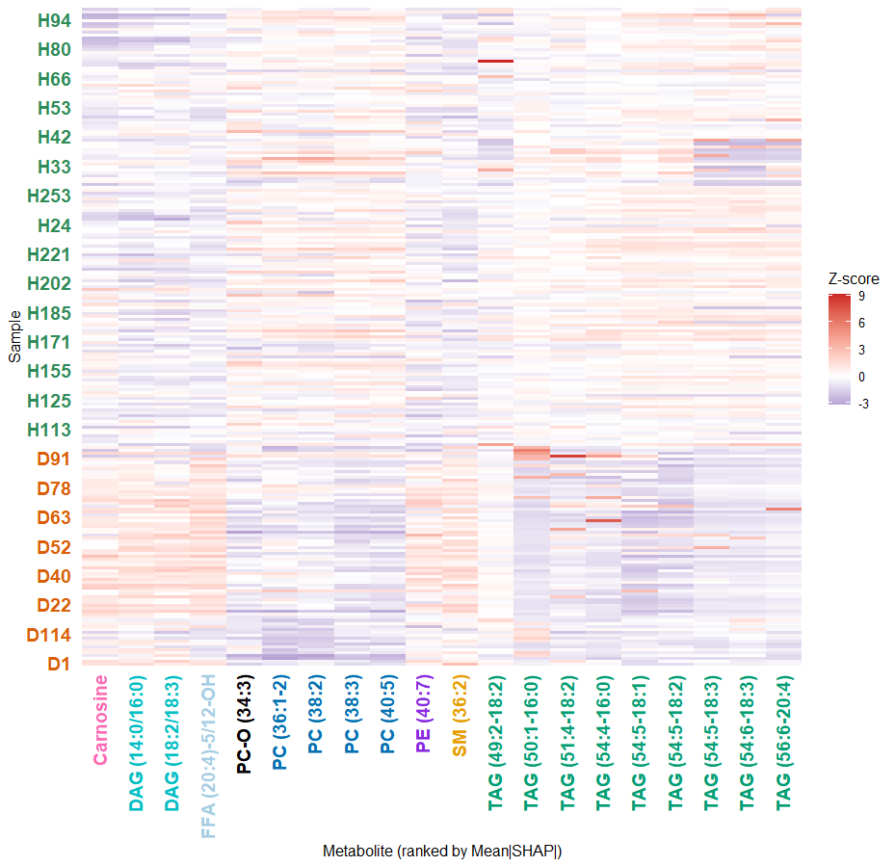
XGBoost: Mean(|SHAP|) per Metabolite
Heatmap shows the top 20 metabolites ranked by mean absolute SHAP values as identified by the XGBoost model, assuming that age, gender, BMI and Waistline (cm) are in the model.
There is a clear metabolic differences between healthy and diabetic groups
Triacylglycerols (TAGs) and free fatty acids (FFAs) show strong group-level differences.
Phosphatidylcholines (PC (36:1-2), PC (38:2), PC (38:3)), phosphatidylethanolamine (PE (40:7)), and sphingomyelin (SM (36:2)) show more mixed patterns, with variation across individuals.
Carnosine and some DAGs show distinct behavior.
T2DM samples exhibit more variability overall.

Slide 67
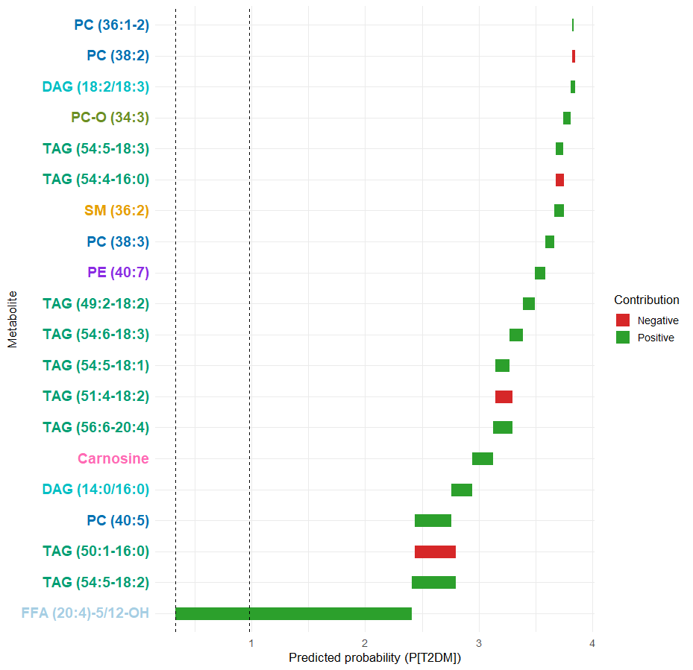
XGBoost: Predicted Probability (P(T2DM))
Waterfall plot that explains how individual metabolite contributions from a XGBoost model, assuming that age, gender, BMI and Waistline (cm) are in the model, influence the predicted probability for a specific sample (D1) of having the target outcome (likely PT2DM).
The free fatty acid (FFA (20:4)-5/12-OH) is the strongest driver of a higher T2DM probability.
Several TAG (TAG (54:5-18:2), TAG (50:1-16:0), TAG (56:6-20:4), etc.) species strongly push the prediction upward.
Triacylglycerol (TAG (50:1-16:0)), Sphingomyelin (SM (36:2)), Carnosine, diacylglycerol (DAG (14:0/16:0)) decrease the predicted probability.
The combined effect of metabolites pushes the final prediction far above the baseline.

Slide 68
XGBoost: Conclusions
The XGBoost classifier identifies T2DM primarily through patterns of lipid overload—especially TAGs, DAGs, and the highly influential free fatty acid (FFA (20:4)-5/12-OH).
Phospholipids, sphingolipids, and peptides provide smaller but consistent refinements.
The model captures nonlinear, threshold-based increases in diabetes risk associated with lipid accumulation, reflecting true metabolic phenotypes of insulin resistance.

Slide 69
All three models
Elastic Net shows a linear, additive lipid signature dominated by TAGs and organic acids, with directionally consistent effects.
Random Forest shows a nonlinear lipid-overload signature dominated by TAGs, DAGs, and FFAs, with moderate influence from phospholipids.
XGBoost is the most nuanced model—capturing nonlinear, threshold-based, and interaction-driven lipid relationships.

Slide 70
All three models
Across all SHAP analyses, T2DM prediction is consistently driven by a lipid-centered metabolic signature dominated by elevated TAGs, DAGs, and specific FFAs.
These models together paint a unified picture of dysregulated lipid metabolism as the primary determinant of T2DM classification in this dataset.

Slide 71
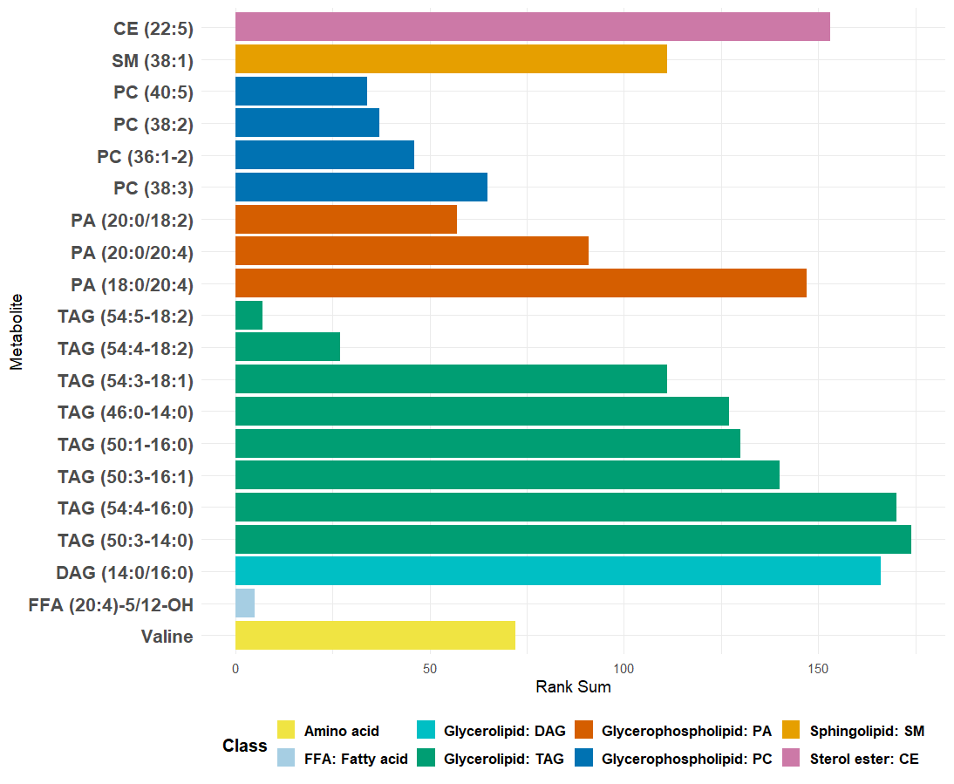
Metabolite Importance Based on Rank Sum
The free fatty acid (FFA (20:4)-5/12-OH) and triacylglycerol (TAG (54:5-18:2)) are the top consensus metabolites
Valine, phosphatidic acid (PA(20:0/20:4)) and triacylglycerol (TAG(54:3-18:1)) are the middle-ranked metabolites
Triacylglycerols (TAG(54:4-16:0), TAG(50:3-14:0)) and cholesteryl ester (CE (22:5)) are the lower consensus metabolites

Slide 72
Metabolites from all three models
Elastic Net
Random
Forest
FFA (20:4)-5/12-OH, SM (32:0)
PC-O (34:3)
Glycolate,
SM (40:3)
CE (22:4),
PA: (18:0/22:6), (20:0/18:2) (20:0/20:4),
TAG (48:3-18:3)
3-Hydroxypropionic acid,
4-Hydroxyphenyllactate, CE (22:5),
DAG: (14:0/16:0), (18:1/20:4),
PC: (38:2), (40:5),
SM: (34:1), (36:1), (36:3), (38:1),
TAG: (52:3-18:1), (54:3-18:1), (52:5-18:2), (56:7-18:2), (52:4-16:1), (54:5-18:2),
Valine
3-Hydroxypropionic acid,
PC (40:6)
XGBoost

Slide 73
Metabolites from all three models
Random
Forest
Elastic Net
CE (22:5), Fumaric acid, Galactaric acid, PA (18:0/20:4), PC (38:3), PI (14:0/18:2),
TAG: (46:0-14:0), (54:4-18:2), (52:4-16:1), (54:3-18:1), (52:4-18:2), Valine
DAG: (16:0/16:0), (16:0/18:0),
SM (38:1),
TAG: (50:3-18:1), (52:3-16:1), (50:3-16:1), (54:4-18:0), (52:5-18:2), (54:4-18:1), (54:5-18:1), (52:3-16:0)
FFA (20:4)-5/12-OH
TAG: (54:6-18:3),(54:4-16:0), (50:1-16:0)
PA: (20:0/20:4), (20:0/18:2), PC: (40:5), (38:2), (36:1-2), TAG: (52:3-18:1), (54:5-18:2)
Carnosine, DAG (18:2/18:3), PC-O (34:3), PE (40:7), SM (36:2), TAG: (49:2-18:2), (56:6-20:4), (51:4-18:2), (54:5-18:3), (54:6-18:3)
XGBoost

Slide 74
Deriving an Interpretable Metabolite-Based Risk Score
500+ metabolites → reduced to 5 biologically meaningful axes
Based on cross-model stability (Elastic Net, RF, XGBoost SHAP)
Predictors showed monotonic relationships (validated via SHAP)
Penalized logistic regression used to estimate interpretable coefficients

Slide 75
Deriving an Interpretable Metabolite-Based Risk Score
Full metabolomics dataset
↓
SHAP / feature stability
↓
Biochemically grouped predictors
TAG, PA, SM, PC(38:2), Valine
↓
Penalized logistic regression
↓
Interpretable risk score

Slide 76
Predictors Included in the Score
Predictor | Biological meaning | Monotonicity | Contribution to Risk
TAG_score | TAG-rich lipid storage | ↓ | strong negative
PA_score | Membrane remodeling lipids | ↑ | strong positive
SM_score | Sphingomyelins / ceramide axis | ↑ | strong positive
PC(38:2) | Glycerophospholipid remodeling | ↓ | strong negative
Valine | Branched-Chain Amino Acid (BCAA) metabolism / insulin resistance | ↑ | strong positive

Slide 77
Final Interpretable Risk Score (Continuous Model)
MRS = -0.74*TAG_score+0.64*PA_score+1.09*SM_score-1.19*PC(38:2)+1.04*Valine
  Coefficients derived using penalized logistic regression
  All predictors standardized (log-transformed and Pareto scaled)
  Higher score → higher metabolic signature of T2DM

Slide 78
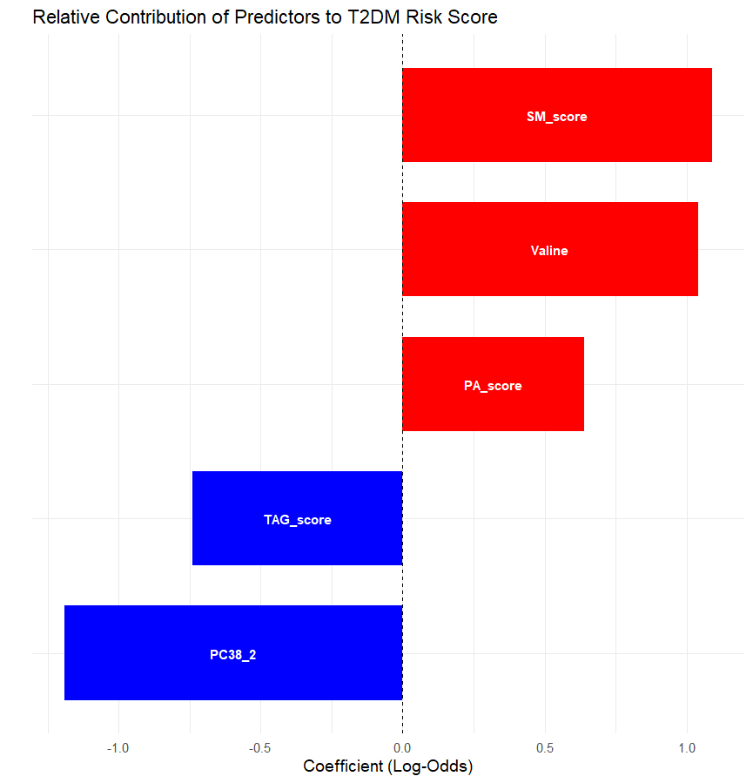
Relative Contribution of Predictors to the MRS
Valine and SM contribute most strongly
TAG and PC (38:2) are protective (negative coefficient)

Slide 79
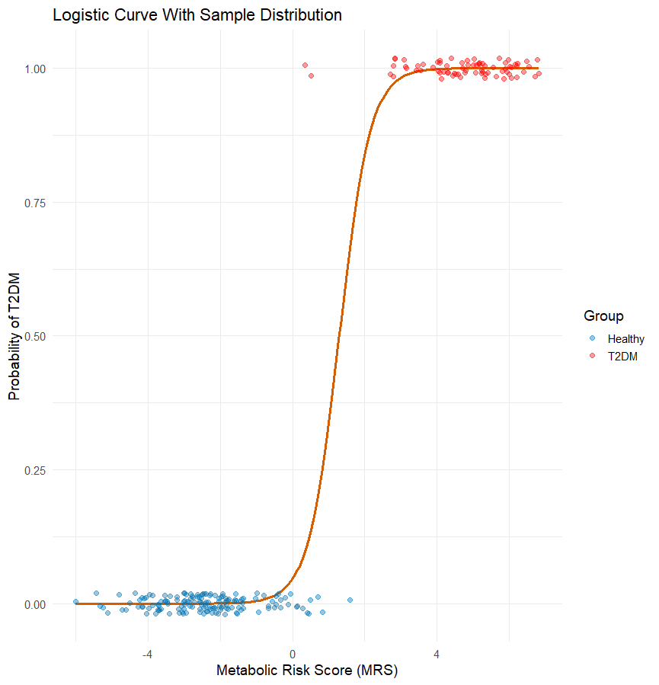
From MRS to Probability
p(T2DM) = 1 / (1+exp(-(-1.65+MRS)))
This plot shows how the MRS translates into the predicted probability of having Type 2 Diabetes (T2DM) using the logistic model. The orange curve is the logistic function, and each point represents an individual in the dataset.
Low MRS values (≈ –5 to –1) correspond to very low predicted T2DM probabilities (near 0), and almost all individuals in this range are Healthy (blue)
High MRS values (≥ 2) produce predicted probabilities very close to 1, and nearly all individuals in this region are T2DM (red).

Slide 80
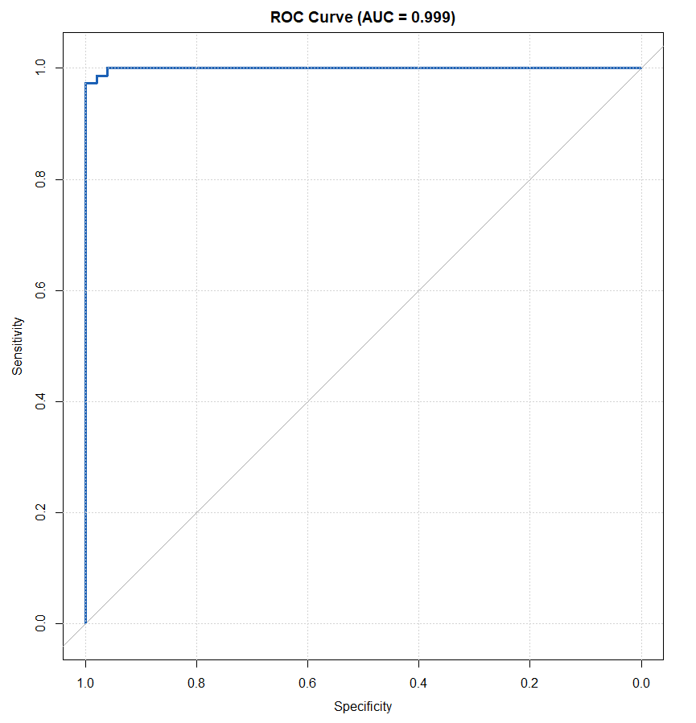
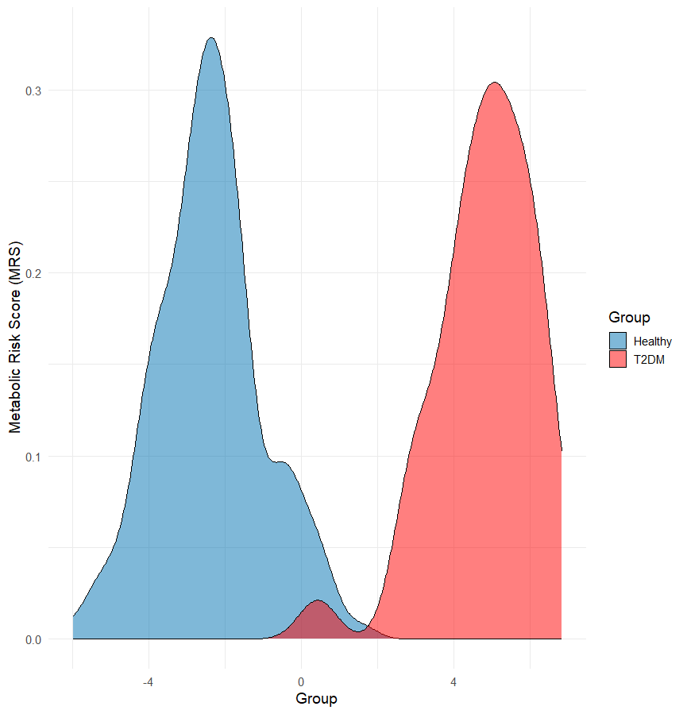
Model Performance (Training set)
AUC = 0.999
Clear separation between T2DM and healthy controls

Slide 81
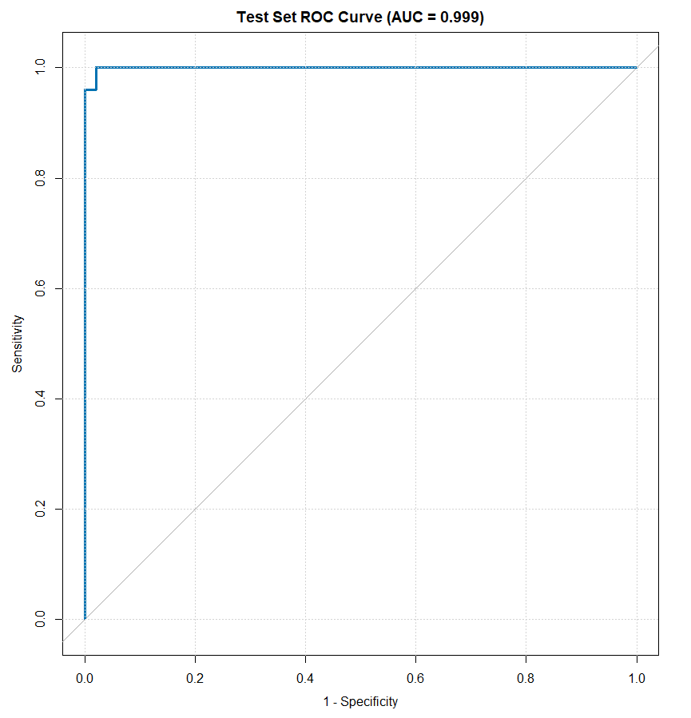
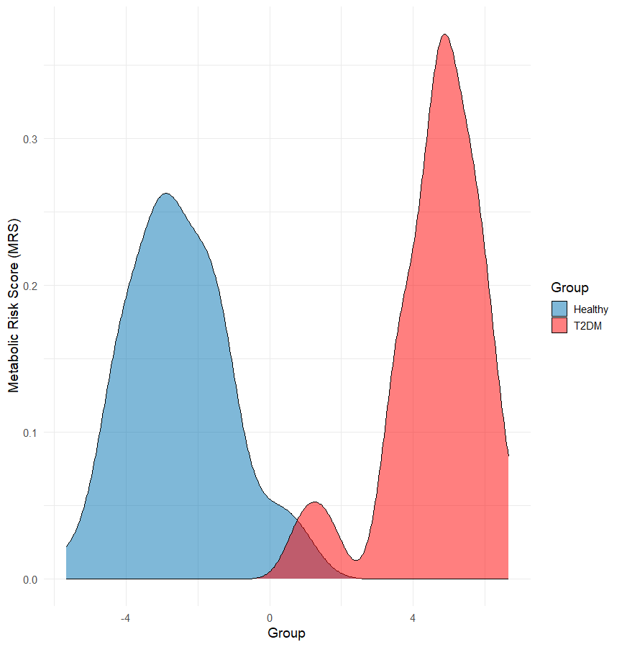
Model Performance (Testing set)
AUC = 0.999
Clear separation between T2DM and healthy controls

Slide 82
Clinical/Biological Interpretability
Each metabolite axis has mechanistic links to T2DM
Strong alignment with known lipidomic and BCAA signatures
Score is linearly interpretable
  +1 SD increase in Valine increases log-odds of T2DM by 1.04
  +1 SD increase in PC (38:2) decreases the log-odds of T2DM by 1.19

Slide 83
External Validation Attempt
Goal:
  Assess whether the interpretable 5-metabolite risk score (TAG_score, PA_score, SM_score, PC (38:2), Valine) generalizes to independent public metabolomics datasets.
Public datasets reviewed:
  Metabolomics Workbench (MW)
  HMDB-linked metabolomics studies
  LC–MS and NMR human metabolic disease datasets
  T2DM and metabolic syndrome cohorts

Slide 84
External Validation Attempt
Validation requirements:
  Processed metabolite intensity tables (now RAW MS files)
  Species-level lipidomics: TAGs, SMs, PCs, PAs
  Amino acids including Valine
  Case-control structure (Healthy vs T2DM)

Slide 85
External Validation Attempt
Findings:
  Many datasets provided only RAW files (no processed metabolite tables).
  Others contained only amino acids or only partial lipid profiles.
  PA species were absent in every dataset examined.
  No dataset contained the full metabolite set needed to compute the risk score.
External validation of the complete 5-metabolite risk score was not possible with currently available public datasets, due to incomplete or incompatible metabolite coverage

Slide 86
Future Work
Pathway mapping – Feed the overlapping top features into KEGG/LIPID MAPS to identify coherent metabolic pathways (e.g., branched‑chain amino‑acid catabolism, altered TAG species).
Cross‑validation stability – Verify that the Gain rankings are stable across CV folds; large variance suggests overfit to specific splits.

