Slide 1
UBER PRICE PREDICTION
Linear regression

Slide 2
PROBLEM STATEMENT
The fare amount of a ride is influenced by various factors such as distance, duration, traffic conditions, time of day, and demand. Your goal is to develop a regression model that can predict the fare amount based on these factors. You will work with a dataset that includes historical ride data, including the fare amount and relevant features.

Slide 3
STRATEGY
Import data
Clean and prepare acquired data for further analysis
Exploratory data analysis for figuring out most helpful attributes for conversion
Prepare the data model building
Build a logistic regression model
Test the model on train set
Evaluate model by different measures ad metrics.
Test the model on test set
Measure the accuracy of model and other metrics for evaluation

Slide 4
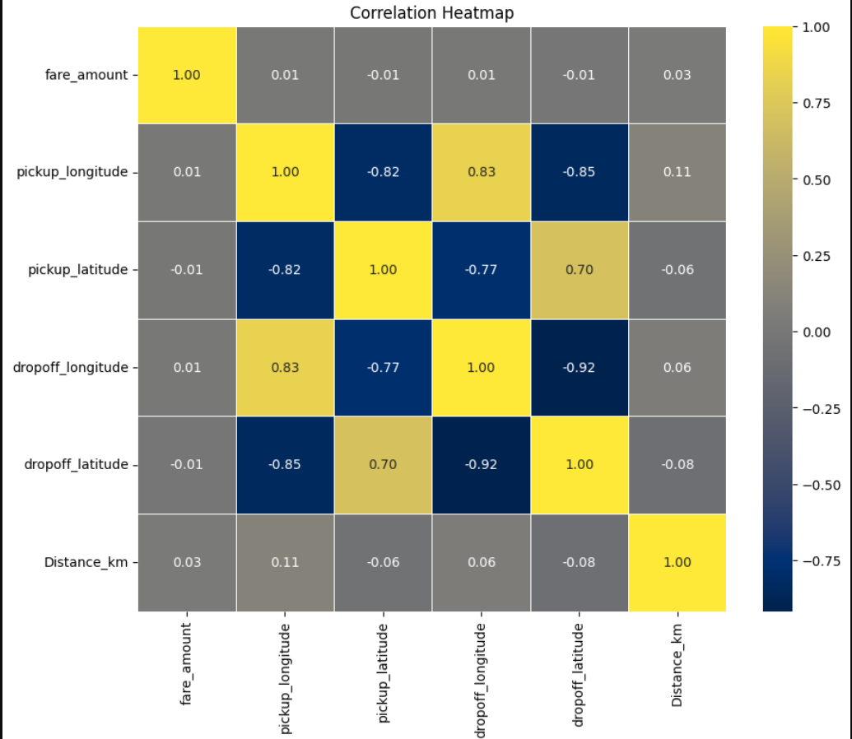
Each square shows the correlation between the variables on each axis. Correlation ranges from -1 to +1. Values closer to zero means there is no linear trend between two variables. The close to 1 correlation is the more positively correlated. The diagonals are all 1/dark yellow because those squares are correlating each variable to itself (so it's a perfect correlation). For the rest the larger the number and darker the color the higher the correlation between the two variables.

Slide 5
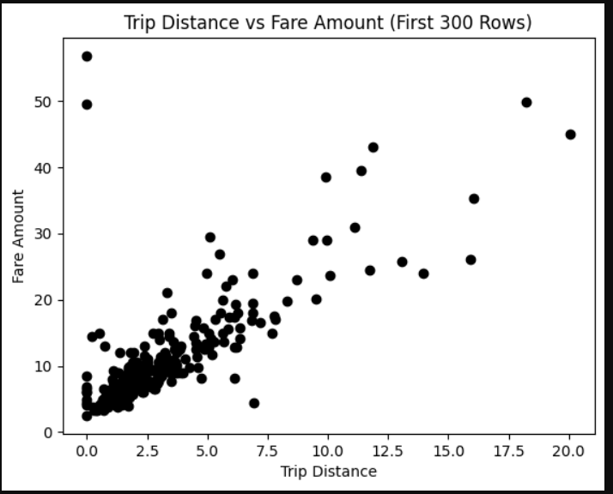

Slide 6
CONCLUSION
The project revolves around the world's largest taxi company, Uber Inc. We aim to predict taxi fares based on variables such as pickup_longitude, pickup_latitude, dropoff_longitude, dropoff_latitude, and Distance_km.To achieve this, we'll undertake the following steps:
Explore the dataset to understand its structure, distributions, and relationships between variables.
Use more insight for better understanding.
Utilize linear regression, a simple yet powerful modeling technique, to predict taxi fares based on the selected variables.Train the model on a subset of the data and evaluate its performance using appropriate metrics such as R-squared, mean squared error, etc.
we aim to develop a robust predictive model that accurately estimates taxi fares for Uber Inc., thereby contributing to decision-making and operational efficiency within the company.

