Slide 1

Traffic Sign Recognition Using Deep Learning
Name: Sushruth Danivasa Sridhar
Course: Programming for Machine Learning

Slide 2
Introduction
Problem Statement: Traffic sign recognition is critical for autonomous driving and road safety.
Objective: Build a model to classify traffic signs into 43 categories using the German Traffic Sign Recognition Benchmark (GTSRB).
Significance: Reduces human error, ensures real-time decisions, and enhances driver assistance systems.

Slide 3
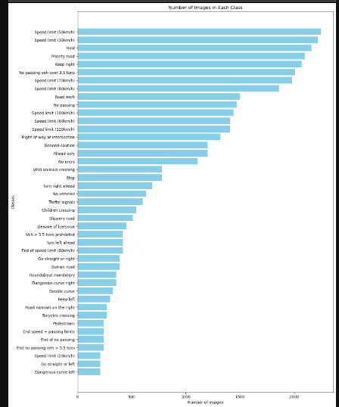
Dataset Overview
Source: GTSRB Dataset.
Dataset Details:
43 classes of traffic signs.
~39,000 training images.
~12,000 testing images.

Slide 4
Methodology
Workflow:
Data Preprocessing:
Resize to 30×30, normalization, one-hot encoding.
Data Augmentation:
Techniques: rotation, zoom, shifting, etc.
Model Training:
Trained three models: MobileNetV2, Model 2 (Custom CNN), and Model 3 (Enhanced CNN).
Evaluation:
Used metrics like accuracy, confusion matrix, and ROC-AUC scores to determine the best model
Data Collection → Data Preprocessing → Model Development → Training & Validation → Evaluation & Insights

Slide 5
Model Architectures
Feature | Model 1 (MobileNetV2) | Model 2 (Custom CNN) | Model 3 (Enhanced CNN)
Base Model | Pre-trained MobileNetV2 | Custom architecture | Enhanced architecture
Parameters | ~2M | ~4M | ~4.5M
Accuracy | 79.22% | 98.81% | 98.52%

Slide 6
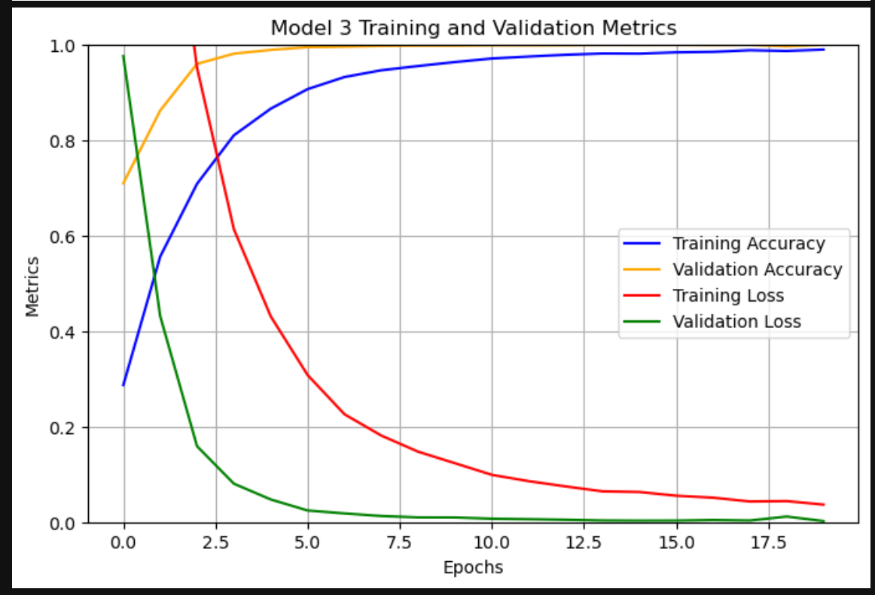
Results and Evaluation
Model 1
Accuracy: 0.7922
Precision: 0.8056
Recall: 0.7922
F1-Score: 0.7919
ROC-AUC Score: 0.99051045
Model 2
Accuracy: 0.9881
Precision: 0.9892
Recall: 0.9881
F1-Score: 0.9878
ROC-AUC Score: 0.99987625
Model 3
Accuracy: 0.9852
Precision: 0.9856
Recall: 0.9852
F1-Score: 0.9850
ROC-AUC Score: 0.99995824

Slide 7
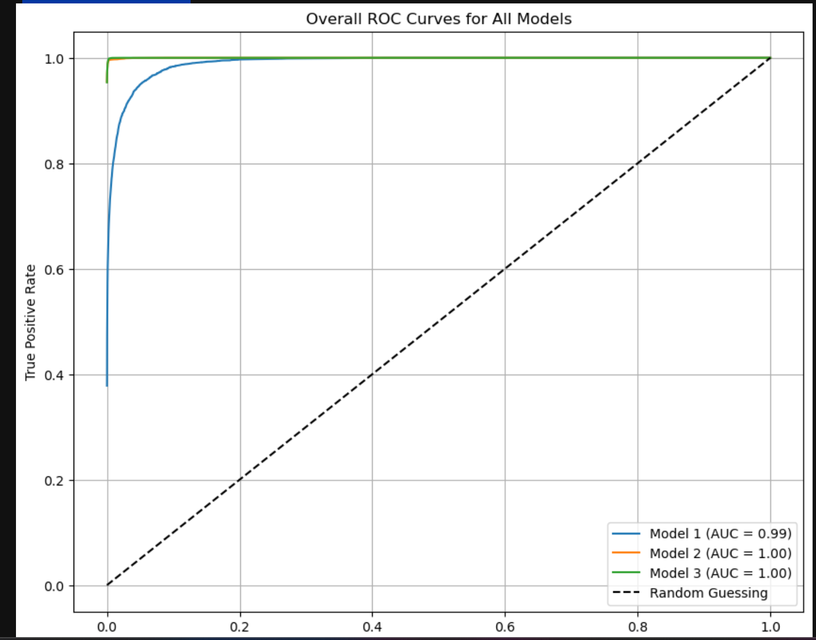
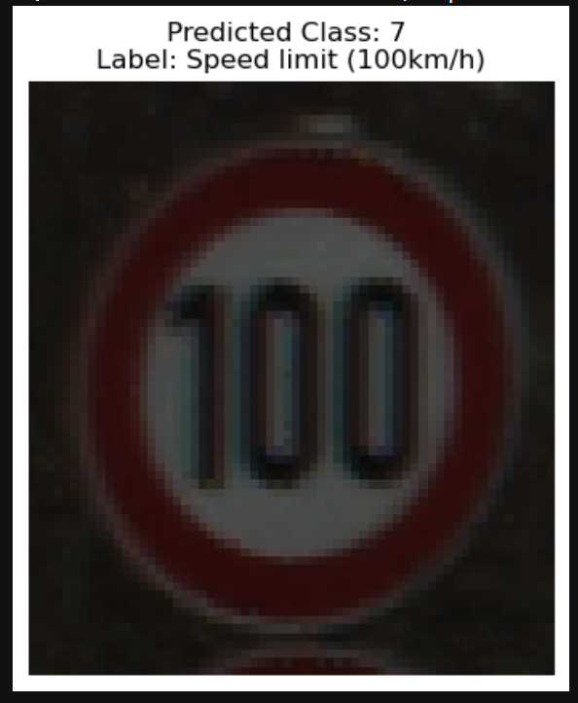

Slide 8
Challenges
Overfitting: Solved using data augmentation, dropout, and L2 regularization.
Imbalanced Classes: Addressed through class balancing techniques and augmentation.
Execution Time: Increased with complexity; mitigated using pre-trained models for Model 1.

Slide 9
Lessons Learned
Data Augmentation: Significantly improved generalization by diversifying the dataset.
Model Selection: Model 3, though complex, achieved better results due to its architecture and hyperparameter optimization.
Importance of Regularization: Techniques like Dropout and L2 regularization were crucial in achieving high validation accuracy.

Slide 10
Conclusion and Future Work
Conclusion:
Model 3 performed best with 98.52% accuracy.
Deep learning effectively handles traffic sign classification.
Future Work:
Real-time detection and classification.
Deployment on edge devices (Raspberry Pi).Expand to include multilingual traffic sign datasets.

Slide 11
Thank you

