Slide 1
SOLID principles of object-oriented design
CMS Tech Team brownbag session

Slide 2
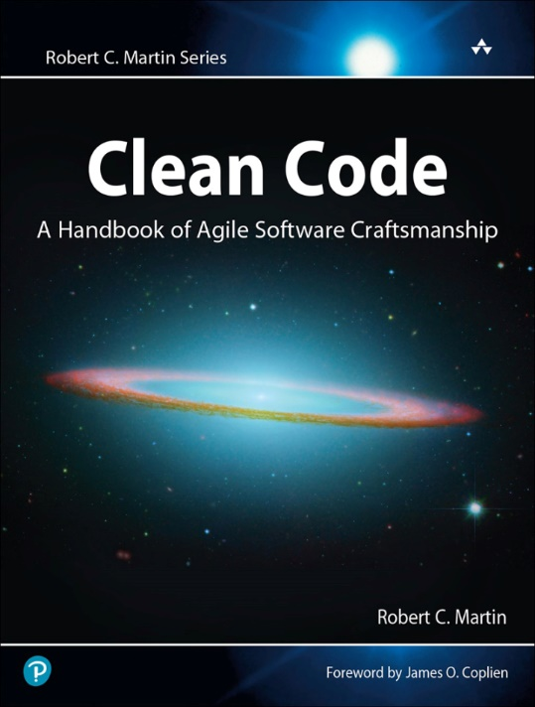
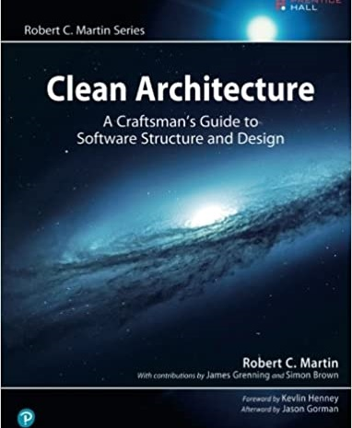
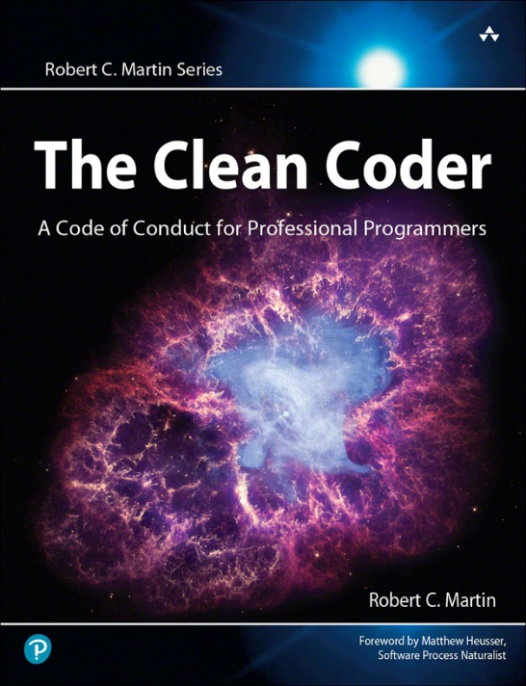
S.O.L.I.D.
S – Single Responsibility Principle
O – Open Close Principle
L – Liskov Substitution Principle
I - Interface Segregation Principle
D – Dependency Inversion Principle
This Photo by Unknown Author is licensed under CC BY

Slide 3
Single Responsibility Principle
A class should do one thing and therefore have one, and only one, reason to change.

Slide 4
Open Close Principle
A class should be open for extension but closed for modification.

Slide 5
Liskov Substitution Principle
Derived classes must be substitutable for their base classes.

Slide 6
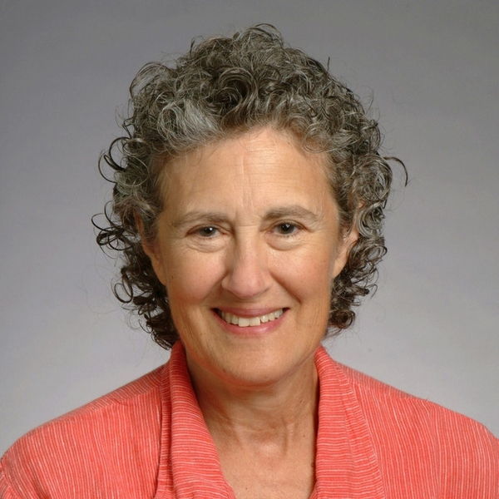
Liskov Substitution Principle
This principle is closely related to the SRP and the OCP, as it helps to ensure that the classes are cohesive and that the program is extensible and maintainable.
Barbara Liskov is an American computer scientist and Turing Award winner known for her work on programming language design and the development of the Liskov Substitution Principle, a concept in object-oriented programming.
She is an Institute Professor at the Massachusetts Institute of Technology (MIT) and a founding member of the computer science department at MIT.
She was awarded the Turing award for her influential work on programming languages.

Slide 7
Interface Segregation Principle
A class should not be forced to implement interfaces it does not use.

Slide 8
Dependency Inversion Principle
High-level modules should not depend on low-level modules; both should depend on abstractions.

