Slide 1
Managed Applications overview
Mastering Managed Application offers
Notes:
Welcome to this module offering an overview of Managed Applications
NAME
This module walks through the fundamentals of managed applications and helps orient you to the rest of the course.
Don’t worry, this won’t just be a module to tell you what’s in the other modules. Let’s see what we’re about to cover.

Slide 2
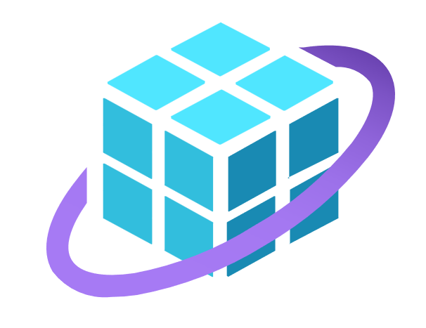
Azure Apps in a nutshell
Managed Applications overview
Managed Apps in the Azure Marketplace
Notes:
Here’s a quick overview of what you’ll find in this module of the course
Azure Apps in a nutshell
We’ll take a quick look at Azure Apps and see some different flavors of them
Managed Applications overview
Next, you’ll get an overview of Managed Applications, the type of Azure Application we’ll focus on in this course
Managed Apps in the Azure Marketplace
Finally, we’ll see how Managed Applications are integrated into the Azure Marketplace

Slide 3
Azure Applications in a nutshell
Notes:
Let’s kick off with what Azure Applications are.

Slide 4
A powerful solution deployment model
A packaging model for software deployments
Installs to the customer’s tenant
Can contain anything ARM templates can deploy
Also contains the software solution
Notes:
A powerful solution deployment model
At their core, Azure Apps are simply a way to package and deploy your software solution for your customers
As you’ll come to understand throughout this course, they offer a powerful deployment architecture
A packaging model for software deployments
Package existing software solution
Installs to the customer’s tenant
Deployment architecture for installing software to the customer’s tenant
Can contain anything ARM templates can deploy
Can contain any Azure resources deployable via ARM templates
Also contains the software solution
Also, will contain the proprietary software solution
For these and other reasons, publishers often choose Azure Apps to deploy their solutions.

Slide 5
Two types of Azure Applications
Solution Templates
Managed Applications
Not transactable in the Azure Marketplace
Transactable in the Azure Marketplace
Notes:
There are two types of Azure Apps one can create, solution templates and Managed Applications
Solution templates
Managed Applications
The biggest difference between these Azure Application types is transactability
ADVANCE
Not transactable in the Azure Marketplace
Solution templates are not transactable in the Azure Marketplace
This means they cannot be sold through Microsoft
This also means that solution template offers are not eligible for most marketplace benefits afforded to transactable offers
ADVANCE
Transactable in the Azure Marketplace
Managed Applications, on the other hand, are transactable
This means MS sells the solution on your behalf
Deploying Managed Application offers comes with many business benefits, which are beyond the scope of this video
Now let's focus on Managed Applications. First, we'll have a look at their traditional deployment model

Slide 6
This course will focus exclusively on Managed Applications
Notes:
Because of their transactability, this rest of this course focuses on Managed Applications, so don’t expect to hear too much more about Solution Template offers.

Slide 7
Managed Applications overview
Notes:
Okay, let's dig in. We'll move into an overview of Managed Apps

Slide 8
Introducing Managed Applications
The transactable Azure Application option
Deploy to special Managed Resource Group (MRG)
Different deployment models
Notes:
Managed apps some have unique characteristics
The transactable Azure Application option
As we’ve mentioned, Managed Apps are transactable through the Azure Marketplace
And Microsoft will bill the customer on behalf of the publisher
Deploy to special Managed Resource Group (MRG)
Resources deploy into a special resource group called a Managed Resource Group (MRG) in the customer’s tenant
We’ll be talking a lot about the MRG in this course
The fact that the MRG exists in the customer’s tenant means the customer pays for running the Azure resources that are part of the solution
Different deployment models
Different deployment models dictate who will maintain the solution over time
We can specify what access rights the customer and the publisher have to the MRG
We’ll cover this in great depth in the next module of this course
Speaking of that MRG, let's look at the MA deployment model

Slide 9



Customer’s Tenant
Managed Application
Managed Resource Group
Publisher
Customer
Notes:
You just heard about the MRG (managed Resource Group)
Let’s walk through a visual on what’s deployed with a managed app and how to make the MRG idea more concrete
When a customer purchases the Managed Application, 2 things are deployed into the customer’s tenant, under the customer’s subscription
ADVANCE
A Managed Application instance, which essentially represents the subscription to the application
ADVANCE
Next, a special resource group, called the Managed Resource Group (MRG), which contains all the resources deployed by the Azure Application
We’ll talk in great depth in future modules about this MRG.
What it contains
How the resources in it are managed
ADVANCE
You can see the MRG has some data storage services, an App Service, and even a custom VM
Anything deployable by an ARM template can be created in this MRG when it is deployed
ADVANCE
Depending on how you configure the application to be managed, the publisher may have access to the MRG and its contents
ADVANCE
The same is true for customers, whose configuration to the MRG and its resources is also configurable.
Thus, customers may have different types of access to the MRG
We’ll explore this concept of access modes in the next module of this course
That’s the Managed Application deployment architecture in a nutshell.

Slide 10
For internal and external use
Internal
External
Deploy to internal Azure environments
Used inside an organization
Uses Azure Service Catalog
Deploy to external customers
Via the Azure Marketplace
A sellable product offer
Notes:
Managed apps can be used internally to an organization or through the Azure Marketplace
Let’s see the differences
INTERNAL
Deploy to internal Azure environments
One can build Managed Applications that are meant to deploy only within an organization
Used inside an organization
Of course, this is meant to provide Managed Applications that are available for installation within an organization only
An internal catalog of products
We use an Azure service called Service Catalog to create the Managed Apps available inside the organization
As we’ll see, we can use the service catalog for development of Managed Applications in general
EXTERNAL
Deploy to external customers
Managed apps can also be offered for sale to external customers
Via the Azure Marketplace
This is done by publishing the offer in the Azure Marketplace
A sellable product offer
This makes it sellable and transactable
Let’s take a moment to learn just a bit more about the service catalog and how we might use it

Slide 11
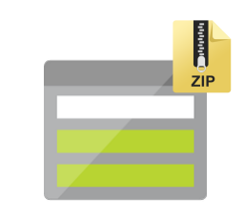

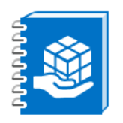
Service catalog process
Service catalog App definition
Managed application
Deployment package in storage account
Notes:
Service catalog process
Let’s look at a simple model of what it means to publish and deploy a App through the service catalog
ADVANCE
First, a deployment package file is uploaded to a blob storage account
ADVANCE
Then, in the service catalog, we create a Application definition that references that deployment package file
ADVANCE
Finally, we can deploy from that app definition to create the actual Application

Slide 12

Common development flow
Create deployment assets
Add assets to service catalog app definition
Deploy as internal app
Notes:
The Service catalog can be very useful in the development of new Apps
It gives developers an opportunity to test out their deployments before without needing to test in the Azure Marketplace, which would take longer in between iterations
Create deployment assets
There are several assets needed to package and deploy a Application
For example, you’ll need an ARM template
So, the first step is to create these assets that will deploy your solution
Add app to Service catalog
Next, the deployment assets are loaded into the service catalog
This makes the solution available for deployment
Deploy as internal app
Deploy app as internal application to check deployment process
This gives developers an opportunity to try their deployment package before integrating into a formal offer in the Azure Marketplace.

Slide 13
The service catalog can aide the development process.
Does not create transactable offers in the Azure Marketplace.
Notes:
The service catalog can aide the development process
We discussed how the service catalog in Azure can be helpful to our development process
Does not create transactable offers in the Azure Marketplace
And it’s important to remember that it’s a great tool, but does not make our application available as an offer in the Azure Marketplace
We spent a little time here on the service catalog because it will be used in labs and in some later demos, so it is useful to know what it is.

Slide 14
Managed Apps in the Azure Marketplace
Notes:
Now that we've seen a bit about managed apps and the fact that we can use them in the context of a Service catalog in Azure, let's focus on how MAs work in the Azure Marketplace

Slide 15
Offer types
SaaS offers
Container offers for Kubernetes
Virtual machine offers
Managed Application offers
Four transactable Azure Marketplace offer types
Notes:
Four transactable Azure Marketplace offer types
At the time of this recording, there are four transactable offer types one may choose from when creating offers for the Azure Marketplace
These differ based on deployment architecture
SaaS offers
Offers that integrate with the publisher’s software-as-a-service product architecture
Container offers for Kubernetes
Container offers that allow packaging your solution into containers and deploying to the customer’s Azure Kubernetes service
Virtual machine offers
Virtual machine offers that allow packaging solutions onto VMs and deploying them to the customer’s tenant
Managed Application offers
Managed Applications, which is the focus of this course
Just know that there are different deployment models based on different solution architecture needs
All but SaaS offers deploy into the customer’s tenant

Slide 16

Azure Marketplace
Customer’s Tenant
Offer
Silver Plan
Managed Application
Gold Plan
Deployment
Managed Resource Group
Platinum Plan
Notes:
You’ve already seen how the application is deployed into the customer’s tenant
Now let’s see how that works with the Azure Marketplace
ADVANCE
Here a public marketplace offer has been defined that has 3 associated plans: silver, gold, and platinum
When a customer subscribes to the gold plan, for example, the deployment occurs
ADVANCE
The Gold plan has a deployment package for the Azure Application and deploys the required elements into the customer’s tenant
Note that each plan has it’s own definition of the managed application, and can therefore deploy different resources into the MRG per plan

Slide 17

Plans have deployment packages
Contains deployment package files such as ARM templates and a UI definition​
Offer
Silver Plan
Gold Plan
Platinum Plan
Notes:
Each plan has an associated deployment package that is held in a ZIP file.
ADVANCE
These deployment packages contain artifacts like
the ARM template that does the deployment
and the file that defines the user interface a customer sees when subscribing to the offer

Slide 18
Pricing and billing options
Currently billed monthly
Supports metered billing
Notes:
There are some considerations for how to set up your offer such that the customer is billed for the solution.
Currently billed monthly
At the time of this recording, only monthly billing is supported for Managed Applications
This may change with time with more billing options being introduced
Annual billing is a possible example
Today, a publisher may, for example, set the monthly price of the solution
It is even possible to set the monthly charge as $0
Supports metered billing
In addition to flat rate pricing, Managed Applications also support metered billing
We’ll go much deeper into metered billing later in the course, but for now think of this as billing per transaction
The Managed Application can charge for specific transactions that take place in the application
For example, take the case of a document scanning service.
The solution may charge some amount per month as a flat fee,
And an additional amount per scan, 1 penny for example
With these billing capabilities, publishers can construct different way to price their solution

Slide 19
Azure Apps
Managed Applications
In the Azure Marketplace
Notes:
Azure Applications in a nutshell
We got a high-level overview of Azure Applications
We saw there are two types of Azure Applications,
Solution templates and Managed Applications
Managed Applications being the transactable type, and therefore the focus of this course
Managed Applications overview
You got an overview of managed applications to include the basic deployment architecture
Managed Applications in the Azure Marketplace
We saw that we can use Managed apps with the Azure Marketplace to deliver transactable solutions to customers
This means publishers can package and sell their software solutions through the Azure Marketplace

