Slide 1
COMPSCI 718
Programming for Industry
Lecture 15 – Introduction to Design Patterns

Slide 2
This week’s learning objectives
By the end of this week, you should be able to:
Describe what is meant by the term design pattern
Describe a small number of well-known and widely-used design patterns, in terms of their structure, benefits and consequences
Develop software that involves applying knowledge of design patterns

Slide 3
A design problem
A file store, e.g. your hard drive, is organised into directories and files. Each file has a name and size. A directory is a special kind of file that can contain other files – be they simple files or directories. A directory’s size is the sum of the sizes of its contents.
Construct a class diagram to show how you might model a directory structure.

Slide 4
Design patterns
A design pattern captures a proven solution to a common design problem
Common design problems include:
How to define the skeleton of an algorithm in a superclass and allow subclasses to redefine certain steps without changing the algorithm’s structure (Template Method pattern)
How to compose objects into tree structures, represent whole-part hierarchies, where leaf and composite nodes are treated uniformly (Composite pattern)
How to make objects with incompatible interfaces work together (the Adapter pattern)
How to define a one-to-many dependency between objects so that when one object changes state, all dependents are notified and updated automatically (the Observer pattern)
Design patterns are a way of harnessing the knowledge of experienced designers
Notes:
Design patterns tend to offer desirable benefits e.g.:
Flexibility (ease of change) – they make a software system easier to change/modify in the future.
Reusability – not having to reinvent the wheel, being able to reuse abstractions (classes) in diverse applications.
Robustness – safeguards against programmer error.

Slide 5
Similar design problems
A file store is organised into directories and files. A file is a primitive object that doesn’t contain other files or directories. A directory is a special kind of file that may contain other files (including directories).
A nesting shape is a special kind of shape which may contain other (nested and non-nested) shapes. The contained shapes move and bounce around within the nested shape.
GUIs are composed from components. Simple components include buttons, text fields, combo boxes, etc. Container components include panels, frames, dialog boxes etc. Containers may contain other containers in addition to simple components.
The above describe very different applications, but they have in common the basic requirement to represent containment hierarchies of arbitrary depth

Slide 6
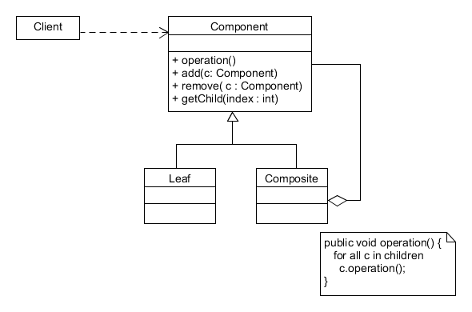
The Composite pattern
“Compose objects into tree structures to represent whole-part hierarchies. Composite lets clients treat individual objects and compositions of objects uniformly.”
Class structure
Manipulates objects using the Component “interface”
Defines an “interface” for objects in the composition;
implements default behaviour as appropriate;
defines an interface for managing children
Represents objects that have no children;
implements behaviour for such objects
Represents objects that can have children

Slide 7
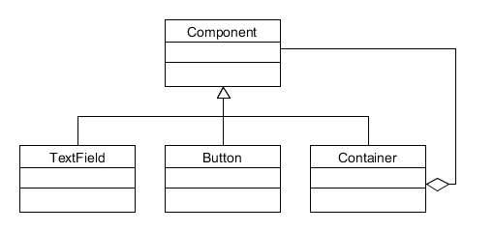
Application #1: GUI layout
: Client
Component
1: paint()
: JFrame
2: paint()
7: paint()
: JPanel
: JTextField
Leaf
Leaf
Composite
3: paint()
4: paint()
: JButton
: JPanel
6: paint()
5: paint()
: JButton
: JLabel
Notes:
In the AWT, Component is, sensibly, an abstract class.
In the File/Directory case, File isn’t abstract – this should be instantiated to represent simple files.

Slide 8
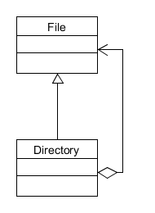
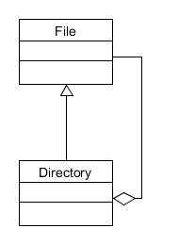
Application #2: Filestore
Component / Leaf
public class File {
…
}
public class Directory extends File {
List<File> contents;
…
}
public class File {
Directory parent;
…
}
public class Directory extends File {
List<File> contents;
…
}
Composite

Slide 9
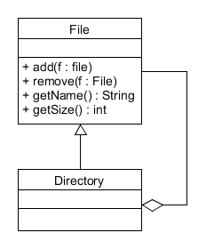
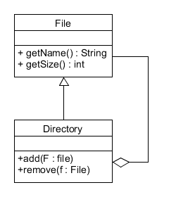
Implementation: Where to define child management operations?
The first (left) option promotes transparency – client code, via a File type reference variable, treats all File and Directory objects uniformly. However, it is less type safe – the compiler will not detect an attempt to add, for example, to a File object.
The second option promotes type safety but forces client code to distinguish between File and Directory instances.
Increasing compile-time safety
Increasing
transparency
Notes:
Implementation for File/Directory available on Cecil. This conforms to the design on the right that declares child management operations in the container (Directory) class.

Slide 10
Example: adding a new File to every top-level Directory in a collection
File parent = …
try {
parent.add(new File());
} catch (CompositeException e) {
/* Child management operation invoked on a primitive file. */
}
Where transparency is favoured, make all child management operations in the Leaf class throw an exception.
Where compile-time safety is required, accessing child management operations (defined in the Composite class) can only be done through a reference variable of the Composite type.
File parent = …
Directory parentDir= (Directory) parent;
parentDir.add(new File());

Slide 11
Implementation: use of parent references
null
: Directory
parent
children
Maintaining references from child components to their parents is often desirable
E.g. File objects might need to know their parent so that they could return their full path name
It’s essential to maintain the invariant that all children of a composite have as their parent the composite that in turn has them as children
: File
✓
root
parent
null
: Directory
parent
: Directory
children
: File
✗
root
parent
Only change a child’s parent when the child is added to or removed from a composite (Directory’s add( ) and remove( ) methods).
Notes:
In the situation shown on the bottom right, the invariant has been broken. In this case a cycle has been introduced.

Slide 12
Implementation: ordering and caching
Child ordering
In many cases, the ordering of children within a Composite is important.
E.g. an AWT layout manager displays a container’s components in the order they were added to the container
Child management operations should be implemented with this ordering in mind
Caching
Composite can cache traversal information about its children
E.g. with the AWT example, Container could cache the bounding box of its children. In response to a paint request, a Container first checks whether its children are visible in the current window
Changes to children may invalidate the cache however
Children should maintain a reference to their parent so that they can inform the parent of the invalided cache
Notes:
Child ordering – in the File store example, renaming a file means that its order within its parent might have to change (assuming alphabetical ordering).
Cache invalidation – consider a Directory structure where a file buried deep in the structure is deleted. If parent Directories (following the path to the root) have cached their size, they’ll all have to update their cached size value.

Slide 13
Consequences
The Composite pattern
Enables recursive structures to be implemented
Where a client expects a primitive, it can also take a composite
Simplifies clients since they work with the Component interface
Client code does not need conditional statements to check the type of object it is working with
Makes it easier to add new components
New subclasses of Composite or Leaf can be added without needing to change existing code
Can make the design overly general
The disadvantage of making it easy to add new components is that it makes it harder to restrict the components of a composite
Run-time checking may be necessary
Notes:
Easier to add new components:
Add a new type of primitive file – e.g. an audio file – no existing Composite pattern classes need to change. Instances of the new file type automatically work with the existing structure.
Client code also remains unchanged.
Overly general design:
E.g. adding a subclass of Directory named WWWCache – it should only store HTML Files (assume class HtmlFile inherits class File). The add() method of WWWCache would have to code a run-time check (using instanceof) to ensure that the type of file is HTML. The check cannot be performed at compile time.

Slide 14
Benefits of design patterns
Design patterns offer several benefits:
They are known to work because they are derived from practical experience
They are sufficiently abstract to be applicable to a generic class of problem
They provide a common vocabulary which enhances communication between developers
They contribute to system documentation
They assist developers in maintaining software since they prescribe rules that should not be broken
Notes:
Known to work – design patterns represent “best practise”.
Sufficiently abstract – patterns are widely applicable and are intended to be refined to meet the needs of a particular context.
Common vocabulary – e.g. the Composite pattern – designers know what this means. In describing the design of software to a colleague, you can talk in terms of relatively high-level concepts (design patterns) rather than individual classes. Patterns are like algorithms such as Linear Search and Binary Search – everyone knows the basic ideas of these algorithms and when they’re applicable.
Documentation – developers are able to understand a system more quickly if they know a familiar pattern has been used.
Evolution – patterns typically give “rules” to follow. At evolution time, when modifying a piece of software, these rules should be maintained to make sure the benefits of using the pattern aren’t lost.

Slide 15
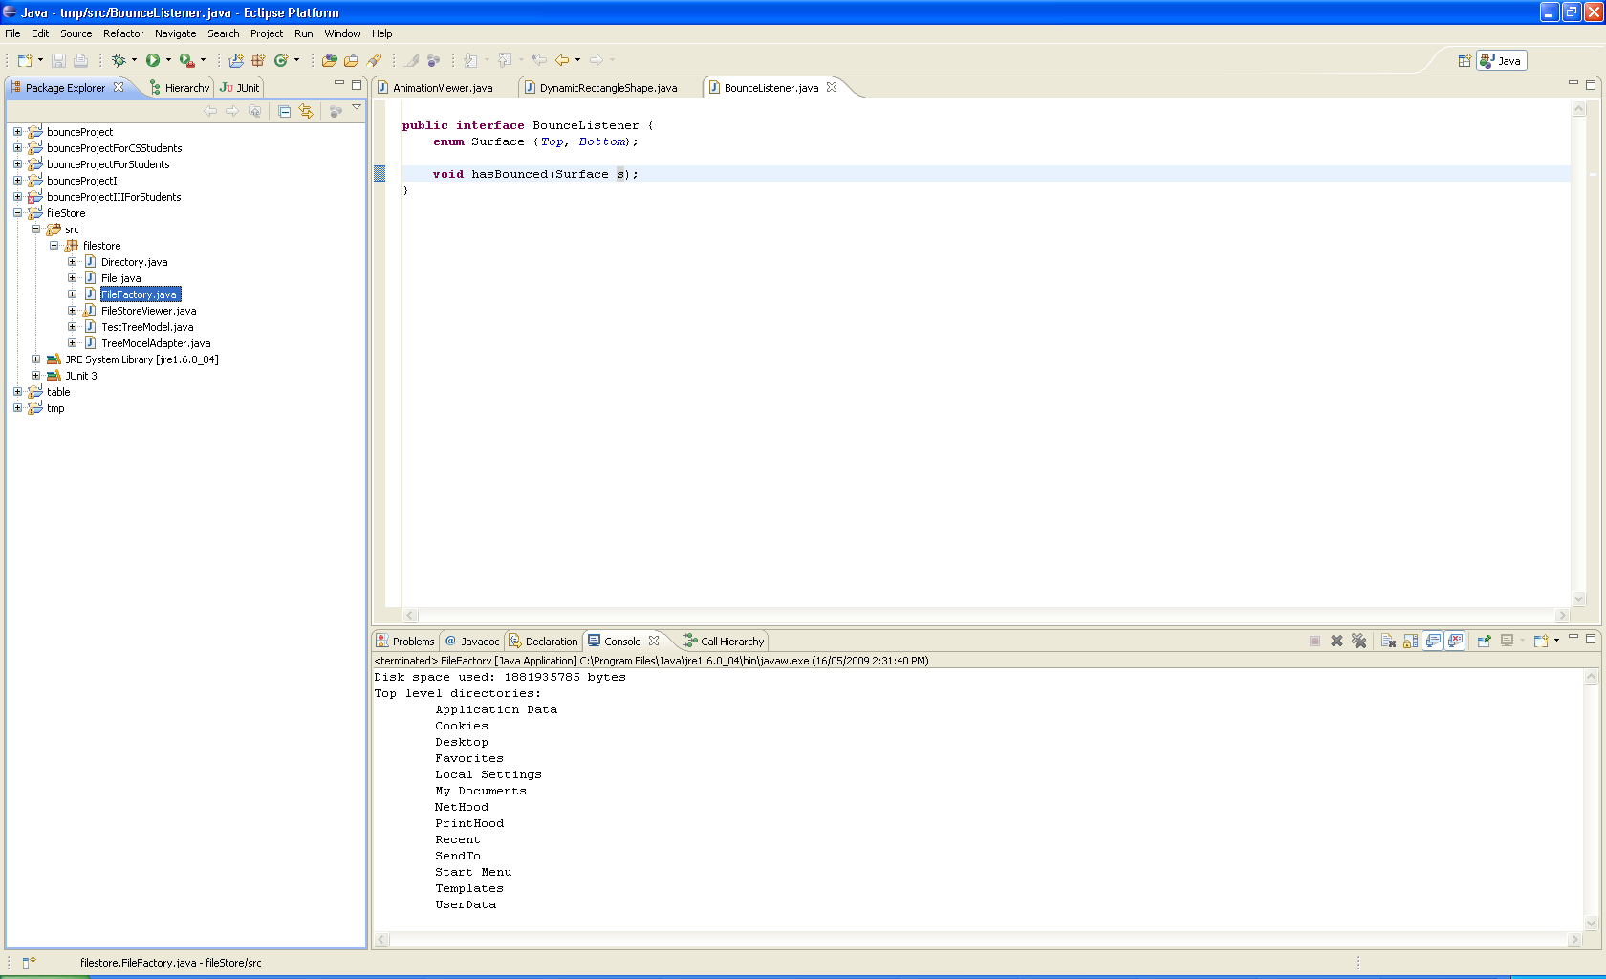
Displaying a composite structure
: Directory
: Directory
: Directory
: Directory
: File
: Directory
: Directory
: Directory
: Directory
: Directory
: Directory
: Directory
: File
: Directory
: Directory
: File
Notes:
Having built the tree structure of Directory and File instances, the program simply prints the amount of disk space used by the structure and the top-level directories.
It would be better if we had a graphical means of viewing and manipulating the structure.

Slide 16
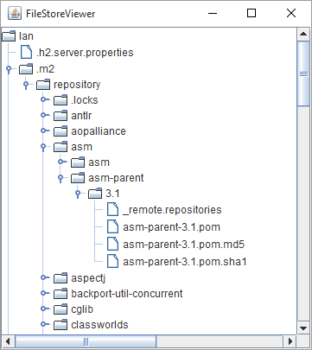
A filestore visualiser
: Directory
: Directory
: Directory
: Directory
: File
: Directory
: Directory
: Directory
: Directory
: Directory
: Directory
: Directory
: File
: Directory
: Directory
: File
Notes:
This is much better – we can much more easily navigate and browse the tree structure, collapsing parts and expanding others.

Slide 17
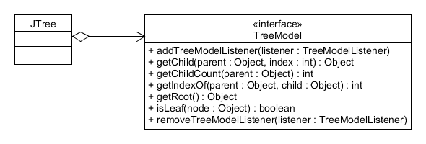
JTree & TreeModel
Returns the child at position index
within parent, null if index is out of
bounds
Returns the number of children
parent has
Returns the index position of child
within parent, -1 if child is not a
child a parent
Returns the root of a tree structure
Returns true if node cannot have
children, false otherwise
A JTree component (ultimately a subclass of Component) can render any object whose class implements the TreeModel interface
JTree uses the methods defined in TreeModel to inspect a hierarchical structure and to build the graphical representation
Notes:
JTree is a Swing component.
Consider interfaces to be contracts.

Slide 18
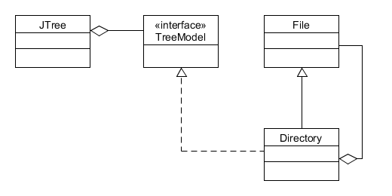
Design options
Edit class Directory to make it implement TreeModel
In a production environment, making a change to an existing piece of software will cause that unit of software to go through a round of quality assurance
This option creates an undesirable coupling between class Directory and Java’s Swing framework
This option is not possible if the source code for Directory is unavailable
✗
✗
✗
Notes:
A poor design!

Slide 19
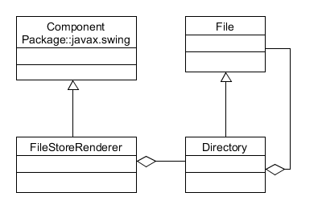
Design options
Write a new class, similar to JTree, that is dedicated to rendering the structure of a set of File and Directory objects
This is reinventing the wheel. There is no reuse of Swing’s tried-and-tested JTree component; the new FileStoreRenderer class has very limited reuse
✗
Notes:
JTree is a sophisticated component that has been purposefully developed to display and work with tree-based structures. It would be expensive to replicate its capability for the Directory browser application.

Slide 20
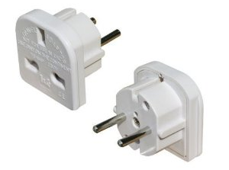
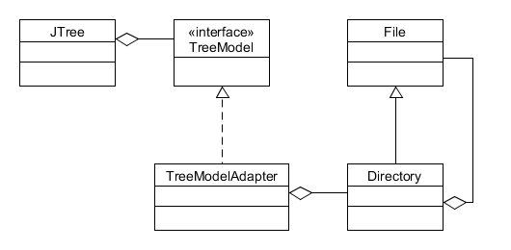
Design options
1: TreeModel method call
2: File / Directory method call
Use an adapter
This requires that no changes be made to existing code
In addition, it reuses both the JTree and File/Directory classes
: JTree
: TreeModelAdapter
root :
Directory
✓
return value
return value
✓
Child directories and files

Slide 21
TreeModel contract
A
Key TreeModel methods:
getRoot() → A
getChildCount( A ) → 3
getChild( A, 0 ) → B
getIndexOf( B, C ) → 1
isLeaf( D ) → false
isLeaf( E ) → false
isLeaf( F) → true
: Directory
B
: Directory
: Directory
: Directory
: File
: Directory
: Directory
C
: Directory
: Directory
: Directory
D
: Directory
: Directory
: File
E
: Directory
: Directory
: File
F
Notes:
First param of getChild() and getIndexOf() is a parent reference.

Slide 22
Implementation
public Object getChild(Object parent, int index) {
Object result = null;
if (parent instanceof Directory) {
Directory dir = (Directory) parent;
result = dir.getFile(index);
}
return result;
}
public int getIndexOfChild(Object parent, Object child) {
int indexOfChild = -1;
if (parent instanceof Directory) {
Directory dir = (Directory) parent;
Iterator<File> i = dir.getIterator();
boolean found = false;
int index = 0;
while (!found && i.hasNext()) {
File current = i.next();
if (child == current) {
found = true;
indexOfChild = index;
} else {
index++;
}
}
}
return indexOfChild;
}
public class TreeModelAdapter implements TreeModel {
private Directory _adaptee;
public TreeModelAdapter(Directory root) {
_adaptee = root;
}
public Object getRoot() {
return _adaptee;
}
public int getChildCount(Object parent) {
int result = 0;
File file = (File) parent;
if (file instanceof Directory) {
Directory directory = (Directory) file;
result = directory.getNumberOfChildren();
}
return result;
}
Notes:
Note how the “target” interface (which is understood by classes that use TreeModel, e.g. JTree) provides a “bridge” between JTree and the File/Directory classes.
A JTree object will be able to use the adapter to grab sufficient data in order to visualise a Directory structure without needing to know anything about Directory and File.

Slide 23
FileStoreViewer application
Create a configuration of Directory and File objects representing the contents of your home directory.
public class FileStoreViewer extends JFrame {
public FileStoreViewer( ) {
super( "FileStoreViewer“ );
Directory root = FileFactory.makeFileStore( );
TreeModel model = new TreeModelAdapter( root );
JTree view = new JTree( model );
JScrollPane treeScrollPane = new JScrollPane( view );
add( treeScrollPane );
}
public static void main( String[ ] args ) {
FileStoreViewer frame = new FileStoreViewer( );
frame.pack( );
frame.setVisible( true );
}
}
Create the adapter, passing a reference to the root Directory object.
Create the JTree and introduce it to our adapter. The JTree will call the TreeModel methods on the adapter to gather the data necessary to render the Directory/File configuration.
Decorate the JTree component with scroll bars, that are activated dynamically (e.g. when the complete tree cannot be seen in the JTree view).
Notes:
The implementation of FileStoreViewer is slightly simplified. The code available on Cecil uses a SwingWorker to read the disk and build the representation in terms of Directory and File objects. While it’s doing this, a progress bar is displayed. See the code for details.

Slide 24
Use of an adapter: design objectives fulfilled
Adaptation contributes to meeting the following design objectives:
Flexibility
Frameworks can be developed that will work with unanticipated classes
Reusability
Existing classes that implement useful functionality can be reused
Robustness
As a consequence of reusability, existing classes are reused without modification. This avoids the potential to introduce bugs
Notes:
Flexibility – e.g. the Swing framework includes a JButton class for buttons. To make the button do something when clicked, you implement the ActionListener interface and register an instance with a JButton. The JButton class itself is kept separate from its on-click behaviour. This means that it’s very easy to change the on-click behaviour associated with a button.
Reusability – similar to above – class JButton is a very reusable class. When writing different applications, you don’t need to write new subclasses of Jbutton that are specific to your application.
Robustness – framework classes are mature and tried-and-tested. Using them without modification remove the risk of introducing errors into the code.

Slide 25
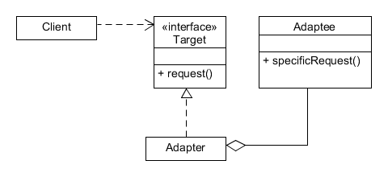
The Adapter pattern
Intent
Convert the interface of a class into another interface clients expect. Adapter lets classes work together that couldn’t otherwise because of incompatible interfaces
Also known as
Wrapper
Applicability
Use the Adapter pattern when
You want to use an existing class, and its interface does not match the one you need
You want to create a reusable class that cooperates with unrelated or unforeseen classes
JTree
TreeModel
Directory
TreeModelAdapter
Notes:
Applicability.
Case 1 is where Directory/File are wanted to be reused, but they’re incompatible with JTree.
Case 2 is about framework development – write interfaces that are designed to be implemented by adapter classes so that classes like JTree can be widely reused.

