Slide 1
COMPSCI 718
Programming for Industry
Lecture 16 – More Design Patterns

Slide 2
The Template Method pattern
“How to define the skeleton of an algorithm in a superclass and allow subclasses to redefine certain steps without changing the algorithm’s structure”
The Template Method pattern is used widely in the JDK
Painting of Swing components
SwingWorker

Slide 3
Painting in Swing
public void paint ( Graphics g ) {
paintComponent( g );
// Code to paint border.
}
4
JComponent
paint( g : Graphics )
paintComponent( g : Graphics )
paint
1
public void paintComponent( Graphics g ) {
// Code to paint a button and its text.
}
paintComponent
3
2
JButton
Press me
Behaviour in response to sending a JButton object a paint message
Message send
Message reply
Notes:
Control structure – JButton doesn’t override method paint(), so when a JButton object receives a paint() request the code in its superclass (JComponent) executes. JComponen’s paint() method is the “template method” that calls the “hook” method paintComponent() – which is overridden by JButton. The JButton code executes and draws a button on screen. When JButton’s paintComponent() method finishes, control returns to the caller (method paint() in JComponent). The remainder of JComponent’s paint() method draws a border around the button.
In this case, class JComponent guarantees that any border will always be drawn around a component as part of the component painting process. The superclass (JComponent) has this responsibility. Subclasses can’t “forget” to draw their borders. This is an example of robustness.

Slide 4
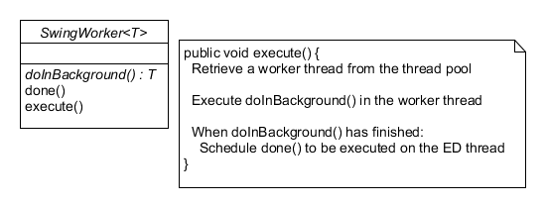
SwingWorker
: SwingWorker
1: execute()
2: doInBackground()
3: done()
The ED thread runs and calls execute(); a free worker thread is retrieved from the thread pool
The worker thread executes the SwingWorker object’s doInBackground() method
Method doInBackground() finishes; the worker thread is returned to the pool
How has the Template Method been applied in SwingWorker?
What is the benefit?
The ED thread executes the SwingWorker’s done() method
Time
ED thread
Worker pool thread
Notes:
SwingWorker’s execute() method is the Template Method. It has the responsibility for acquiring a thread and using the thread to execute the code in hook method doInBackground(). Once doInBackground() has finished, control returns to the execute() and it then arranges for the second hook method, done(), to be executed by the ED thread.
This simplifies life for the developer – he/she doesn’t have to worry about creating/starting/synchronising with other threads and simply writes their application background-processing code in doInBackground() and GUI updating code in done(). In short, much of the complexity has been taken away from the application developer. execute() shouldn’t be overridden by subclasses – it implements a control structure that can be customised by overriding the hook methods.
Note too that for tasks with intermediate results, SwingWorker’s publish() method is a template method. It is intended to be called by the worker thread and arranges for the process() hook method to be executed by the ED thread to update some GUI component with the partial result.
So, the Template Method is an inheritence-based pattern that distributes an algorithm over a superclass and subclasses. The superclass defines the overall sequence of steps, and allows subclasses to customise/override processing at a particular step by overriding a hook method. The superclass guarantees that all steps will be executed in order.

Slide 5
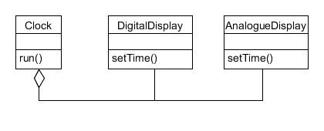
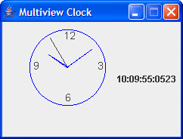
A “multi-view” application
public class Clock {
private DigitalDisplay digital;
private AnalogueDisplay analogue;
public Clock() {
analogue = new AnalogueDisplay();
digital = new DigitalDisplay();
// code to construct GUI
}
public void run() {
// repeat every second…
digital.setTime(…);
analogue.setTime(…);
}
}
How good is this design in terms of reusability and flexibility?
Notes:
Reuse – can’t reuse Clock, a general purpose abstraction, without also having DigitalDisplay and AnalogueDisplay.
Flexibility – to have the general clock notify others of changes in time Clock must be edited and have knowledge of all its dependents.
Overall, not a great design. A pattern named the Observer pattern has been developed to solve this sort of problem and turns this design inside out.

Slide 6
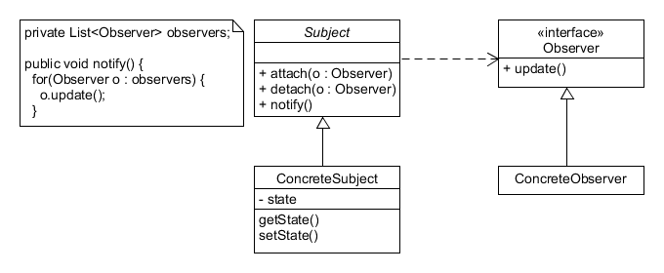
The Observer pattern
client
: ConcreteSubject
obs1
obs2
attach( obs1 )
attach( obs2 )
setState( )
notify ( )
update( )
update( )
Where have you seen this idea before?
Notes:
Participant roles:
Subject defines methods for attaching and removing Observers. Subject stores a list of observers. Subject also provides a method that when called causes each attached Observer to be notified (method update on each Observer is called).
ConcreteSubject extends Subject with some application-specific class whose instances are of interest to others.
Observer is an interface, with a single update() method, that is implemented by classes interested in Subject instances.
Previous cases of the this basic idea:
ActionListener. E.g., a button can have many ActionListener objects attached (registered) to it. Whenever the button is clicked, each attached ActionListener is executed.
Other listeners – e.g. MouseListener, etc.
Bounce uses an ActionListener to be notified about Timer events. The idea is the same, an ActionListener (the AnimationViewer) is registered with the Timer. Whenever the timer changes its state (time passes), it lets its registered ActionListener objects know about the change.

Slide 7
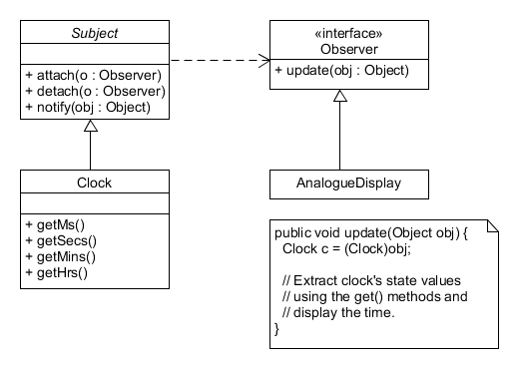
The Observer pattern
client
: Clock
analogue
digital
attach( analogue )
attach( digital )
run( )
notify ( this )
update( this )
update( this )
Notes:
This shows a light variation where the Observer interface has an extra argument telling Observers which Subject has changed.
Imagine a scenario where an Observer is registered (attached) to more than one Subject. When either Subject changes, it sends a reference to itself in the update() call so that the Observer knows which Subject has changed.
Alternatively, the argument can be an Object that’s not a Subject, but something else that describes how the Subject has changed. This is the “push” variant, where an object that describes how exactly the Subject has changed is pushed out to each Observer. E.g. imagine a spreadsheet is the Subject and that it has some graphical views that are the Observers. The Spreadsheet might create a Modification object describing which cells have changed in value and send this descriptor out in update() messages. In this case, the Push variant makes sense – without the Modification object the graphical views wouldn’t know which parts of the spreadsheet have changed and would be left to work it out for themselves.

Slide 8
The Observer pattern
registered-with
Model / Subject / Observable
View / Observer / Listener
notifies
Intent
Define a one-to-many dependency between objects so that when one object changes state, all dependents are notified and updated automatically
Also known as
Dependents, Publish-Subscribe
Applicability - use the Observer pattern in any of the following situations
When an abstraction has two aspects, one dependent on the other. Encapsulating these aspects in separate objects lets you vary and reuse them independently
When a change to one object requires changing others, and you don’t know how many objects need to be changed
When an object should be able to notify other objects without making assumptions about who these objects are
Notes:
As with all design patterns, here’s the formal description.
Each point of applicability is illustrate by the Clock motivating example.

Slide 9
The Observer pattern
Consequences
Abstract coupling between Subject and Observer
“Programming to the Observer interface”
Support for broadcast communication
All interested parties who have subscribed to an event are notified when it happens
Some implementation issues
Observing more than one subject
Have the notify( ) method include a parameter to the Subject that has changed
Who triggers the update?
Clients – they call notify( ) after making a series of small changes to the subject; clients must remember to make the notify( ) call
The subject itself – its state-setting methods call notify( ) ; update( ) notifications are guaranteed but this can lead to several (inefficient) consecutive updates
Push vs pull protocols
With the push model, update( ) includes a parameter to describe the update
With the pull model, update( ) has no such parameter and observers are left to work out how the subject has changed
Specifying modifications of interest
Have Subject’s addObserver( ) method take a parameter to describe events of interest; observers will only be notified of these events
Notes:
Abstract coupling – loose coupling between subject and Observer. A Subject assumes nothing more of its Observers than that they implement the Observer interface.
Push vs pull. With the Clock example, passing the Clock as a parameter in update allows Observers to not only see who changed but also to query the clock to find out what exactly changed. The spreadsheet example is a good example of the need for a push-based system.
Another example of “push” is with MouseListener in AWT. A MouseEvent is send that gives the x,y position where the mouse was clicked. Any registered listener is notified of the x,y position when updated.

Slide 10
Swing: a model/view framework
Swing components are rooted in Observer principles
A Swing component is a view (Observer)
A Swing component is associated with a separate model (Subject)
A Swing component is any JComponent subclass
registered-with
submits-change-request
Model
Swing component
notifies

Slide 11
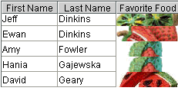
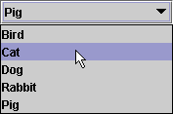
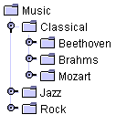

Swing components and models
For each Swing component type, there is a corresponding model interface
A JComponent will work with any object whose class implements its model interface
The model interfaces differ – but the model/view principles are common

Slide 12
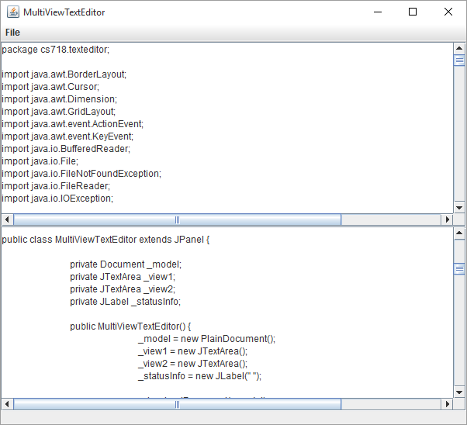
A Multiview text editor
How might you develop a multiview text editor using Model View concepts?
Swing provides an interface named Document; implementations, e.g. PlainDocument, store document text
JTextArea is a multiline Swing component for editing and displaying text
Notes:
What are the key Model View objects that are required and how will they interact?

Slide 13
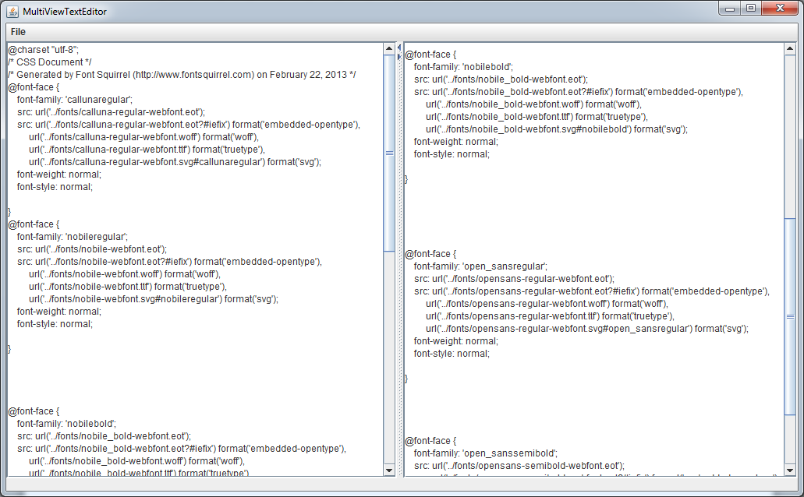
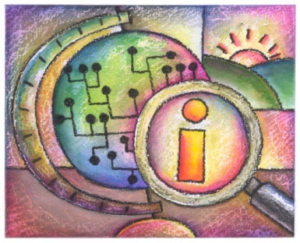
A Multiview text editor
2. The model updates its state. It then broadcasts to its registered views a change notification message – via insertUpdate(). The details of the change are described and pushed out as a DocumentEvent parameter.
JTextArea (view)
insertUpdate( )
Document (model)
insertString( )
JTextArea (view)
1. Using the JTextArea, the user enters a character. The character is not yet visible. The view makes an insertString() call on the model.
Notes:
Essentially, have one Document object – which is the model. Attach two JTextArea components to the Document model. Whenever one view is used to edit the text, it sends a change request to the Document model. The model responds by broadcasting the update notification to each JTextArea.
Note that it’s not when a key is pressed that the view is updated to show the effect of the key press – this simply causes the view to send a change request to the model. Only when the model broadcasts out the update notification does each view change to show the new state of the model.

Slide 14
A multiview text editor
// Create a PlainDocument to use as the model. _model = new PlainDocument(); // Create the JTextAreas which will be used as the text editors _view1 = new JTextArea(); _view2 = new JTextArea(); // Set the document of both editors to the same model. _view1.setDocument(_model); _view2.setDocument(_model);
Notes:
Note the ease of writing an application like this in a Model/View based framework. AWT, Swing’s predecessor, doesn’t support the model/view concepts, and so writing a multiview text editor would be much more difficult.
Note too that models often have multiple views (like in this case) – and that the model guarantees that all views are held in sync and provide consistent views of the model.
This is another key benefit of the Observer pattern – and one that provides for robustness. Having a mechanism that keeps all views in sync with a changing model is important for any kind of multiview application.
The ‘views’ needn’t be visual. E.g. we could have an extra view that autosaves the model whenever it changes – this functionality would cleanly be separated from the model implementation. Another view might be one that converts the edited content into some other representation – e.g. editing a Latex document and generating a corresponding PDF view.
The full source code is available on Cecil – there’s more to the application (e.g. it has a menu that allows the user to open a file to edit etc.) but the Model/View (Observer) set up is as simple as that shown on this slide.

Slide 15
Swing Table classes and interfaces
<< interface >>
TableModelListener
tableChanged( event : TableModelEvent ) : void
JTable
<< interface >>
TableModel
addTableModelListener( l : TableModelListener ) : void
getColumnCount( ) : int
getRowCount( ) : int
getValueAt( row : int, col : int ) : Object
isCellEditable( row : int, col : int ) : boolean
removeTableModelListener( l : TableModelListener ) : void
setValueAt( value : Object, row : int, col : int ) : void
AbstractTableModel forms part of the API for tables and provides a partial implementation of the TableModel interface.
Code reuse methods (add/removeTableModelListener()) are implemented.
Code reuse methods (fireXX()) are implemented and provide a convenient facility for subclasses to fire events to listeners of a TableModel.
Concept reuse methods that must be implemented in order for a JTable to extract sufficient information to build the visual representation.
Concept reuse methods that should be implemented in order for the model to be edited by a JTable component.
AbstractTableModel
fireTableCellUpdated( row : int, col : int ) : void
fireTableDataChanged( ) : void
fireTableRowsDeleted( startRow : int, endRow : int ) : void
fireTableRowsInserted( startRow : int, endRow : int ) : void
fireTableRowsUpdated( startRow : int, endRow : int ) : void
Notes:
Exercise 1 for this week involves completing a multiview application, where one of the views of a model is rendered in a Swing JTable.
Just like other Swing components, with tables there is a model and a view.
The TableModel interface represents the model. The interface has methods (those shown in blue) that are sufficient for a JTable component to extract enough data to show a visual representation of the tabular-based data.
JTable implements the TableModelListener interface – whenever the TableModel changes its state, it notifies any registered TableModelListeners (e.g. a JTable view).
TableModel conforms to the push-based variant of the Observer pattern. Whenever the TableModel changes, it calls tableChanged() on each registered TableModelListener and pushes out a TableModelEvent describing the way in which the table has changed (e.g. a row has been added, a row has been deleted, a particular cell has changed its value etc.).
AbstractTableModel is a convenience class that implements several of the TableModel methods. When implementing your own TableModels, you typically extend AbstractTableModel rather than implement the interface from scratch.

Slide 16
Swing Table object interaction
: JTable
model : TableModel
: Client
setModel( model )
getRowCount( )
Setting up the model and view
When introduced to its model, the view (JTable) asks the model how many rows and columns it has. It then calls getValueAt() r * c times, obtaining a value for each cell.
The view renders each value.
r rows
getColumnCount( )
c cols
getValueAt( row, col )
value
setValueAt( newValue, row, col )
Handling a change request
In response to a change request on the model (i.e. a setValueAt( ) call), if the model accepts the change it creates a TableModelEvent object to describe the change, and sends this to its view(s).
fireTableCellUpdated( row, col )
create( … )
tableChanged( event )
event : TableModelEvent
Notes:
The slide shows the key interactions between model and view objects where the view is a JTable and the model is a TableModel implementation.
The interaction assumes model is some implementation of TableModel whose class extends AbstractTableModel (because it calls the fire() method).

Slide 17
Review
Learnt something about:
The notion of a design pattern
A general and proven solution to a common design problem
Design patterns are documented with a structure, benefits and consequences
Design patterns can often be implemented with variations to suit particular applications
Four well-known patterns
Composite, for representing recursively-defined whole-part hierarchies
Adapter, for making objects with incompatible interfaces work together
Template Method, for defining the skeleton of an algorithm in a superclass, and allowing subclasses to redefine certain steps without changing the algorithm’s structure
Observer (Model/View), for defining a one-to-many dependency between objects so that when one object changes state, all dependents are notified and updated automatically
Application of patterns to the JDK

