Slide 1

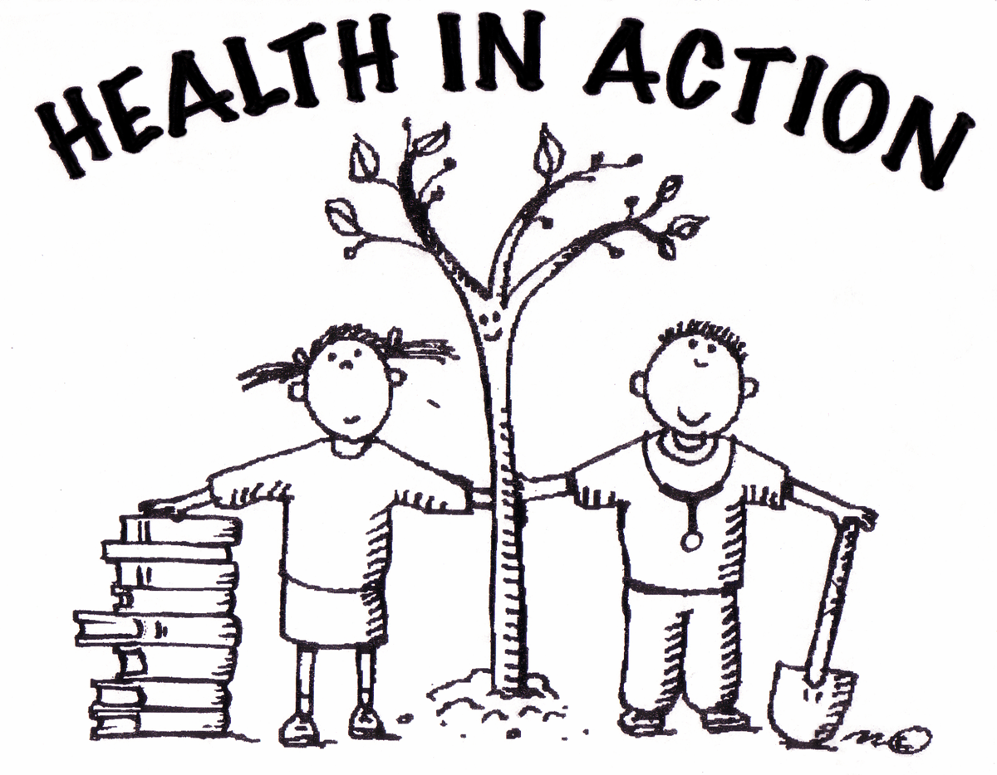
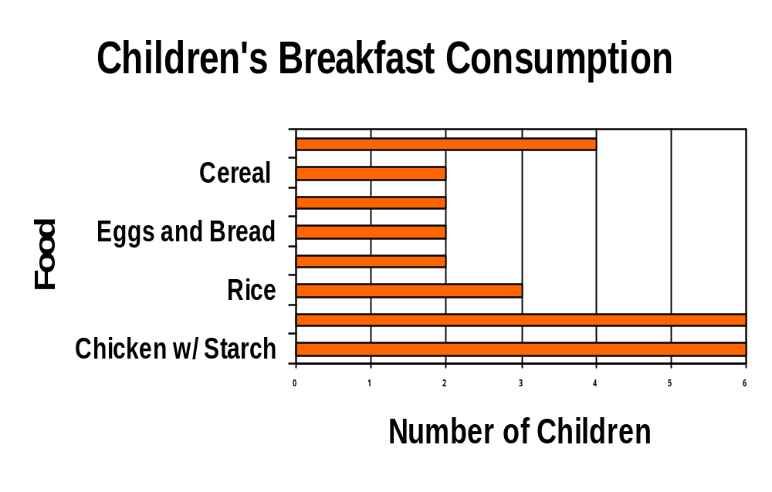
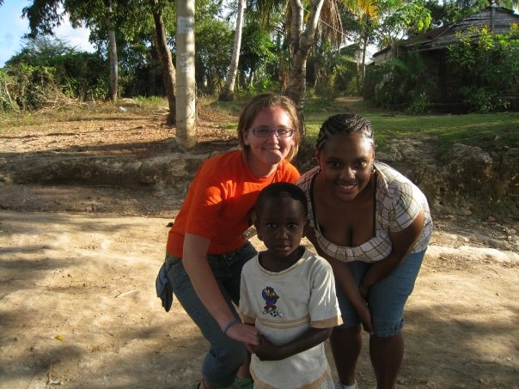

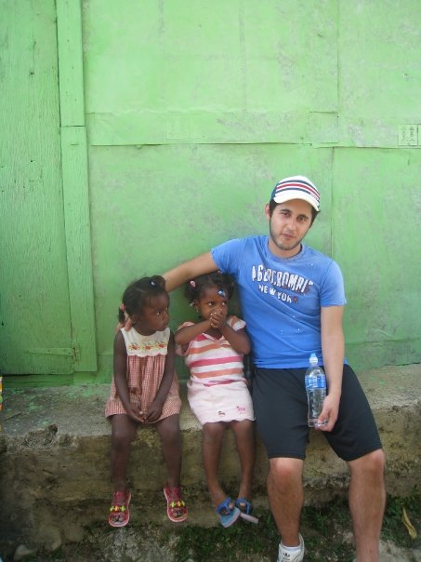
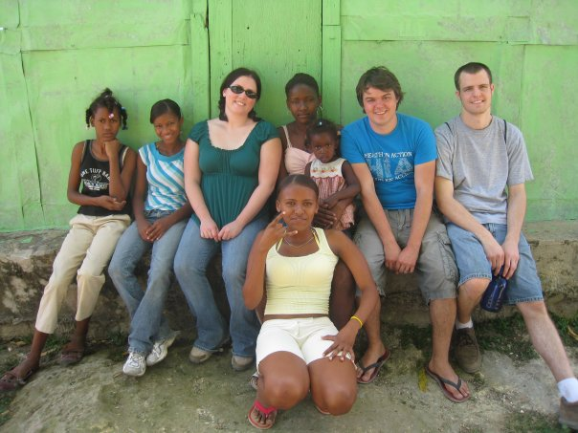
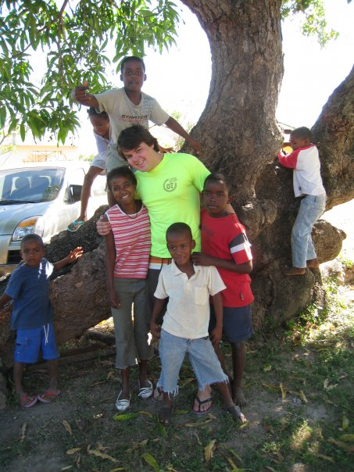
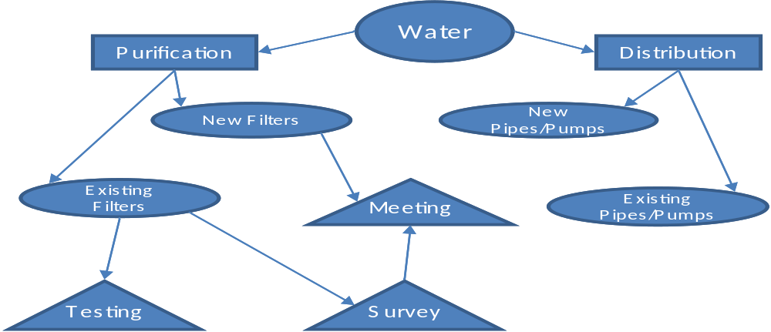
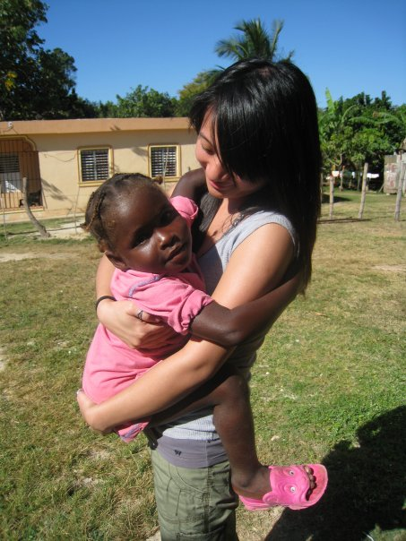
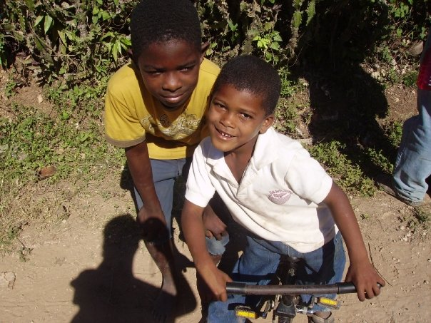
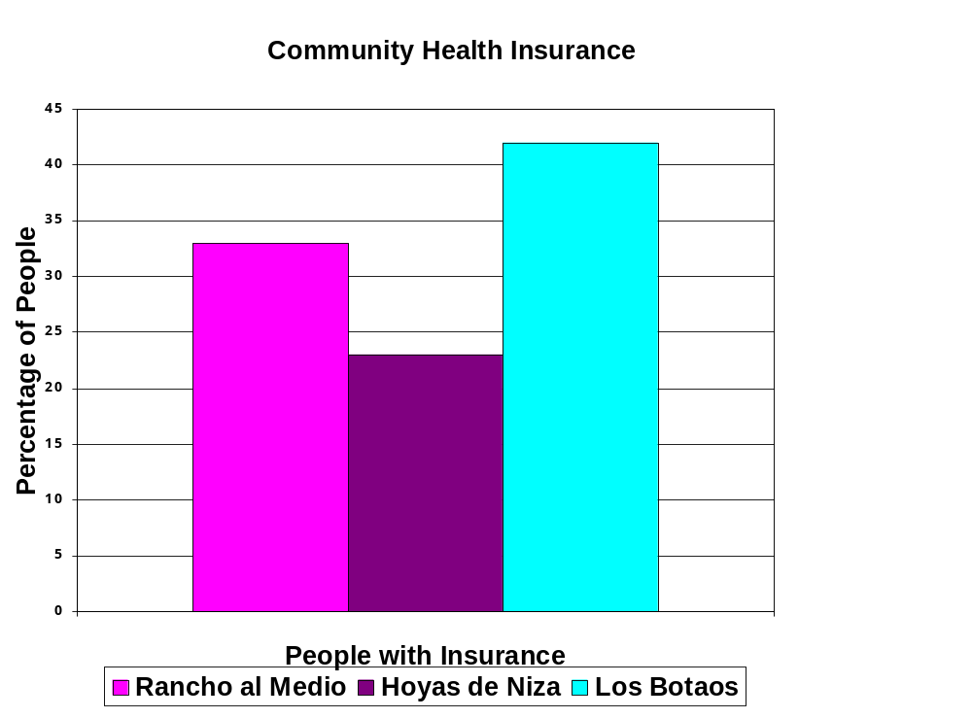
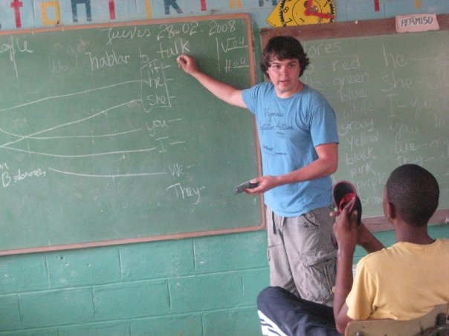
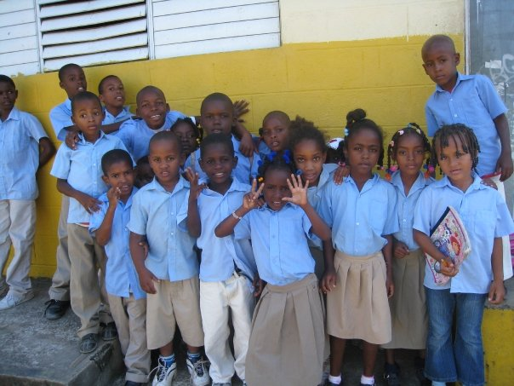
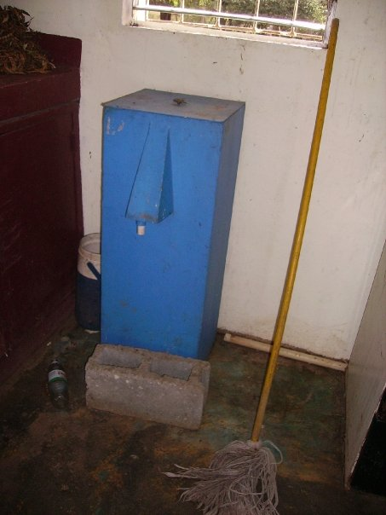
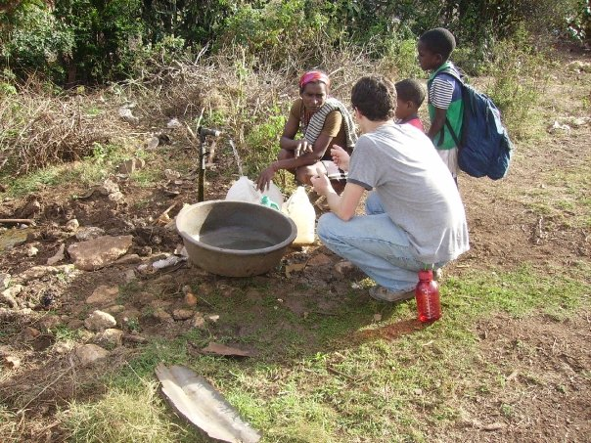
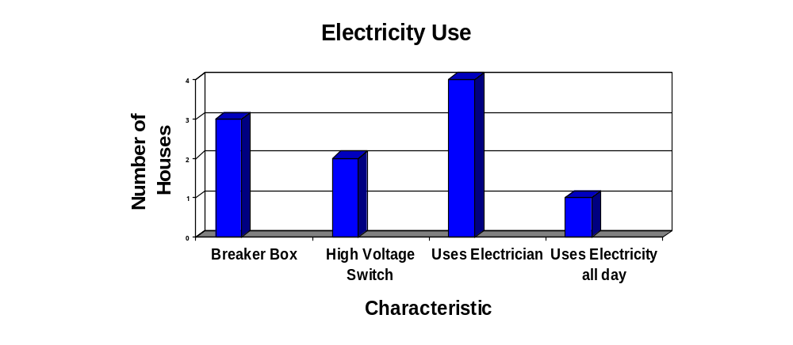
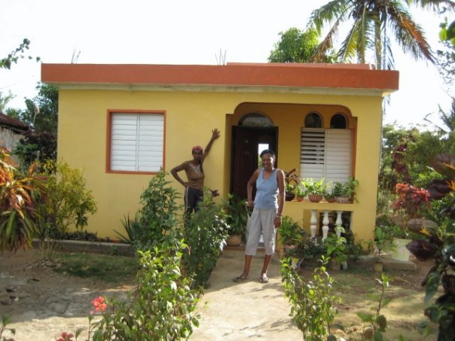
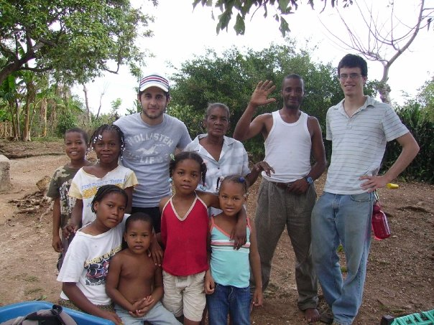
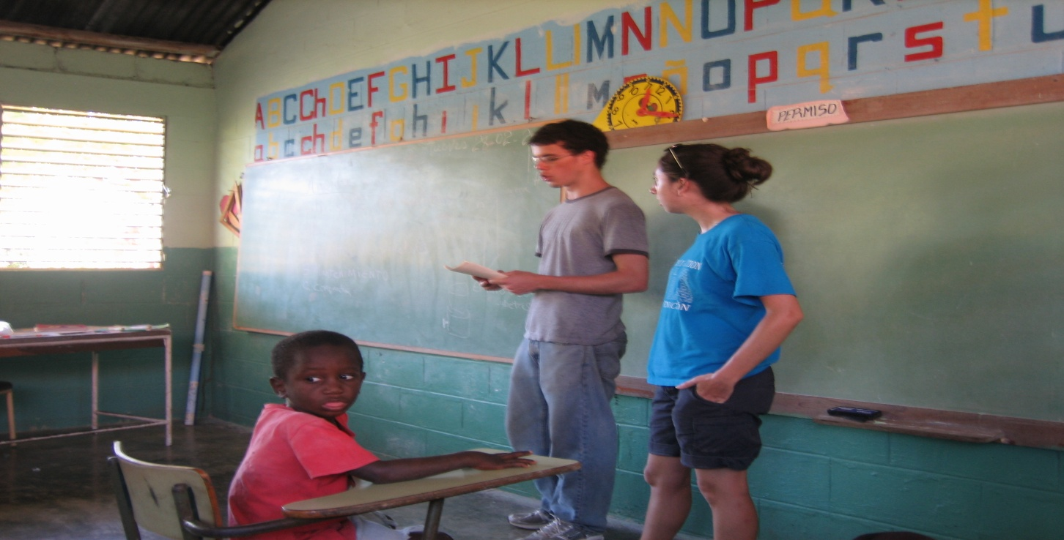
HEALTH IN ACTION
Sustainable Living Through Education
University of Michigan
Abstract
Educational Programs in the Dominican Republic
Health in Action’s Mission
Health in Action is an organization that creates health care education presentations to present in a rural community of the Dominican Republic during spring break. These programs cover a variety of educational topics, including basic health care, literacy in Math and English, and engineering solutions to local problems. These programs focus on making sustainable changes within the community to improve their standard of living. True improvements to the community will only ever be made if the programs are sustainable. We attempt to make these programs sustainable by training leaders within the community that will hopefully continue to improve the well being of the others community members when we leave. To make our programs more sustainable in upcoming years we are hoping to have students in the Dominican Republic year round. In addition to the above mentioned projects, this year’s trip included a module on possible economic opportunities for community members presented by a Business student and an Industrial and Operations Engineering student. There is also a team working on a community wide survey attempting to find out why community members are not taking advantage of the health care resources that are available to them. In past years the focus of Health in Action has been to implement these programs to the same community in the Dominican Republic. This year for the first time we will be branching out and also be working on similar programs for impoverished local communities.
Health in Action is an interdisciplinary group of students from the University of Michigan committed to sustainable health and health literacy both at home and abroad, focusing not only on the development of communities but also on the development of team leadership skills within our organization. We strive to achieve this goal using empowerment through education, research, technological innovation, and of course the dedication and invaluable knowledge provided by the community members with whom we work. Using a multi-faceted approach to health, we strive to take into consideration not only health beliefs and behaviors when designing interventions, but also larger structural factors such as economics, politics, and globalization.
Pregnancy and Family Planning
Nutrition
Goals:
Educate adults in about family planning strategies to prevent unwanted pregnancies
Educate community members about the stages of pregnancy
Explain the importance of nutrition during pregnancy
Goals:
Inform the community about nutrition related ailments.
Increase knowledge about healthy eating.
Gain knowledge for future nutrition programs
Results:
Children have previous knowledge about nutrition
Fruits are home grown and bought in the city
Meals in the community lack variety
Results:
Women are interested in learning different ways to prevent pregnancy
Condoms are easy to obtain and fairly inexpensive
Women are satisfied with their gynecological and prenatal care
www.plughia.com
Water Purification
*N = 27
English Literacy
Community Survey
Goals:
To teach simple English words and phrases to adults and children providing a foundation for further education in English language
Strengthen trust with the community by responding to their requests for English lessons
Goal: To assess the barriers to health care in the community
Results:
Children are enthusiastic to learn English
Children have varied levels of English vocabulary
Children have mastered basic vocabulary and simple verb conjugations
Goals:
  Coliform testing of all filtered water
  Needs assessment for future purification and distribution projects
  Survey community about proper filtration and sanitary water use
  Hold a community meeting about new and existing water purification and distribution systems
Electricity
Business Possibilities
*N = 24 (Rancho); 26 (Hoyas de Niza); 22 (Los Botaos)
Goals:
Educate children in the community about safely using electricity, and protecting themselves in case of an emergency
Learn about electrical usage in the community
Goals:
Have conversations with community members about potential business opportunities using micro-credit
Survey community business owners
Results:
Local resources like tamarinds, flowers, coconuts, and honeybees, can be used to make multiple products for sale in larger and wealthier cities
Many businesses are not local but managed by owners in larger Dominican cities or the United States
Results:
Transportation costs are the most common barriers to obtaining health care
Most community members are uninsured but generally happy with the health care in their country and have confidence in their doctors.
Results:
Children know how electricity works, how to use electricity safely and what to do in emergencies
Results:
Four out of five previously installed Biosand filters are functioning optimally
The community has a good understanding of the need to sanitize their water
Treatment methods such as boiling, chlorination, and filtration are widely used
Community members provided with biosand filter contacts within the Dominican Republic
Sample Size: 5 Houses

