Slide 1
Challenges in valuing sustainability:
Four years of student experience
Tammy Chang, M4
University of Michigan Medical School
Founding Director of Health In Action
Notes:
Good Afternoon. My name is Tammy Chang and I am a fourth year medical student and MPH candidate at the University of Michigan. Thank you for this opportunity to share with you an issue that I and other leaders of international health initiatives have found to be a challenge and would benefit from further discussion at a meeting like this one. That problem is valuing sustainability in student projects abroad.

Slide 2

Give a man a fish and you feed him for a
day. Teach a man to fish and you feed him
for a lifetime.
- Chinese Proverb
Notes:
This is a very common proverb- Give a man a fish…
Most students will easily understand and agree with this message. However, we find that even though our goals are to teach rather than give in our work in developing communities, in so many of our programs, we end up doing more giving than teaching and empowering, and are thus not addressing sustainability.
I understand that sustainability is a very complex and wide reaching topic, so I hope to narrow the focus of this short talk and give examples of the challenges our groups have faced in regards to planning for and obtaining sustainability in our programming in developing areas in the dominican republic.

Slide 3
Outline
Health In Action
Definitions of Sustainability
Challenges
Barriers to Sustainability
Solutions
Notes:
To begin, I would like to describe our student lead initiative called Health In Action.
Then talk about the definitions of sustainability and exactly what we mean by sustainability in this talk.
Then, the talk about the challenges we are facing with our students in regards to valuing sustainability
Then, talk about the barriers to sustainability in programs
And proposed solutions to help students begin to incorporate sustainability in their programs

Slide 4
Health In Action (HIA)
Inter-campus initiative
Mission:
  Comprehensive education and service to underdeveloped areas.
  Opportunity to design, implement, and collaborate on scholarly projects
Accomplishments
Notes:
- Health in Action (HIA) is an inter-campus initiative at University of Michigan including the Medical School, School of Engineering, School of Public Health, School of Literature, Science and the Arts, and also in collaboration with medical students in Action, a student group at the Univ of Miami Miller School of Medicine.
- HIA is one component of the student alliance of Global REACH (Global Research, Education And Collaboration in Health) whose mission is to facilitate health research, education, and collaboration among the University of Michigan Medical School faculty, students, and our global partners for the benefit of patients worldwide.
MISSION:
To address fundamental problems in healthcare and public health infrastructure through intensive education and service in underdeveloped areas.
To provide students of all disciplines with an opportunity to design, implement, and collaborate on scholarly projects that benefit those communities most in need.
ACCOMPLISHMENTS:
- Sent over 200 students to developing areas around the world, particularly to the Dominican Republic, to gain insight and experience in creating sustainable change.
- Particularly in our community in the DR, we have assisted in the construction of community wells, septic system, toilets, sinks at the community schoolhouse, and the installation of electricity. All support continued education and literacy for for communities within 50 mi radius.
-Based on the needs of our community, we have created and executed health education seminars in our community including hygiene, reproductive health, dental care, nutrition, and water treatment to name a few.
-Promoted the concept of social responsibility for the health of all people.

Slide 5
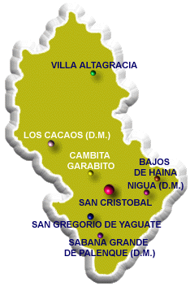
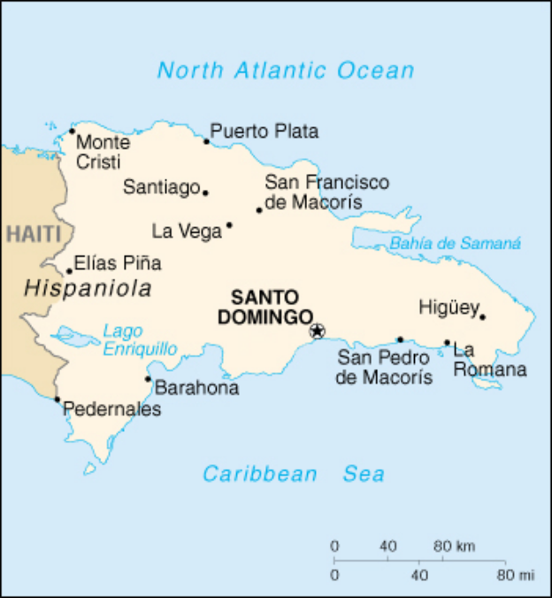
Rancho al Medio
Population: 1200
Mostly women, children and elderly
91% illiteracy rate
Up to 95% unemployment rate
2 Public Wells (1 damaged)
No sewage system
Notes:
Rural

Slide 6
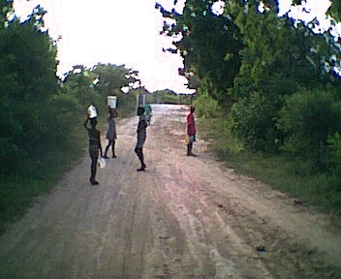
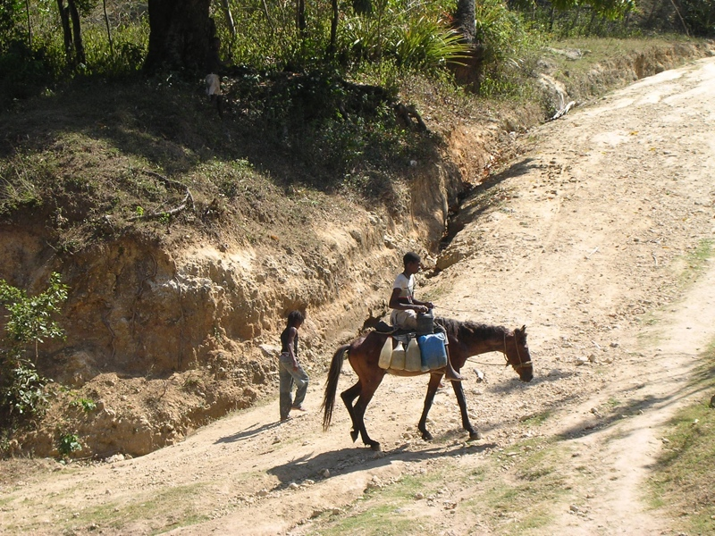
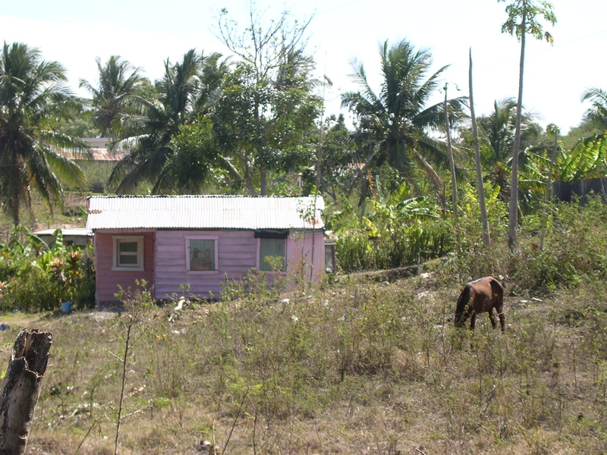
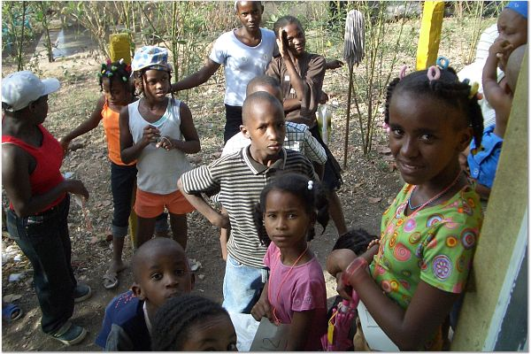
Rancho al Medio

Slide 7

Definition of Sustainability
SUSTAINABLE DEVELOPMENT (UN):
“Development that meets the needs of the present without compromising the ability of future generations to meet their own needs.”
Environmental, Social, Economic
Notes:
While many definitions of the term have been introduced over the years, the most commonly cited definition comes from the report Our Common Future, more commonly known as the Brundtland Report, which states that sustainable development is development that "meets the needs of the present without compromising the ability of future generations to meet their own needs”.
Sustainable development does not focus solely on environmental issues. More broadly, sustainable development policies encompass three general policy areas: economic, environmental and social. In support of this, several United Nations texts, most recently the 2005 World Summit Outcome Document, refer to the "interdependent and mutually reinforcing pillars" of sustainable development as economic development, social development, and environmental protection.

Slide 8
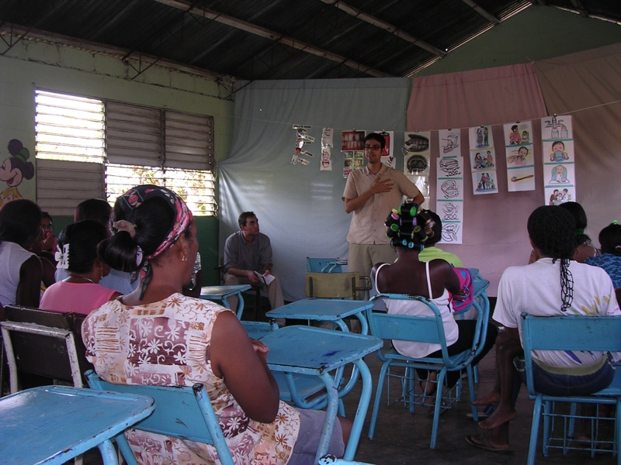
Definition of Sustainability
Program or project that endures and provides benefit beyond the time of our involvement.
Notes:
To simplify, I would like to focus on this general definition of sustainability in reference to the challenges we have faced in our student initiatives.

Slide 9
Challenge
Student led initiatives are executing short term projects without addressing long term effects.
EXAMPLES:
Short term medical clinics- no follow-up
Education without proper resources
Lack of involvement and understanding of local leadership

Slide 10
Why?
Time constraints
Easier
Inexpensive
Immediate Results
What community members seem to want
“Unrealistic”
Notes:
Easier- easier to execute short term project without thinking about the long term effects. Easier to just treat the infection. Not look into the source. Cannot educate properly because cannot speak the language.
Inexpensive- easy to fundraise in US.
Immediate gratification.
It’s just not realistic- we should just do what we can. Do not believe they can make a long term impact.

Slide 11
Learning Curve
Sustainability
Time
Notes:
Learning Curve
Excitement to Serve- rush head first into projects. Just wanting to do good.
Understanding of Problem- understanding community needs, members, culture
Sustainable projects

Slide 12
Solutions
UNDERSTAND sustainability
  Case studies, readings
PLAN for sustainability
  Predict long term consequences
Thorough community assessment
Work with local resources
Notes:
At home:
UNDERSTAND: Read about sustainable projects- projects that succeed and provide lasting improvements, those that fail and learning from their mistakes.
PLAN for sustainability- from the beginning, make it an integral part of your goals.
In the field:
Meet and learn about the community members and what they need, understand their culture, and politics.
Involve the community, work with community leaders and local officials to help fulfill each other’s goals.
What factors affect sustainability?
Locally Driven (e.g., Need Identification)
Local Resources
Long Term Logistical Plan
Impact on the Community (e.g., Indicators)

Slide 13


Acknowledgements
Global REACH- University of Michigan Medical School
Manos A Tiempo- San Cristobal, DR

