Slide 1
PCI Express
Sean Link
David Stockhouse

Slide 2
Overview
Sean
Why PCI -> PCIe
Small nuances and confusion about backwards compatibility (software vs hardware)
David
Architecture and connection characteristics

Slide 3
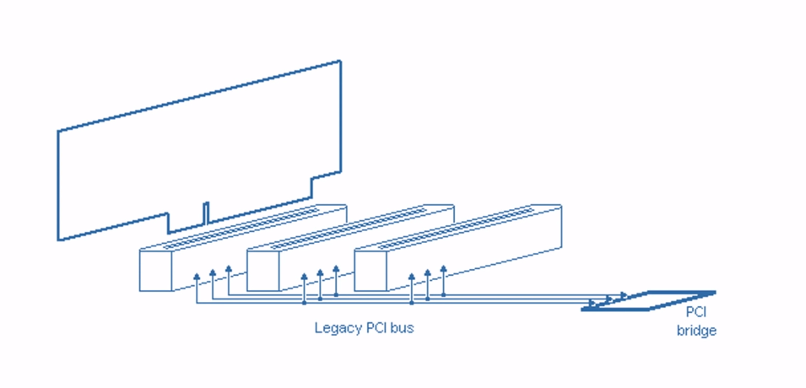
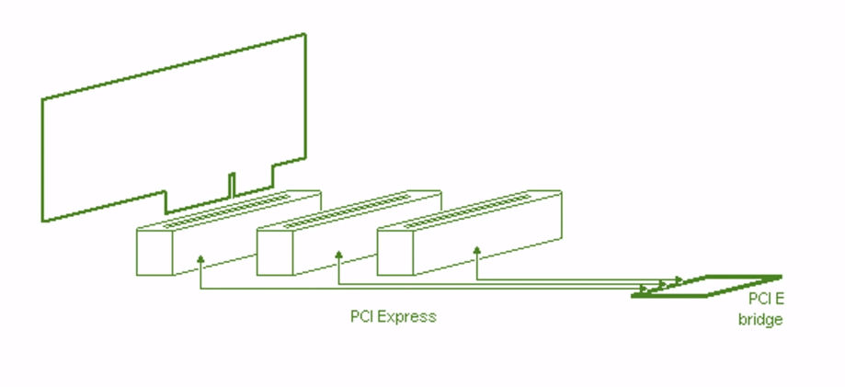
Why PCI->PCIe
PCI
The bus shortcomings
PCIe
Point to point. Simulated bus.

Slide 4
Backwards Compatible?
Software
Yes
Hardware
No

Slide 5
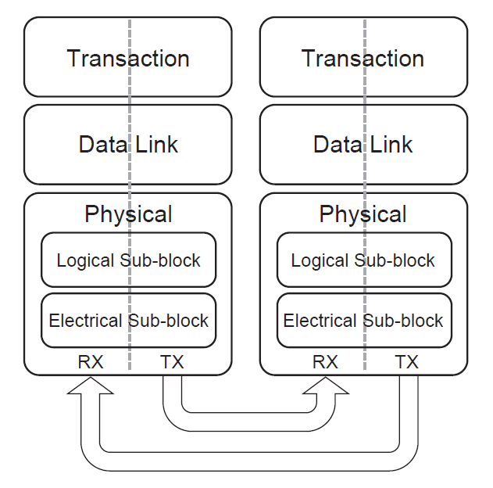
Network Architecture
Similar to OSI layers 1-4
Transaction layer
TLP construction and management
Data link layer
Connection management (DLLP), virtual channel control
Physical layer
2 sublayers
8b/10b logical encoding
LVDS electrical connection

Slide 6
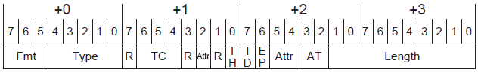
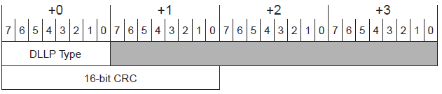
Packet Structure
TLP – for component read/write
Different length and contents depending on format and type
DLLP – for link control metadata

Slide 7
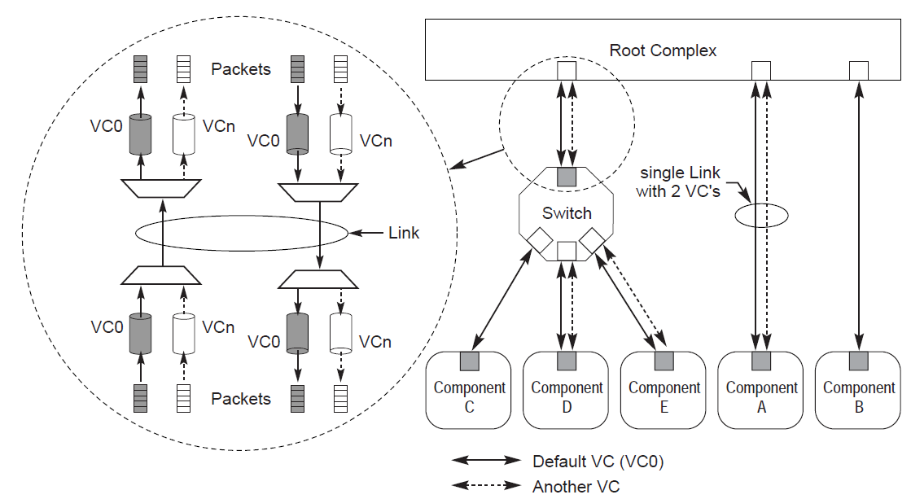
Connection
Data link layer manages starting connection for new devices, through DLLPs
Each message has traffic class (TC) mapped to virtual channel (VC)

Slide 8
Conclusion (is this necessary?)
PCIe demonstrates a movement away from parallel buses
Virtual bus replaces physical bus connections with point-to-point

Slide 9
Questions?

