Slide 1
PCI Express
Sean Link
David Stockhouse

Slide 2
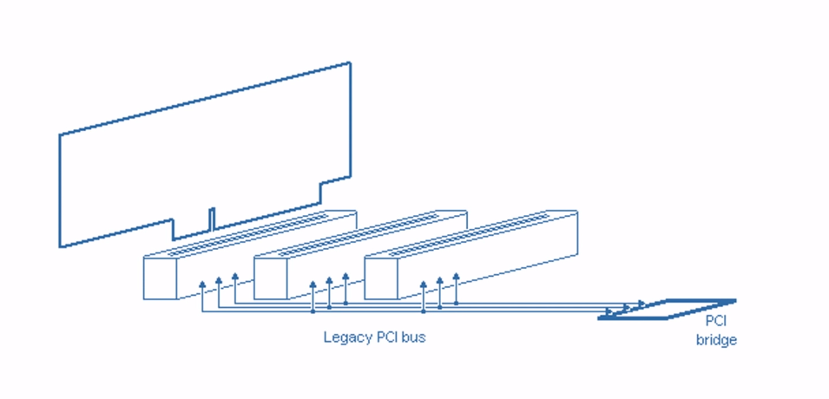
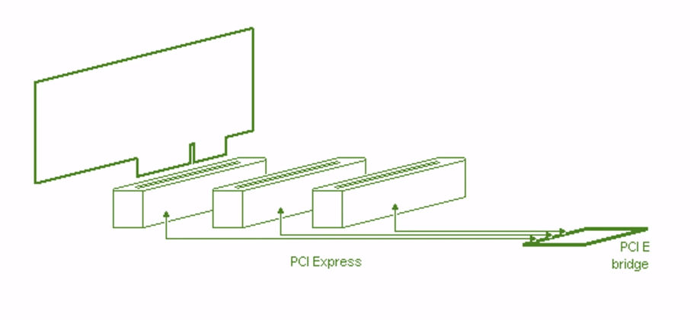
Introduction
Serial better for high speeds
Not a true bus – emulated using switches

Slide 3
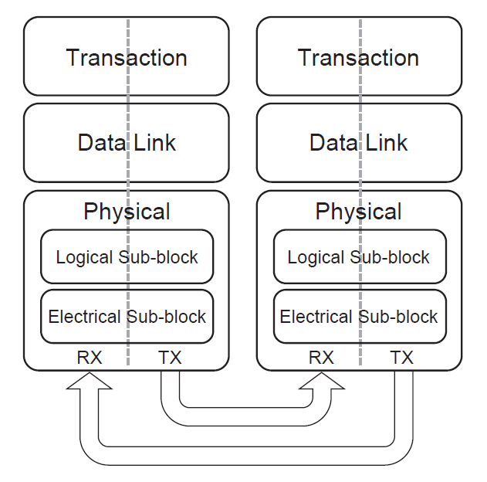
Network Architecture
Similar to OSI layers 1-4
Transaction layer
TLP construction and management
Data link layer
Connection management, virtual channel control
Physical layer
2 sublayers
LVDS signals, 8b/10b encoding

Slide 4
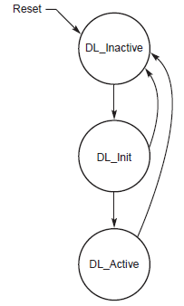
Connection
FSM in each PCIe device for connection state
Data link layer manages starting connection for new devices, through DLLP

Slide 5

TLP Packet Structure

