Slide 1
PCI Express
Sean Link
David Stockhouse

Slide 2
Overview
Sean
Why PCI -> PCIe
Small nuances and confusion about backwards compatibility (software vs hardware)
David

Slide 3
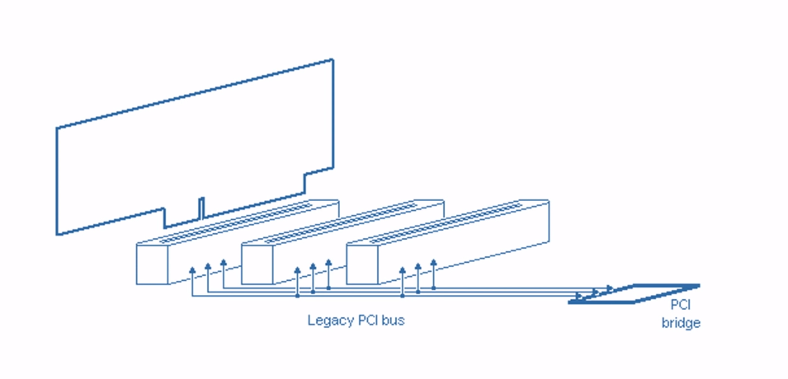
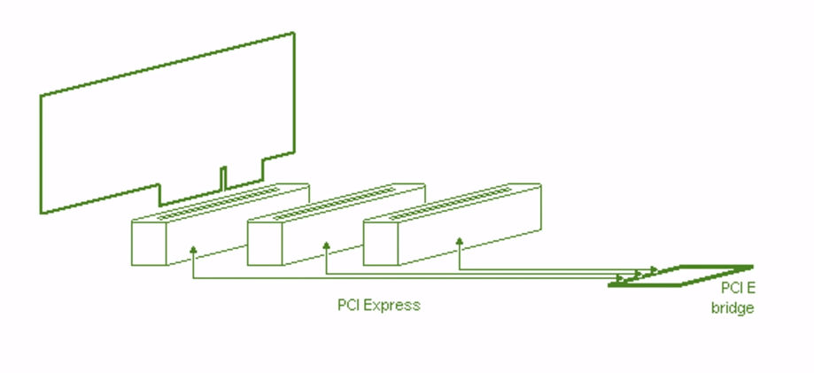
Why PCI->PCIe
PCI
The bus shortcomings
PCIe
Point to point. Simulated bus.

Slide 4
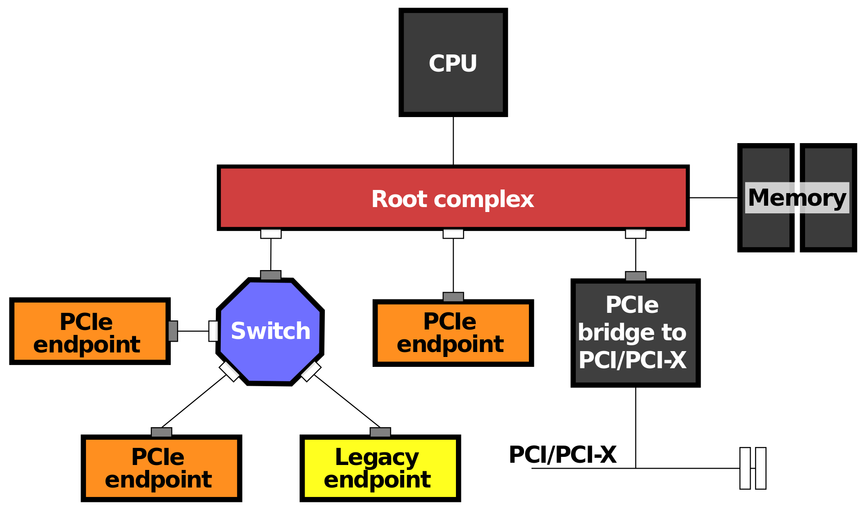
Backwards Compatible?
Software
Yes
Hardware
No

Slide 5
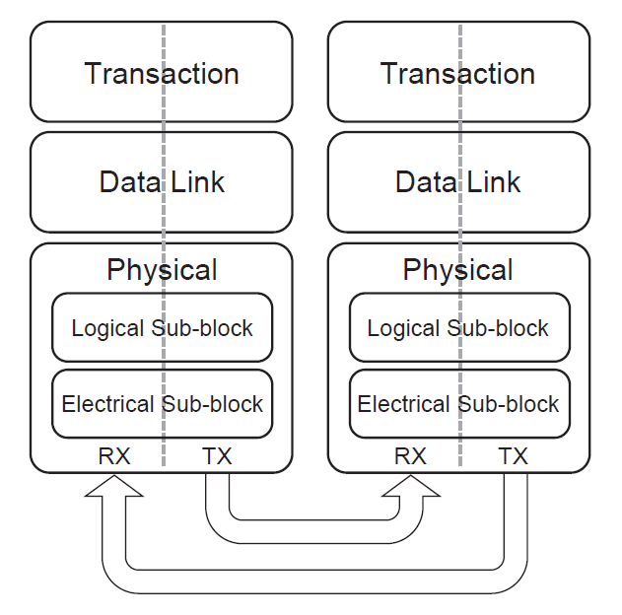
Network Architecture
Similar to OSI layers 1-4
Transaction layer
TLP construction and management
Data link layer
Connection management, virtual channel control
Physical layer
2 sublayers
LVDS signals, 8b/10b encoding

Slide 6
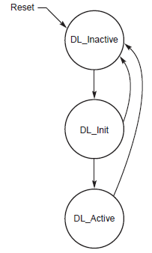
Connection
FSM in each PCIe device for connection state
Data link layer manages starting connection for new devices, through DLLP

Slide 7

TLP Packet Structure

