Slide 1
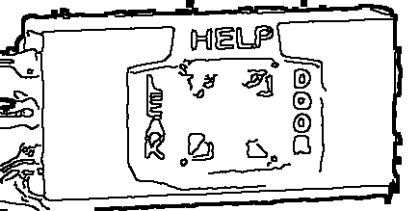
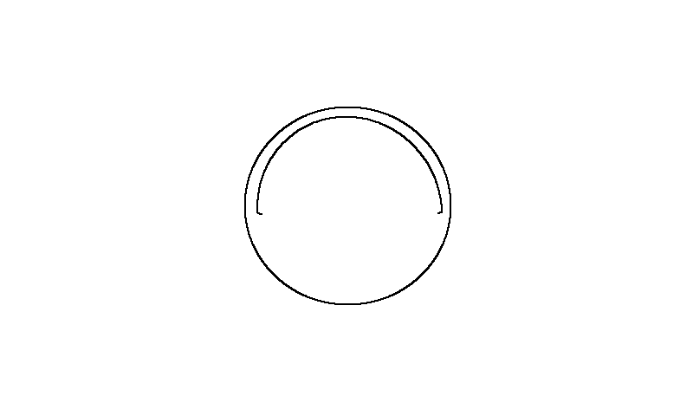
Alarms Safety — Edge Components
Alarm Strobe Horn
Blue Refrigerant Leak Horn/Strobe
Door Annunciator / Strobe
S360/DA
Door Open Horn/Strobe DA
S360/DA
Entrapment Alarm EA
S360/EA
Entrapment Alarm Strobe
S360/EA
Entrapment Light Switch
54161
Entrapment Switch Box
5320-0
Entrapment Switch ES
5320-0
Horn Silencer Button
56PB
Leak Annunciator / Strobe
S360/LI
Magnetic Door Contact Switch
VIP100-69L
Red Alarm Strobe
CS-24WRW
Red Entrapment Horn/Strobe
Yellow Door Open Horn/Strobe

Slide 2
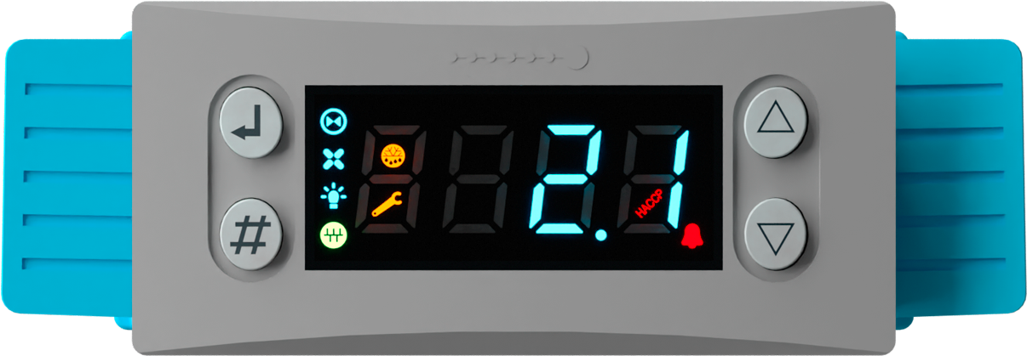
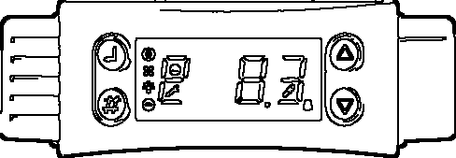
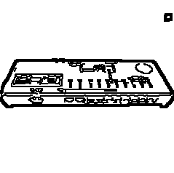
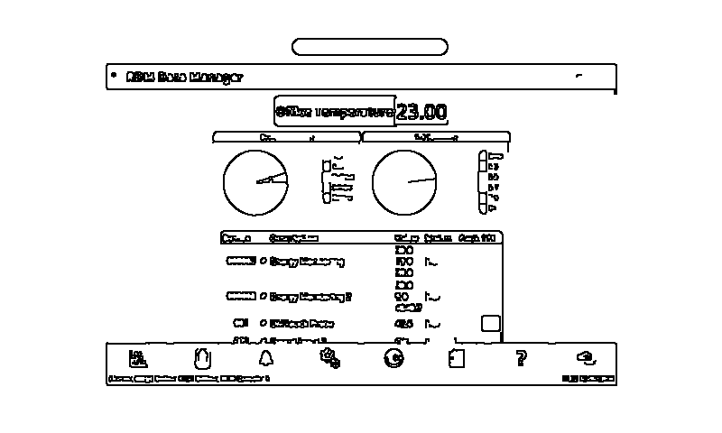
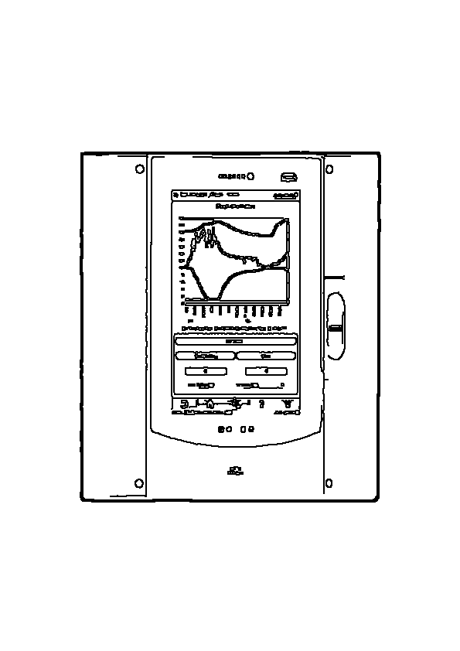
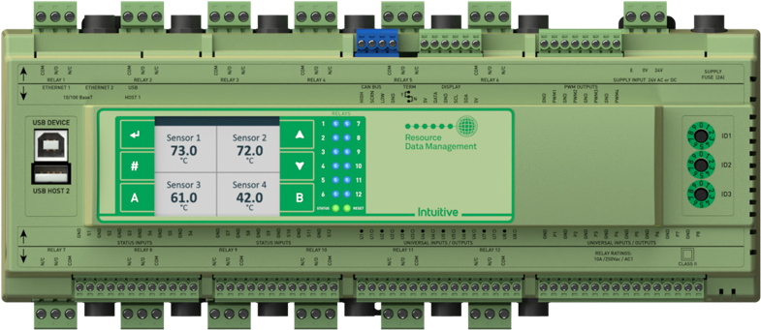
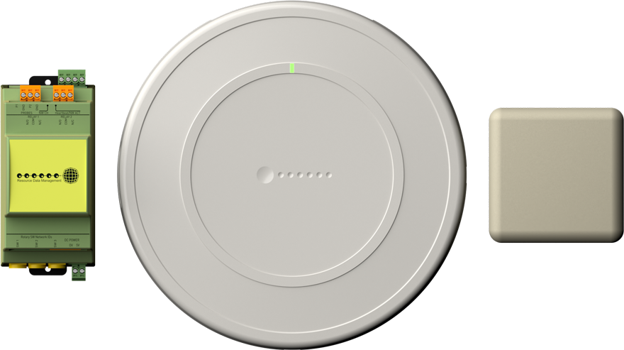
Controllers — Edge Components
Mercury - Review
Mercury Controller
Mercury
Mercury Switch
Mercury
Mini TDB - Review
Orbit Touchxl Console
PR0617-OB-E-BK
Pr0652-cct Case Controller
PR0652-CCT
PR0660 Top Row Controller
PR0660
PR0680 TDB Touchscreen Controller
PR0680
PR0685 Case Controller
PR0685
Pr0685-3ec Case Controller
PR0685-3EC
PR0740 Case Controller
PR0740
PR0751 Evaporator Controller
PR0751-IP
Pr0751-ip EEV Evaporator Controller
PR0751-IP
RDM 652
RDM's Bluetooth

Slide 3
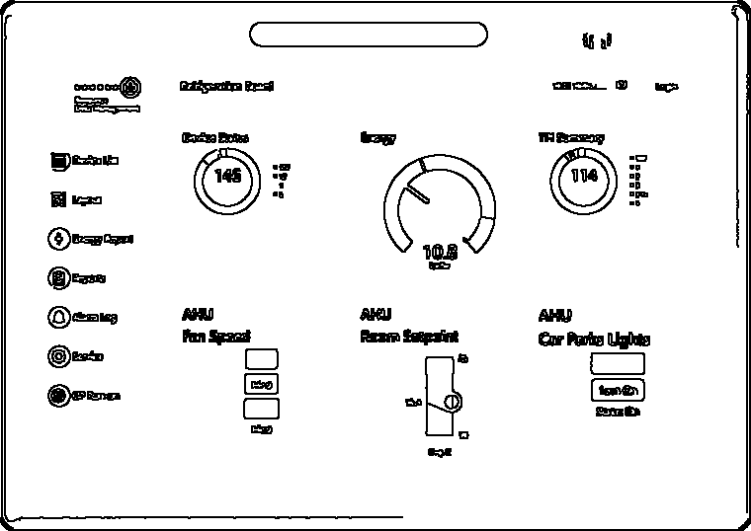
Controllers — Edge Components
TDB - Review
Touchxl
TouchXL

Slide 4
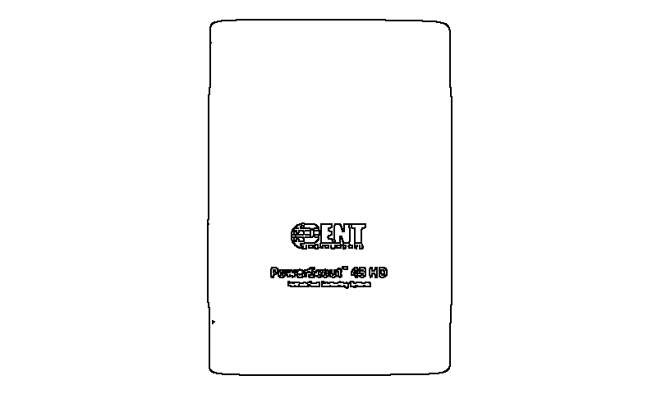
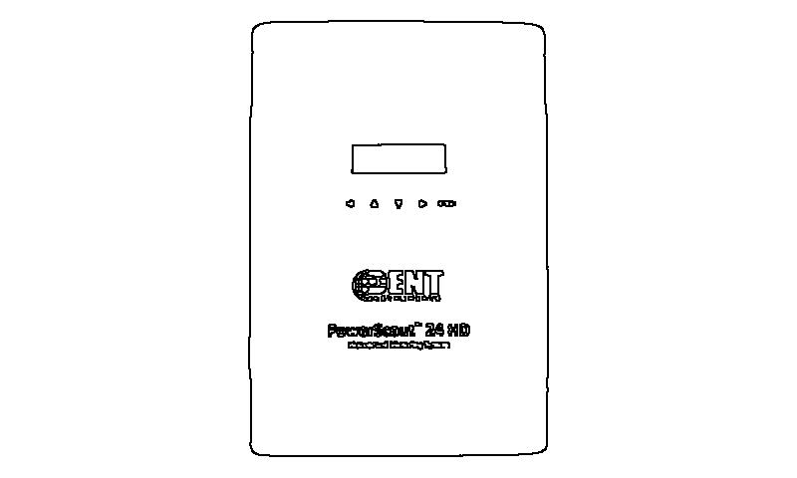
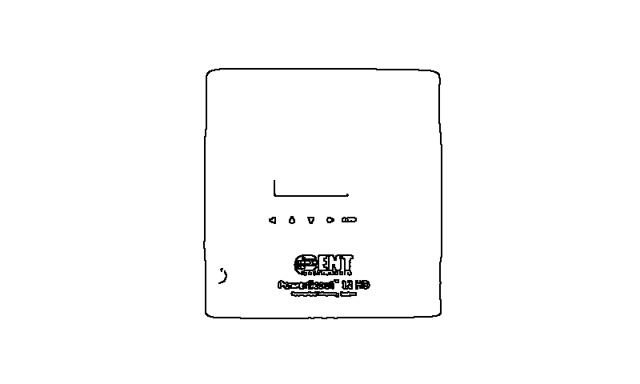
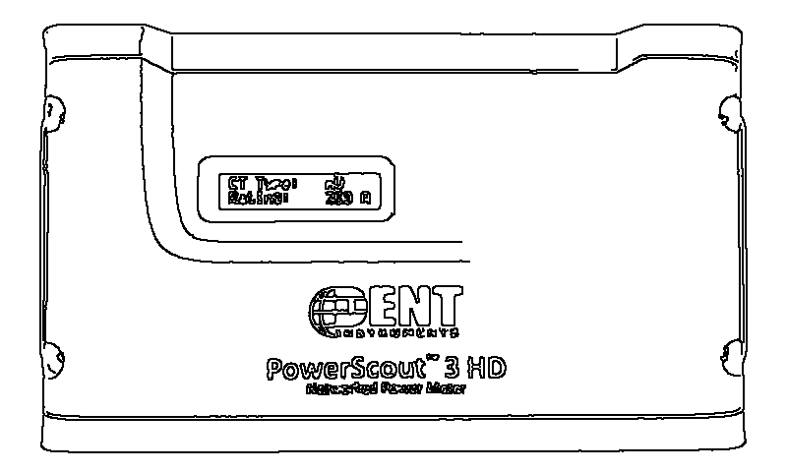
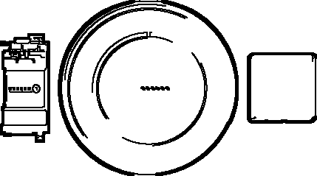
Custom — Edge Components
DENT PowerScout PS12
PS12HD-C-D-N
DENT PowerScout PS24
PS24HD-C-D-N
DENT PowerScout PS3
PS3HD-C-D-N
DENT PowerScout PS48
PS48HD-C-D-N
DS Door Switch
DS
ET Entrapment Switch
ET
LLSV Liquid Line Solenoid Valve
LLSV
RDM Bluetooth
Rogowski Coil CT
CT-R36
Split Core CT
CT-SMC/HMC

Slide 5
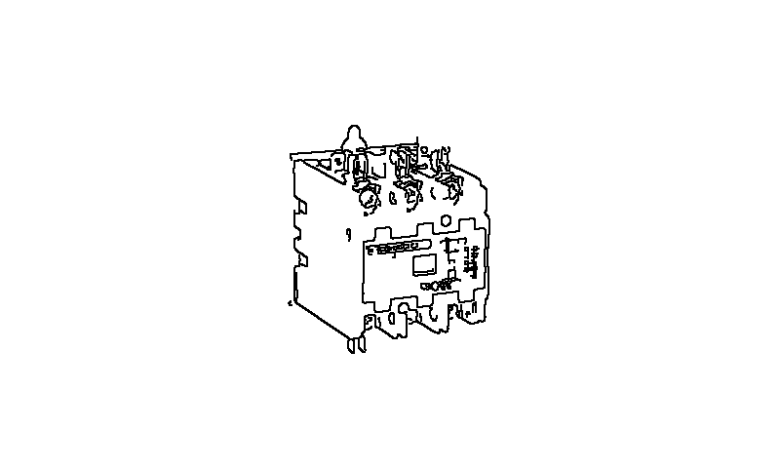
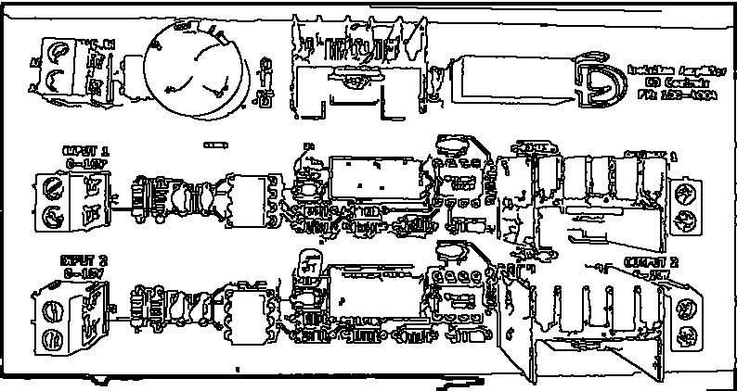
Electrical Power — Edge Components
1-Pole Lighting Contactor
1-pole Power Contactor
1P Contactor
2-Pole Lighting Contactor
2-pole Power Contactor
2P Contactor
24VDC Power Supply
APV-25-24
3-pole Power Contactor
3P Contactor
Electrical Generator Monitor
Generator Monitor
Generator
Generic Contactor 3-pole
Isolation Amplifier
100-4004
Lighting Contactor Bank
Terminal Block
UPS / Backup Power
UPS

Slide 6
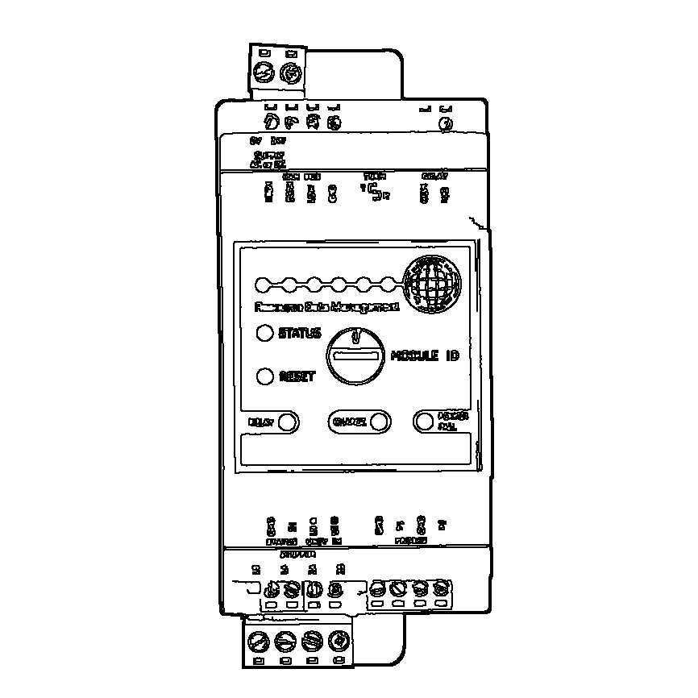
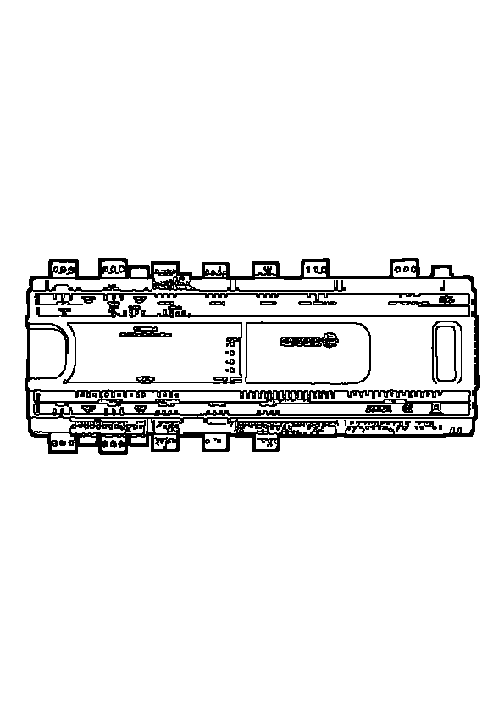
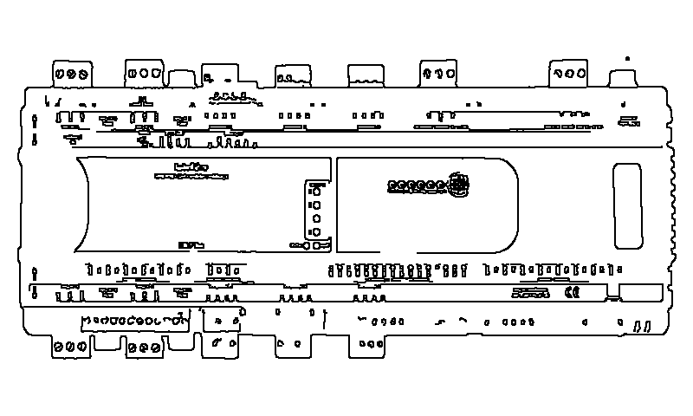
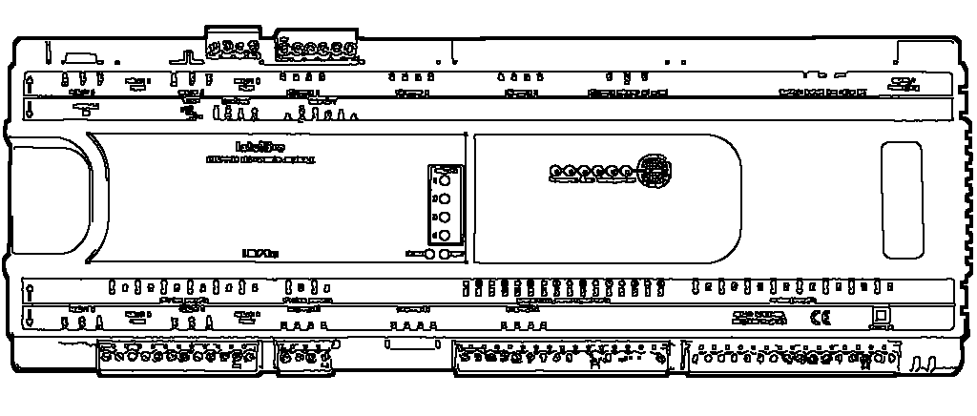
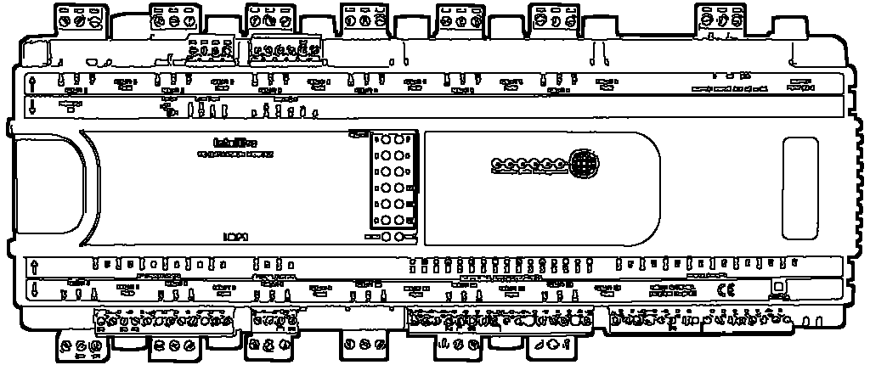
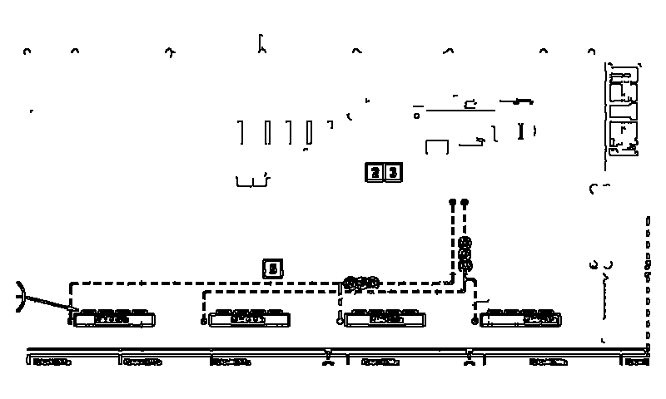
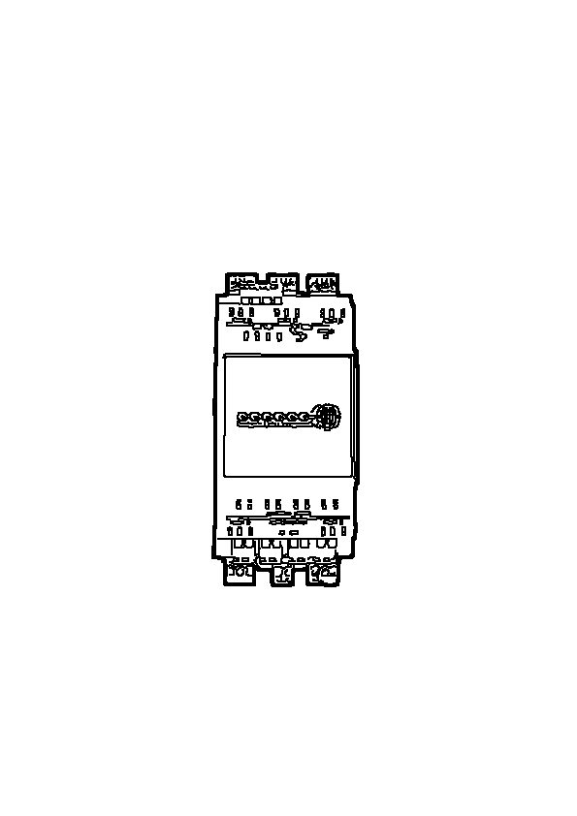
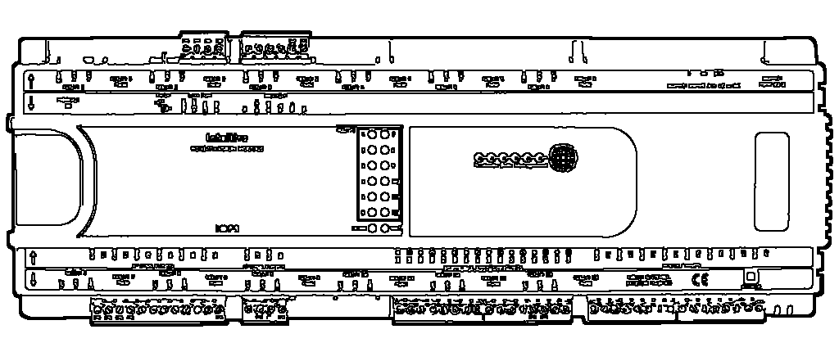
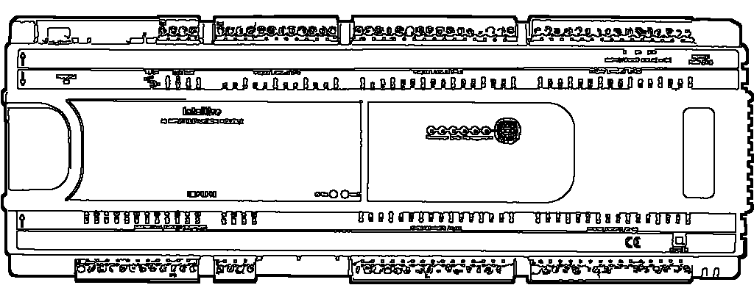
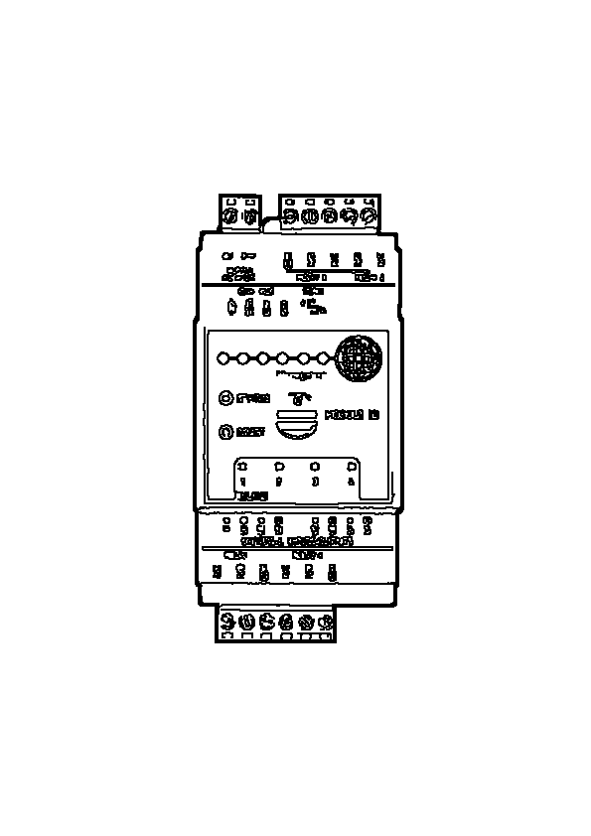
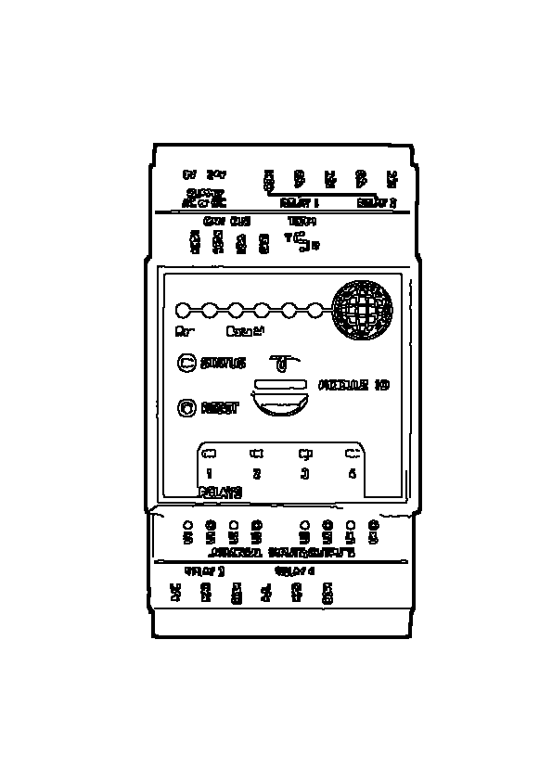
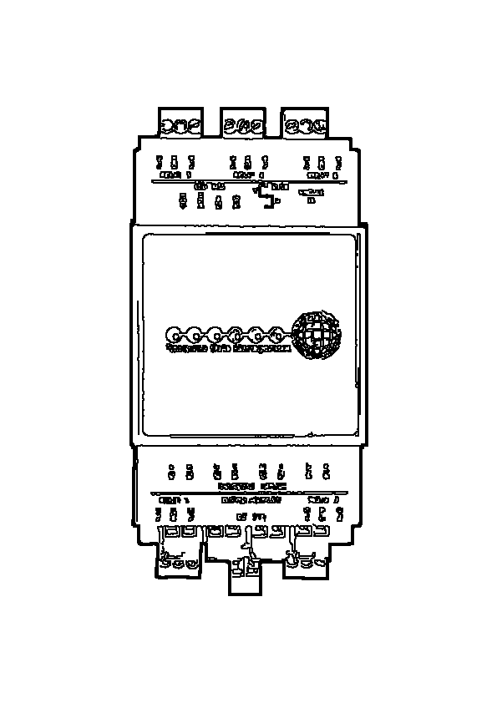
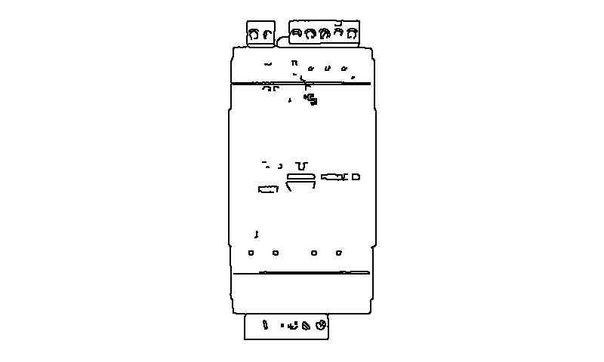
Expansion Modules — Edge Components
PR0653 Top Row Connections
PR0653
PR0656 Expansion Module
PR0656
PR0660 Bottom Row Connections
PR0660
PR0660 Stepper Expansion Module
PR0660
PR0660 Top Row Connections
PR0660
PR0661 Bottom Row Connections
PR0661
PR0661 I/O Expansion Module
PR0661
PR0661 IO Expansion
PR0661
PR0661 Top Row Connections
PR0661
PR0662 Connections
PR0662
PR0663 4-4 Bottom Row Connections
PR0663
PR0663 4-4 Top Row Connections
PR0663
PR0663 Bottom Row Connections
PR0663
PR0663 Expansion I/O Module
PR0663
PR0663 Mini I/O Expansion
PR0663

Slide 7
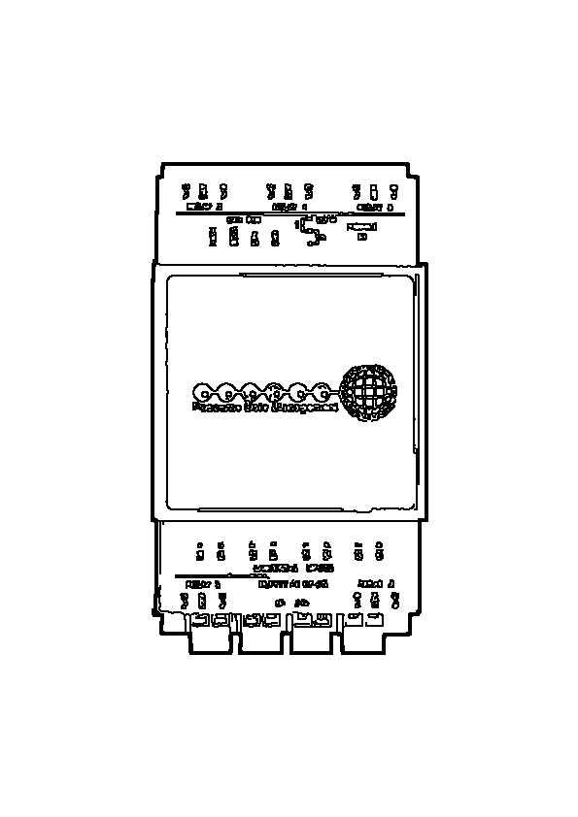
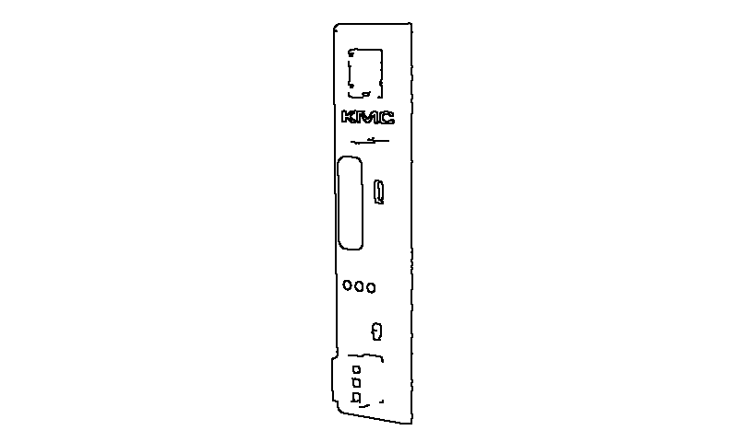
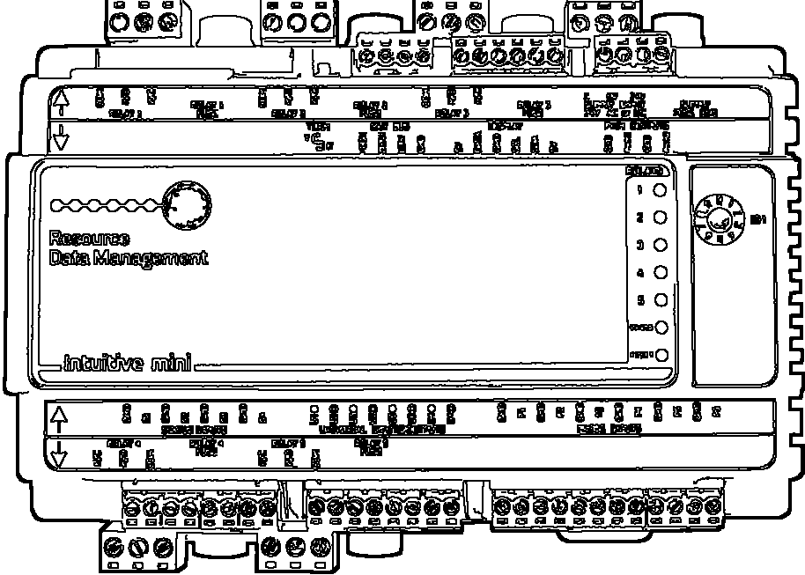
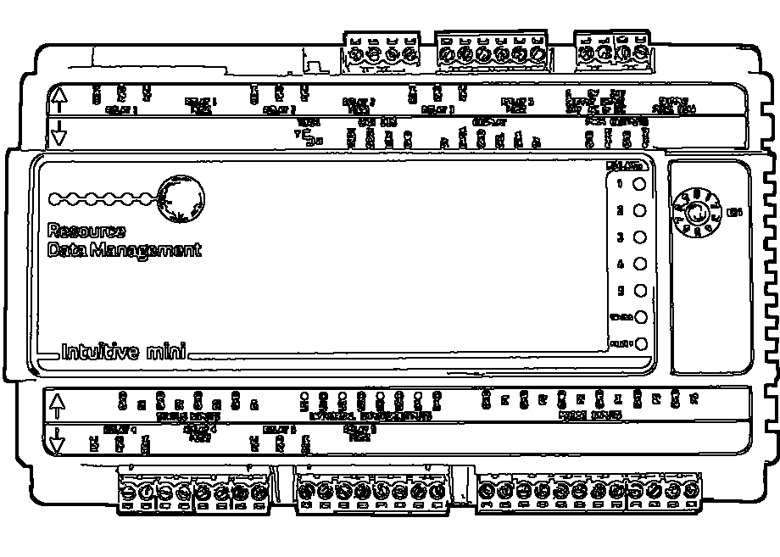
Expansion Modules — Edge Components
PR0663 Top Row Connections
PR0663
PR0681 Mini I/O Expansion
PR0681
PR0681 Top Bottom Connections
PR0681
PR0681 Top Row Connections
PR0681

Slide 8
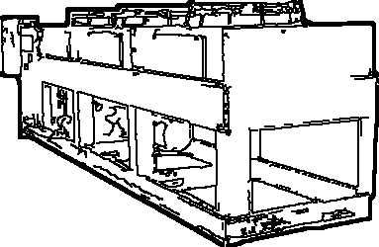
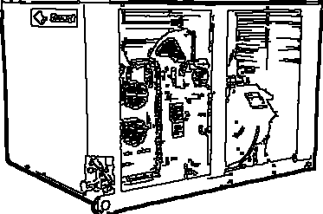


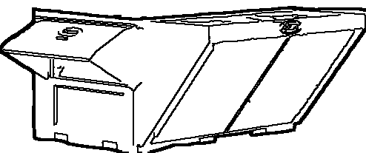
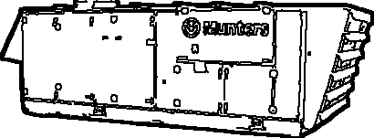
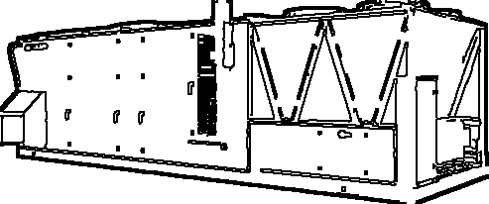
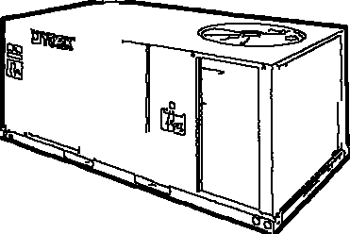
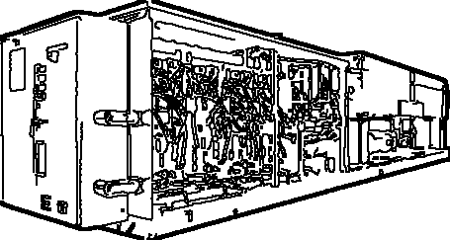
Hvac — Edge Components
Bacnet PACU/OAU Loop
Condenser
Condenser Fan
Condensing Unit
Fans
Humidistat
MAU
Munters Dehumid
OAU Outside Air Unit
OAU
OAU Unit
OAU
PACU
PACU Rooftop Unit
PACU
PACU RTU York
PACU Unit
PACU
Rack RTU

Slide 9
Hvac — Edge Components
Thermometer

Slide 10
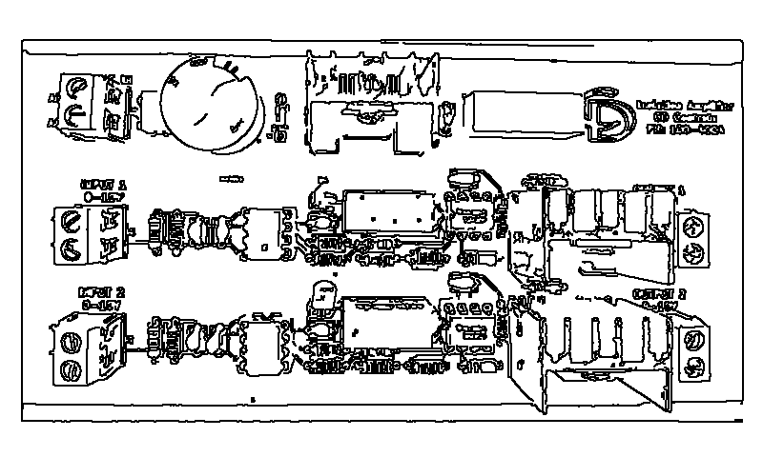
Lighting — Edge Components
Dimming Module
100-4004
LCP1 Lighting Controls
LCP1

Slide 11





Logos — Edge Components
H-E-B Logo
RDM Logo
RDM Logo
Singh360 Logo
Singhg360 Logo

Slide 12
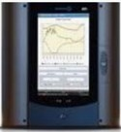

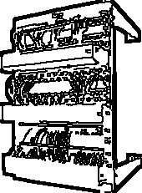
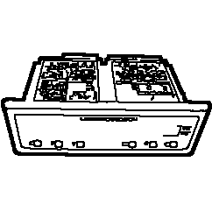
Network Data — Edge Components
48-port RDM IDF Switch
48-port
Bacnet Router Basrt-b
BASRT-B
Data Manager
DM Data Manager Marker
DM
IDF
MDF
MDF / IDF Rack
MDF/IDF
MDF Rack
Orbit TouchXL
PR0617-OB-E-BK
PRO Pack
Data Manager
RDM Data Manager
PR0510
RDM IDF 48-port Switch
RDM IDF Switch Stack
IDF Stack

Slide 13
Panels Enclosures — Edge Components
CCP Case Control Panel
CCP
LCP Enclosure
LCP
LCP Lighting Control Panel
LCP
PCP Pharmacy Control Panel
PCP
WICP Enclosure
WICP

Slide 14
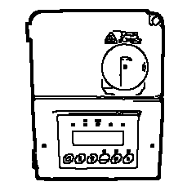
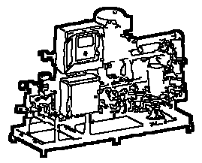
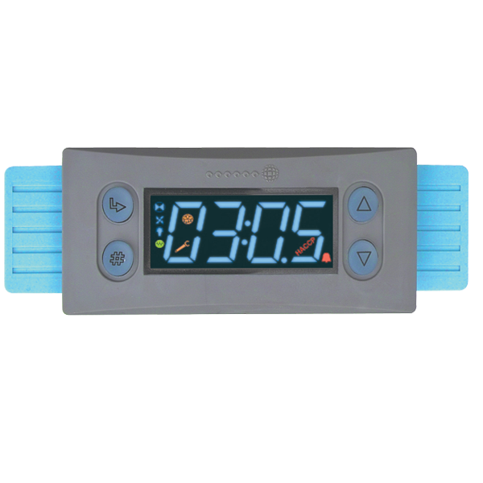
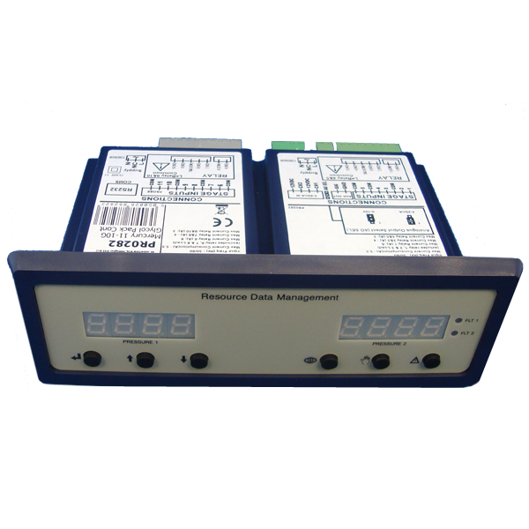
Refrigeration — Edge Components
Anti-Sweat / Trim Heater
CO2 Refrigeration Rack
Coldroom
Compressor
EEPR Electronic Evaporator Pressure Regulator
EEV Electronic Expansion Valve
EPR Mechanical Evaporator Pressure Regulator
Evaporator Coil
Evaporator Fan
Glycol Pump Skid
Liquid Line Solenoid Valve
LLV
Liquid Line Solenoid — Closed
Liquid Line Solenoid — Open
Mercury 2
PR0282 Pack

Slide 15
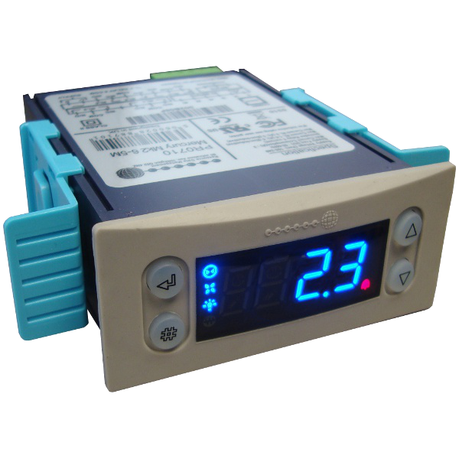

Refrigeration — Edge Components
PR0710 Mercury Mk2
Rack Zero Zone
Refrigeration Rack
Refrigeration Rack RA
RA
Refrigeration Rack RB
RB
Refrigeration Rack RC
RC

Slide 16

Sensors Transducers — Edge Components
10K Temperature Probe
PR0250-P4
10K2 Temperature Probe
10K2
Clean Switch
CO2 Leak Transducer
CT1O-A3D
Defrost Termination Sensor
HFC Leak Transducer
REF-LK-832
HFC Refrigerant Leak Sensor LS
REF-LK-832
Indoor Temp / RH Sensor
A/RH3-CP-R
Light Level / OAT Sensor
PR0198-10K2
Pressure Transducer
Temp / RH Sensor
A/RH3-CP-R
Zone Temperature Sensor
A/CP-R

Slide 17

Symbols Markers — Edge Components
Callout Number 1
1
Callout Number 10
10
Callout Number 11
11
Callout Number 12
12
Callout Number 2
2
Callout Number 3
3
Callout Number 4
4
Callout Number 5
5
Callout Number 6
6
Callout Number 7
7
Callout Number 8
8
Callout Number 9
9
DA Door Open Horn/Strobe
Dimming Zone Marker
DZ
DIN Rail

Slide 18
Symbols Markers — Edge Components
DS Defrost Sensor
DTS Dual Temperature Switch
EA Entrapment Horn/Strobe
Electric Defrost Marker
ES Entrapment Switch
HELP TRAPPED / PERSONA ATRAPADA Sign
HELP TRAPPED Symbol
HELP TRAPPED
HS Horn Silencer Button
IDF Network Marker
IDF
LCP Panel Marker
LCP
LI Leak Indicator Horn/Strobe
Liquid Line Solenoid Marker
LS Leak Sensor
LT Light Level / OAT Sensor
LT
MDF Server Rack Marker

Slide 19

Symbols Markers — Edge Components
OAT Outdoor Air Temp Sensor
OAT
Person Trapped Inside Sign Symbol
PM Power Monitor Marker
PM
rdm eepr electronic
rdm eepr mechanical
RDM IDF Marker
Signage Legend - Safety / Trapped / Leak
Signage Legend
Signage Legend Safety
Signage Legend Safety Trapped Leak Help
Signage Legend Strip
Signage Legend
Sym Pm Power Monitor Marker
Sym T Temp Input
T Temperature Input
T
TS Temperature Sensor
When Lit Refrigerant Leak — Do Not Enter Sign

Slide 20
Symbols Markers — Edge Components
WICP Panel Marker
WICP

