Slide 1

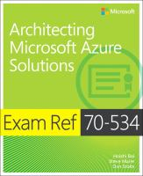
Exam Jump Start 70-534 Architecting Microsoft Azure Solutions DevOps and Next Steps
Dan Stolts - Author
Chief Technology Strategist, Microsoft
http://ITProGuru.com
http://ITProGuru.com/join
http://LinkedIn.com/in/danstolts
ITProGuru@Microsoft.com
@ITProGuru
Get Invited…
ITProGuru.com/Join
Microsoft Virtual Academy
Notes:
http://aka.ms/certification/70-534
https://mslibrary.measureup.com/

Slide 2
Architect Defined
Given Challenge
<=>
Create Solution
Noun:
1. a person who designs and in many cases also supervises construction
2. the deviser, maker, or creator of anything: the architects of the Constitution of the United States.
Verb:
4. to plan, organize, or structure as an architect: The house is well architected.

Slide 3
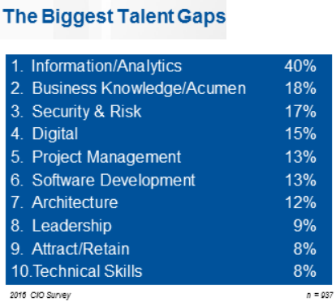

2016 CIO Priorities & Challenges
Talent has now been recognized globally as the single biggest issue standing in the way of CIOs achieving their objectives.
The biggest talent gaps are around Information/Analytics followed by business knowledge/acumen.
Understanding what is possible with the cloud can help close the gap
http://www.gartner.com/imagesrv/cio/pdf/cio_agenda_insights_2016.pdf
Notes:
http://www.gartner.com/webinar/3139617/player?commId=175277&channelId=5500&srcId=1-2973089105

Slide 4


Translate Business Objectives Into Actions
Identify Problems (especially root problems)
Determine the requirements to solve each problem
Determine technology available to help solve the problem
Identify strategic partners
Determine likely barriers
Determine additional value (if any)
Get Started

Slide 5
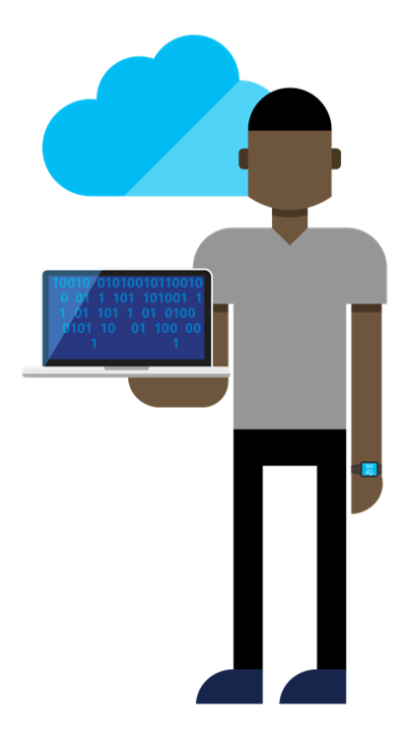





DevOps is the union of people, process, and tools to enable continuous delivery of value of our end uses.
DEV
OPS
1
People
2
Process
3
Tools
Shared Mission: Deliver a great product that inspires our customers to become raving fans
Notes:
People = Culture
Fundamental attributes of successful cultures:
Shared mission and incentives: infrastructure as code, apps as services, DevOps/all as teams
You need to consider your hardware as a commodity, (don't give your servers names) , servers are like farm animals, it is just harder if you let theids name them
Build deep instrumentation into services, push complexity up the stack
Rally around agile, shared metrics, CI, service owners on call, etc.
Changing the culture: any change takes time, changing culture is no exception and you can't do it alone, exploit compelling events to change culture: downtimes, cloud adoption, devops buzz
PROCESS Definition and design, compliance, and continuous improvement
PEOPLE Responsibilities, management, skills development, and discipline
Tools and infrastructure

Slide 6
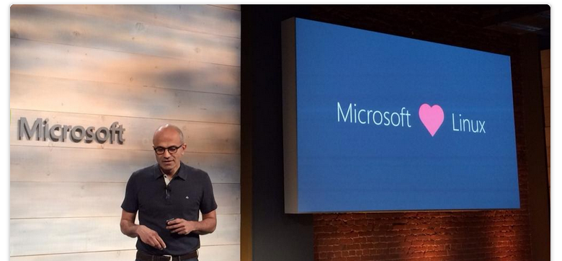
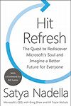
Culture Change & Digital Transformation
Hit Refresh
The Quest to Rediscover Microsoft's Soul and Imagine a Better Future for Everyone
2017 - Satya Nadella, Greg Shaw, Jill Tracie Nichols - Biography & Memoirs

Slide 7
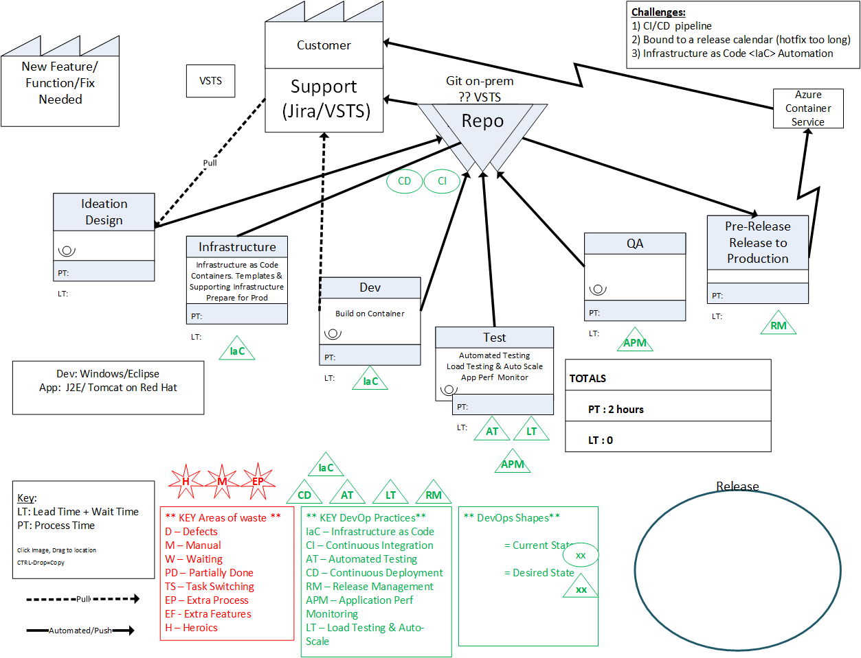
Value Stream Mapping – Understanding and Teaching

Slide 8
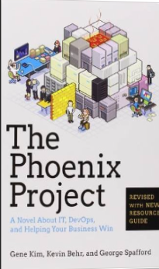
Tip: Must Read Book
Amazon…
The Phoenix Project: A Novel about IT, DevOps, and Helping Your Business Win Paperback
– October 16, 2014
The book is available on Audio Book; you can likely get it for free, if you do not already have an account. If you do not have an Audible Account, you get two free books when signing up for your free account.
This is the BEST IT Book I have ever read.

Slide 9
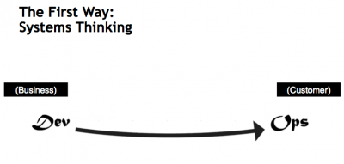
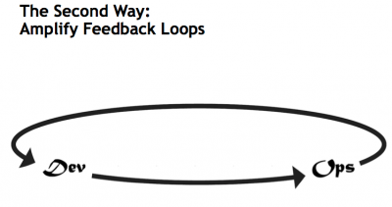
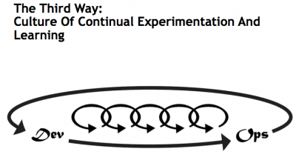
What is DevOps…
Infrastructure as Code (IaC)
Continuous Integration (CI)
Automated Testing
Application Performance Monitoring/Management (APM)
Continuous Deployment (CD)
Release Management
Configuration Management
DevOps Fundamentals
Advanced Monitoring
Capacity Management
Feature Flags
Self-Service Environments
Automated Recovery (Rollback & Roll-Forward)
Hypothesis Driven Development
Testing in Production – partial user base
Fault Injection
Usage Monitoring/Telemetry
A/B Testing (aka canary testing)
Gene Kim’s “3 ways”
The First Way emphasizes the performance of the entire system, as opposed to the performance of a specific silo of work or department — this as can be as large a division (e.g., Development or IT Operations) or as small as an individual contributor (e.g., a developer, system administrator).
The Second Way is about creating the right to left feedback loops. The goal of almost any process improvement initiative is to shorten and amplify feedback loops so necessary corrections can be continually made
The Third Way is about creating a culture that fosters two things: continual experimentation, taking risks and learning from failure; and understanding that repetition and practice is the prerequisite to mastery.
http://www.itproguy.com/devops-practices/
http://itrevolution.com/the-three-ways-principles-underpinning-devops/

Slide 10
Traditional vs modern dev-ops
Category | Traditional | Modern DevOps
Quality of code check-ins | Unknown | Validated through unit tests
Environment Creation/Configuration | Manual | Automated
Deployment Frequency | 1-2 months (or less frequent) | Deploy whenever needed, including several per day
App Deployment Process | Requires meetings and planning | Push-button deployment
Deployment validation | Manual | Automated
Monitoring | Minimal to none | Health and Performance monitoring
Dev and Ops relationship | Blame culture | Culture of trust

Slide 11
Containerization
ARM Template
2 Hosts
4 Instances of Container A
2 Instances of Container B
Container are… a technology that ENABLES and ACCELERATES DevOps
Abstract the unit of work from the VM
Lightweight, fast provisioning, density
Simplify application updates
Works with cluster managers for auto-scale capabilities
Container Host - 1
Container Host - 2
Container
A
Container
A
Container
A
Container
A
Container
B
Container
B
Orchestration Engine

Slide 12





Cloud is a new way to think about a datacenter
I AM SPECIAL
WE ALL LOOK ALIKE
VIRTUAL
MACHINES
VM SCALE SETS
CONTAINER SERVICE
SERVICE FABRIC
Build on
Infrastructure Mindset
Build on
Platform Mindset
Ultimate Control
Traditional Model Cloud Model
Cost and Agility
System
Admin
Windows and Linux
.NET, Java, Python, PHP, Ruby, GO, Node.JS
Docker Swarm
Mesos, etc.,
Cloud Foundry,
Marathon, Deis, OpenShift etc.
Developer
Azure is Open at Every Layer
Notes:
Notes coming soon – please check back on http://aka.ms/opensource for latest version

Slide 13
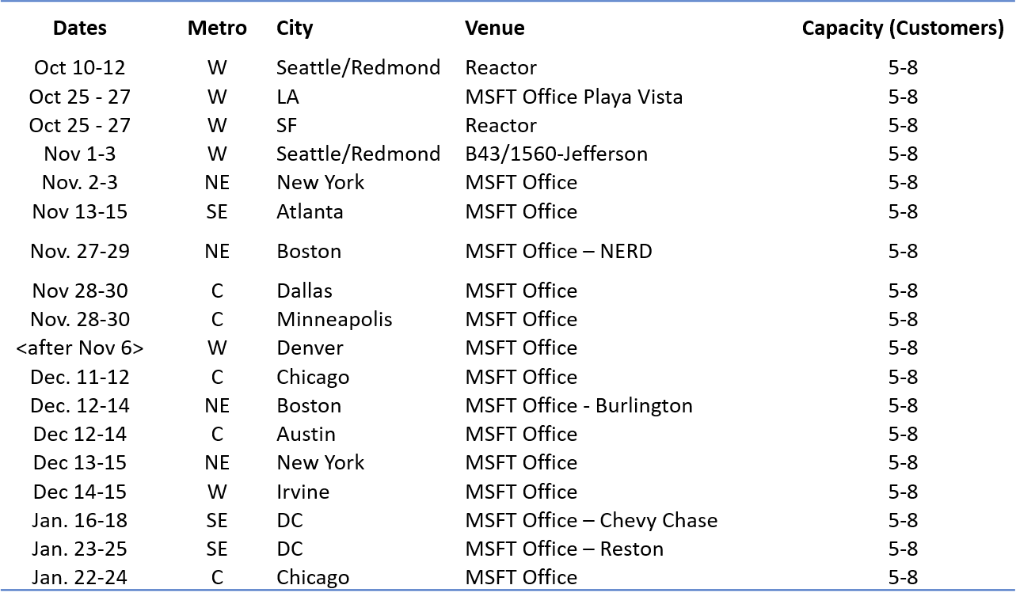
DevOps Journey
“There are many secrets to showing quick results with DevOps. Results, where the true value of DevOps can be realized in just a few weeks” – Dan Stolts, Chief Technology Strategist, Microsoft
Not Started?
Already started:
Feel you should be able to get results faster
It is too hard
Takes too long
There is too much bureaucracy
Event Schedule ➔
How to Join: Reach out to your Sales Team; cc dstolts@microsoft.com
Alert: Many pre-req’s
Let Microsoft show how to kick your journey into high gear.
Where you are executing at top speed with lower amounts of energy being consumed.

Slide 14
Kickstart Your DevOps Journey
Introductory Meeting [1.5 hours]
Quick review of pipeline: Feedback.. Production -> Planning/Ideation. This review will help us answer the following:
Identify primary tools, processes and perceived weaknesses if any
Define needed participants/roles to be included in VSM (and hack) - includes name, email address, tittle, role (Homework?).
Schedule VSM (Aug 31-Sept 1) & Hack October ????
If time, identify any training desired
VSM – Day 1-2
Around the room intro’s
Short DevOps Training
Whiteboard Value Stream Map
Working Lunch
Plan hack priority - {if needed}
Define Success
Identify expected outcomes
Homework – if needed
Lock hack dates
Training (Docker, VSTS, Azure, Hybrid, whatever) if needed and time permits
Hackfest
Day 1 - Setup Teams; Identify requirements, Identify scribe; Perform Training; Hack rest of day 😊
Day 2- Hack all day ☺ 3pm Team scrums
Day 3-? Hack all day ☺
Last Day
Morning Test process; tweak as needed
Document – outline will be provided; Teams can use to share their success with their leadership
Working Lunch
Afternoon Document; Create follow-up plan (future hacks, deploy in production, work on different part of pipeline, etc)
2:30-3:30pm; 10-15 mins team presentations to all hackers and Q&A from other hack teams
Provide Feedback using Event Feedback URL
Plan Project Phase II
Define Post hack Schedule
Leadership team discussions of projects and priorities
Plan continued hack schedule
4:30pm hack ends

Slide 15
Questions… Answered at Events
?
?
?
?
?
?
?
?
?
?
?
?
?
?
?
?
?
?
?
?
?
ITProGuru.com/Join

Slide 16
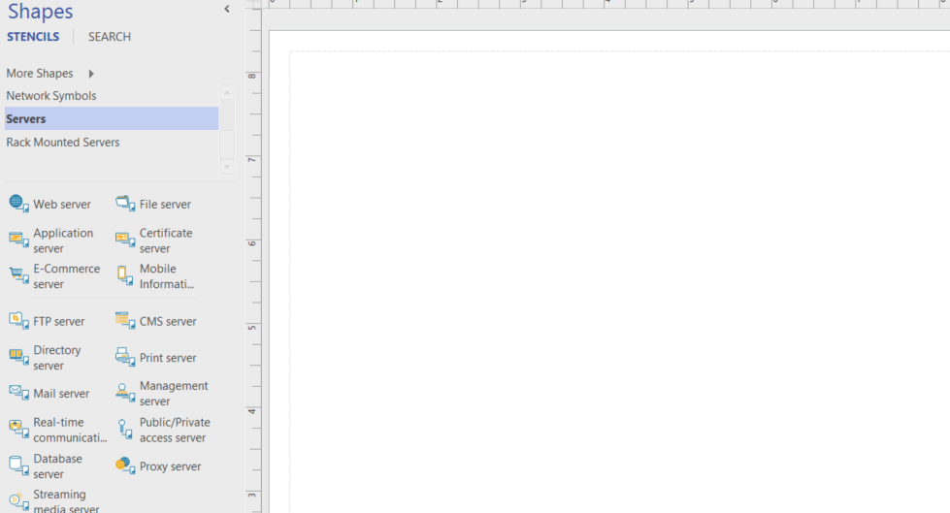
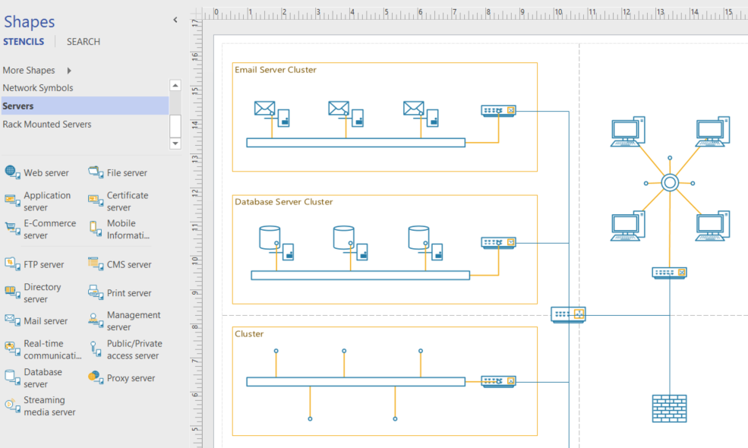
Azure..Like Visio, you start with a blank canvas…
Architect what is possible for your company. Solve Your Business Challenges with the Azure Cloud

Slide 17
Tips, Tricks and Field Experiences
Recognize Accomplishments
Finish a chapter, Finish a Lab, Watch a video, Read a white paper… All Accomplishments
Get Family On Board
Make your goals, their goals. Trip to Dave & Busters upon completion, ice cream shop for a chapter
Make the Decision… Get STARTED NOW!
Self, Career, Income, Stature
Value of Certification
Excuses
Excuses are Easy; Results are forever! Just Do IT!
Value of time
What is your time worth? When you are sitting in front of the tube, that is what it is costing you
Notes:
Tips, Tricks and Field Experiences Value of Certification: I want to make sure you are on board with the value of certification. Certification can offer many advantages including: getting a raise at your next review, preparing you for new job opportunities, increasing the likelihood your resume will be seen by the hiring manager, increasing your self confidence, increase you image (how people see you) in your business and in your social circles, lines on your resume, most hiring managers consider certification as part of their hiring criteria, you get experience while preparing for certification,…. and the list could go on and on. The fact of the matter is there is never any shortage of reasons why we should get certified. I am glad you have read this far… Make the decision to read this article in it’s entirety, then GET STARTED!!! Write down the reasons you want to obtain certification and look at them daily. Recognize Accomplishments: Recognize your accomplishments not matter how small. Feel good about the fact that you finished reading this article and realize that having done so has gotten you one step closer to obtaining your MCP in the Azure Cloud. Each time you finish something, even if it is just watching a 20 min video or reading a blog post that is relevant to the exam, recognize to yourself that it is a positive step in the right direction. Reflect back on why you want to do this in the first place. Get Family On Board: Often having family (spouse, kids, etc) on board with your goals and objectives will help you stay the course. Engage them, offer the kids a night out at Dave & Busters or an ice cream shop once you pass the exam. Show them your great study habits, maybe they will pick some of them up for their school studies. Excuses: Excuses for not getting certified are easy to come by… I do not have time, can’t concentrate because of the kids, tired when home from work, my boss does not care anyway, it will not help me in my job… and on and on… Give it up! Stop making excuses; stop procrastinating and make the decision to put your career in motion! Keep doing what you have been doing, and you will keep getting what you have always gotten. Value of time: Put a value on your time. What is your time worth? When I was a consultant billing out $250 an hour, that was the value I had on my time. Now it is often somewhat less. Now, during my busy season, I use a value of $100 per hour. During my slow season, when I am much less stressed and work fewer hours, I use a value of $50 per hour. During the summer, family time, the value shoots back up to $250. This may seam silly but it will help you prioritize your time. It will also help you justify purchases. When you consider purchasing a $40 book it will be a no brainer. Spending $40 will potentially save you dozens of hours of time because you will be studying exactly what you need to know, nothing more, nothing less. It may help you decide you should just be taking a class to get this behind you quickly. Even if you just use a value of $10 per hour, it is important to pick a value for your time! If you are broke and have a zero value for your time, fake it. Put a value on your time anyway it will help you prioritize. Even if it is only $1, is sitting in front of the tube watching a sitcom by yourself worth a dollar? Not usually, get up and pick up a book or watch a certification video instead! Dedicated Study time: Set time on the calendar every day or every week for preparation. Just like any other appointment, take the attitude that you have to be there at the scheduled time to perform the duties that are expected of you. Blocking the time on the calendar then sticking to it is likely the single best thing you can do to help you succeed. Figure out what works best for you. Maybe it is 30 mins every day at lunch? How about 45 hour every night from 8:15pm-9:00pm? Whatever time block works for you is great. Personally, I find the best time for me is in the morning before work. This is when I am the most alert and can absorb the most information. I tend to get into the office before others, so I leverage the quite time as my personal development time. Try it, go into the office 45 minutes early to see if that works for you. You have to stick with it though, if you do it once and get distracted, don’t give up, try it a few more times. If people bug you, put a sign up letting them know you will be available for questions at 9:00am or whatever time you actually start working. Personally, when I am cramming, I will often spend 3-4 hours a day. I suffer from insomnia so I have plenty of extra time in my day. I prioritize that time on preparation. Ultra Focus With Intent: When you sit down to study, don’t take it lightly. Stay hyper-focused on learning. Don’t let your mind wander. You are on a very important mission. That mission is to learn as rapidly as possible. If you do this you will find that you will retain far more information and you will be able to consume it much faster. Read Faster: You can read faster. Use your ultra focus, it is a must to achieve this one. While reading, move your finger across the page or the screen at a steady pace, do not stop your finger, make sure your eyes focus on the word over your finger. It is ok if you miss a word or two, DO NOT GO BACK! Then when you master that move your finger faster, then faster, then faster. Eventually, you will be able to do this without the use of your finger as an aid. Objective: Recognize your objective when you set out to take an exam. The objective should be to “Pass the Exam”. Kind of self explanatory right? Not… Some people think, and will tell you that you have to learn everything about the topic in order to pass the exam. Total crap! Learn what you have to learn to pass the test, then leverage that knowledge to learn more as you progress your career. Study Smart: I have studied for many exams and hold more certifications than I can put in my signature block. What I have found in preparing for all the exams I have taken is “it is easy to study the wrong thing”. You know, you go to a blog post or a white paper to get information about an exam and they are telling you to read some 380 page document or white paper. That is bogus, don’t waste you time. I would guess that if you did read that document, you may learn more and maybe get one or two more questions right. But at what cost? Better to cover the materials on the test than, everything there is to know about a topic. More on this later! Objective: Recognize your objective when you set out to take an exam. The objective should be to “Pass the Exam”. Kind of self explanatory right? Not… Some people think, and will tell you that you have to learn everything about the topic in order to pass the exam. Total crap! Learn what you have to learn to pass the test, then leverage that knowledge to learn more as you progress your career. Exam Reference Material: There is often plenty of exam reference material available. Often it is even free. I will point you to some of it later in this article. If you do not mind spending a bit of money, I strongly recommend you just start with an exam reference guide. This could be much faster than spending countless hours learning what may or may not be on the exam. I am personally not a fan of just studying exam questions. I do find them useful, I just find having more context around the topic helps me retain it. by all means, try the practice tests, they be be helpful for you. Practice & Experience: There is no substitute for practice other than maybe experience! Use the technology you are trying to learn. If you have the ability to use the technology in your job, even better! Take advantage of these opportunities. If the opportunities are not there, go out of your way to make opportunities. Think about how you might be able to use this technology in your job, then justify to yourself why it is important to understand the technology for your job. Most employers want their staff IT staff to keep up with technology. They often also will accept that you do it partially on work time. Especially if they know you are spending a bunch of personal time learning. Even if it is just setting up a lab environment, getting your hands dirty will go a very long way to you understanding the technology. Exam Objectives: Most exams (and all of Microsoft exams) have well documented Exam Objectives or Skills Measured. Use the Exam Objectives as a “list of things to learn”. Print out the exam objectives and check them off one at a time, as you search that topic and spend time learning it. For the cloud exam, I have done much of the work for you, you can just print this blog post. Like writing a book: I am in the process of writing a book on a certification exam. When writing a book on a topic, you do not automatically know everything there is to know about that topic. You are generally not in a situation where you know it all and want to write a book to share your vast knowledge on the subject. On the contrary, you may know a bunch about the topic, but to teach people everything they need to know to pass the test, you have to learn much, much more. The way I do this is using the Exam Objectives. I research & learn what I can on each exam objectives, teaching and writing as I go. One of the other things you do prior to writing a book is, take the test. Take the test: Take the test, get a feel for what is on it. Microsoft offers a “2nd shot” so you can take the test a second time for free. Once you have gone through all of the exam objectives one time quickly, take the test to see how you do. This will give you a report so you can see what you need to study. As you are studying you will remember exam questions so you will know the relevance. After you pass the exam, if you want to learn more, use the exam report to study the things you did not ace (if you are so inclined.) What Exam: Figuring out what is the best exam to take next is often a challenge. Really though, it does not matter. See https://www.microsoft.com/learning whichever exam you chose will likely prepare you for what is next in your professional life because getting certified will make you better at it! If you are a general or specialized IT person start with 70-533. If you are a developer, start with 70-532. If you are an architect or infrastructure designer start with 70-534. If you are not sure, start with 70-533. Whatever you do, just start NOW! Once you pass the first cloud exam, go back and study the next one. Then repeat until you have passed them all. By then you should have caught the bug (the high that comes with a great accomplishment) and you will pick another topic and repeat! - See more at: http://itproguru.com/expert/2015/03/azure-cloud-certification-jump-start-70-532-70-533-70-534-exam-preparation/#sthash.sDikFZa4.dpuf

Slide 18
Tips, Tricks and Field Experiences
Practice & Experience
NO SUBSTITUTE! Do the labs; Azure @ Work
Take the test
2nd shot? Much easier after you take it because you know where you are weak ☺
Ultra Focus With Intent
After you pass the test, you can work on learning more and developing your career
Objective – Pass the Exam!
Don’t let your mind wander; You are on a mission to learn FAST!
Excuses
Excuses are Easy; Results are forever! Just Do IT!
Value of time
Dedicated Study time
30 mins Day/night Pick a time; make it happen!
What is your time worth? When you are sitting in front of the tube, that is what it is costing you
Read Faster
DO NOT GO BACK!
Use your finger, keep it moving make eyes follow

Slide 19
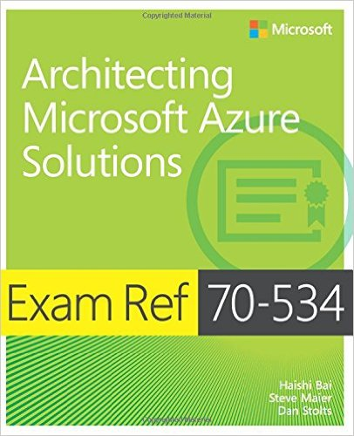
Event Notifications – Http://ITProGuru.com/join Example: Azure Certification Jump Start 70-534 Architecting Microsoft Azure Solutions
Brought to you By:
@ITProGuru
Microsoft
#1 Design Azure Resource Manager (ARM) networking (5–10%)
Design Azure virtual networks - Extend on-premises
Describe Azure VPN and Express Route architecture and design
#2 Secure resources (20–25%)
Secure resources by using managed identities
Secure resources by using managed identities
Secure resources by using identity providers
Identify an appropriate data security solution
Design a role-based access control (RBAC) strategy
Manage security risks by using an appropriate security solution
#3 Design an application storage and data access strategy (5–10%)
Design data storage
Select the appropriate storage option
#4 Design advanced applications (20–25%)
Create compute-intensive applications
Create long-running applications
Integrate Azure services in a solution
Implement messaging applications
Implement applications for background processing
Design connectivity for hybrid applications
#5 Design Azure Web and Mobile Apps (5–10%)
Design Web Applications
Design Mobile Applications
#6 Design a management, monitoring, and business continuity strategy (20–25%)
Design a monitoring strategy
Describe Azure business continuity/disaster recovery (BC/DR) capabilities
Design a disaster recovery strategy
Design Azure Automation and PowerShell workflows
Describe the use cases for Azure Automation configuration
#7 Architect an Azure Compute infrastructure (10–15%)
Design ARM Virtual Machines (VMs)
Design ARM template deployment
Design for availability
+ Bonus: Containers
Join EVENTS Mailing List NOW!
http://www.amazon.com/dp/0735697442/ref=rdr_ext_tmb
Other Event Plans:
DevOps, Containers,
Application Pipeline,
MicroServices & More
ITProGuru.com/Join
Curriculum for Attendees
Notes:
http://aka.ms/70-534 – Once it goes live..
Learn what you need to know to become a certified Azure Solutions Architect. We will go through the lessons found in the book 70-534 Architecting Microsoft Azure Solutions. We will wrap things up with our speakers (and authors of the book) doing a book signing so bring your copy of the book.
70-534 Introduction
Exam Tips and Tricks
Design an advanced application (15–20%)
Design websites (15–20%)
Design a management, monitoring, and business continuity strategy (15–20%)
Design Microsoft Azure infrastructure and networking (15–20%)
Secure resources (15–20%)
Design an application storage and data access strategy (15–20%)
Field Experiences
Book Signing – Authors Dan Stolts, Steve Maier

Slide 20



TechNet Virtual Labs
Deep technical content and free product evaluations
Hands-on deep technical labs
Free, online, technical courses
At the TechNet Evaluation Center you can download free, trial versions of Microsoft software, with no feature limits. Dozens of trials are available – all at no cost.
Try Windows Server 2012 R2 for up to 180 days. Download the Windows 8.1 Enterprise 90-day evaluation. Or try Microsoft Azure at no-cost for up to 90 days.
Microsoft Hands On Labs offer virtual environments that will take you through guided, technically deep product learning experience.
Learn at your own pace in labs that you can complete in 90 minutes or less. There is no complex setup or installation is required to use TechNet Virtual Labs.
Microsoft Virtual Academy provides free online training on the IT scenarios that are important to your company and your career.
Learn at your own pace and boost your IT skills with over 100 courses across more than 15 Microsoft technologies including Windows Server, Windows 8, Microsoft Azure, Office 365, virtualization, Windows Phone, and more.
Download Microsoft software trials today.
Find Hand On Labs.
Take a free online course.
Technet.microsoft.com/evalcenter
Technet.microsoft.com/virtuallabs
microsoftvirtualacademy.com

Slide 21
More Resources
Resource | Link
Virtual Academy Videos | https://mva.microsoft.com/product-training/microsoft-azure#!jobf=IT%20Pros&lang=1033
Various On-line training | https://www.microsoft.com/en-us/learning/azure-training.aspx
Visual Studio Developer Incentives | https://www.visualstudio.com/dev-essentials/
Azure training for AWS professionals | https://openedx.microsoft.com/courses/course-v1%3AMicrosoft%2BAzure213x%2B2016_T4/
Microsoft Azure for IT Pros Content Series | https://mva.microsoft.com/search/SearchResults.aspx#!q=Microsoft%20Azure%20for%20IT%20Pros%20content%20series&lang=1033
LinkedIn Learning Center | https://learning.linkedin.com/in/overview
Microsoft Learning
https://www.microsoft.com/en-us/learning/default.aspx

