Slide 1

ElectroPsych (EPsych) Matlab Toolbox
http://epsych.googlecode.com
2014
by Daniel Stolzberg

Slide 2


EPsych
Easy scripting/debugging
Huge library of functions and toolboxes available
Real-time control of stimuli and behavioral apparatus
Precise event timestamps for pairing with electrophysiology
High quality signal generation and acquisition
Experiment Parameterization
Complete trial-by-trial parameterization based on custom Matlab functions
Signal Calibration
Modular design allows customizable functionality
Custom RPvds circuit macros for behavior real-time behavior control

Slide 3


Basic Workflow
RPvds Circuit
RPvds Circuit
RPvds Circuit
Create real-time components for signal generation and data acquisition
Integrates with TDT OpenEx software
Behavioral hardware input/output
RPvds Circuit
TDT RPvds Software
(*.rcx)
Experiment Protocol
ep_ExperimentDesign
Experiment Protocol
ep_ExperimentDesign
Define hardware and RPvds circuits
Parameterize experiments
Custom trial-selection function for dynamic experiments (optional)
Experiment Protocol
ep_ExperimentDesign
Experiment Protocol
ep_ExperimentDesign
(*.prot)
Behavior/Electrophysiology
ep_RunExpt/ep_EPhys
Runs behavior/electrophysiology experiment by controlling OpenEx and trial-by-trial stimulus parameters

Slide 4

Obtaining and Updating EPsych
http://tortoisesvn.net/
Install whatever is the latest version for your computer (typically 64-bit)

Slide 5
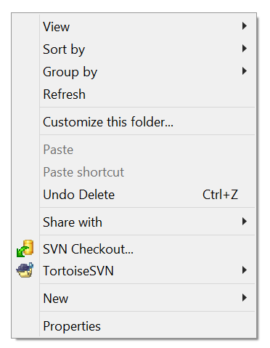
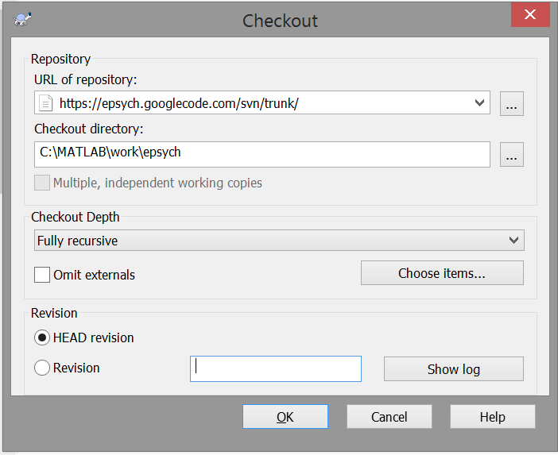
Installation
Navigate to target directory in Windows Explorer.
Recommended: ‘c:/MATLAB/work/’
Right-click in empty area within Windows Explorer.
Click “SVN Checkout…”
URL of Repository: https://epsych.googlecode.com/svn/trunk/
Checkout Directory: C:\MATLAB\work\epsych (or wherever)
Click OK
If successful, you should see folders and files being downloaded from the internet.

Slide 6
Installation
To make sure MATLAB recognizes the software, open MATLAB, type pathtool in the command window, and add the directory of the ephys svn checkout (suggested, C:\MATLAB\work\epsych).
Click the Save button and close the path tool dialog.
Finally, type the command esych_startup(‘C:\MATLAB\work\epsych’); in the command window and appropriate paths will automatically be added to the path.
It is recommended that you modify the “startup.m” file (in the command window, type: edit startup.m) so that the correct paths are set every time Matlab is started.
addpath('C:\MATLAB\work\epsych\');
epsych_startup('C:\MATLAB\work\epsych\');

Slide 7
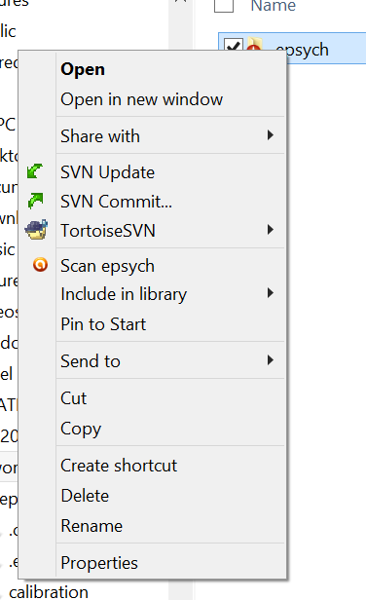
Updating
Right-click “epsych” folder in Windows Explorer.
Click “SVN Update”
You should see a list of files being updated.

Slide 8
Designing RPvds Circuits for EPsych
RPvds Circuit
RPvds Circuit
RPvds Circuit
RPvds Circuit
TDT RPvds Software
(*.rcx)
Experiment Protocol
ep_ExperimentDesign
Experiment Protocol
ep_ExperimentDesign
Experiment Protocol
ep_ExperimentDesign
Experiment Protocol
ep_ExperimentDesign
(*.prot)
Behavior/Electrophysiology
ep_RunExpt/ep_EPhys

Slide 9

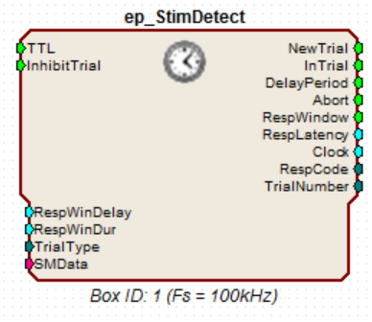
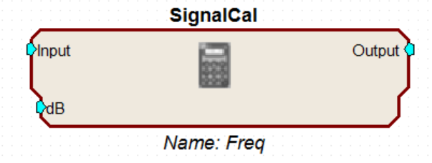
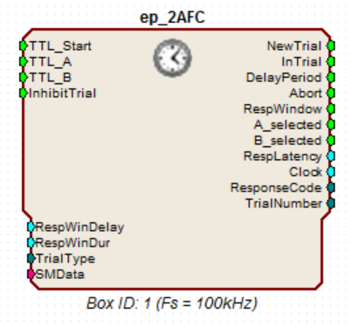
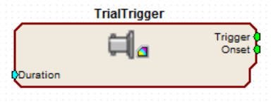
Custom RPvds Macros
Behavior Paradigms
Signal Calibration
Cross-module Synchronous Trigger
(ep_EPhys)

Slide 10
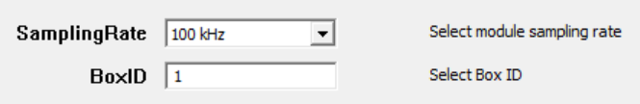
Custom RPvds Macros
Stimulus Detection Tasks
Controls timing of basic stimulus detection behavior paradigm.
One circuit per subject
When InhibitTrial is true, the macro is inhibited. In other words, if TTL goes high while InhibitTrial is high then nothing happens.
Can be used for a timeout or to institute a mandatory inter-trial interval.
The RespLatency output is the time since the end of the RespWinDelay period until the TTL goes low or the RespWinDur expires.
The sampling rate being used in the RPvds must be selected using the setup tab.

Slide 11
Custom RPvds Macros
Stimulus Detection Tasks
GO
|Clock ->->->->->->->->->->->|
InTrial
RespWinDelay
RespWindow
TTL
RespLatency
NewTrial
GO/NO-GO
|Clock ->->->->->->->->->->->|
|Clock ->->->->->->->->->->->|
InTrial
InTrial
RespWinDelay
RespWindow
RespWinDelay
TTL
NewTrial

Slide 12
Custom RPvds Macros
Two-Alternative Forced Choice Tasks
Controls timing of basic Two-Alternative Forced Choice behavior paradigm.
One circuit per subject
When InhibitTrial is true, the macro is inhibited. In other words, if TTL goes high while InhibitTrial is high then nothing happens.
Can be used for a timeout or to institute a mandatory inter-trial interval.
Trial is over when either TTL_A or TTL_B goes high. The first of these two to go high is maintained until trial is reset.
The RespLatency output is the time since the end of the RespWinDelay period until the TTL_A or TTL_B goes high or the RespWinDur expires.
The sampling rate being used in the RPvds must be selected using the setup tab.

Slide 13
Custom RPvds Macros
Two-Alternative Forced Choice Tasks
|Clock ->->->->->->->->->->->->->->->|
InTrial
RespWinDelay
RespWindow
TTL_Start
TTL_A
TTL_B
RespLatency
NewTrial

Slide 14
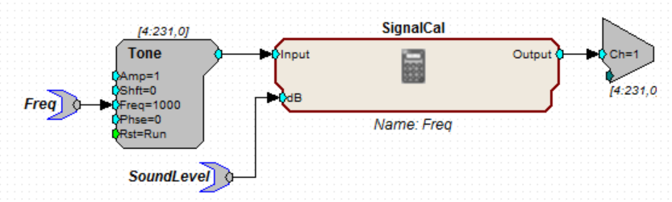
Custom RPvds Macros
Signal Calibration
Adjusts the voltage of a signal based on calibration data
Use the ep_CalibrationUtil GUI to calibrate signals
Associate a parameter – in this case “Freq” – with the calibration file during experiment setup (next section)
Edit the macro name to be the same name as the parameter – “Freq” – by double clicking the macro.
Signal will be calibrated to the SoundLevel parameter value

Slide 15
Custom RPvds Macros
Cross-module Synchronous Trigger
(ep_EPhys)
Synchronous trigger across all modules with this macro
Only used with electrophysiology experiments not using the “Operational Trigger” (next section)

Slide 16
Parameterizing Experiments
RPvds Circuit
RPvds Circuit
RPvds Circuit
RPvds Circuit
TDT RPvds Software
(*.rcx)
Experiment Protocol
ep_ExperimentDesign
Experiment Protocol
ep_ExperimentDesign
Experiment Protocol
ep_ExperimentDesign
Experiment Protocol
ep_ExperimentDesign
(*.prot)
Behavior/Electrophysiology
ep_RunExpt/ep_EPhys

Slide 17
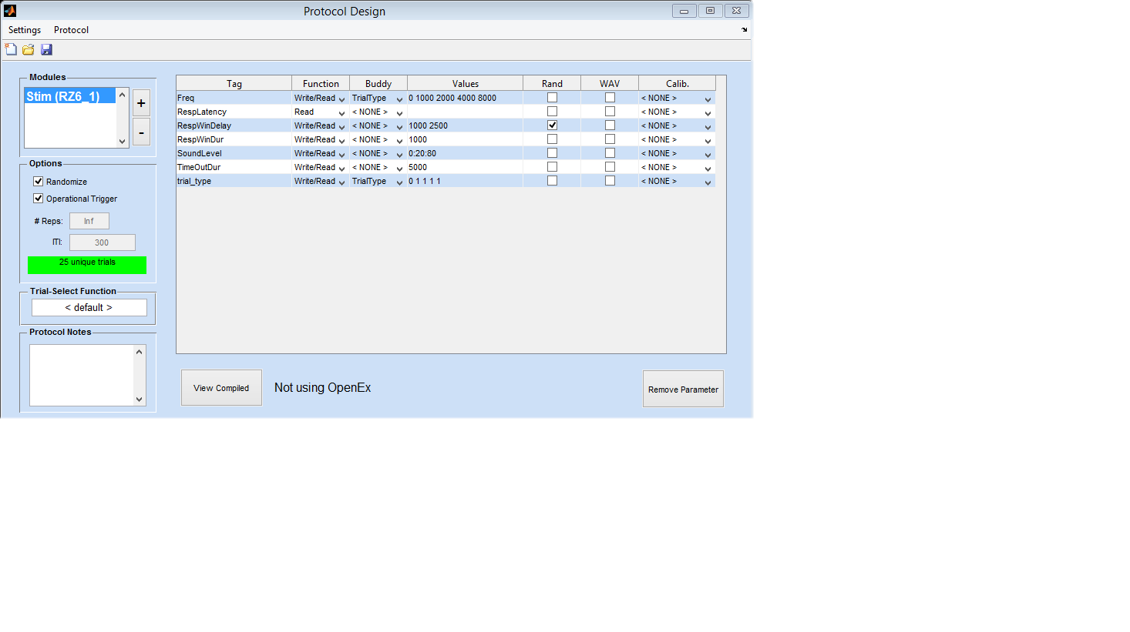
Parameterizing Experiments
ep_ExperimentDesign
Define TDT hardware module types

Slide 18
Parameterizing Experiments
ep_ExperimentDesign
Define parameter values, functions, and calibrations

Slide 19
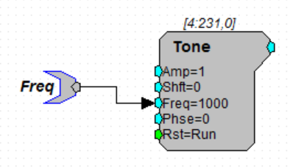
Parameterizing Experiments
ep_ExperimentDesign
Relates to parameter tags in RPvds circuits
Use “$” prefix to prompt for values when beginning an experiment. ex: $Freq
Use “*” prefix to have the parameter be ignored by the updater during runtime. ex: *SomeParameter
Useful when using custom trial selection functions.

Slide 20
Parameterizing Experiments
ep_ExperimentDesign
Determines functionality of the parameter.
Typically “Write/Read” is appropriate.
In this example, the parameter “RespLatency” is “Read” only because the value will be determined during the experiment.

Slide 21
Parameterizing Experiments
ep_ExperimentDesign
Specify values for each (‘write’) parameter.
Express as a scalar, vector, or any Matlab expression that evaluates in the command window including function calls
ex: randn(1,5) which would generate 5 normally distributed random values between -1 and 1.
Use two values and check the “Rand” box to generate a new value for each trial selected from a randomized uniform distribution bounded by the values

Slide 22
Parameterizing Experiments
ep_ExperimentDesign
Associate parameter values together
Click dropdown menu and select “Add New” and enter an arbitrary string
Parameters can be “buddied” across modules

Slide 23
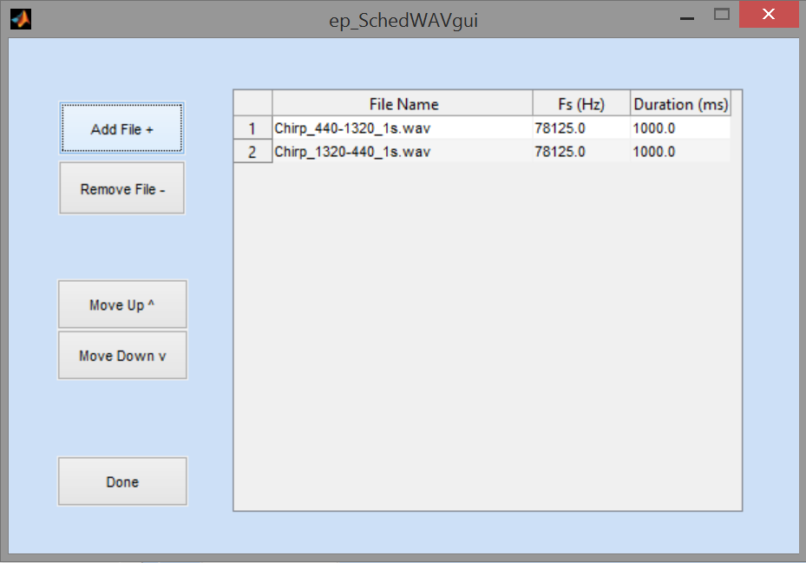
Parameterizing Experiments
ep_ExperimentDesign
Check to use WAV files or data buffers as values for the parameter.

Slide 24
Parameterizing Experiments
ep_ExperimentDesign
Associate a calibration file with parameter values
File is created using the calibration utility (ep_CalibrationUtil) or a manually created file.

Slide 25
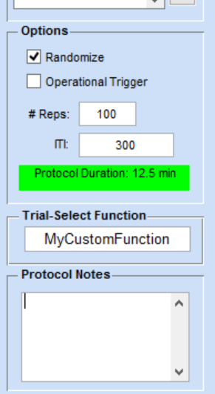
Parameterizing Experiments
ep_ExperimentDesign
Operational Trigger
Unchecked
The next trial is presented automatically
Typical stimulus presentation
# Reps determines how many presentations of each individual stimulus will be delivered
ITI is the inter-trigger-interval (in milliseconds). If two values are specified (ex: 1000 2000) then a random ITI will be generated between the two values (from a uniform distribution).
Checked
Wait for a trigger to run the next trial
Behavioral experiments in which the subjects initiates its own trials
Electrophysiology experiments in which the user presses a button (ex: physical button attached to a digital line on hardware; click a button in a Matlab GUI; spike-triggered stimulus; etc)

Slide 26
Parameterizing Experiments
ep_ExperimentDesign
Trial-Select Function (optional)
Specify a custom Matlab function to select each trial.
Function must be on the Matlab path.
Function must have one input and one output.
Function Prototype:
function NextTrialID = MyCustomFunction(TRIALS)
See the help for the default function for instructions on how to create a custom trial-select function
>> help DefaultTrialSelectFcn

Slide 27
Parameterizing Experiments
Creating a custom trial selection function
function NextTrialID = DefaultTrialSelectFcn(TRIALS)
if TRIALS.TrialIndex == 1
% THIS INDICATES THAT WE ARE ABOUT TO BEGIN THE FIRST TRIAL.
% THIS IS A GOOD PLACE TO TAKE CARE OF ANY SETUP TASKS LIKE PROMPTING
% THE USER FOR CUSTOM PARAMETERS, ETC.
end
% find the least used trials for the next trial index
m = min(TRIALS.TrialCount);
idx = find(TRIALS.TrialCount == m);
% return a random trial index
NextTrialID = randsample(idx,1);

Slide 28
Parameterizing Experiments
Creating a custom trial selection function
function NextTrialID = DefaultTrialSelectFcn(TRIALS)
TRIALS structure:
TrialIndex | Scalar (integer) | Index of current trial. This value is incremented by 1 for each trial.
TrialCount | Array (integer) | Running count of how many times each index of TRIALS.trials has been used.
trials | Matrix (cell) | Contains unique trials in rows and parameters for each trial in columns. TRIALS.writeparams serves as a look-up table for the parameters (columns) in TRIALS.trials.
writeparams | Array (cellstr) | Serves as a look-up table for the parameters in TRIALS.trials.

Slide 29
Parameterizing Experiments
Creating a custom trial selection function (advanced controls)
Global variables
AX | TDevAcc.X | OpenDeveloper ActiveX control for interacting with experiments using OpenEx. See TDT’s documentation on how to use the OpenDeveloper ActiveX.
AX | RPco.X | ActiveX used while running behavioral experiments without OpenEx. This may be an array of ActiveX controls, one for each real-time processor being used. See TDT’s documentation on how to use the ActiveX.
RUNTIME | Structure | This structure contains all information for the experiment and is created each time the experiment is run. Manipulating the contents of this structure can have serious consequences for the current experiment. Test the program thoroughly when manipulating this structure.

Slide 30
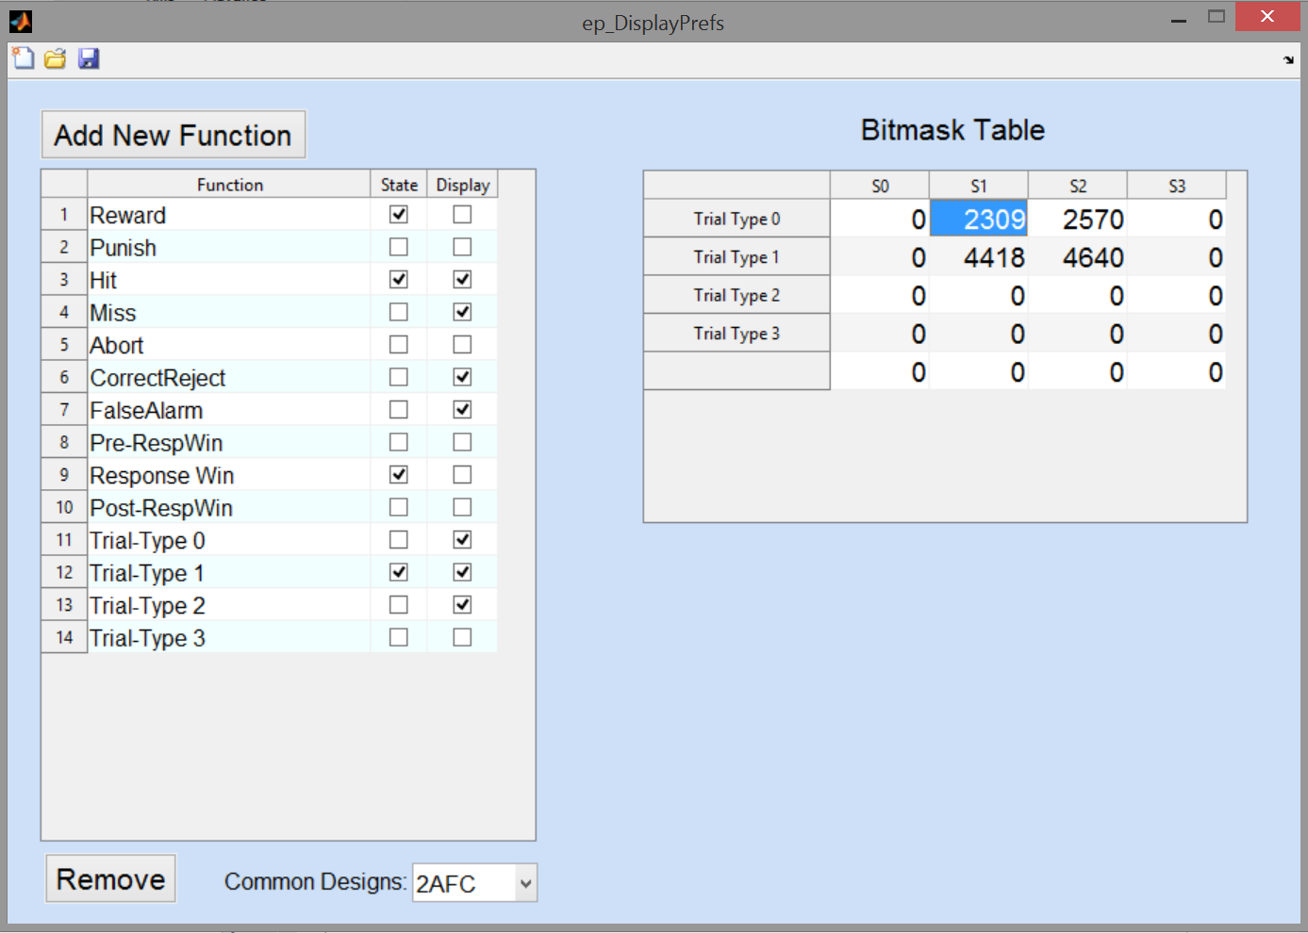
Working with “Bitmasks” and Setting Display Preferences
ep_DisplayPrefs

Slide 31
Working with “Bitmasks”
Define a bitmask for each program contingency
“Catch-Trial”
“Punish”
“Reward”
“Miss”
“Hit”
Bit n
4
3
2
1
0
1 (ON)
0 (OFF)
2^{n}
0
0
4
0
1
sum(2^{n}) = 5

Slide 32
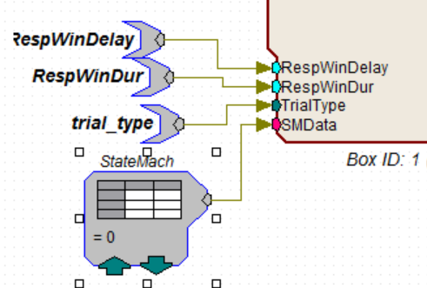
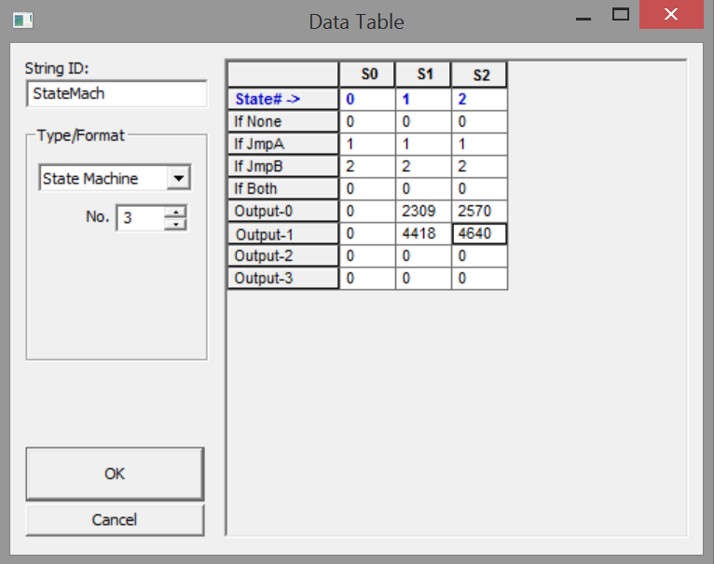
Working with “Bitmasks”

Slide 33
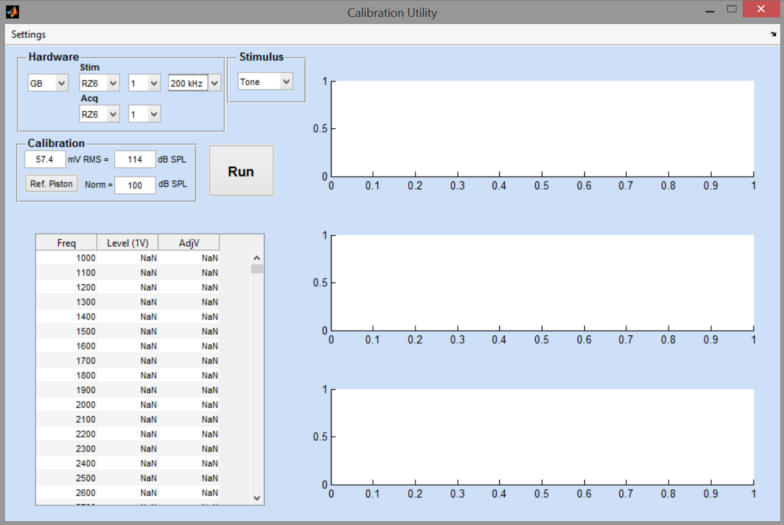
Calibration Utility
Basic Calibration
Setup hardware
Enter reference data or reference a calibrated sound source (ex: piston phone)
Select stimulus type and enter stimuli to calibrate
Click “Run”
ep_CalibrationUtil

Slide 34
Running an Experiment
RPvds Circuit
RPvds Circuit
RPvds Circuit
RPvds Circuit
TDT RPvds Software
(*.rcx)
Experiment Protocol
ep_ExperimentDesign
Experiment Protocol
ep_ExperimentDesign
Experiment Protocol
ep_ExperimentDesign
Experiment Protocol
ep_ExperimentDesign
(*.prot)
Behavior/Electrophysiology
ep_RunExpt/ep_EPhys

Slide 35
Electrophysiology
ep_EPhys
Behavior / Behavior & Electrophysiology
ep_RunExpt
Note: TDT’s OpenEx software must be open and in “Idle” mode whenever running a “electrophysiology” experiment (with or without behavior)

Slide 36
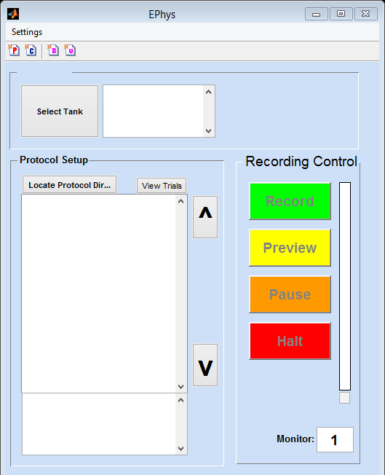
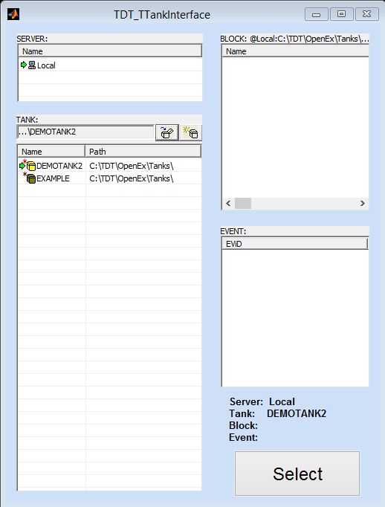
ep_EPhys

Slide 37
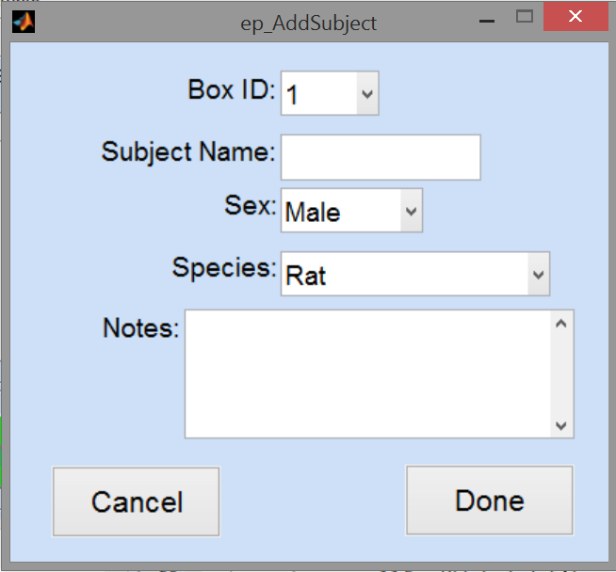
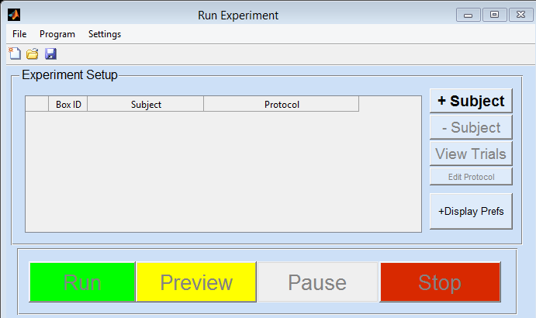
ep_RunExpt

Slide 38
Data Analysis for Non-OpenEx Experiments
A Matlab file is saved for each subjecting during the experiment. The file has two data structures: info and data
info contains fields with information about the experiment including when the experiment started, subject information, etc.
data is an array structure with a field for each “read” parameter defined using the ep_ExperimentDesign GUI.
Each index of the array structure is a an experiment trial in sequence (ex: trial 5 is accessed using: data(5))
A field called “ResponseCode” is added to the data structure and contains the bitmask response for each experiment. It is easy to “decode” this value using the Matlab function bitget and associated functions.
Note: Currently, there is no GUI for analyzing the data since it is relatively easy to do so and each user’s needs vary. A general GUI for exporting data may be developed in the future.

Slide 39
Data Analysis for OpenEx Experiments
When using ep_RunExpt for behavioral experiments, the same file format described on the previous slide is available, however, it is a good idea to use the TDT scalar epoch data saving macros for saving data along with precise timestamps that can be paired with electrophysiological records.

Slide 40
Other Stuff
GUIs
Calibration of stimuli … ep_CalibrationUtil
Display Preferences … ep_DisplayPrefs
Generate Bitmasks … ep_DisplayPrefs
Helpful Functions
Retrieve Tank Data … TDT2mat
TDT to Plexon (PLX) … TDT2PLX
Plexon to TDT … PLX2TDT
Resources
Examples ..\epsych\.examples
RPvds Macros ..\epsych\.circuit_macros
Integration with MySQL Database ..\epsych\database
Uploading … DB_UploadUtility
Accessing/Browsing … DB_Browser

Slide 41
MySQL Database
Upload to Database
DB_UploadUtility
Database Browser, Analysis, & Export
DB_Browser
TDT
Tank
TDT2PLX
Spike Sorting
PLX2TDT

Slide 42
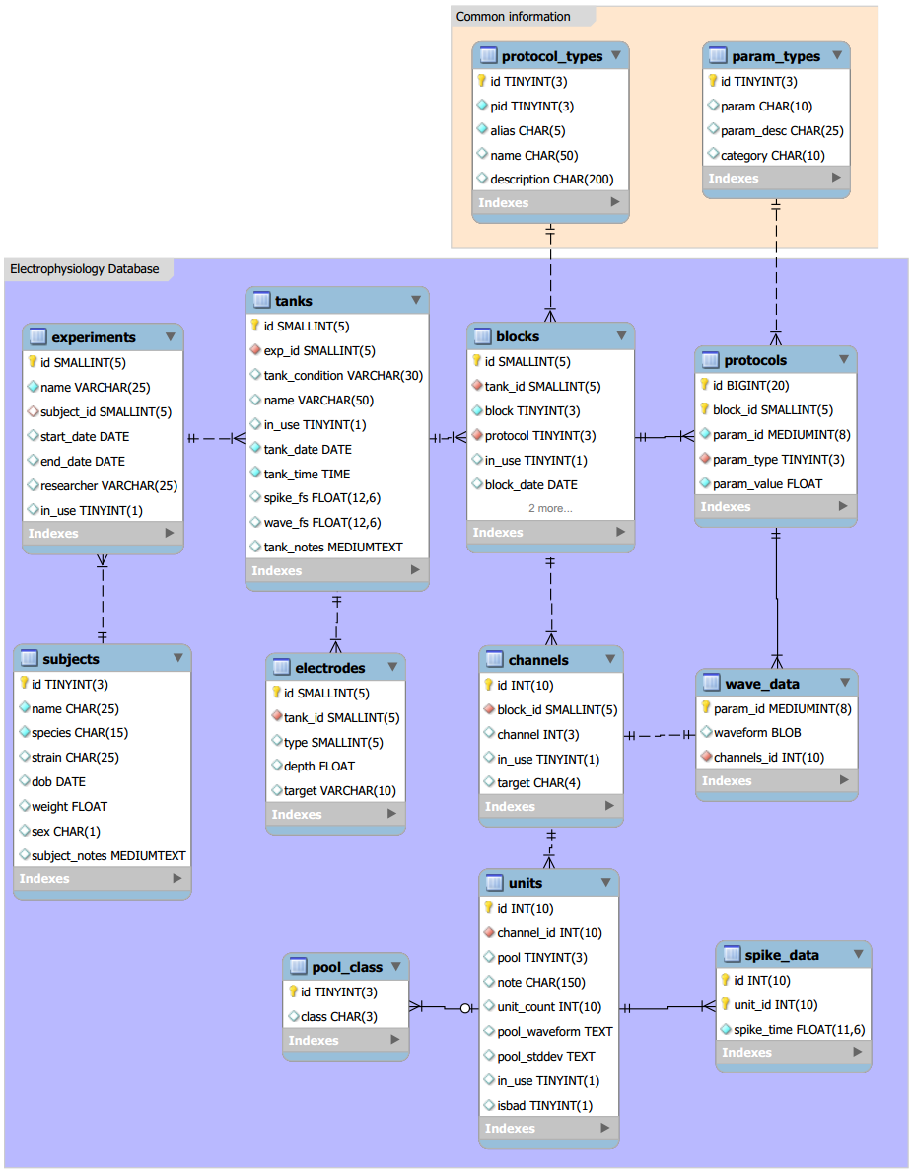
MySQL Database

