Slide 1
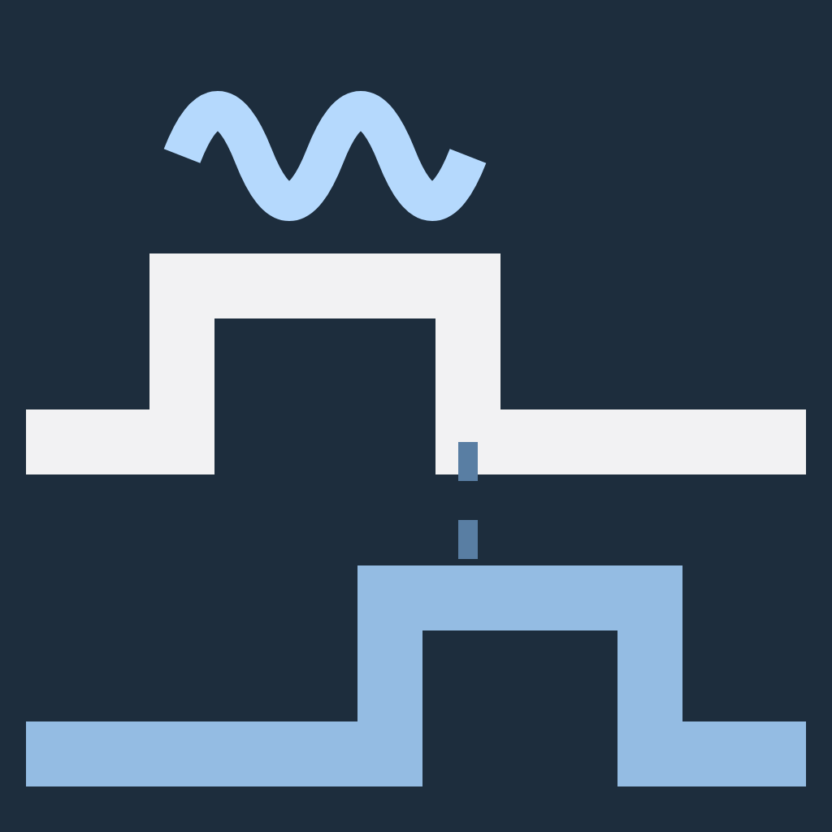
REPOSITORY OVERVIEW
EPsych v2
A MATLAB toolbox for behavioral experiments — protocol design, session runtime, hardware I/O, stimulus generation, and online analysis in one repository.
Design, run, and analyze
behavioral experiments in MATLAB
1,154
COMMITS
2019
FIRST COMMIT
GPL-3.0
LICENSE
Daniel Stolzberg, PhD · github.com/dstolz/epsych2
Notes:
EPsych v2 is an actively used laboratory toolbox, not a greenfield framework. This deck maps what is in the repository and how the pieces fit together.

Slide 2
ORIENTATION
What EPsych is
One repository, one workflow. Protocol authoring, a session runtime GUI, a hardware abstraction layer, stimulus generation and calibration, and online psychophysics all ship together.
91K
109
Built for TDT auditory labs, not locked to them. The protocol records which backend an experiment uses, and the runtime is written against a single hw.Interface contract, so rigs are swappable.
lines of MATLAB
excluding the submodule
class definitions
in nine obj/ packages
An evolved tool, by design. Legacy procedural code, GUIDE-era GUIs, and newer object-oriented runtime components coexist. That mixed structure is the key architectural fact to grasp before making changes.
9
83
Extensible without forking. Trial selectors, save functions, behavior GUIs, and analysis classes are all pluggable through documented seams.
hardware backends
one shared contract
documentation pages
plus a project wiki
THE PACKAGES UNDER obj/
+epsych
+hw
+gui
+psychophysics
+stimbridge
+teensy
+peripherals
+eplog
+util
stimgen · submodule
Notes:
The headline: broad scope, deliberately layered, and honest about being a mixed-vintage codebase. The counts are measured against the working tree, excluding the stimgen submodule.

Slide 3
THE USER'S PATH
Four stages, from protocol to result
Most of the repository exists to support one of these four stages.
1
2
3
4
Design a protocol
→
Enrol the subject
→
Run the session
→
Analyze the data
Protocol Designer — conditions, pairing, triggers, compiled and saved to a versioned .eprot file
Subjects & Projects — the shared .esub roster carries each animal's protocol and session settings
Runtime dispatches trials to TDT, Teensy or Bpod; the paradigm's behavior GUI tracks it live
BitMask decoding, d′, A′, staircase and threshold estimates — live, or replayed offline
epsych_startup
epsych.ProtocolDesigner
epsych.RunExpt
prepares MATLAB
prepares the protocol
runs the session
Notes:
Design, enrol, run, analyze. Stage two changed in 2026: subjects now live in a shared roster file rather than a per-session config.

Slide 4
LAYERED VIEW
Architecture at a glance
Protocol Designer
RunExpt
Subjects & Projects
Behavior GUIs
Behavior Builder
Self-Test
GUIS
↓
EPSYCH CORE
STIMGEN · SUBMODULE
PSYCHOPHYSICS
Protocol
Runtime
EventHub
StimType
StimPlayer
Metrics
Detection
TrialSelector
BitMask
StimCalibration
NAFC
Staircase
SubjectRoster
TrialJournal
HardwareHost
BestPEST
MLP
Trial dispatch, parameter writes, session state, crash-safe saving
Stimulus objects and calibration, reached through the stimbridge seam
Signal-detection arithmetic, online and offline threshold estimation
↓
TDT RPvds
TDT Synapse
Teensy
Bpod
Intan RHX
NE1000
VLC
Software
Replay
HW.INTERFACE
GUIs sit on top; stimgen is a submodule with no dependency on EPsych, reached only through the stimbridge seam; every rig lands on one backend contract.
Notes:
Four layers. The middle band is where the session state lives; the bottom band is the one contract every rig implements.

Slide 5
DATA MODEL
The protocol is the experiment
epsych.Protocol is the central data model, serialized to a versioned .eprot file.
WHAT A PROTOCOL CAPTURES
Interfaces — the hw.Interface objects, always including at least one hw.Software design-time parameter store
COMPILATION
compile() expands the cross-product of unpaired parameter levels into the trials matrix. Paired parameters advance together. Several parts of the codebase depend on the compiled structure being stable.
Options — trial selector class (trialFunc), compileAtRuntime, IncludeWAVBuffers, ConnectionType
COMPILED — the trial table produced by compile(): parameters, trials, writeparams, ntrials
meta — format version, EPsych version, and a protocolVersion bumped on every save
PARAMETER EXPRESSIONS
WHAT ENDS UP ON DISK
A parameter can reference another — Param.Prop or Module.Param.Prop. On String and StimType parameters the result is a 1-based index into Values instead of the value itself.
.eprot protocols, carrying their own version archive · .esub the shared subject roster · .eblt behavior-GUI layout specs · .epj the crash-safe trial journal. The legacy .prot and .ecfg formats were retired in 2026.
Notes:
The protocol is the unit of reuse. What used to be spread across .prot, .ecfg and JSON phase files is now one versioned .eprot plus the roster.

Slide 6
VERSIONING
Every protocol keeps its own history
A subject carries no version of its own, so the roster is the only thing that can notice a protocol edited between sessions.
FOUR VARIABLES INSIDE EVERY .eprot
WHAT protocolStatus REPORTS
protocol the current definition, unchanged
current
the membership is on the version in the file
outdated
the file has been saved since
history the payload of every version it replaced
pinned
a restored version is held for this subject
historyIndex the archive lookup table
differs
not the project's default protocol
historyFormat the archive's own schema version
unknown
no version was ever recorded
epsych.Protocol.writeProtocolFile is the one writer, atomic and shared with phase saves, so a save cannot drop the archive.
missing
the protocol file is gone
REVERT, AND MAKE IT STICK
revertProtocol restores a membership from the archive and reports where it came from: disk, archive or none. A revert that does not rewrite the shared file pins the membership, and the session then loads that version out of the archive instead of the file. Without the pin, adding the subject to a session silently undid the revert.
epsych.Protocol.compareVersions diffs two versions straight from their stored payloads, without rebuilding the object graph, so it can compare a version naming a backend this installation cannot construct. gui.compareProtocolVersions is the window over it.
Notes:
Added 2026-08. Every save archives the version it replaces inside the .eprot itself, which is what makes a subject-level revert meaningful on a protocol file shared by a whole lab.

Slide 7
SESSION CONFIGURATION
Subjects, projects, and what a session inherits
The shared .esub roster replaced the per-session .ecfg file: selecting a subject selects everything needed to run it.
PROJECT
MEMBERSHIP
SESSION
Investigator, IACUC protocol, links and an archived flag — plus a Session Defaults template.
→
Stamped from that template at assign. Carries the protocol, its version, box memory and the session fields.
→
assignToSession resolves every planned subject first and refuses the batch when they disagree.
WHAT THE MEMBERSHIP CARRIES ONTO THE SESSION
DefaultDataPath
SavingFcn
BehaviorGUI
TimerPeriod
Timer*Fcn
video root
Intan root
EMPTY MEANS INHERIT
NOTHING IS WRITTEN BACK
A blank field means the built-in default — NaN for TimerPeriod, ep_TimerFcn_* for the callbacks. There is no rig-preference floor underneath them any more, which is the only reading an older roster can have. BehaviorGUI has a third state: none runs no GUI at all.
Closing a session persists nothing to the preferences. What stays on RunExpt's Customize dialog describes the machine — log path and viewer, roster file, add-subject function, the rig's default data path. Everything that describes the experiment moved onto the membership.
Notes:
The roster is a shared, file-backed, many-to-many record: a subject belongs to projects, and each membership carries that project stage. Two rigs can share one .esub on a network drive because every mutation is a reload-apply-atomic-write.

Slide 8
EXECUTION
Runtime and the trial lifecycle
NOCONFIG
›
CONFIGLOADED
›
READY
›
RUNNING
›
POSTRUN
›
STOP
PRGMSTATE — ERROR is reachable from any state.
TIMER CALLBACK CHAIN
1
ep_TimerFcn_Start
Build RUNTIME.TRIALS, create the trial selectors, capture the session snapshot, resolve the CORE trigger parameters, and dispatch the first trial.
SWAPPABLE
The four callback names are session settings carried on the subject roster membership, so a paradigm substitutes its own trial loop without touching core runtime files. Left empty, they inherit ep_TimerFcn_*.
Hardware interfaces stay connected across reruns within one session.
2
ep_TimerFcn_RunTime
Poll the TrialComplete trigger; on completion append the trial to the crash-safe journal, pick the next trial, dispatch it.
3
ep_TimerFcn_Stop
Return interfaces to Idle, broadcast ModeChange, merge the journal back into the data file, save via the configured save function.
4
ep_TimerFcn_Error
Handle timer errors while preserving collected data.
Notes:
A MATLAB timer drives the session. Start builds the trial list and dispatches trial one; RunTime polls for completion and dispatches the next. The callbacks are no longer set from an operator dialog - they belong to paradigm code.

Slide 9
DURABILITY
A session that survives being killed
Per-trial data is appended to a journal during the run and merged back into the data file at the end.
~2 ms
flat, every trial, epsych.TrialJournal
40 ms
by trial 600, with save('-append')
Durability is guarded by a hard-kill harness, not a throughput benchmark.
During the run
At the stop
The saved file
After a crash
each completed trial is appended to RUNTIME_DATA_x.epj
→
ep_TimerFcn_Stop merges the journal into the seed .mat
→
keeps its info + data_NNNN layout, so no save function changes
→
TrialJournal.recover rebuilds the .mat from the journal
THE SNAPSHOT
THE NOTES
epsych.SessionSnapshot.forSubject(RUNTIME,i) is the one line a saving function needs to make its file reviewable later. It keeps every buffer's metadata but blanks the contents — the difference between a 67 kB snapshot and a 16 MB one in every saved file.
epsych.SessionNotes stamps every note with the completed trial count, not the wall clock, because the trial index is the axis the data is already on. Each commit rewrites the whole log into the journal, so a crash leaves the newest complete log.
Notes:
Before the journal, appending to the session .mat grew linearly with trial count. The journal is append-only and torn-write tolerant; run tmp/crash_test_trialjournal.m after any change to it.

Slide 10
COMMUNICATION
Everything reacts to events
epsych.EventHub is the broadcaster on Runtime.EVENTS. GUIs and analysis objects subscribe rather than poll.
NewTrial
NewData
ModeChange
A new trial begins and parameters are written to hardware.
payload epsych.TrialsData
A trial completed; listeners fold in the result.
payload epsych.TrialsData
The session changed mode — run, pause, standby, stop.
payload epsych.eventModeChange
WHO IS LISTENING
psychophysics.Psych subclasses — constructed with a Runtime, they update results trial by trial
WHY IT MATTERS
gui.OnlinePlot, gui.SessionPerformance, gui.PsychPlot, gui.History — real-time visualization
New analysis or visualization attaches to a running session without any change to the trial loop. The events are declared NotifyAccess = public, which is also what lets a finished session be replayed through the same displays.
gui.BehaviorGUI subclasses — onNewTrial / onNewData / onModeChange hooks; the base class owns listener lifecycle and teardown
paradigm code under paradigms/ — the reference pattern for extending the runtime without modifying it
Notes:
The hub was named epsych.Helper until 2026-08; the property is Runtime.EVENTS. Public notify access is what makes offline review possible without touching any display component.

Slide 11
ABSTRACTION
One contract, many rigs
Every backend inherits from hw.Interface. Code reads and writes through hw.Parameter, never a backend-specific API. A failed connect can offer the operator a port picker, or let the session run without that device.
THE hw.Interface CONTRACT
connect / disconnect
get_parameter / set_parameter
trigger
setup_interface()
getCreationSpec()
hw.TDT_RPcox
hw.NE1000
Direct RPvds circuit control; auto-discovers circuit tags
in progress
New Era syringe pump over RS-232; recovers a renumbered COM port
hw.TDT_Synapse
hw.VlcRecorder
in progress
TDT Synapse API; auto-discovers gizmo parameters
Webcam preview and recording via a VLC process
hw.Teensy
hw.Software
in progress
Teensy 4.x over USB serial; firmware in firmware/EPsychTeensy
In-memory backend: design-time store and hardware-free testing
hw.Bpod
hw.Replay
in progress
Bpod 0.5/0.6 state machine, speaking the firmware byte protocol
Read-only backend answering reads from a saved session record
hw.Intan_RHX
Adding a backend touches four hardcoded registry sites outside the class folder — there is no reflection.
in progress
Intan RHX electrophysiology over TCP
Notes:
Nine concrete backends behind one abstract class. hw.Replay is deliberately absent from the four registry sites: it is built from a session snapshot, never saved into a protocol.

Slide 12
CLOSED LOOP ON THE BOARD
The contingency lives in a file, not in firmware
obj/+teensy/ turns an operant paradigm into a state table the Teensy executes. It has no dependency on the GUI layer, which is what makes all of it testable headlessly.
THE DOCUMENT MODEL
Program
Channel
State
Transition
Condition
Action
Variable
BoardProfile
teensy.Compiler
teensy.Simulator
teensy.Templates
Emits the wire records the firmware reads, and checks the program against the firmware's fixed array sizes before anything is uploaded.
A reference implementation of the firmware's execution semantics. It powers the designer's test bench, the headless tests, and tells the firmware author what to build.
Ready-made paradigms to start from: Go/No-Go, 2AFC, fixed ratio, shaping, passive.
ONE STATE TABLE, MANY TRIALS
Any numeric field may hold a literal or an "@Name" reference to a teensy.Variable. A reference compiles to a constant-table index, which is how a protocol varies a duration per trial without re-uploading the state table. teensy.TrialDesigner is the GUI over all of it; renames cascade through every reference, including nested condition operands.
Notes:
The design-time half of the Teensy backend. Value semantics on the model classes make toStruct/fromStruct an exact round trip, which is what makes the designer undo exact.

Slide 13
SUBMODULE BOUNDARY
Stimulus generation lives elsewhere
obj/stimgen is a git submodule pinned to an exact commit of dstolz/stimgen, released independently of this repository.
A ONE-WAY DEPENDENCY
THE SIGNAL PIPELINE
stimgen has no dependency on EPsych. Nothing inside it names an epsych.* or hw.* type. The three classes that translate live in obj/+stimbridge/.
update_signal() implemented by each subclass
apply_normalization() scale to [-1, 1]
apply_calibration() SPL → voltage, lookup table and EQ
stimbridge.RuntimeHost
implements stimgen.HardwareHost over Runtime / Protocol
apply_gate() cosine-squared onset/offset window
stimbridge.InterfaceAdapter
Signal the final waveform
implements the calibration HwAdapter over an hw.Interface
Calibration precedes gating: apply_calibration renormalizes before scaling to the lookup-table voltage, which would undo an earlier ramp.
stimbridge.LogBridge
routes stimgen's messages into the session log, attributed to their own call site
Guarded by the self-test. Check A3 verifies the pinned commit still satisfies the stimbridge contract, and EPsychInfo.stimgenChksum records it in saved session metadata.
Clone with --recurse-submodules — skipping it degrades protocols silently.
Notes:
The submodule boundary is enforced by convention plus a self-test check. A new abstract method on a stimgen contract class must be concrete with a safe default, or the stimbridge subclass becomes unconstructable.

Slide 14
RESULTS
Psychophysics, online and offline
psychophysics.Metrics holds the signal-detection arithmetic with no state; the analysis classes run the same code live against a Runtime or post-hoc against a saved DATA array.
ONLINE
OFFLINE
Construct with a Runtime. The object subscribes to EVENTS.NewData and updates trial by trial while the session runs.
Construct with a saved per-trial DATA struct array to compute exactly the same results after the fact.
THE ANALYSIS CLASSES
OUTCOME ENCODING
Metrics
d′, criterion, ln β, A′, and the z-transform under them, as statics
epsych.BitMask is a uint32 enumeration packing a trial's outcome bits into one value that every analysis class decodes the same way.
Detection
Hit rate, false alarm rate and sensitivity per stimulus value
NAFC
N-alternative forced choice: choice functions, confusion matrix, bias
SessionMetrics
Session counts and rates over a psychophysics.TrialWindow
Staircase
Reversal detection and threshold estimation
ABORTS ARE EXCLUDED
BestPEST
Maximum-likelihood threshold tracking
An abort is a lapse of engagement, not a wrong answer. IncludeAborts opts back in.
MLP
Bayesian estimation with sweet-point placement
Notes:
Until 2026-08 the toolbox disagreed with itself about abort denominators, so one session could give two different sensitivity values. psychophysics.Metrics is now the single place that arithmetic lives.

Slide 15
PARADIGM UI
Build a behavior GUI from components
gui.BehaviorGUI owns lifecycle, listeners, position preferences and teardown. A subclass writes build(fig) and the event hooks.
classdef MyGUI < gui.BehaviorGUI
gui.BehaviorBuilder
methods (Access = protected)
Load a protocol, pick components from a palette, drag snap-to-grid regions on a canvas, export a subclass. The design round-trips through an .eblt JSON spec.
function build(obj, fig)
obj.addControl('Stim_Level')
obj.addHistory()
obj.addPsychPlot()
obj.addSessionPerformance()
obj.addNotesButton()
gui.PopOut
obj.addComponentToolbar()
Any display can open in a window of its own, with its own listeners and its own preference key, so the pop-out never disturbs the embedded copy.
end
end
end
gui.ComponentToolbar
GENERATED OR HAND-WRITTEN, SAME RULES
One icon per display on a single toolbar. Lazy entries build their component on first click, so a polling monitor costs nothing until it is asked for.
Each add* helper registers what it builds for teardown. A helper whose component the session cannot supply returns empty and logs at debug level rather than throwing, which is what keeps a GUI openable against a runtime with no interfaces.
Notes:
The add* helper DSL is the documented way to reach every reusable component. BehaviorBuilder generates code that calls only that DSL, so generated output survives the same self-test checks a hand-written subclass does.

Slide 16
INTERFACE LAYER
The GUIs a lab actually touches
AUTHORING & CONTROL
CUSTOM BEHAVIOR GUIs
epsych.ProtocolDesigner
gui.BehaviorGUI is the abstract base for a paradigm's own window: lifecycle, event listeners, position preferences, registry teardown and parameter wiring.
examples/customgui/
Build and edit protocols; compile and preview trials; browse version history
epsych.RunExpt
Session state, run and stop, self-test, parameter debugger, offline review
gui.SubjectManager
Subjects & Projects: the roster, session defaults, protocol versions
gui.BehaviorBuilder
Lay out a behavior GUI by hand and export it as a subclass
LIVE MONITORING
ALSO IN obj/+gui/
gui.OnlinePlot · gui.SessionPerformance
History · NextTrial · ModeIndicator · StatusBar · Triggers · SessionClock · ElapsedTrialTimer · ScreenCapture · ComponentToolbar · PhaseSelector · StaircaseTraining · Parameter_Control / _Monitor / _Update
Live parameter traces, and running rates, counts and d′
gui.PsychPlot · gui.ParameterScatter
Psychometric fits and generic X / Y / colour scatter
gui.SyringePump · gui.Notes · gui.SessionGate
Reward control, timestamped notes, and a start-of-session gate
Notes:
Thirty-eight classes under obj/+gui/. Everything on the right-hand list is reachable from a behavior GUI through an add* helper.

Slide 17
AFTER THE SESSION
Reopen a finished session and scrub through it
epsych.ReviewSession reopens a saved file in the paradigm's own behavior GUI, every display showing what it showed when the session ended.
No display
component was modified.
Two things already held: the events are declared NotifyAccess = public; and every consumer takes the whole DATA array out of the payload and recomputes, so one notify carrying Data(1:k) is worth k notifies, and seeking backward costs what seeking forward costs.
epsych.SessionSnapshot
hw.Replay
gui.ReviewTransport
Captured by ep_TimerFcn_Start, so even the crash-recovery file is reviewable. Any saving function writes it in one line.
Answers parameter reads from the saved record. It reports IsConnected on purpose, and never assigns a value.
The scrubber: slider, step, play, rate and elapsed time, in its own window so it stays out of the paradigm layout.
One thing a paradigm must do: a GUI that drives the rig stands down on gui.BehaviorGUI.ReviewMode. The base class cannot tell a display from a contingency.
Notes:
Added 2026-08. The runtime a review builds is a real epsych.Runtime with a real EventHub, not a fake - required, because psychophysics.Detection is not a Psych subclass and has no struct-source path.

Slide 18
WHEN SOMETHING IS WRONG
Diagnostics you can leave running
Only one of these polls the hardware, which is the difference that decides what is safe to leave open beside a running experiment.
epsych.SelfTest
gui.ParameterDebugger
Nine headless pre-flight check groups over a configured session: environment, functions, timer, config, protocol, trial selection, hardware, data saving, GUI. A window on RunExpt's Help menu runs the same checks.
Every hw.Parameter a protocol defines, in one table, readable and writable by hand. It never polls: a read happens only when you ask for one. Colour on the value cell is the read report.
gui.ParameterTracker
obj/+eplog/
The polling the debugger refuses to do, in its own window with its own timer and an operator-set rate, so bus traffic is something visibly turned on. Samples are stamped with the clock, so a missed period widens a gap rather than drifting the axis.
vprintf is a facade over the logging package. The console and the log have separate gates: GVerbosity quietens the command window while GLogVerbosity defaults to Inf, so every message still reaches .error_logs/.
Notes:
The debugger and the tracker are the same data seen two ways. Nothing in the eplog package throws, because EPsych logs from inside catch blocks.

Slide 19
FOR DEVELOPERS
Where to plug in
Four common extensions, each with a reference implementation already in the repository.
1
Add a hardware backend
2
Add a stimulus type
Subclass hw.Interface; implement setup_interface, connect, get/set_parameter, trigger, and a static getCreationSpec.
Then register it in four sites outside the class folder. Omitting Protocol.createInterfaceFromStruct_ fails silently.
Subclass stimgen.StimType in the submodule; implement update_signal() and declare IsMultiObj, CalibrationType, Normalization.
The base class handles gating, normalization and calibration. Commit to the stimgen repo, then bump the pointer here.
obj/+hw/@Software/ · documentation/hw/hw_Interface_Tutorial.md
obj/stimgen/+stimgen/Tone.m · Noise.m
3
Add an online analysis
4
Add a paradigm
Subclass psychophysics.Psych and implement update(); wire a listener to Runtime.EVENTS.NewData.
Reuse psychophysics.Metrics for the arithmetic, and pair it with a display class in obj/+gui/.
A custom trial selector, save function and behavior GUI. No core runtime file is modified.
Subscribe to EventHub events, and carry the timer callbacks on the subject roster membership.
obj/+psychophysics/@Detection/ · obj/+gui/@OnlinePlot/
paradigms/ · examples/customgui/ · runtime/savefcns/
Notes:
Four seams, none of which require editing a core runtime file. The hardware registry is the one place with no reflection, so a missing registration fails quietly.

Slide 20

GETTING STARTED
Clone, start up, design, run
WHERE TO READ NEXT
git clone --recurse-submodules
Installation_Guide.md prerequisites and setup
https://github.com/dstolz/epsych2.git
Toolbox_Overview.md orientation for experimenters
addpath('C:\path\to\epsych2')
epsych_startup
Architecture_Overview.md internals, for developers
epsych.ProtocolDesigner
RunExpt_GUI_Overview.md a session, walked through
epsych.RunExpt
Programmers_Toolkit.md the extension seams
Class_Map.md classes and dependencies
Skipping the submodule step does not fail loudly — protocols with stimulus objects load with degraded placeholder values. epsych_startup warns when it detects this.
epsych2/wiki the guided companion, two paths
Daniel Stolzberg, PhD · daniel.stolzberg@gmail.com · GNU GPL v3.0
Notes:
Clone with submodules, run epsych_startup, then the two entry-point GUIs. The documentation directory and the wiki cover both the experimenter path and the developer path.

