Slide 1
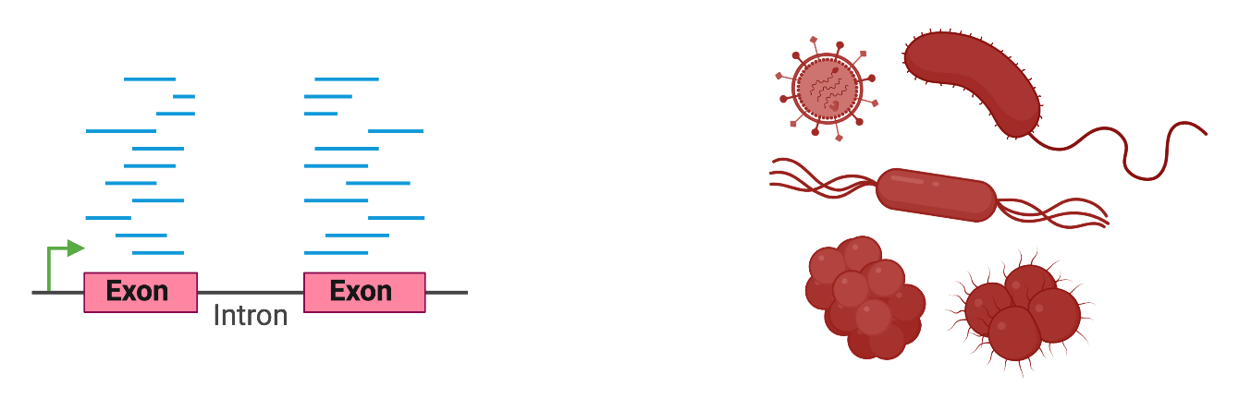
Metatranscriptomic analysis of complex microbial communities
Team
Alec Candib
Priyanka Roy
Emmanuel Saake
PI
PI: Adam Labadorf
Postdoc: Joseph Orofino
Image Credit:
https://smart.servier.com/smart_image/cerebrospinal-fluid/
WhiteDragon / Shutterstock.com

Slide 2
Background
Background
Bayesian Approach
Results
Future Directions

Slide 3
Background
Bayesian Approach
Results
Future Directions
Goals of characterizing microbial communities

Slide 4
Background
Bayesian Approach
Results
Future Directions
Identifying constituents
Quantifying relative proportions
Identifying genes represented
Goals of characterizing microbial communities
Measuring activity of genes
Understanding microbe-microbe interactions
Understanding host-microbe interactions

Slide 5
Background
Bayesian Approach
Results
Future Directions
DNA Sequencing (metagenomics)
Identifying constituents
Quantifying relative proportions
Identifying genes represented
Goals of characterizing microbial communities
Measuring activity of genes
Understanding microbe-microbe interactions
Understanding host-microbe interactions

Slide 6
Background
Bayesian Approach
Results
Future Directions
Identifying constituents
Quantifying relative proportions
Identifying genes represented
Goals of characterizing microbial communities
Measuring activity of genes
Understanding microbe-microbe interactions
Understanding host-microbe interactions
Total RNA profiling (metatranscriptomics)

Slide 7
Background
Bayesian Approach
Results
Future Directions
Total RNA profiling (metatranscriptomics)
Identifying constituents
Quantifying relative proportions
Identifying genes represented
Challenges of characterizing microbial communities
Drawbacks: High levels of conservation enrichment of functional ribosomal RNA and short-reads make these calculations challenging; Still missing a lot of genes

Slide 8
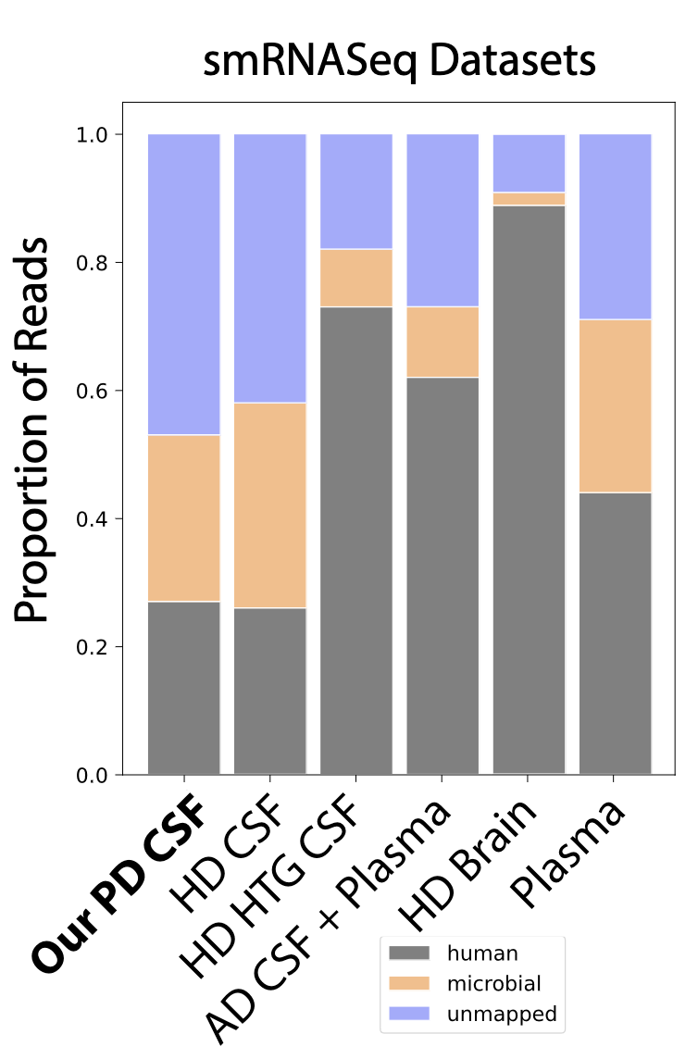
Identifying microbial taxa from short-read RNA-seq data
Background
Bayesian Approach
Results
Future Directions
all life
bacteria
nocardia

Slide 9
Some short RNA sequences are shared by all life
Background
Bayesian Approach
Results
Future Directions
Taxonomic tree
Nocardia species specific Nocardia clade specific
Bacterial
All Life
all life
all life
all life
bacteria
bacteria
bacteria
nocardia
nocardia
nocardia
Schematic by Adam Labadorf

Slide 10
Some short RNA sequences are shared by all life
These shared sequences make taxon inference challenging
Background
Bayesian Approach
Results
Future Directions
Taxonomic tree
Nocardia species specific Nocardia clade specific
Bacterial
All Life
all life
all life
all life
bacteria
bacteria
bacteria
nocardia
nocardia
nocardia
Schematic by Adam Labadorf

Slide 11
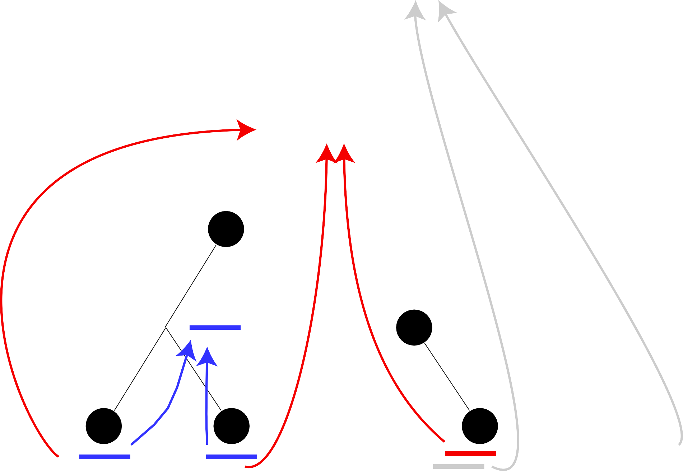
We can assign reads to Least Common Ancestor (LCA)
Background
Bayesian Approach
Results
Future Directions
all life
all life
1
bacteria
bacteria
1
nocardia
nocardia
1
1
Schematic by Adam Labadorf

Slide 12
Aggregate all reads for each sample at each taxon
Background
Bayesian Approach
Results
Future Directions
all life
4
all life
1
bacteria
1
bacteria
3
nocardia
2
nocardia
1
1
1
Schematic by Adam Labadorf

Slide 13








Every taxon has a proportion of reads of total dataset for each sample → representation differs based on sample context
Background
Bayesian Approach
Results
Future Directions
Sample 1
Sample 2
Sample 3
B
B
B
A
C
A
C
A
C

Slide 14
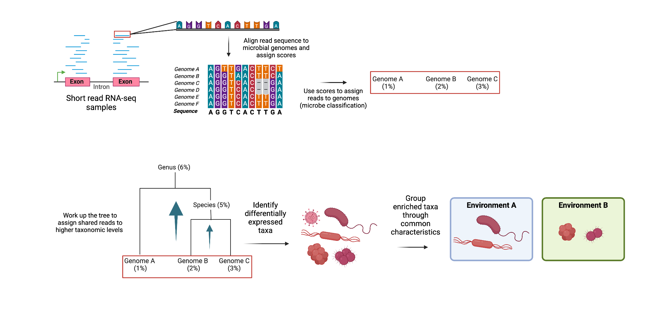
Overall pipeline
Background
Bayesian Approach
Results
Future Directions

Slide 15
Overall pipeline
Background
Bayesian Approach
Results
Future Directions

Slide 16
Challenge
The high level of conservation in RNA-seq reads makes identifying exactly which organisms are present because it can be difficult to differentiate between taxa.
Background
Bayesian Approach
Results
Future Directions

Slide 17
Challenge
The high level of conservation in RNA-seq reads makes identifying exactly which organisms are present because it can be difficult to differentiate between taxa.
Goal
We aim to incorporate this uncertainty into the microbe profile using a Bayesian framework that models each read assignment as a probability distribution.
Background
Bayesian Approach
Results
Future Directions

Slide 18
Bayesian Approach
Background
Bayesian Approach
Results
Future Directions

Slide 19
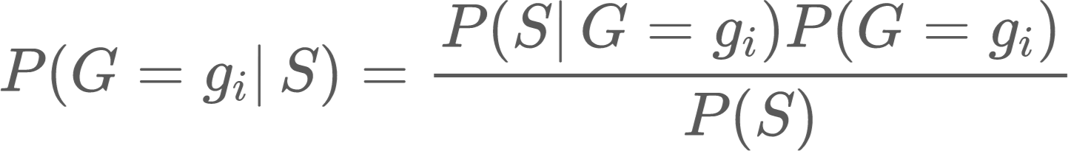



What is the probability of seeing a particular microbial genome given a sequencing read?
Background
Bayesian Approach
Results
Future Directions
Where
Read from short-read RNA sequencing
Microbial genome, where each genome is ,
represented by an accession number
Priyanka Roy

Slide 20
Background
Bayesian Approach
Results
Future Directions
Likelihood
Prior
Posterior
Evidence (Normalizing factor)
Where
Read from short-read RNA sequencing
Microbial genome, where each genome is ,
represented by an accession number
Priyanka Roy

Slide 21
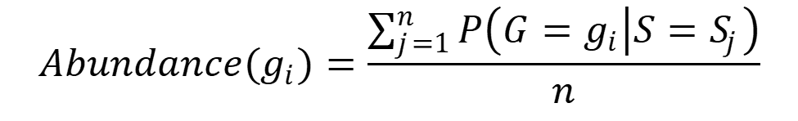
Abundance of each genome
Background
Background
Bayesian Approach
Bayesian Approach
Results
Results
Future Directions
Future Directions
Abundance: Expected proportion of RNA originating from each genome
Sum the probability each read came from a genome, then normalize by number of reads
Alec Candib

Slide 22
Tree-Based Abundance
Background
Bayesian Approach
Results
Future Directions
Alec Candib

Slide 23
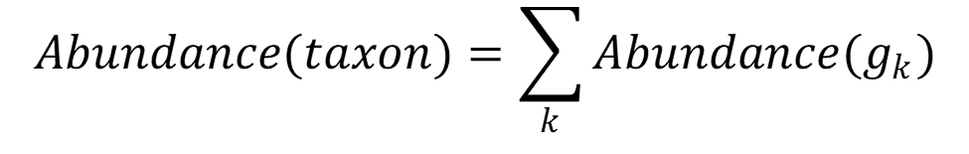
Abundance of higher taxonomic levels
Background
Background
Bayesian Approach
Bayesian Approach
Results
Results
Future Directions
Future Directions
Calculate abundance of RNA from each taxa: Sum abundance of RNA from all k genomes within that taxa
Alec Candib

Slide 24
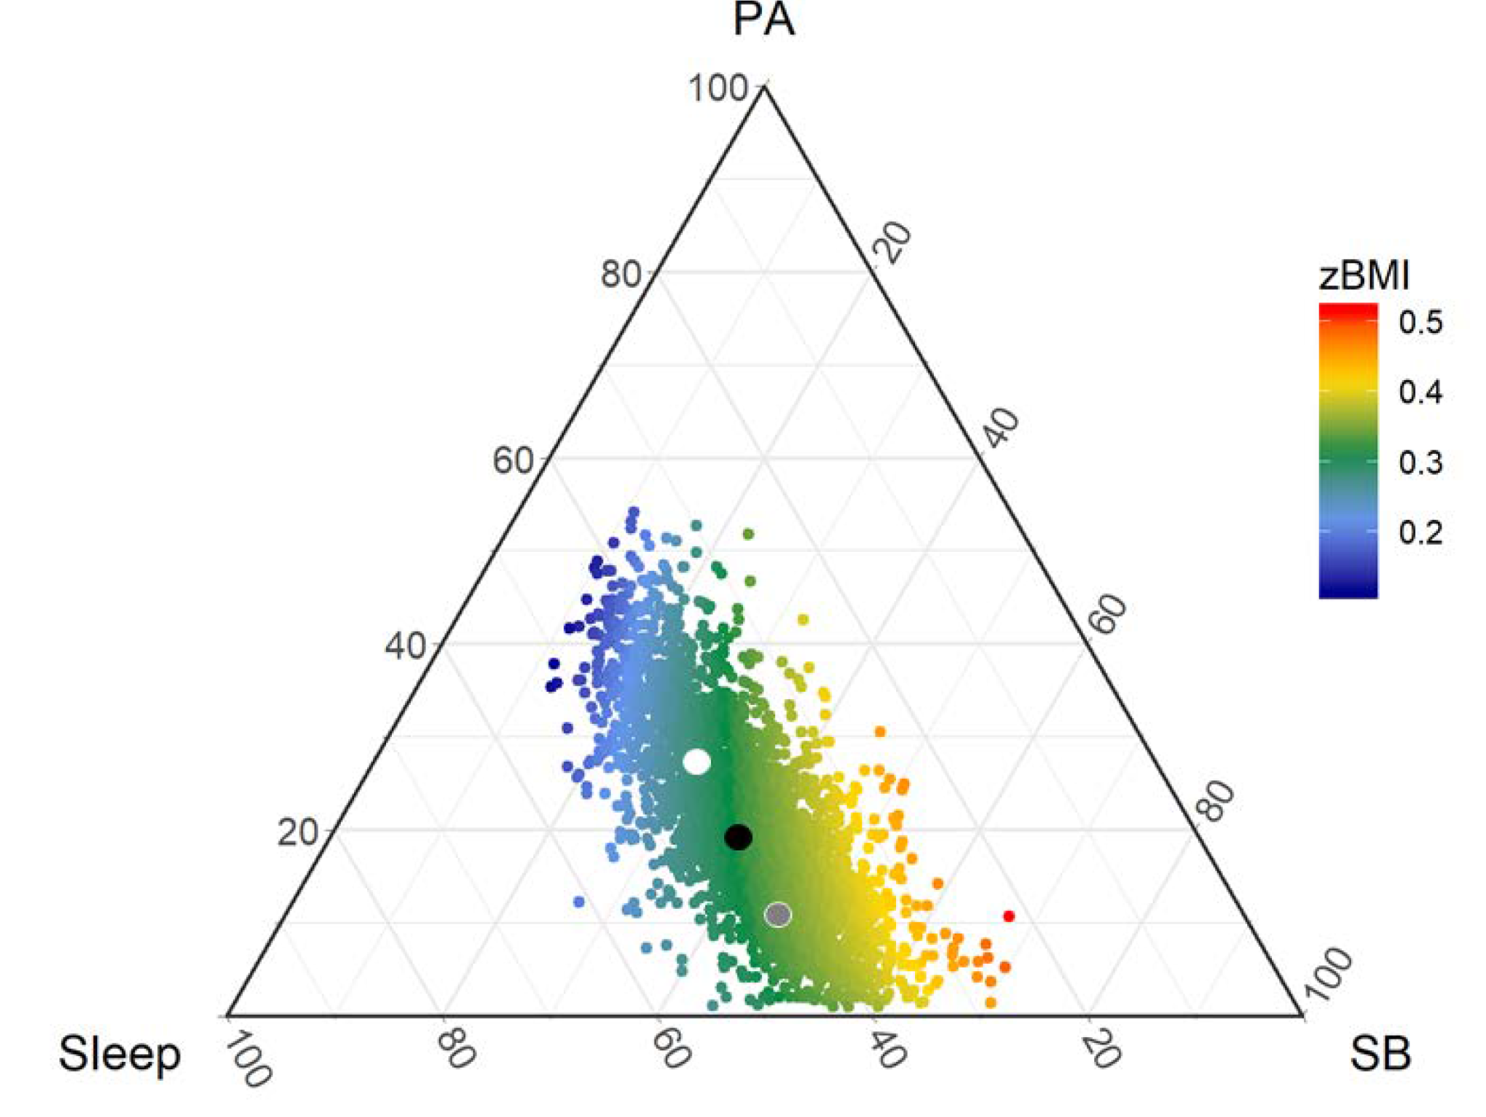
Tree-based differential abundance
Background
Bayesian Approach
Results
Future Directions
Goal: Evaluate relationships between experimental conditions and the abundance at each taxonomic level
Challenges:
Abundances are constrained between 0 and 1
Abundances do not sum to 1: Abundances counted multiple times up the tree
Positive correlations between taxa
Accounting for multiple experimental variables/covariates
Missing values
Alec Candib

Slide 25
Previous Approach: Tree-based differential abundance regression method
Background
Bayesian Approach
Results
Future Directions
Procedure:
Transform data with the Centered Log-Ratio: log-transform, then shift mean of data to 0
Linear model: CLR(Abundance) ~ Conditions + Covariates
Calculate adjusted p-values with the BH correction
Does this address challenges?
CLR: transforms data from constrained [0,1] space to unconstrained Euclidean space, where traditional statistical techniques work
BH correction: upper bound on p-values for positively correlated data
Linear model: Compatible with any number of experimental variables
Alec Candib

Slide 26
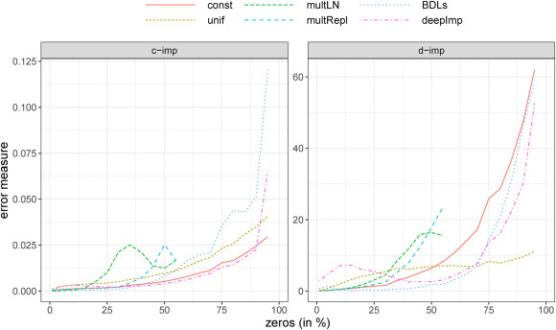
Missing Values
Background
Bayesian Approach
Results
Future Directions
Often >50% of values
Breaks CLR transformation: log(0)
Solution: Fill in missing values with some value (0, detection limit)
Constant value, random value, imputation, or Bayesian regression
Method: random value within (0.1*detection limit, detection limit)
Compatible with our data, available, and tolerant of high missing values
Alec Candib

Slide 27
Our Project: Improved Differential Abundance
Background
Bayesian Approach
Results
Future Directions

Slide 28
Limitations of Previous Approach
CLR might not fit assumptions of linear model (Normally-distributed residuals)
Hierarchical information not considered in the model
Missing values filled in randomly, without considering other information about the sample

Slide 29
What the Solution Needs to Consider
Data constrained [0,1]
Hierarchical structure
Sparse data with many missing values
Missing not at random: Anything missing is either not present, or too low to detect
Covariates
Other characteristics of the patients that we’re not interested in. Ex: age, sex, batch

Slide 30
Solution Ideas: Multi-level Hierarchical Beta Model
Model taxon abundance as beta distribution
Initial pre-processing step with logistic regression: Is variable of interest linked to the taxon being measured at all?
Beta regression? https://en.wikipedia.org/wiki/Beta_regression
MCMC Sampling approach:
Use parameters to sample missing values
Use data, including sampled missing values, to sample parameters
Repeat
Overall goal: Compare means, which can be calculated from beta parameters
From samples calculate Pr(Experimental variable mean)>Pr(Control variable mean)

Slide 31

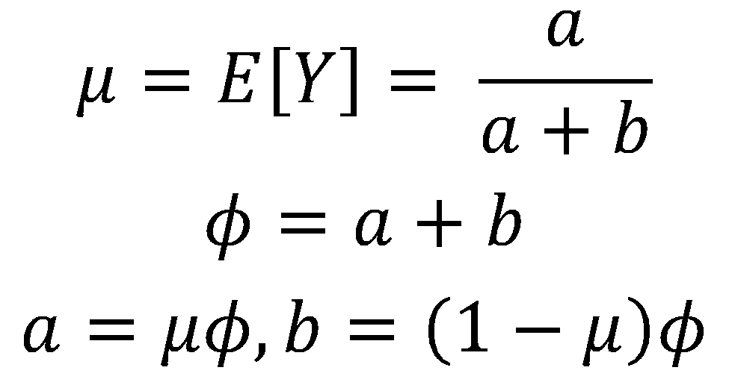
Beta Regression
Models data from (0.1) as beta distributed
Utilizes a reparameterization of the beta distribution:
Where

Slide 32
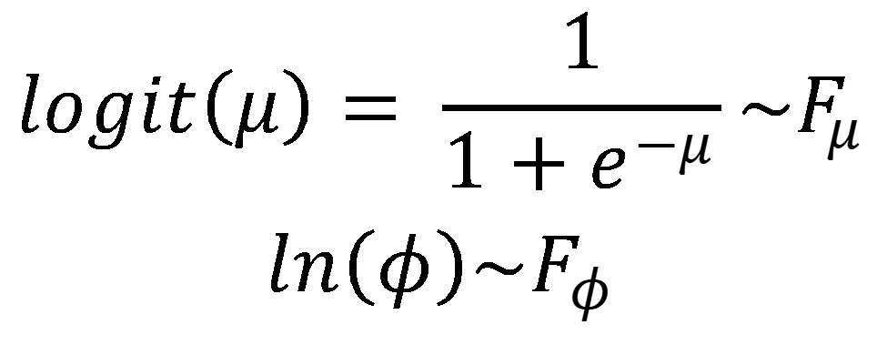
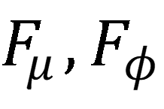
Model Fitting
Goal: Optimize a formula for transformed beta distribution parameters, given predictive variables that you think affect the data:
Where are formulas of your predictive variables
Ex.

Slide 33
Hypothesis Testing - Danny
From Beta Regression for each bacteria we check to see if variables such as age, sex, and presence of disease are significant predictors the abundance of bacteria
Significant predictors will have beta values of close to 1 or negative 1
Add standard variables such as age and sex because they are recommended for any biomedical study
Even if they are not significant they would have beta values close to zero so they shouldn’t affect the model too much
(Research hierarchical p-value adjustment to see if

Slide 34
Acknowledgements
Lily Chou, PhD
Marie-Helene Saint-Hilaire, MD
Stephanie Bissonnette, MD
Rachel Flynn, PhD
Funding
The Cogan Family Foundation
NIH T32 Grant
Bioinformatics Program
Dave King
Johanna Vasquez
Caroline Lyman
Mary Ellen Gipson-FitzPatrick
Julia TCW, PhD
2023 Cohort
2023-2024 Labadorf Challenge Project Team
Priyanka Roy
Emmanuel Saake
Joseph Orofino, PhD
Adam Labadorf, PhD

Slide 35
References
Roumpeka DD, Wallace RJ, Escalettes F, Fotheringham I, Watson M. A Review of Bioinformatics Tools for Bio-Prospecting from Metagenomic Sequence Data. Front Genet. 2017 Mar 6;8:23. doi: 10.3389/fgene.2017.00023. PMID: 28321234; PMCID: PMC5337752.
National Institute of Environmental Health Sciences. Neurodegenerative Diseases. National Institute of Environmental Health Sciences. Published 2018. https://www.niehs.nih.gov/research/supported/health/neurodegenerative/index.cfm
Bennett, James P., Jr, Paula M. Keeney, and David G. Brohawn. 2019. “RNA Sequencing Reveals Small and Variable Contributions of Infectious Agents to Transcriptomes of Postmortem Nervous Tissues From Amyotrophic Lateral Sclerosis, Alzheimer’s Disease and Parkinson's Disease Subjects, and Increased Expression of Genes From Disease-Activated Microglia.” Frontiers in Neuroscience 13 (March): 235.
Bjornevik, Kjetil, Marianna Cortese, Brian C. Healy, Jens Kuhle, Michael J. Mina, Yumei Leng, Stephen J. Elledge, et al. 2022. “Longitudinal Analysis Reveals High Prevalence of Epstein-Barr Virus Associated with Multiple Sclerosis.” Science, January. https://doi.org/10.1126/science.abj8222.
Emery, David C., Maria Davies, Tanya L. Cerajewska, Jelena Taylor, Mae Hazell, Alex Paterson, Shelley J. Allen-Birt, and Nicola X. West. 2022. “High Resolution 16S rRNA Gene Next Generation Sequencing Study of Brain Areas Associated with Alzheimer’s and Parkinson's Disease.” Frontiers in Aging Neuroscience 14 (December): 1026260.
Emery, David C., Deborah K. Shoemark, Tom E. Batstone, Christy M. Waterfall, Jane A. Coghill, Tanya L. Cerajewska, Maria Davies, Nicola X. West, and Shelley J. Allen. 2017a. “16S rRNA Next Generation Sequencing Analysis Shows Bacteria in Alzheimer’s Post-Mortem Brain.” Frontiers in Aging Neuroscience 9 (June): 195.
———. 2017b. “16S rRNA Next Generation Sequencing Analysis Shows Bacteria in Alzheimer’s Post-Mortem Brain.” Frontiers in Aging Neuroscience 9 (JUN): 195.
Farmen, Kristine, Miguel Tofiño-Vian, and Federico Iovino. 2021. “Neuronal Damage and Neuroinflammation, a Bridge Between Bacterial Meningitis and Neurodegenerative Diseases.” Frontiers in Cellular Neuroscience 15 (June): 680858.

Slide 36
References
Laurence, Martin, Julián Benito-León, and Frédéric Calon. 2019. “Malassezia and Parkinson’s Disease.” Frontiers in Neurology 10 (July): 758.
Otake, Kentaro, Hidenori Kamiguchi, and Yoshihiko Hirozane. 2019. “Identification of Biomarkers for Amyotrophic Lateral Sclerosis by Comprehensive Analysis of Exosomal mRNAs in Human Cerebrospinal Fluid.” BMC Medical Genomics 12 (1): 7.
Pisa, Diana, Ruth Alonso, and Luis Carrasco. 2020. “Parkinson’s Disease: A Comprehensive Analysis of Fungi and Bacteria in Brain Tissue.” International Journal of Biological Sciences 16 (7): 1135.
Readhead, Ben, Jean-Vianney Haure-Mirande, Cory C. Funk, Matthew A. Richards, Paul Shannon, Vahram Haroutunian, Mary Sano, et al. 2018. “Multiscale Analysis of Independent Alzheimer’s Cohorts Finds Disruption of Molecular, Genetic, and Clinical Networks by Human Herpesvirus.” Neuron 99 (1): 64–82.e7.
Wood, D.E., Salzberg, S.L. Kraken: ultrafast metagenomic sequence classification using exact alignments. Genome Biol 15, R46 (2014). https://doi.org/10.1186/gb-2014-15-3-r46
Lu J, Breitwieser FP, Thielen P, Salzberg SL. 2017. Bracken: estimating species abundance in metagenomics data. PeerJ Computer Science 3:e104 https://doi.org/10.7717/peerj-cs.104
Wood, D. E., Lu, J., & Langmead, B. (2019). Improved metagenomic analysis with Kraken 2. Genome biology, 20, 1-13.
Huson, D. H., Auch, A. F., Qi, J., & Schuster, S. C. (2007). MEGAN analysis of metagenomic data. Genome research, 17(3), 377-386.
Lu, J., & Salzberg, S. L. (2020). Ultrafast and accurate 16S rRNA microbial community analysis using Kraken 2. Microbiome, 8(1), 124.

Slide 37
References
Patrick, K. L., Bell, S. L., Weindel, C. G., & Watson, R. O. (2019). Exploring the “multiple-hit hypothesis” of neurodegenerative disease: bacterial infection comes up to bat. Frontiers in Cellular and Infection Microbiology, 9, 138.
Oulas, A., Pavloudi, C., Polymenakou, P., Pavlopoulos, G. A., Papanikolaou, N., Kotoulas, G., ... & Iliopoulos, L. (2015). Metagenomics: tools and insights for analyzing next-generation sequencing data derived from biodiversity studies. Bioinformatics and biology insights, 9, BBI-S12462.
Frith, M. C. (2020). How sequence alignment scores correspond to probability models. Bioinformatics, 36(2), 408-415.
Richter M, Rosselló-Móra R. Shifting the genomic gold standard for the prokaryotic species definition. Proc Natl Acad Sci U S A. 2009 Nov 10;106(45):19126-31. doi: 10.1073/pnas.0906412106. Epub 2009 Oct 23. PMID: 19855009; PMCID: PMC2776425. Sugnet Lubbe, Peter Filzmoser, Matthias Templ, Comparison of zero replacement strategies for compositional data with large numbers of zeros, Chemometrics and Intelligent Laboratory Systems, Volume 210, 2021, 104248, ISSN 0169-7439, https://doi.org/10.1016/j.chemolab.2021.104248.
Aitchison, J. (1982). The Statistical Analysis of Compositional Data. Journal of the Royal Statistical Society. Series B (Methodological), 44(2), 139–177. http://www.jstor.org/stable/2345821
Benjamini, Y., & Yekutieli, D. (2001). The Control of the False Discovery Rate in Multiple Testing under Dependency. The Annals of Statistics, 29(4), 1165–1188. http://www.jstor.org/stable/2674075

