Slide 1

Notes:
Alex

Slide 2
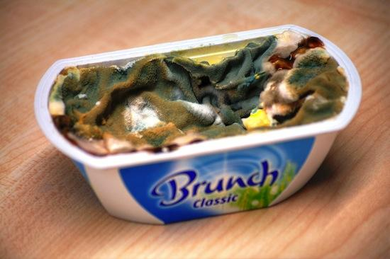
Problem: Consumers Often Let Food Expire!
Notes:
Alex

Slide 3
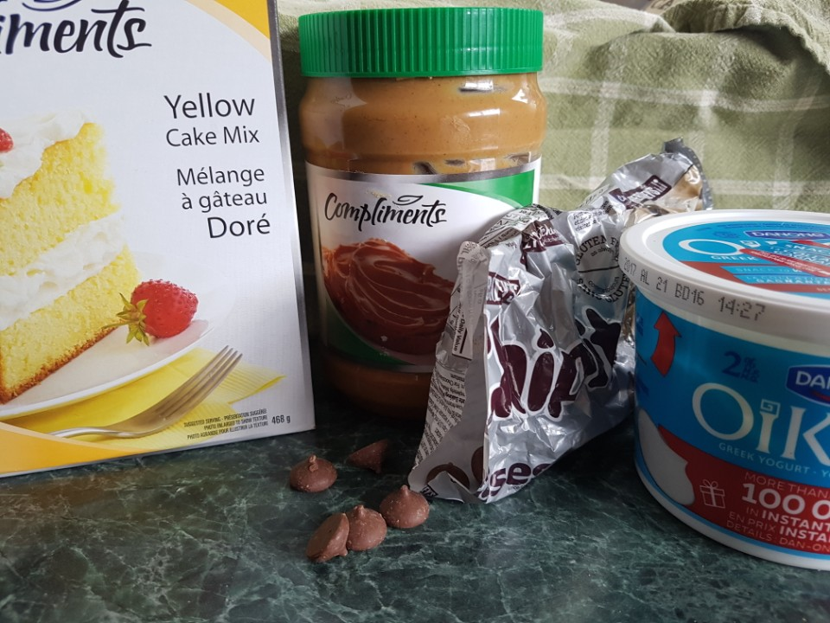

Solution: Keep Track Of Foods About To Expire and Use Them!
Notes:
Alex

Slide 4
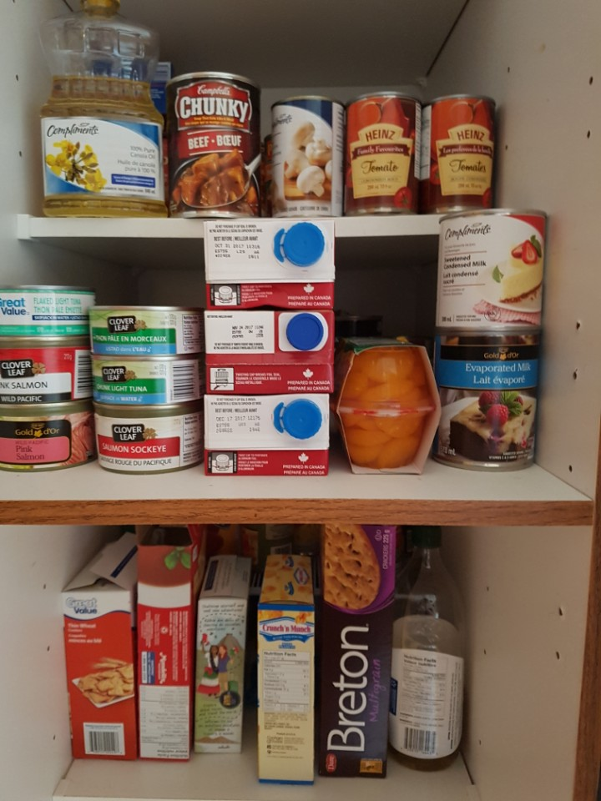
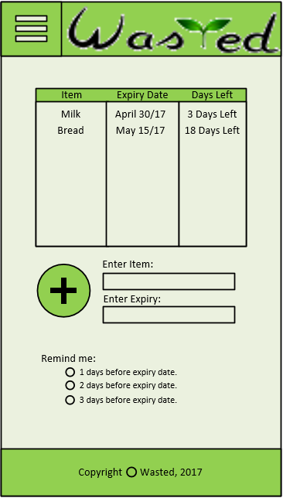
Implementation: The Wasted WebApp
Notes:
Misha

Slide 5

Our Goal:
Create an app that:
Monitors the expiry dates of food that the user has bought
Alerts the user when the food is going to expire
*Offers suggestions on storage and for recipes
Notes:
Misha

Slide 6

Our Requirements:
Users should be able to input and remove items with ease
User should be able to sort items by expiry date
App should notify user when the food is about to expire
App should offer suggestions on what to do with expiring food
Notes:
Dasha

Slide 7
Success Criteria:
App successfully stores, retrieves, and removes expiry date/ item info from the database
Users can easily navigate through the app to find the information they need
App is user friendly and attractive
App is usable on phone and computer browsers
App is proven to be usable, useful and interesting to consumers through tests
Notes:
Bhagwan

Slide 8
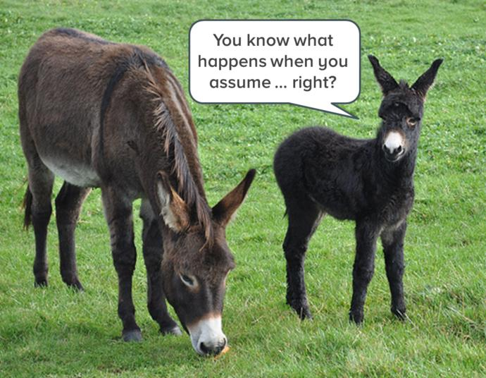
Assumptions:
Different backgrounds
Simple UI navigation
Internet
Notes:
Simran

Slide 9
Risks:
Project “Creep” (Our constant desire to add new features)
Inflexibility (The desire to retain features we wished to include even in the face of time, budget, or technical constraints)
Lack of Competitive Differentiation (Several groups have ideas very similar to ours)
Inequity of Work
Conflict of Ideas/Personal
Notes:
Simran

Slide 10

Demo:
http://students.bcitdev.com/A00989687/Wasted/index.html
http://students.bcitdev.com/A00541112/Webpage/fridge.html
Notes:
B(website)
A(database)
M(authentication)

