Slide 1

Team Mandelbrots
Video Game Design - CS6457

Slide 2
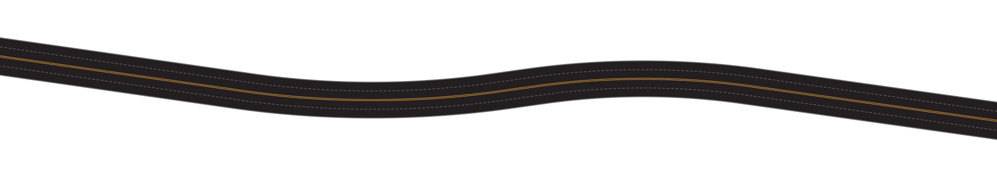
Project Workplan
Five phases design lifecycle
Our team is committed to equitable division of work, ensuring each member equally participates and contributes to our collective success.
Planning
Brainstorming and requirements gathering
Development & Implementation
List algorithms/ libraries here*
Prototyping
Wireframing of initial design
Deployment
Some sentence here*
Testing
Modified games changes based on user testing
Notes:
We broke out project into 5 main design phases: Planning and Requirements Gathering, Designing and Wireframing, Development and Implementation, Testing and Validating and lastly, Deployment.
Planning and Requirements Gathering: In this initial phase, we planned our dungeon exploration game project, defining the requirements and key functionalities to ensure a clear roadmap for development.
Designing and Wireframing: During the design phase, we created wireframes and sketched the overall architecture, translating our vision into a tangible plan that guided the subsequent development stages.
Development and Implementation: The crust of our project unfolded in the development phase, where we utilized Python Flask, HTML5, CSS, and JavaScript to build the back-end and front-end components, following the modular approach for efficient implementation.
Testing and Validating: Ensuring the reliability and functionality of our application, the testing phase involved rigorous validation of features, addressing initial proposals, and adapting the application to changes.
Deployment: Upon successful testing, we proceeded to the deployment phase, hosting the application on the PythonAnywhere platform, and despite time constraints, achieving core functionality to allow participants to create and engage in games.

Slide 3

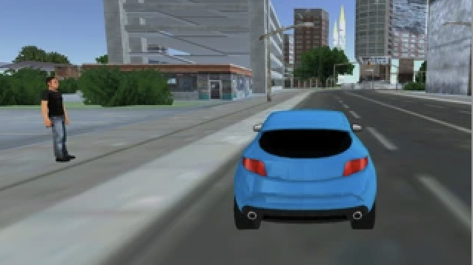
Driving Game – Urban Wheels
Vision
A driving game in which you play as an Uber driver, tasked with picking up and delivering passengers while avoiding obstacles such as cats and children running onto the road.
Video Game
An Uber driving game: dodge obstacles, deliver passengers.
Game Rules
Navigate the city as an Uber driver, picking up and delivering passengers to their destinations while avoiding obstacles to earn points.
Winning condition
Maintain a high score across levels by efficiently picking up and delivering passengers while minimizing collisions with obstacles.
Safe delivery
Drop off passengers at their specified destinations. Each successful delivery increases your score and replenishes your health bar slightly.
Level up
Complete all passenger deliveries to advance to the next level, which introduces more passengers and faster-moving obstacles.
Dangers
Avoid obstacles like cats and children that randomly appear on the road. Hitting an obstacle results in a loss of points or a game over if your health bar depletes.
Notes:
- For a general overview, our team is re-creating the board game Diamant into a digital web application game for educational learning. The game's objective remains the same: collect the most treasure while surviving the temple's dangers.

Slide 4
Formal Game Elements
Urban Wheels is a dynamic driving game where players navigate as Uber drivers, picking up passengers and avoiding urban obstacles like traffic, pedestrians, and animals to earn points and progress through increasingly challenging levels.
Characters
Driver
The Uber driver, controlled by the player.
Traffic Lights & Signs
Incorporating traffic lights and signs that the player must obey to avoid penalties, enhancing the realism and complexity of the game.
Cats & Children
Cats and children that randomly appear on the road, acting as hazards.
Emergency Vehicles
Ambulances, police cars, and fire trucks that may appear. Players might need to pull over or avoid blocking these vehicles, adding another layer of challenge.
Rules
Movement
Players can move the car left and right on the screen to navigate the city streets.
Scoring
Points are awarded for each successful pickup and delivery. More points are awarded for faster deliveries.
Levels
Completing a set number of deliveries progresses the player to the next level, which increases in difficulty with more passengers and faster obstacles.
Health
The player has a limited health bar that decreases with each obstacle collision. The game ends when health runs out.
Notes:
Tags: text, opportunities, challenges

Slide 5
Story Narrative Components
Urban Wheels' story follows an Uber driver's rise from novice to city hero, navigating through ethical dilemmas and forming deep connections within a diverse urban community.
Backstory
The protagonist, a new Uber driver, aims to become the most reputable driver in the city. Each passenger brings their unique background, contributing to the driver's journey and the city's vibrant tapestry.
Progression
Journey from novice to pro, unlocking new stories and challenges, reflecting personal growth and city's culture.
Climax and Resolution
Ultimate test in a city-wide event, leading to recognition as a key city figure, celebrated for impactful connections.
Challenges
Beyond driving, face ethical dilemmas and navigate city's complexities, affecting reputation and passenger satisfaction.
Themes
Explores community, responsibility, and human connections within the urban setting.
Notes:
Tags: text, list, fundamental principles, icons

