Slide 1
Dasher - a Data Entry Interface Using Continuous Gestures and Language Models
David J. Ward, Alan F. Blackwell, & David J. C. MacKay
of Cambridge Universtiy
presented by David Strube

Slide 2
Abstract
Existing devices for communicating information to computers are bulky, slow to use, or unreliable. Dasher is a new interface incorporating language modeling and driven by continuous two-dimensional gestures, e.g. a mouse, touch screen or eye-tracker. Tests have shown that this device can be used to enter text at a rate up to 34 words-per-minute (wpm), compared with typical ten-finger typing keyboard typing of 40-60 wpm.

Slide 3
Information Content of Text and of Hand Movements
Fitt's Law
Conventional keyboard efficiency
Inefficient for two reasons
  text redundancy
  finger tapping frequency limit

Slide 4
Information Content of Text and of Hand Movements (cont’d)
Fitt's Law
  Information rate of visually controlled pointing tasks = 14 bits/s => 14char/s => 170 wpm;
  About as fast as talking.
  Ability to bring this theory to reality depends on model of English

Slide 5
Previous Solutions
Minature / Rearranged Keyboards
  Half QWERTY, Fitaly, T9, TCK
Gestural Alphabets
  Graffiti, Jot, Unistrokes
Dynamic Selection
  T-Cube, Quikwriting, FOCL

Slide 6
Dasher
Overall user's view
Screen layout determined by probabilistic model
Dynamics of the interface
Benefits of Continuous Gestures and Languages Modeling
The Language Model

Slide 7
Rest of the Article
Empirical Evaluation
Results
Discussion
Further Work
Conclusion
References

Slide 8
Empirical Evaluation
The Power Law of Practice
Evaluation Approach
Pilot Experiment
Method
  Subjects
  Task
  Apparatus
  Procedure
  Configuration
  Analysis

Slide 9
Discussion
Comparison to Other Devices
Attention Demand
Current Information Rate of Dasher
Measuring Potential Rate of Dasher Interface
Potential Writing Speed

Slide 10
Further Work
Eye-tracking
Modeling

Slide 11
Conclusion
Dasher is still under development; as yet it is still unclear whether the principal benefit will be increased absolute writing speed or ease of use and learning for keyboard-less text entry.

Slide 12

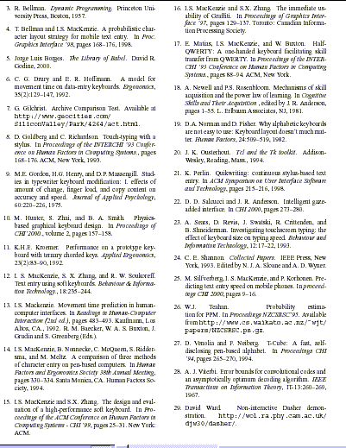

Slide 13
Additional References
The Matias Corporation. (1996). Product Information. Retrieved October 23, 2002 from http://edgarmatias.com/matiascorp/#how
Textware Solutions (July 2000). Dom Perignon II Speed Contest. Retrieved October 23, 2002 from http://www.fitaly.com/domperignon/domperignon2.htm
America Online, Inc. (2002). T9 Text Input Help. Retrieved October 23, 2002 from http://www.t9.com/t9_help.html
Palm Inc. (2002). Palm Products: How to Enter Data into a Palm Handheld. Retrieved October 23, 2002 from http://www.palm.com/products/input/
NYU Media Research Lab. (2002). NYU Media Research Lab. Retrieved October 23, 2002 from http://mrl.nyu.edu/projects/quikwriting/
David Strube. (October 23, 2002). Index of /~drussel1/ui. Retrieved October 23, 2002 from http://pigseye/~drussel1/ui
David Ward. (August 22, 2002). Dasher: Intro. Retrieved October 23, 2002 from http://www.inference.phy.cam.ac.uk/djw30/dasher/

