Slide 1
A Comparison of Standard and Ergonomic Keyboards
David Strube
User Interface Design
CSIS 4490-01
KSU, Fall Semester 2002
12-04-02

Slide 2
Abstract - Objective
To investigate the efficiency of a standard keyboard as compared to that of an ergonomic keyboard

Slide 3
Intro
Christopher Sholes, inventor of the typewriter, designed a keyboard layout to slow typists
Attachment to old ways can hinder progress and reduce efficiency.
On the other hand,…

Slide 4
Ergonomic keyboards
Reduce pain and injury caused by improper typing technique and posture
Unusual shapes of keys and key layout may result in a drop in typing speed and accuracy

Slide 5
Review of Current Literature
Basics of ergonomic design
  Ergonomics: “the study of work” (Briscoe, 10)
  Goal = make the user’s environment as conducive to health and safety as is reasonably possible while maintaining a productive workplace

Slide 6
Basics of ergonomic design (continued)
Split keyboards
  Divide keys of the board into halves and angle each half slightly, in essence "splitting" the keyboard
  Pinkies pointing down and inward, without requiring your elbows to extend as far (HealthyComputing.com, 2002)

Slide 7
Research Questions
Do ergonomic keyboards slow down typing and cause more typing errors?
If so, is this drop in typing efficiency justified by the benefits provided by ergonomic keyboards?
If efficiency decreases as ergonomic redesign increases, how ergonomic should keyboards be?
What alternatives may be considered?

Slide 8
Solutions / Alternatives
Alternate key layout
  Dvorak
  Mathematical optimization
Gestural Approach
  Dasher
  Graffiti
Various Shapes and Sizes - ½ QWERTY, etc
Something else - Keybowl
Combinations
  ½ Dvoark (Huffman)
  Dvoark Ergonomic
  Spliced Ergonomic and Standard

Slide 9
Theoretical Framework
Independent and Dependent Variables
Null Hypotheses
Limitations of the Study
Technical Terms

Slide 10
Methodology
The investigational procedure of comparing ergonomic keyboards to standard keyboards was designed, developed and implemented using test subjects from the CSIS4490-01 class. (The design was modeled after the methodology used in the Dasher research.)
Subjects (n=8) were selected from class to type text on both keyboards in three sessions. Their respective speed and error rates were noted, charted, and graphed.

Slide 11
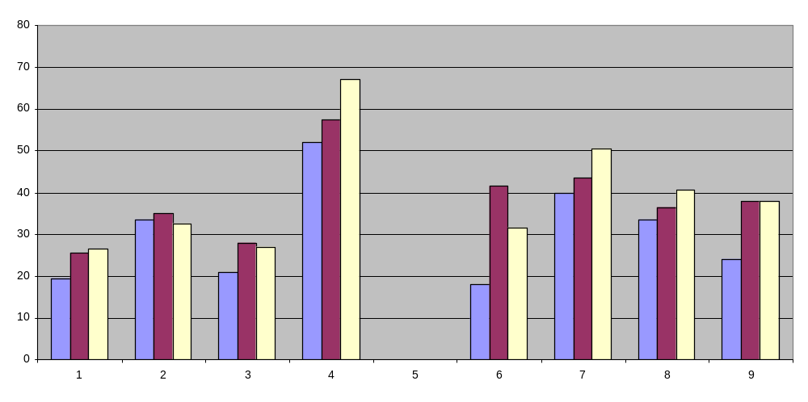
Results - WPM

Slide 12
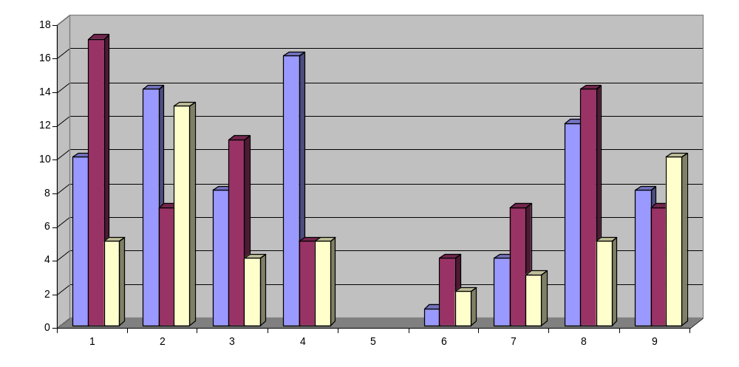
Results - Errors

Slide 13
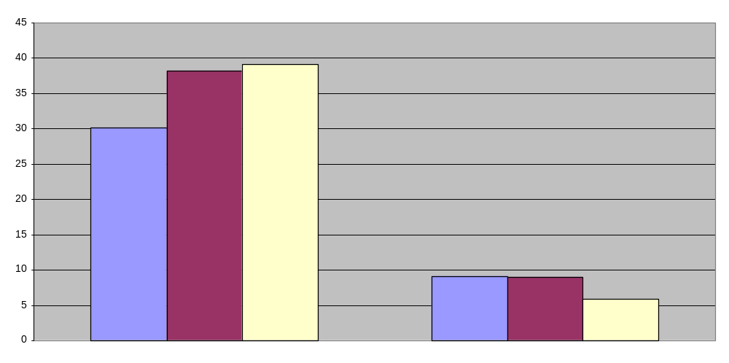
Results – Averaged WPM & Errors

Slide 14
Conclusions and Discussion
The results indicated that there is no significant evidence between keyboard style and typing efficiency
The direct correlation between keyboard style and typing efficiency may require more test subjects, if such a correlation exists.
This research has, in the end, proven to be, like 90% of all research, useless.

Slide 15
References
Ashbrook, D. (October 1999). Context Sensing with the Twiddler Keyboard. 3rd International Symposium on Wearable Computers, 197-198.
Bass, S. (July 1, 2002). Treat your fingers to a new keyboard: 'Penny wise, pound-foolish' goes for your favorite input device, too. PC World 20 (7), 55.
Billingsley, P. (March/April 1994). Ergonomic Standards Go Beyond Hardware. IEEE Software, 11 (2), 82-84.
Blackwell, A. F., MacKay, D. J. C., & Ward, D. J. (2000). Dasher - a Data Entry Interface Using Continuous Gestures and Language Models. Symposium on User Interface Software and Technology, 13, 129-137.
Breen, C. (April 1, 2002). The choice is yours. Macworld 19 (4), 84-86.
Briscoe, G. (January 1983). 1983 Acm annual conference: "Health and safety aspects of office automation - the European scene." Proceedings of the 1983 annual conference on Computers : Extending the human resource, 83-115.
Burmester, M., Hassenzahl, M., Lehner, K., & Platz, A. (April 2000). Hedonic and ergonomic quality aspects determine a software's appeal. Conference on Human Factors and Computing Systems, 2 (1), 201-208.
Charles, P. (October 9, 2002). Parking tickets surprise students. The Sentinel 37 (6), 1-2.
Darragh, J.J., James, M.L., & Witten, I.H. (November 1990). The Reactive Keyboard: A Predictive Typing Aid. Computer 23 (11), 41-49.
Ehrhardt, I., Gebhardt, H., & Herper, H. (1994). Modelling strain of manual work in manufacturing systems. Winter Simulation Conference, WSC '94, 1044-1049.
Halpern, N., Hargreaves, W., Dr. Ing, Kroemer, K., Litewka, J., Markison, R., & Rempel, D. (1992). Toward a more humane keyboard. Conference on Human Factors and Computing Systems, CHI '92, 365-368.
HealthyComputing.com (February 4, 2002). Keyboard FAQs -- BestBuy.com. [WWW page]. URL http://www.bestbuy.com/ComputersPeripherals/MiceKeyboards/faq/faqKeyboards.asp
Heintzelman, M., & Pfeiffer, P. (1997). Machines, statues, and people: strategies for promoting RSI awareness in computing curricula. Technical Symposium on Computer Science Education, SIGCSE '97, 296-299.
Kauppinen T., MacKenzie, I. S., & Silfverberg M. (2001). Accuracy measures for evaluating computer pointing devices. Conference on Human Factors and Computing Systems, 9-16.
Keybowl. (n.d.). Keyboard History [WWW page]. URL http://www.keybowl.com/ergonomics/keyboards/history/history_p.htm

Slide 16
More references
Manes, S. (May 1, 2002). How to fix keyboards: don't touch 'em!: Why do PC vendors keep shuffling keys on us?. PC World 20 (5), 164.
Molter, W. & Vielsack, F. (Aug 2002). An alternative? Keyboards made of TPE can replace silicone. Kunststoffe-Plast Europe 92 (8), 74.
Neely, A. N. & Sittig, D. F. (Sep-Oct 2002). Basic microbiologic and infection control information to reduce the potential transmission of pathogens to patients via computer hardware. Journal Of The American Medical Informatics Association 9 (5), 500-508.
Nobel, C. (July 15, 2002). Kyocera will launch keyboard to ease smart-phone data entry. eWeek 19 (28), 28.
Reisman, S. (November/December 1992). Is the Pen Mightier Than the Keyboard?. IEEE Software, 9 (6), 128-127.
Schade, G. (April 2000). Multimedia Systems: On the Ergonomic Design and Evaluation of User Interfaces and System Structures. 7th IEEE International Conference and Workshop on the Engineering of Computer Based Systems, 256-262.
Stoddard, S. (2001). Fun With Words: Pangrams. [WWW page]. URL http://rinkworks.com/words/pangrams.shtml
TelePrint Systems. (2000). TelePrint Systems Maltron Ergonomic Keyboard History [WWW page]. URL http://www.teleprint.com/keyboard/history.html
The University of Chicago. (1990). keys1 [WWW page]. URL http://www.utdallas.edu/~liebowit/keys1.html

