Slide 1
Adapter Pattern

Slide 2
Intent
convert interface of a class into another interface that clients expect

Slide 3
Motivation
toolkit might not be able to be used since its interface does not match interface required by client
  motivating example: drawing editor
    key abstraction: graphical object represented by abstract class Shape
    TextShape subclass - display & edit text
      want to use off the shelf toolkit TextView which has an interface different from TextShape
      cannot change TextView without source code
        undesirable option even if have source code

Slide 4
Motivation con't
  have TextShape adapt TextView interface to that of Shape
    inherit Shape's interface & TextView's implementation
      class Adapter
    compose TextView instance with a TextShape & implement TextShape in terms of TextView
      object Adapter
    adapter can add functionality

Slide 5
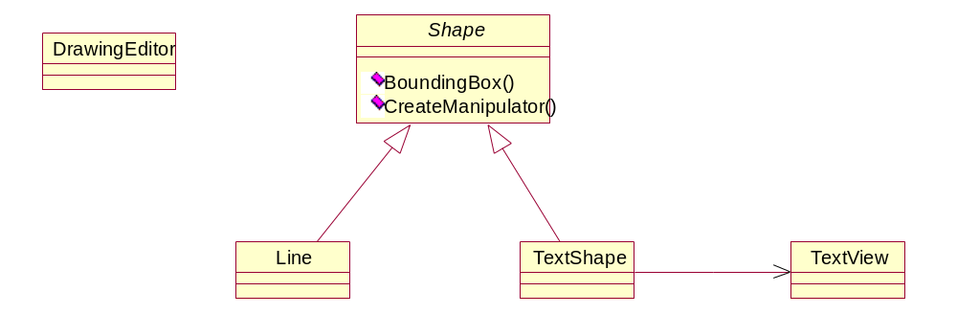
Motivation con't

Slide 6
Applicability
want to use an existing class & its interface does not match needed one
want to create reusable class
  ⇒needed interface may not be known
want to use some existing subclasses - want to avoid adaptation by continued subclassing

Slide 7
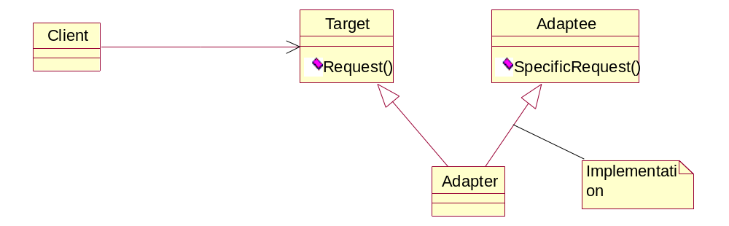
Structure
Class adapter

Slide 8
Structure con't
Object adapter

Slide 9
Participants
Target
  defines domain-specific interface
Client
  collaborates with objects conforming to Target interface
Adaptee
  defines existing interface which needs adapting
Adaptor
  adapts interface of Adapter to Target interface

Slide 10
Collaborations
Clients call operations on an Adapter instance which calls operations on Adaptee

Slide 11
Consequences
class adapter
  Adaptee commits to a concrete Adapter class
    cannot adapt a class & its subclasses
  Adapter can override some of Adapter's behaviour
  only 1 new object with no additional indirection
object adapter
  1 Adapter can work well with an Adaptee & all of its subclasses
  Adapter can add functionality
  more difficult to override Adaptee behavior - have to subclass Adaptee

Slide 12
Consequences con't
how much adapting does Adapter do?
  simple interface conversion to entire new set of operations
pluggable adapters
  fewer assumptions other class must make ⇒ more reusable
  interface adaption ⇒ other classes do not need
    to see the same interface

Slide 13
Consequences con't
  Using 2-way adapters to provide transparency
    possible to have 2 classes which use each other & they have incompatible interfaces
    consider 2-way adapter class which inherits from both classes
implementing class adapters in C++
  Adapter would inherit publicly from Target & privately from Adaptee

Slide 14
Implementation
pluggable adapters
  find narrow interface for Adapter - smallest which allows adaptation
  using abstract operations
    define corresponding abstract operations for narrow Adaptee interface
    subclasses implement abstract operations

Slide 15
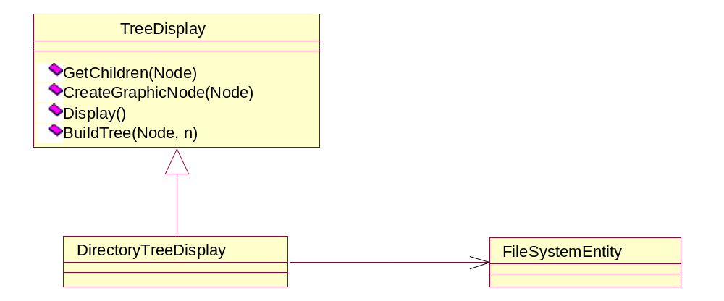
Implementation con't

Slide 16
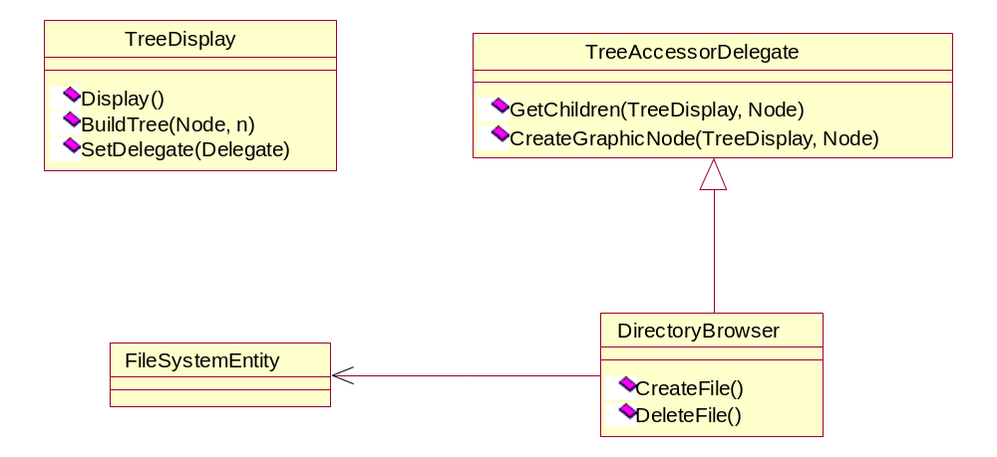
Implementation con't
using delegate objects
  Client forwards request to delegate object (Target)
    ⇒ different adaptation strategies with different delegate objects

Slide 17
Sample Code
C++
Java

Slide 18
