Slide 1
Bridge Pattern

Slide 2
Intent
decouple abstraction from its implementation

Slide 3
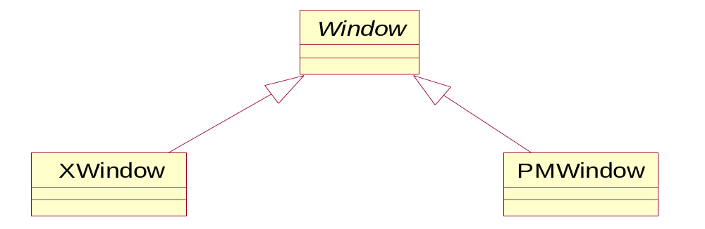

Motivation
abstraction - could have several possible implementations
  inheritance - 1 possibility
  difficult to modify, extend, or reuse abstractions & implementations independently

Slide 4
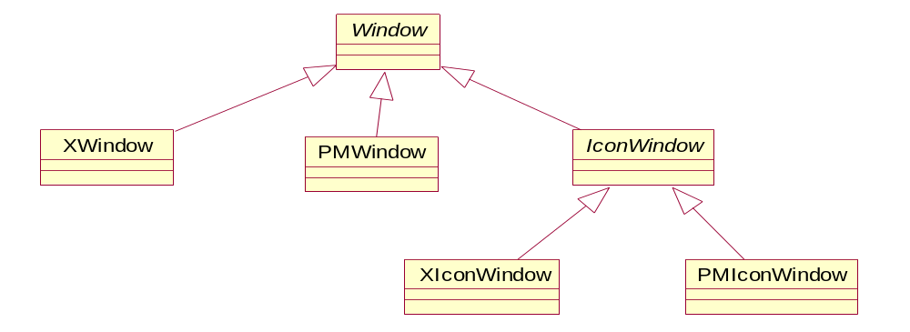


Motivation con't
  adding an additional kind of window requires 2 new classes
  adding an additional platform would require an additional class for each type of window
  client code becomes platform dependent
    concrete class instantiated to create a window

Slide 5
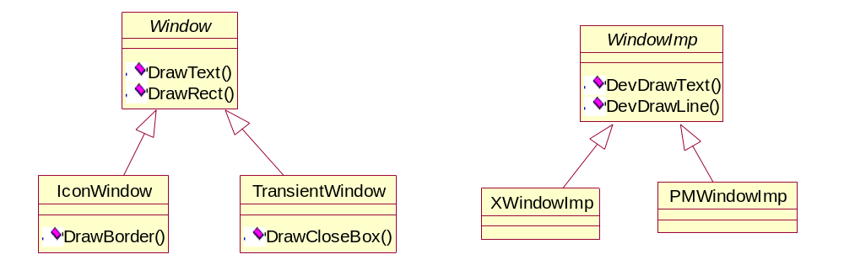
Motivation con't
bridge pattern - puts Window abstraction & its implementation in separate class hierarchies
all operations on Window subclasses - implemented in terms of abstract operations from WindowImp class

Slide 6
Applicability
want to avoid a permanent binding between an abstraction & its implementation
  can select implementation at run-time
both abstraction & their implementations should be extensible by subclassing
  can be extended independently
changes in implementation should have no impact on clients
  no recompilation necessary

Slide 7
Applicability con't
want to hide implementation of abstraction
  language dependent
proliferation of classes because of nested inheritance
want to share implementation among multiple objects
  hide sharing from client

Slide 8
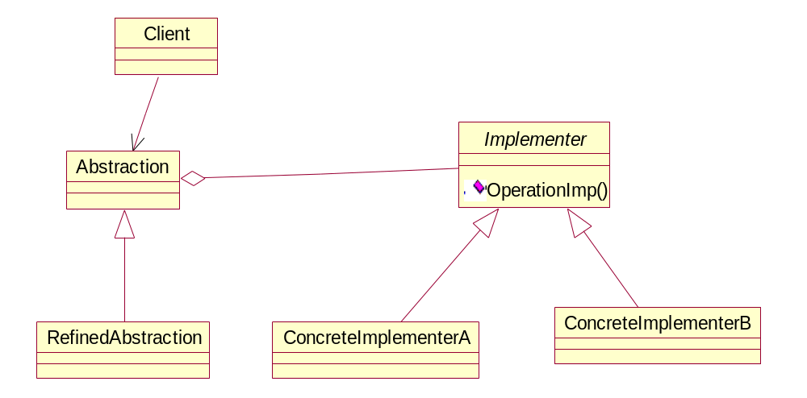
Structure

Slide 9

Participants
Abstraction
  defines abstraction's interface
  maintains a reference to an object of type Implementer
RefinedAbstraction
  extends interface defined by Abstraction
  Ιmplementer
  defines interface for implementation of classes
    can be different than Abstraction's interface
  usually Implementer interface has only primitive operations
    high level operations by Abstraction
ConcreteImplementer
  implements Implementer interface

Slide 10

Collaborations
implements Implementer interface

Slide 11
Consequences
decoupling interface & implementation
  implementation of abstraction - can be configured at run-time
  eliminate compile time dependencies on implementation
  encourages layering
improved extensibility
  Abstraction & Implementer - can be extended independently
hiding implementation details from clients

Slide 12
Implementation
only 1 implementer
  when there is only 1 implementation - do not need abstract Implementer class
creating the right implementer object
  timing & location of which Implementer class to instantiate
  if Abstraction knows about all ConcreteImplementer classes - instantiate 1 of them in constructor
  default implementation
    change later as appropriate
  delegate decision to another object
    factory can encapsulate platform specifics

Slide 13
Implementation con't
sharing implementers
  implementer - stores reference count which is modified by abstraction
  Handle& Handle::operator = (const Handle& other) {
    other._body -> Ref ();
    _body -> Unref ();
    if (_body -> RefCount () == 0)
      delete _body;
    _body = other._body;
    return *this;
  }

Slide 14
Implementation con't
using multiple inheritance
  inherit publicly from Abstraction & privately from ConcreteImplementation
  static inheritance ⇒ implementation permanently bound to interface

Slide 15
Sample Code
C++
Java

Slide 16
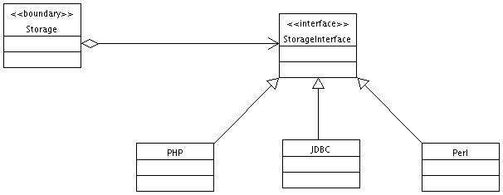

Slide 17
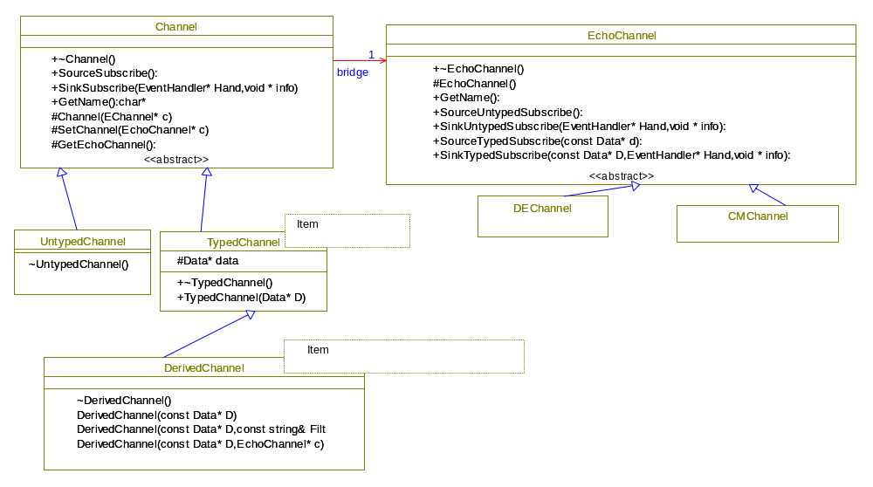

Slide 18
