Slide 1

Broker Pattern
Structure distributed software systems with decoupled components that interact by remote service invocations
Broker component – responsible for coordinating communication & transmitting results & exceptions

Slide 2
Example
City information system – run on a wide area network
Some computers in network host 1 or more services that maintain city tourist information
Terminals connected to network – browser interface
Data – distributed throughout network
Future growth & change ⇒ services need to be decoupled
Terminal software – needs to access services without knowing their location

Slide 3
Context
Environment is distributed & possibly heterogeneous with independent cooperating components

Slide 4
Problem
Complex software system consisting of a set of decoupled & interoperating components
  Greater flexibility, maintainability, changeability
  More distributable & scalable
Inter-process communication required
  Handled by components
    System becomes dependent upon communication mechanism used
    Clients need to know location of servers
    Solution may be programming language dependent

Slide 5
Services for adding, removing, exchanging, activating, locating components needed
  Applications using these services should not depend upon system specific details
For developer – should be no difference between developing for centralized systems or distributed systems
  Using object should not require knowing location of object

Slide 6
Use broker architecture to balance the following forces
  Components should be able to access services provided by others through remote, location-transparent service invocations
  Need to exchange, add, or remove components at run-time
  Architecture should hid system & implementation specific details from users of components & services

Slide 7
Solution
Introduce a broker component
Servers
  register with broker
  Make services available to clients through method interfaces
Clients
  Access functionality of servers by sending requests via broker
Broker
  Locate appropriate server
  Forward request to server
  Transmit results & exceptions back to client

Slide 8
Distributed services accessed by sending message calls to appropriate object
Reduces development complexity
  Distribution of objects – transparent to developer
Broker pattern – integration of distribution & object technology

Slide 9
Structure
Components
  Server
    Implement objects that expose functionality through interfaces
    Interfaces made available through standard format (IDL)
  Clients
    Applications that access services of at least 1 broker
    forward requests to broker
    Receive responses or exceptions from broker

Slide 10
  Broker
    Responsible for transmission of requests from clients to servers & responses & exceptions back to client
    Needs to be able to locate receiver of a request
    Offers API’s to clients & servers
      Includes operations to register servers & invoking server methods
    If requested server is hosted by broker – request is passed directly to server
    If requested server is hosted by a different broker – forwards request to broker hosing server
    Potentially supports name services or marshaling support

Slide 11
  Client-side proxies
    Layer between clients & broker
    Provides transparency – remote object appears to client as a local object
    Hide from client
      Inter-process communication mechanism
      Creation & deletion of memory blocks
      Marshaling of parameters & results
  Server-side proxies
    Receive requests
    Unpack incoming messages
    Unmarshal parameters
    Call appropriate service
    Marshal results or exceptions

Slide 12
  Bridges
    Optional components for hiding implementation details when 2 brokers interoperate
      i.e. different networks or operating systems

Slide 13
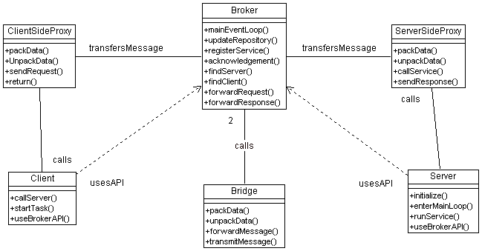

Slide 14
Server registers itself with local broker
Broker is started in initialization phase of system – enters event loop
Server application started – executes initialization code
Server registers itself with broker
Broker receives registration request
  Extracts necessary information
Acknowledgement sent back to server
Server enters main loop

Slide 15
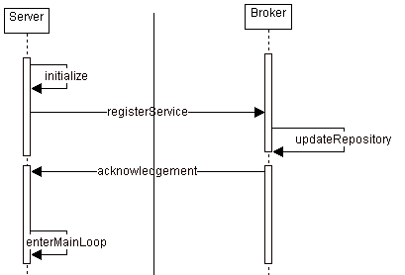

Slide 16
Client sends request to local server
Client application started – invokes method of a remote server object
Client-side proxy packages all parameters & forwards message
Broker looks up location of required server
Broker forwards message to server-side proxy
Server-side proxy unpacks parameters & invokes appropriate service
Server returns result to server-side proxy
Server-side proxy packages data & passes it to broker
Broker forwards response to client-side proxy
Client-side proxy unpacks result & returns it to client application

Slide 17
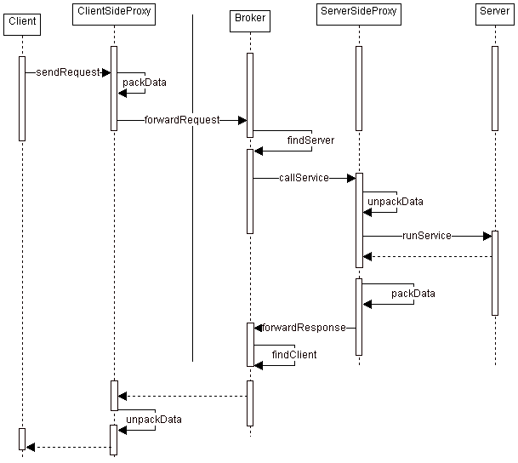

Slide 18
Interaction of different brokers via bridge components
Broker A receives incoming request
Broker A looks up server responsible for handling request & forwards request to Bridge A
Bridge A converts message to appropriate format & sends message to Bridge B
Bridge B converts message from network format to appropriate local format
Bridge B forwards message to Broker B
Broker B looks up server & forwards message to server

Slide 19
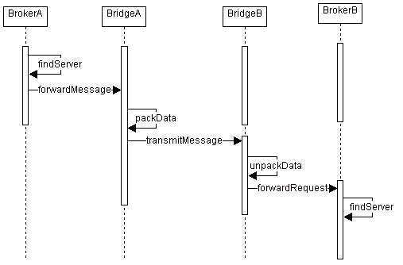

Slide 20
Implementation
Define an object model or use an existing model for the server
Select component-interoperability to be used
  IDL, JavaBeans, …
  Need consistency at boundaries
Specify API’s broker component provides for collaborating with clients & servers
  Dynamic or just static of server operations – determines how much information broker needs to supply client

Slide 21
Use proxy objects to hide implementation details from clients & servers
  Client side proxies
    package procedure calls into messages & forward these messages
    Receive responses & exceptions from local broker & pass them to client
  Server side proxies
    Receive requests from local broker & call methods in interface implementation of server
    Forward server responses & exceptions to local broker after packaging them
  Hide implementation details by using own inter-process communication mechanisms
  Implement marshaling & unmarshaling of parameters & results

Slide 22
Design broker component compatible with proxies
  Specify detailed on-the-wire protocol for interacting with proxies
    Mapping of parameter values, method names, return values to structures in protocol
  Local broker must be available for every participating machine in the network
    Use bridges to hide network protocols & os specifics
    Must maintain repository to locate brokers or gateways to which messages are to be forwarded

Slide 23
  System must remember which client sent request
  Broker must handle marshaling if not supplied by the proxy
  If system supports asynchronous communication – must supply message buffers
  Directory service – associate local server identities with their physical location
  Must support system unique identifiers if required

Slide 24
  If dynamic method invocation is supported – need to get type information about existing servers
  Must build in error handling
    Types of errors
      Server error
      Communication error
  IDL compilers must be constructed

Slide 25
Known Uses
Corba – Common Object Broker Architecture
  OMG – object management group
SOM/DSOM
  IBM
  Corba complient
OLE
  Microsoft
WWW
ATM-P
  Siemens

Slide 26
Advantages
Location Transparency
  Clients do not need to know location of servers
Changeability & extensibility of components
  Changes can be transparently made behind interfaces
Portability of broker system
  Os & network details hidden from client
  Broker interface would be the same.
Interoperability between broker systems
  Common protocol is required
Reusability
  New clients can use existing servers

Slide 27
Disadvantages
Restricted efficiency
  Applications usually slower
Lower fault tolerance
  Many clients may be depending upon the same server
  Can be increased through replication

Slide 28
Testing & Debugging
Client can be tested separately – advantage
Testing & debugging broker – tedious because of all the possible interactions

